Slide 1
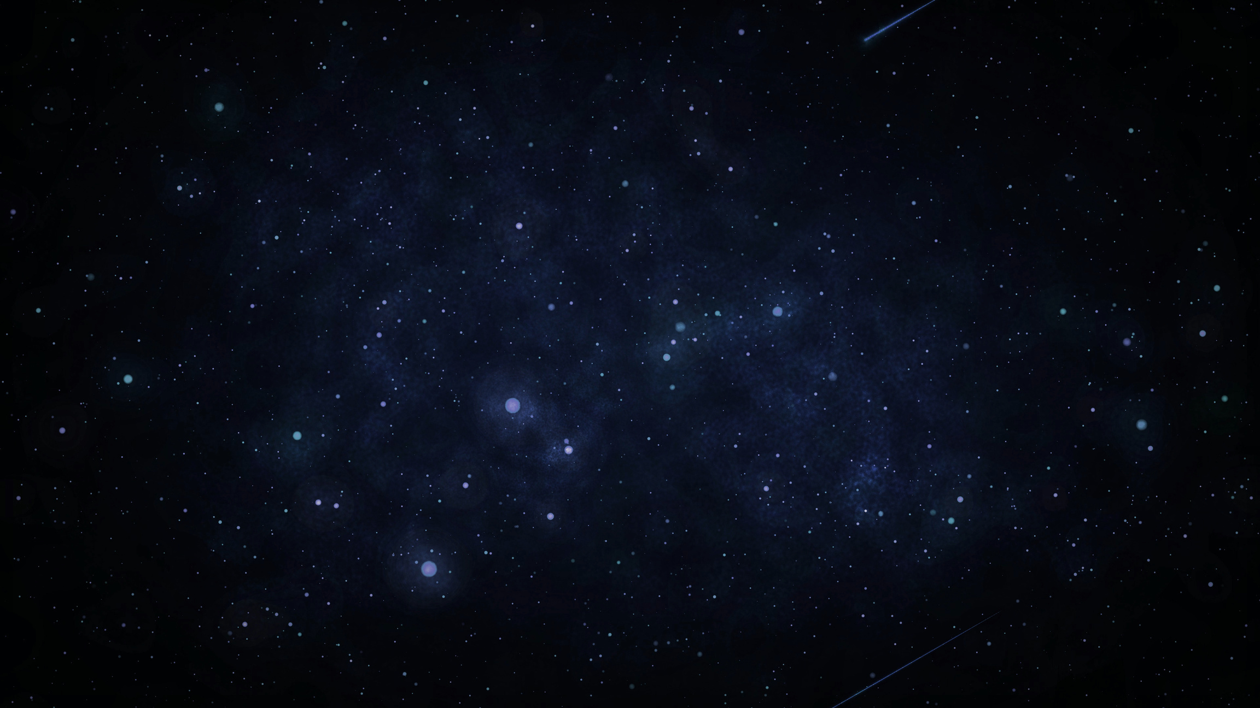


PRECONCEPTIONS OF EXTRATERRESTRIAL LIFE
HOW SCI-FI ALIENS REVEAL OUR IDEAS, ASSUMPTIONS, AND BIASES ABOUT EXTRATERRESTRIAL LIFE
© 2025 Arizona Board of Regents on behalf of the University of Arizona. Licensed under CC BY 4.0

Slide 2
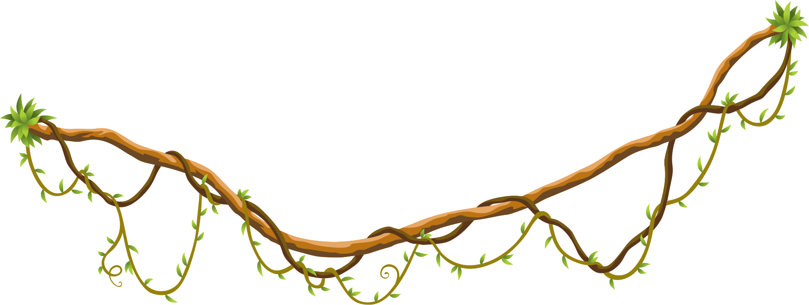


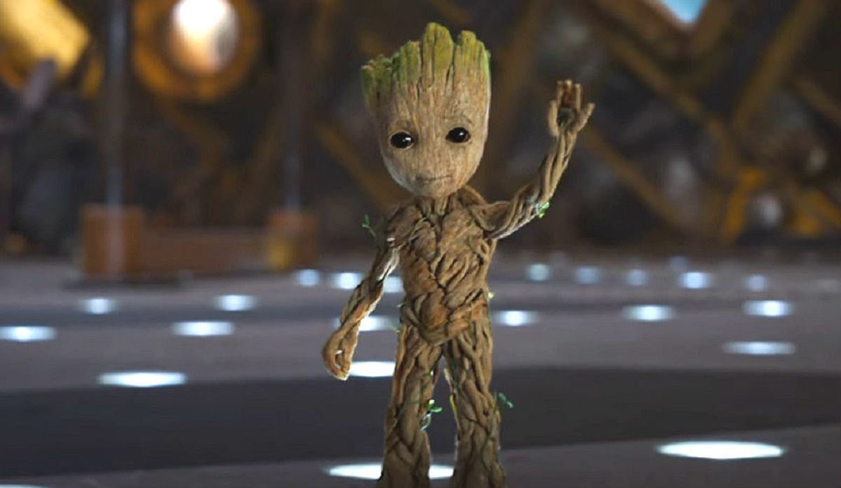
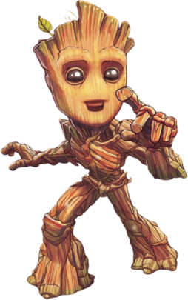
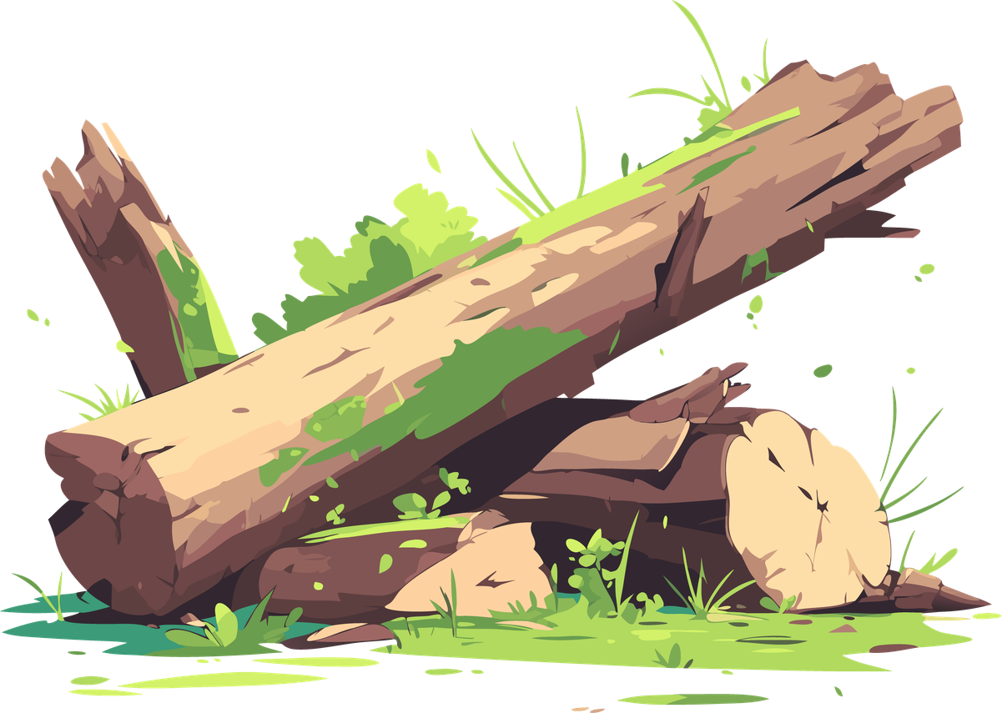
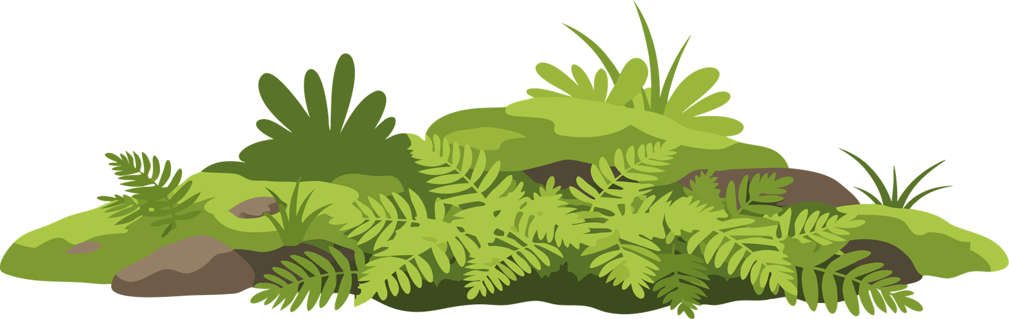

Slide 3
FLORA COLOSSUS
(Groot)
Marvel
Very little is known about this species because only one of them has been seen. They are big, tree-like creatures that can change their shape a bit, usually by stretching their limbs.
They can heal themselves and grow back if they are almost destroyed. They have tough, bark-like skin that protects them. Sometimes, they even have leaves growing from their body. They might not talk much, but people close to them can still understand them.

Slide 4
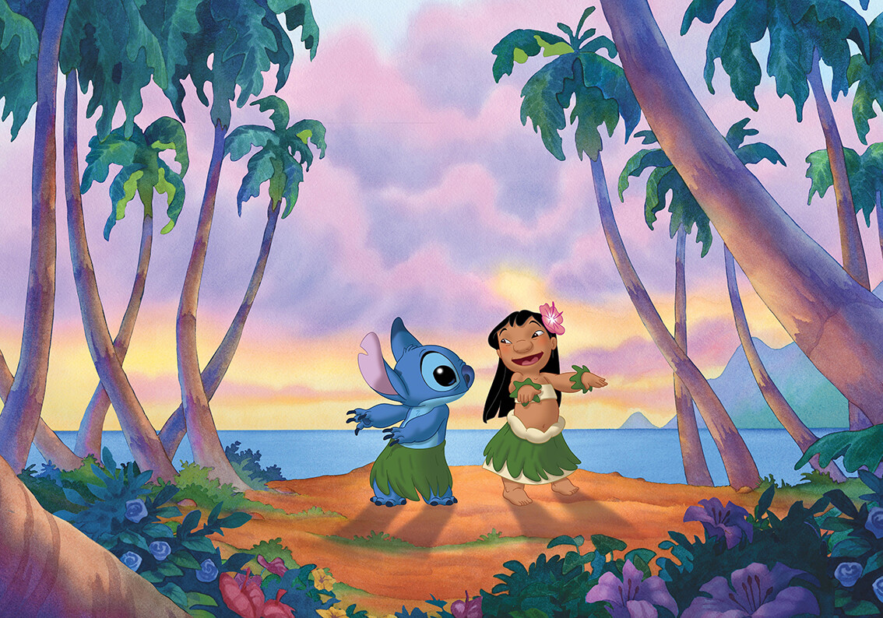
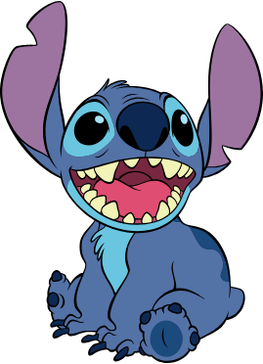
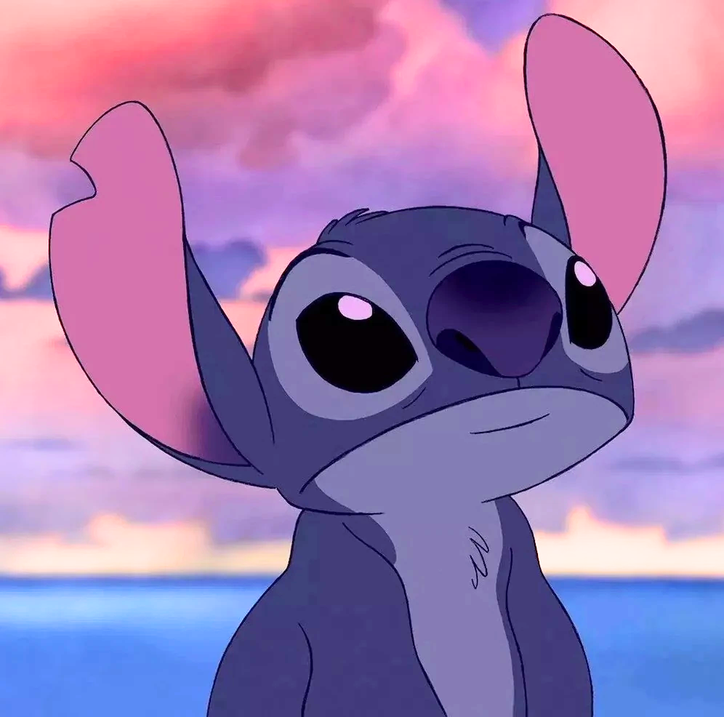
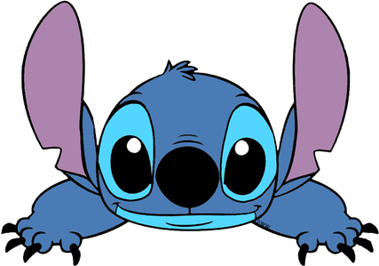

Slide 5
STITCH
Lilo & Stitch
Stitch, also called Experiment 626, is a small blue alien that was genetically engineered instead of naturally evolved. He has big ears, sharp claws, strong arms, and can hide extra body parts like his second pair of arms, antennae, and back spines.
He is much stronger than he looks and can climb walls, survive dangerous situations, and learn very quickly. On Earth, he disguises himself as a dog, but his body has many traits that make him more powerful than a normal animal.

Slide 6

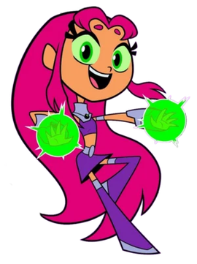
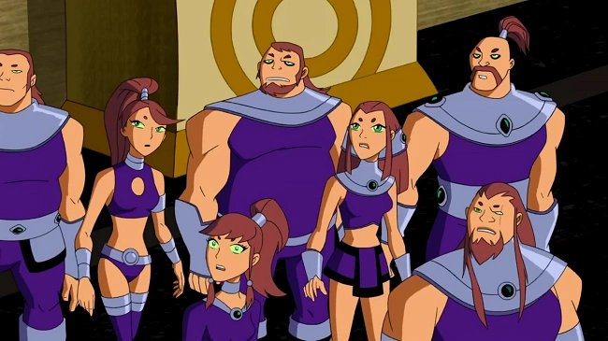
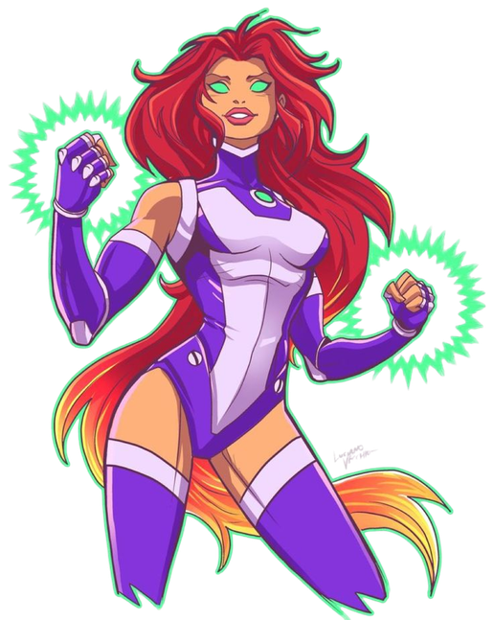

Slide 7
TAMARANEAN
(Starfire)
Teen Titans (DC Comics)
These aliens look like humans with golden skin, but they come from the Vega system, which is 25 light years away from Earth. Most of them have red hair (from auburn to bright pink) and green eyes, including the normally white part.
They can fly by using ultraviolet light. The most famous member of this species is Starfire. She can shoot energy blasts, but this isn't a natural ability. It happened because of experiments that overloaded her and her sister with ultraviolet radiation.

Slide 8
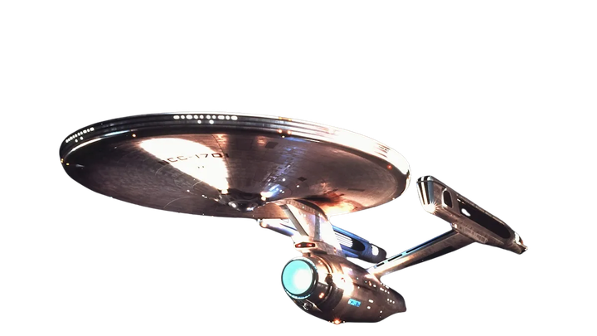
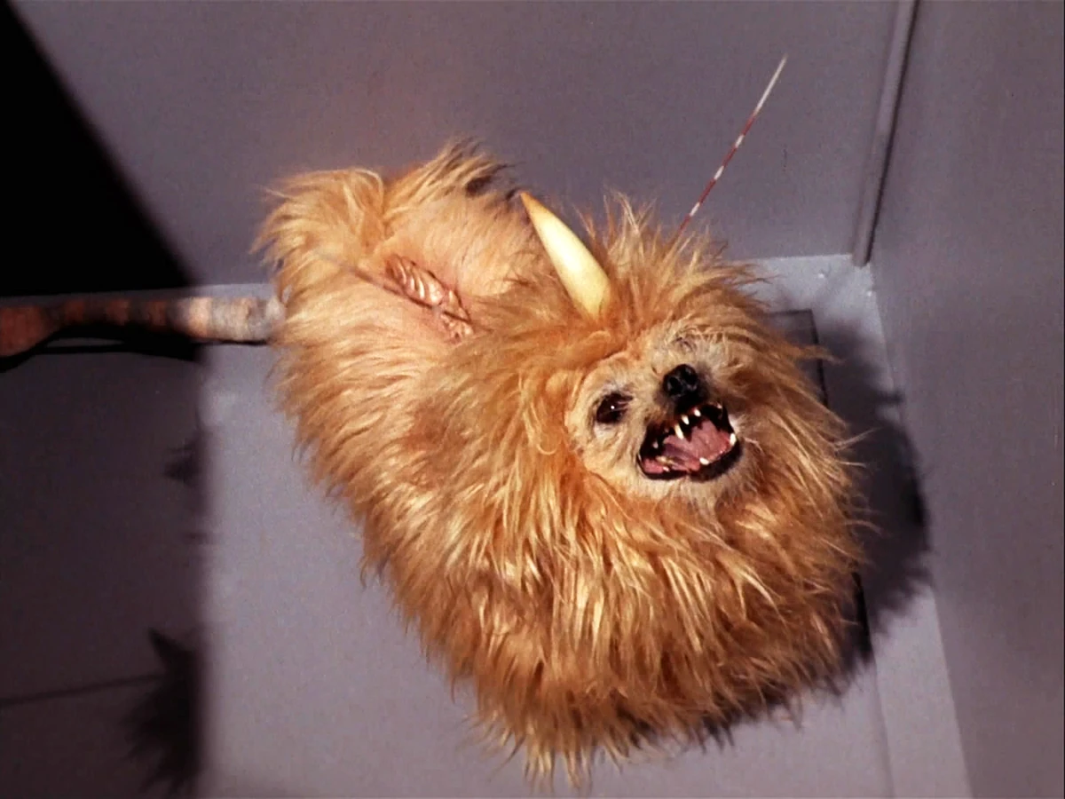

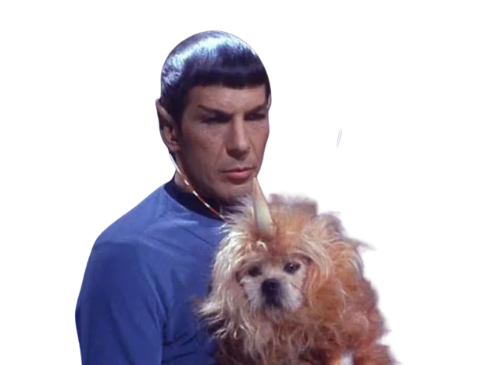
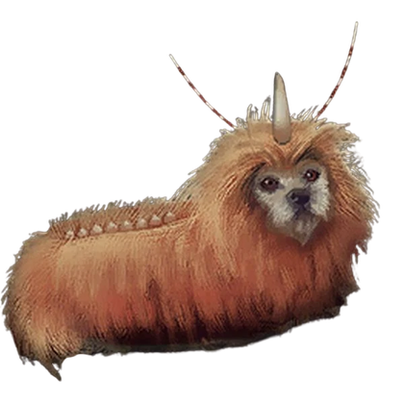

Slide 9
ALFA 177 CANINE
Star Trek
This animal looks like a small dog, but its long, shaggy fur hides most of its body. Later pictures showed that its body is also dog-like.
It has some differences from a regular dog, like a single straight horn on its forehead and two antennas next to it. It also has a bony ridge along its spine that you can see through the fur. Its tail is a long, hairless cone with a tuft of fur at the end, looking a bit like a mix between a rat and a lion's tail.

Slide 10
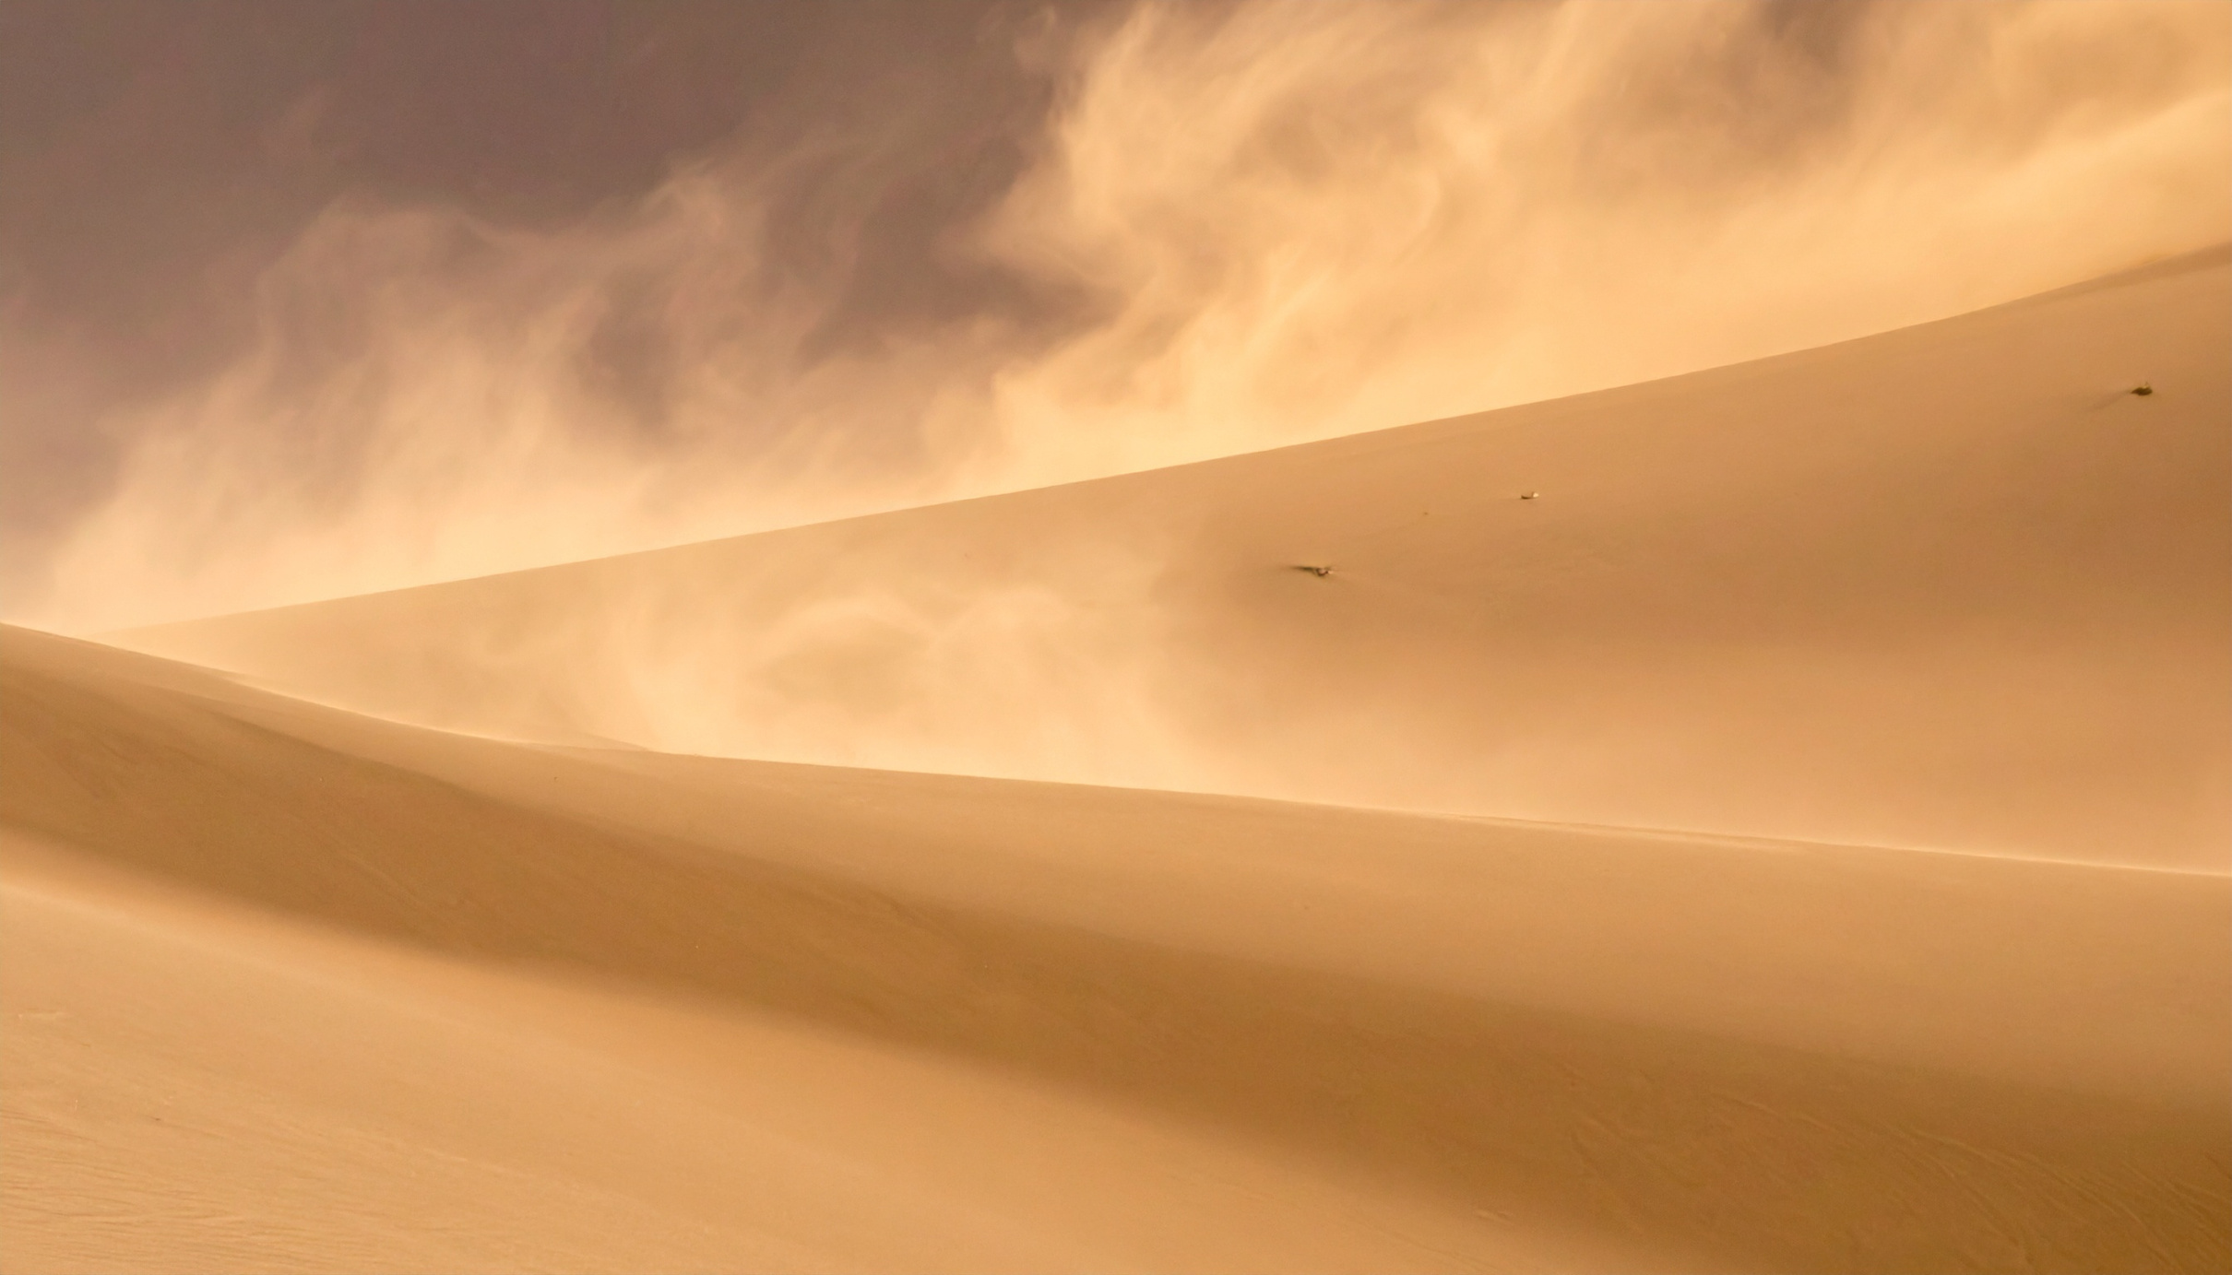
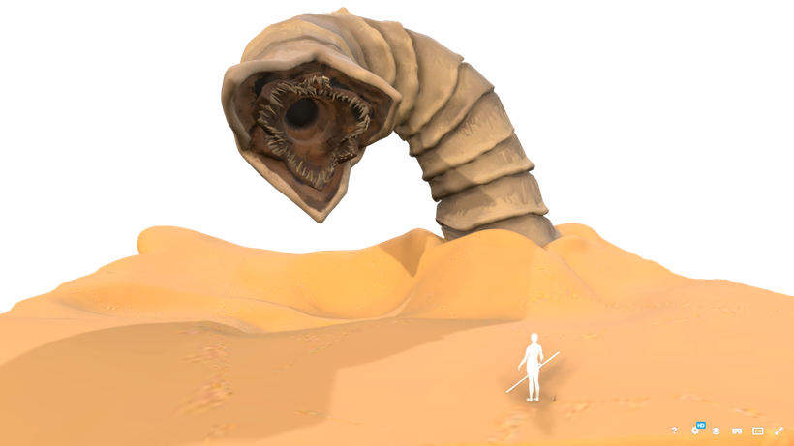
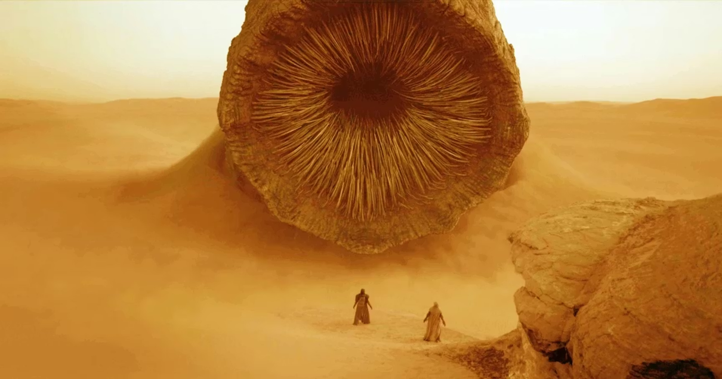
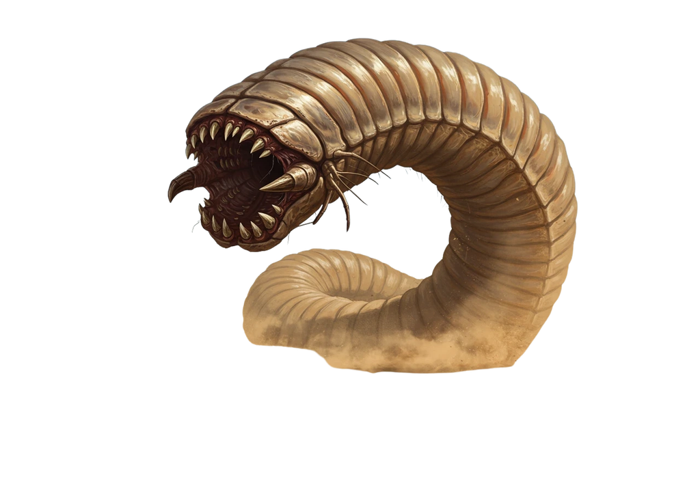
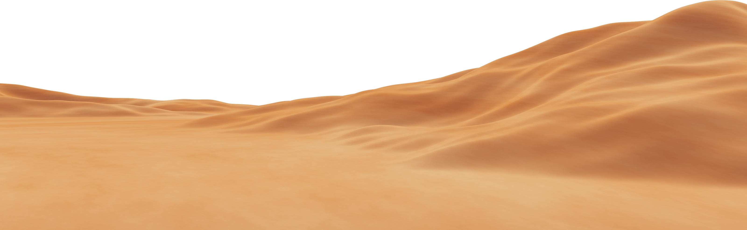
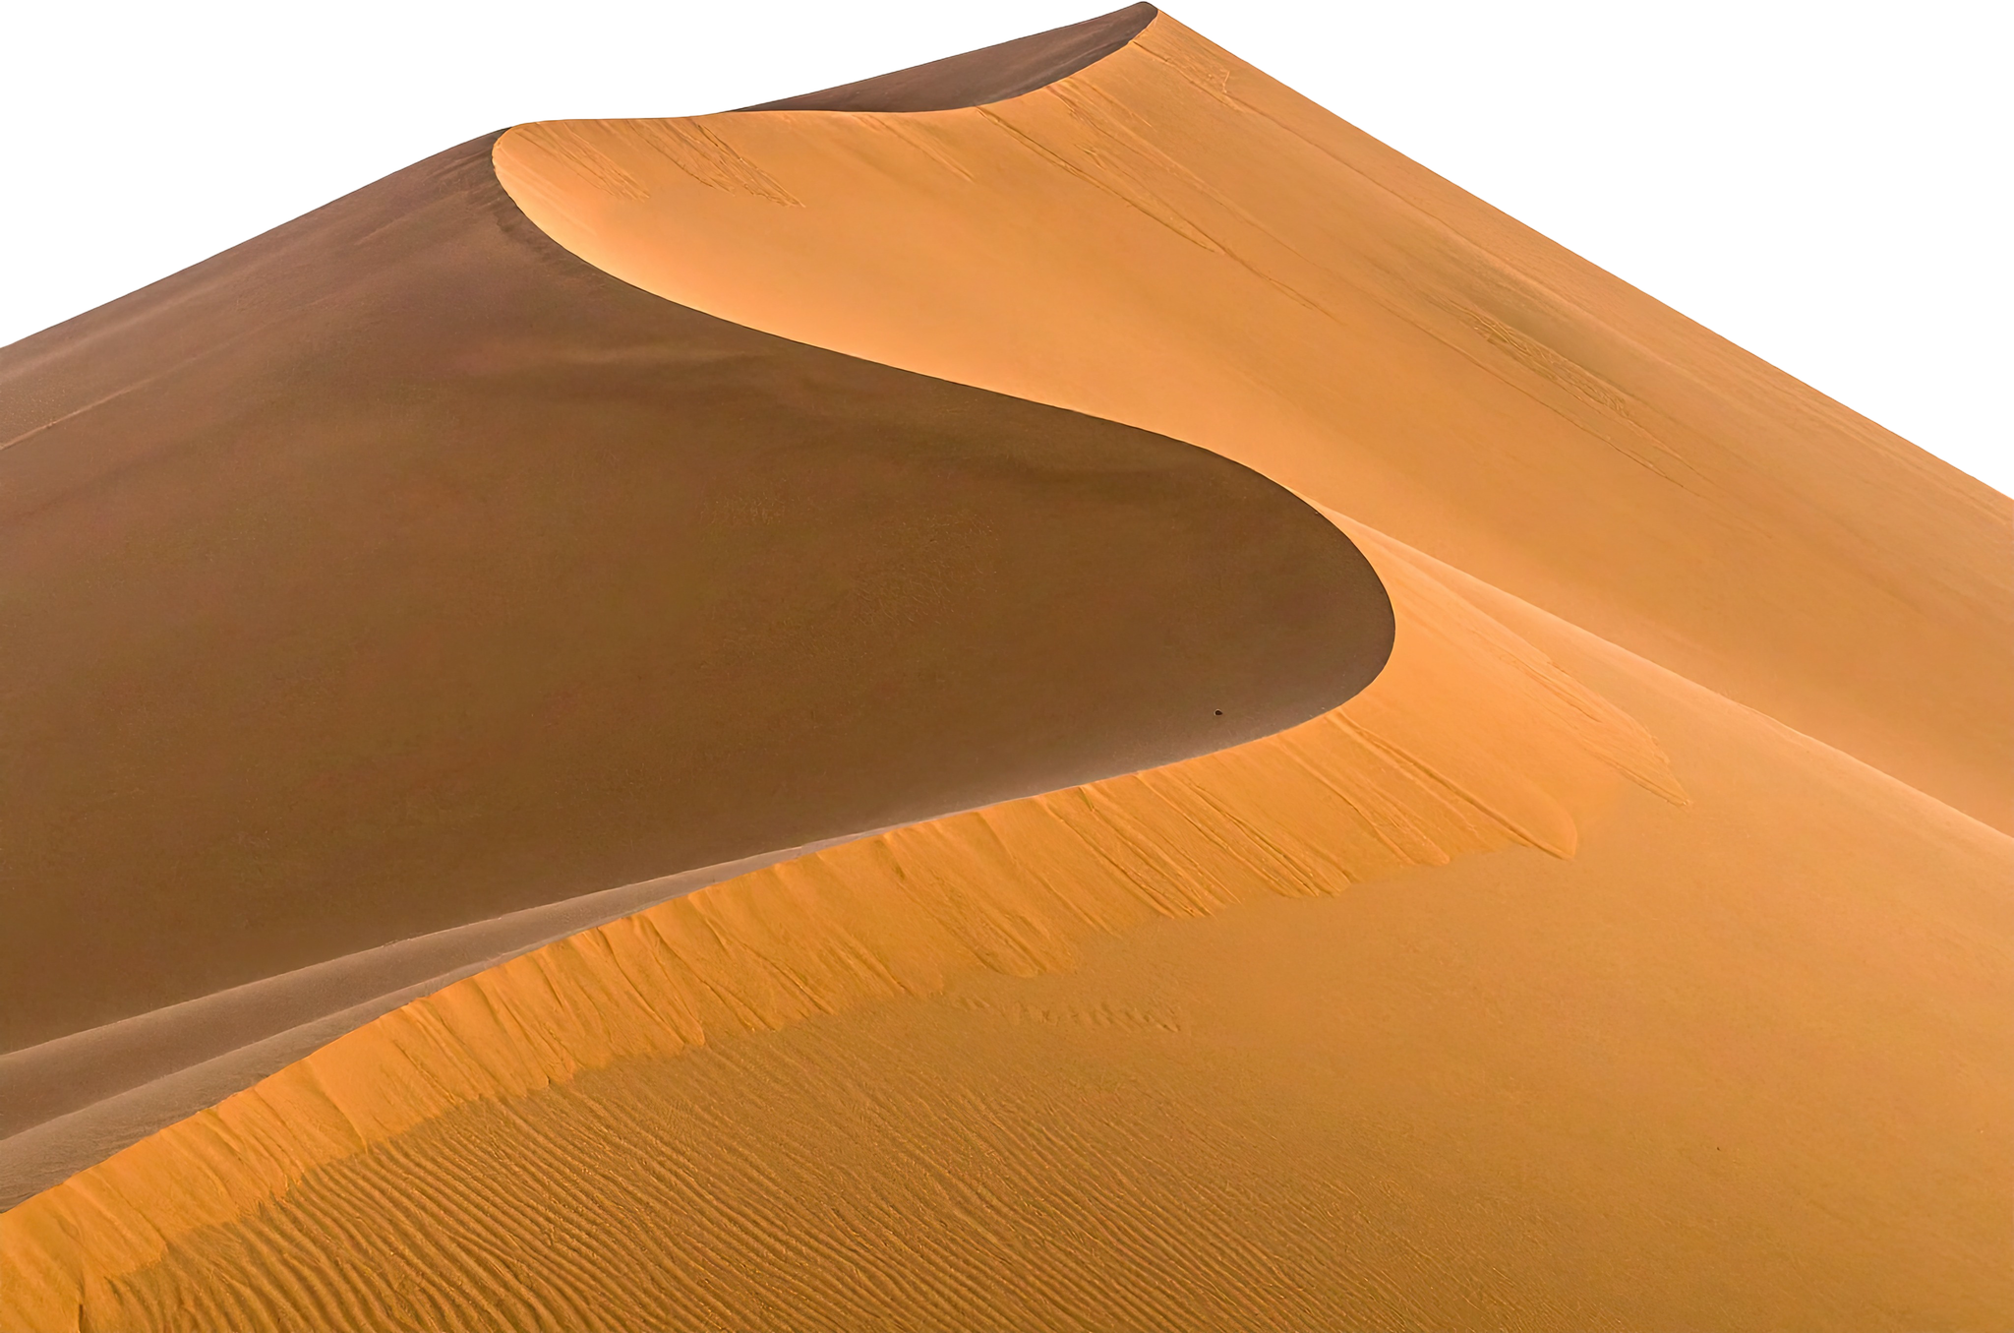

Slide 11
SHAI-HULUD
Dune
This giant creature can grow up to 1300 feet long (almost a quarter mile!) and 400 feet wide. They start as tiny animals called sand plankton that eat a substance called spice. Then, they become leathery, flatworm-like creatures called sandtrouts that love water.
When sandtrouts poop, it turns into spice! Some sandtrouts go into a 6-year hibernation and come out as 10-foot-long sandworms. These sandworms keep growing by eating other sandworms and sand plankton. At this stage, too much water is very dangerous for them (even the small amount inside a person).

Slide 12
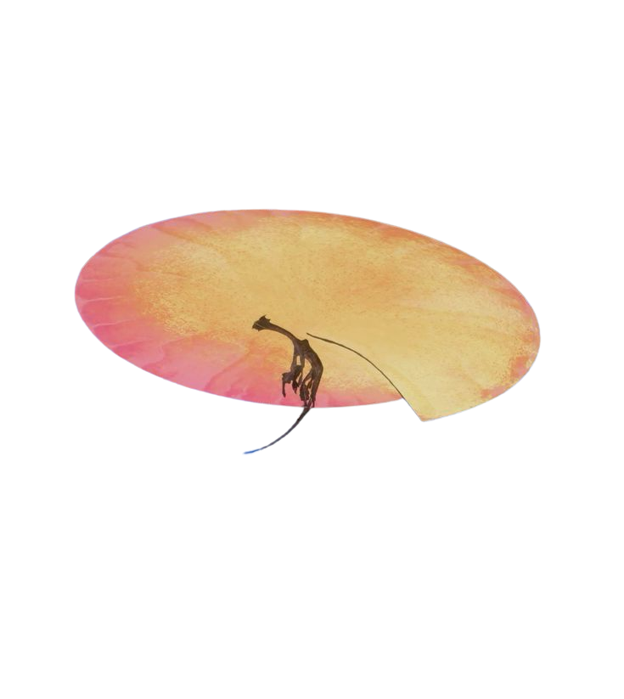
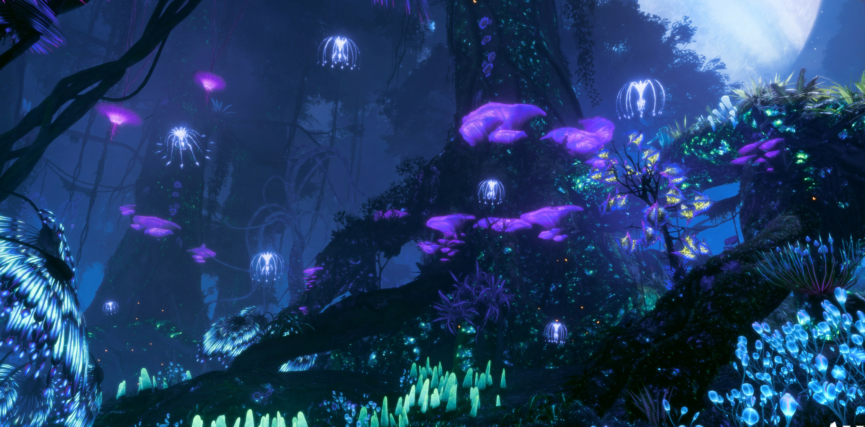
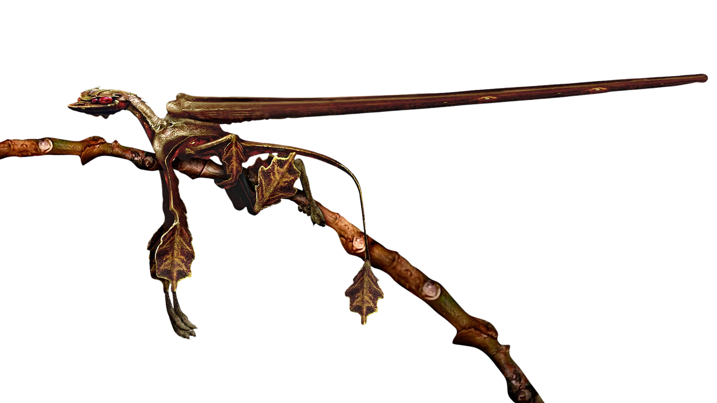

Slide 13
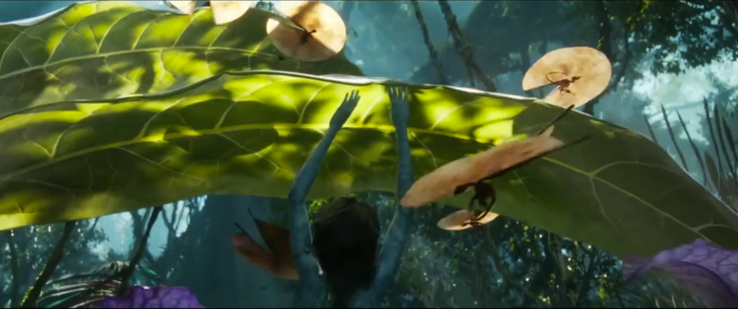
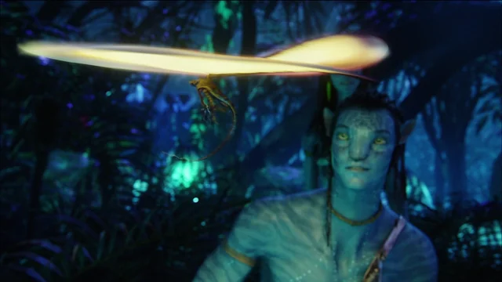
KENTEN
Avatar
The Kenten, or Fan Lizard, is a six-legged animal, like many creatures on Pandora. They have two extra 18-inch long appendages on their back that are connected by a fan of glowing skin.
When they feel scared, they swing the appendages around to spread out the fan, and it launches them into the air. This works because Pandora has lower gravity and a thicker atmosphere. Their skin looks like tree bark, and their legs and tail look like leaves.

Slide 14

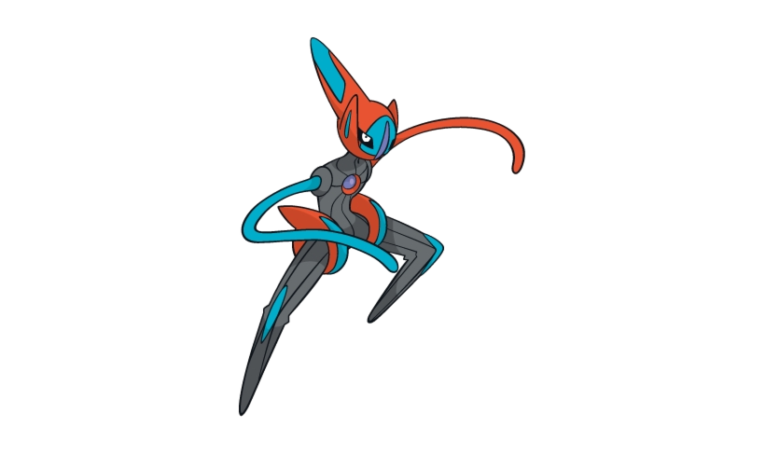
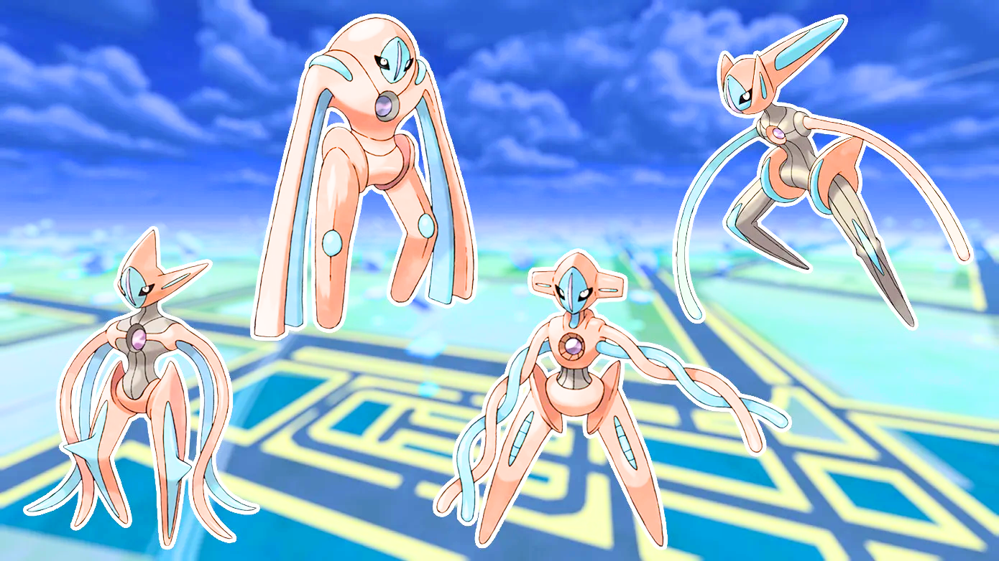
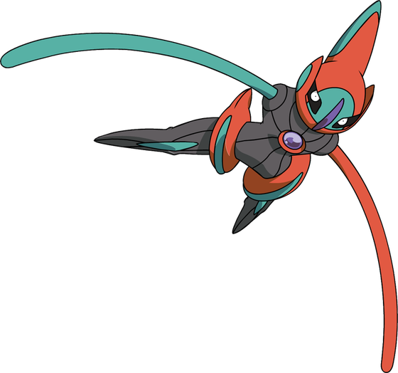
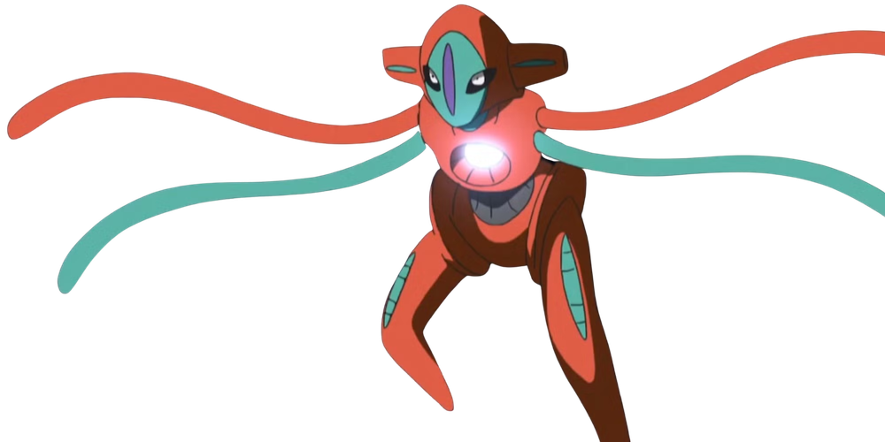

Slide 15
DEOXYS
Pokemon
Deoxys was a space virus on a meteorite, but when it crashed on Earth, its DNA changed. Its brain is in the purple crystal on its chest, which can shoot laser beams.
Deoxys can change its shape and abilities to deal with different challenges. It has four main forms: normal, attack, defense, and speed. It can also make small changes, like switching its arms from tentacles to human-like arms.

Slide 16




Slide 17
KIRBY
Nintendo
Kirby is a small, round, pink creature who comes from a planet called Popstar, and his body is squishy and bendy, almost like he doesn't have any bones—like how a jellyfish or an octopus can squeeze through tiny spaces. His best trick is sucking things up with his huge mouth.
When he wants to float, he puffs himself up like a balloon, similar to a pufferfish. If Kirby swallows certain enemies, he gets their special powers! He can also get squashed flat, stretched out, or dropped from high up without getting hurt, because his body is so soft and stretchy.

Slide 18
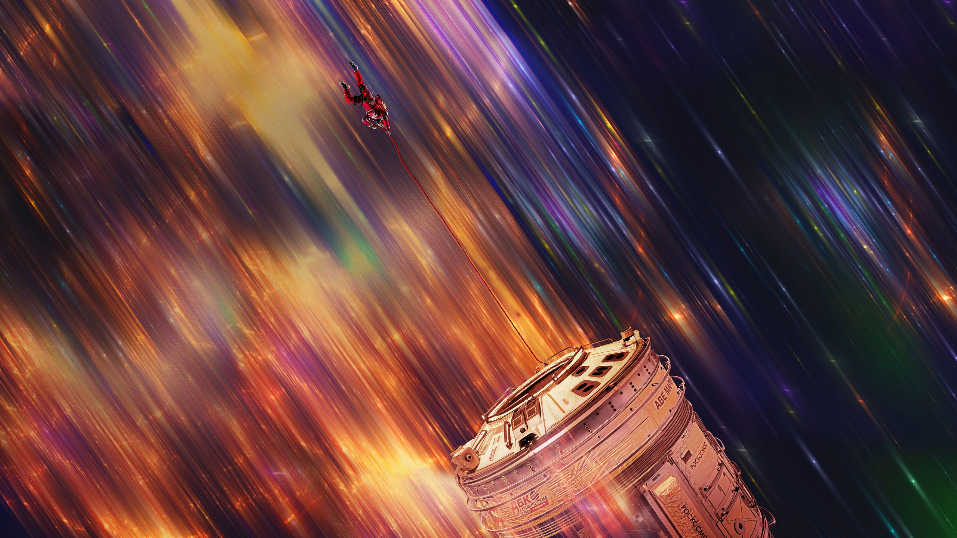
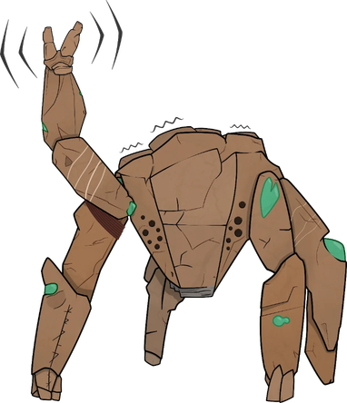
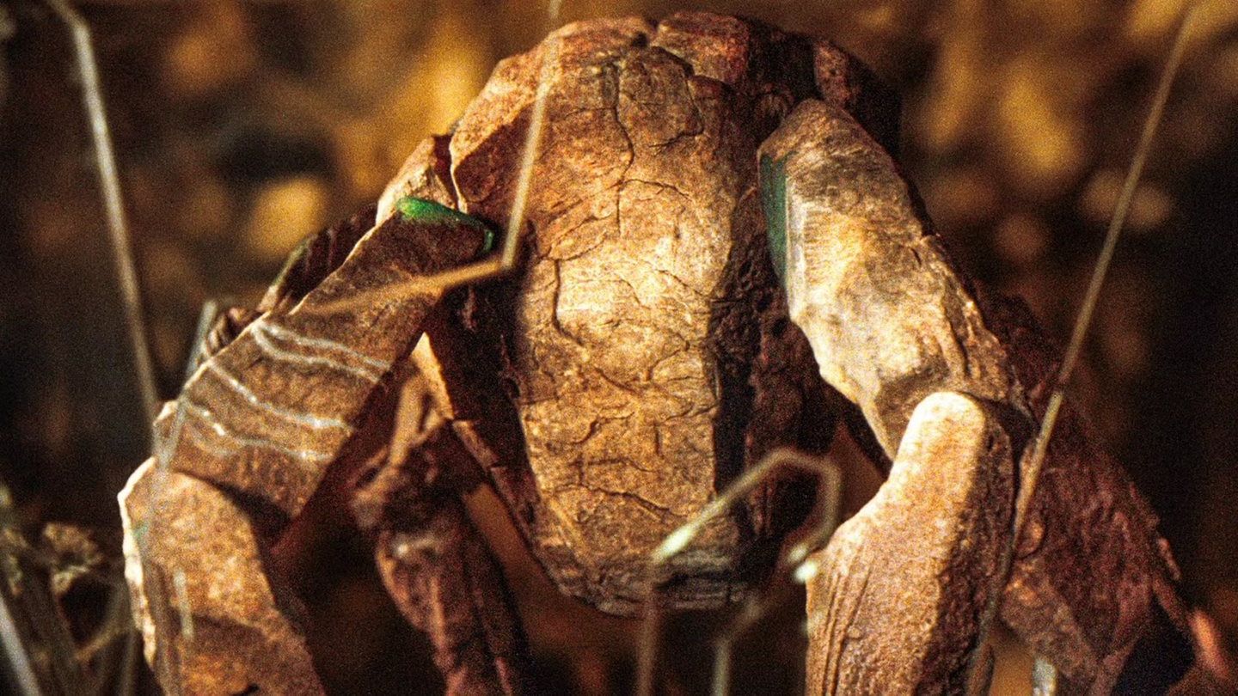
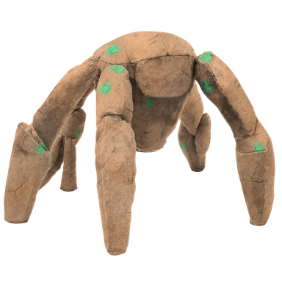

Slide 19
ROCKY
Project Hail Mary
Rocky is an Eridian, a rock-like alien from the 40 Eridani system. He has five legs, a hard body, and no eyes. Instead of seeing like humans do, he understands the world mostly through sound.
He can use echolocation, kind of like a bat or dolphin, and he communicates with musical sounds. His home planet is much hotter and has much higher air pressure than Earth, so he and humans cannot breathe the same air. Rocky is also very smart and is especially good at building things.

Slide 20
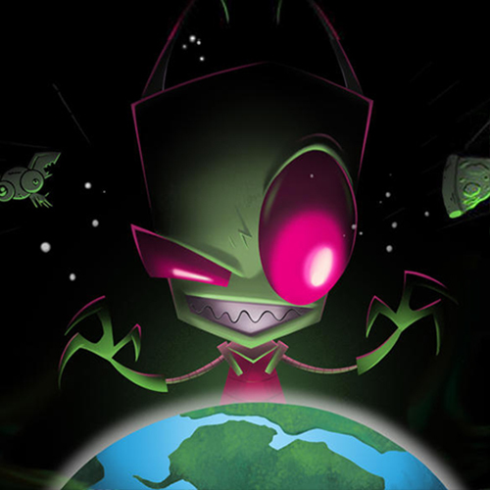
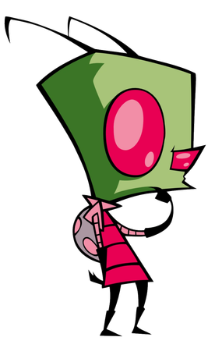
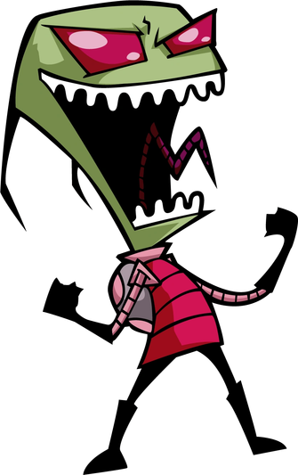

Slide 21
ZIM
Invader zim
Zim is a small green alien from the planet Irk, and his head and eyes are big compared to his body, almost like an insect’s eyes. Zim doesn't have normal human ears, but he has antennae on his head that he can move and react with. Strangely, water makes Zim scream and his skin burn like he's been hurt badly.
Zim wears a robot-like backpack called a PAK. It does a lot of jobs at once, like helping him breathe, giving him extra power, and even controlling some of his moods and memories. If Zim ever gets separated from his PAK for too long, his body starts shutting down. The PAK can also pop out little mechanical spider legs that help Zim climb walls, move fast, or grab onto things.

Slide 22
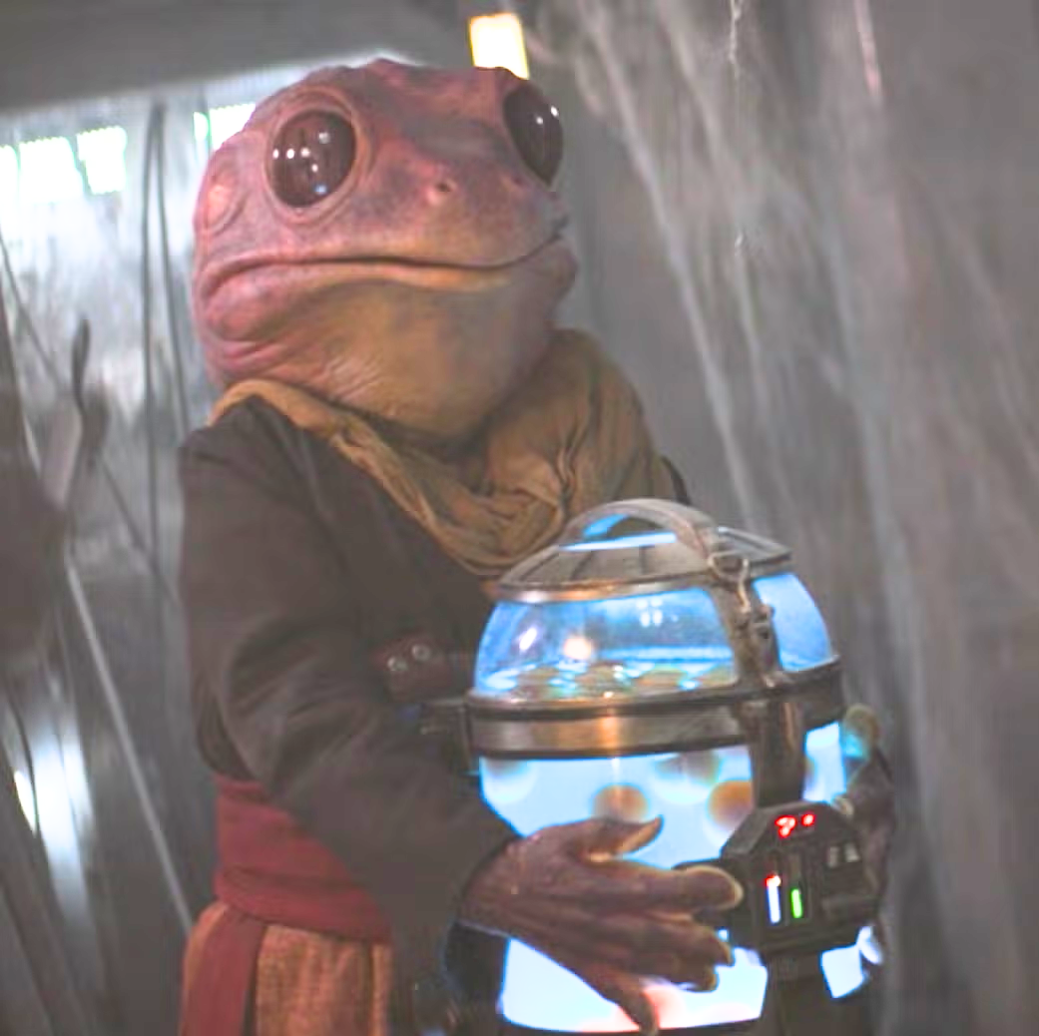
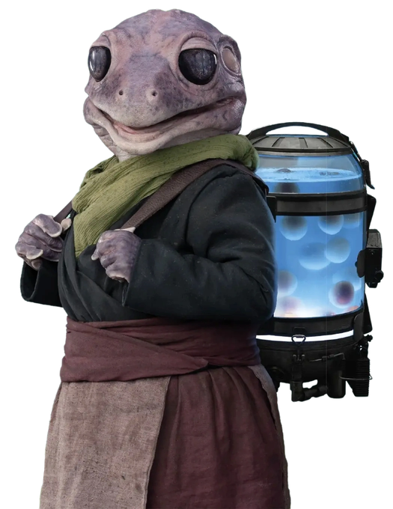

Slide 23
ANN
Ann is a creature who looks a lot like a big frog, with smooth skin, wide eyes, and a wide mouth. She can hold her breath underwater for a really long time and swims well.
Her species needs to keep their eggs safe until they're ready to hatch. The eggs are slimy and do not have a shell, similar to many real-life amphibian eggs. She also seems to handle cold and wet places pretty easily, the same way amphibians can survive in damp, chilly spots that might bother other animals. Her voice sounds like croaking and ribbiting instead of talking!
(Frog lady)
star wars
(Mandalorian)

Slide 24

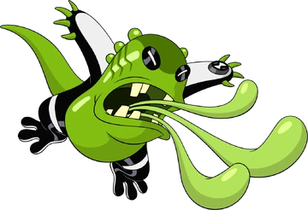
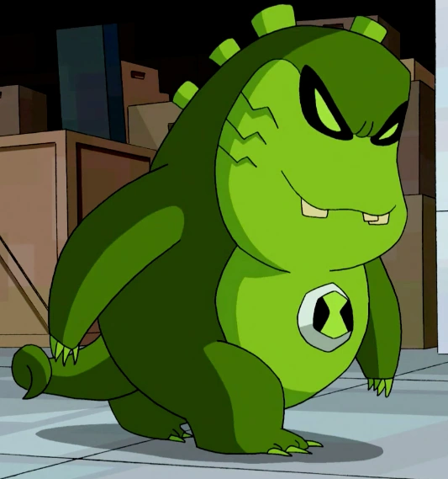
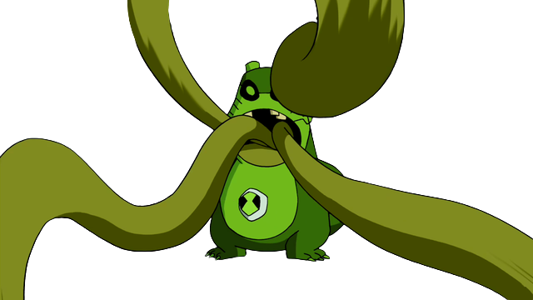

Slide 25
UPCHUCK
Ben 10
Upchuck is a small, green alien with a big mouth and four strong, bendy tongues it can use to pick up and grab things.
It can eat almost anything, even stuff that other creatures can't. Upchuck turns what it eats into powerful energy blasts. This makes Upchuck very useful and strong, especially when other aliens might have trouble. Upchuck's small size and surprising strength make it a tough opponent.

Slide 26

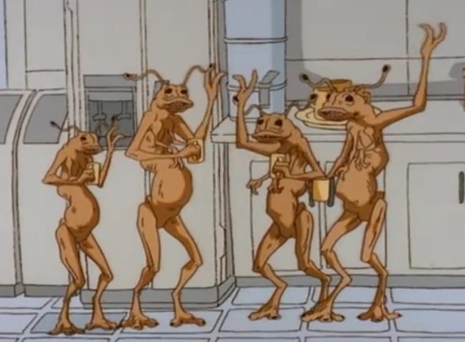
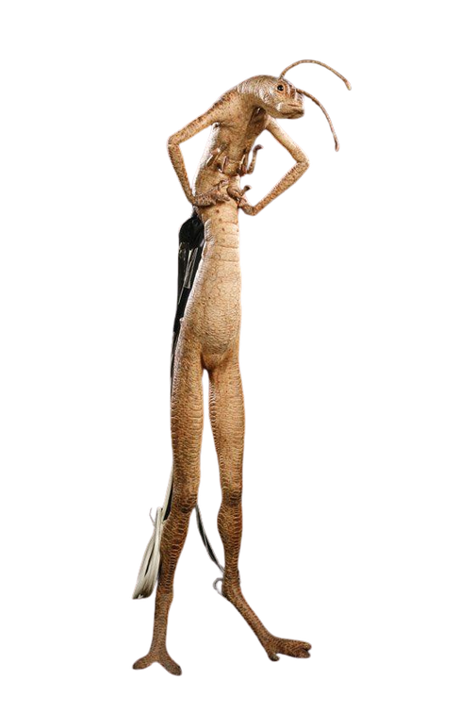
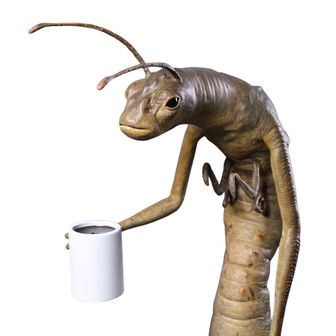

Slide 27
WORMS/ANNELIDS
Men in Black
These short, two-legged aliens have long torsos and legs compared to their main set of arms. Besides their main arms, they have two sets of smaller arms on their torso.
Their skin is sandy and mottled. They have small heads with black eyes, a big mouth, and two large antennae.They can survive being cut in half and can easily reattach their two halves.

Slide 28
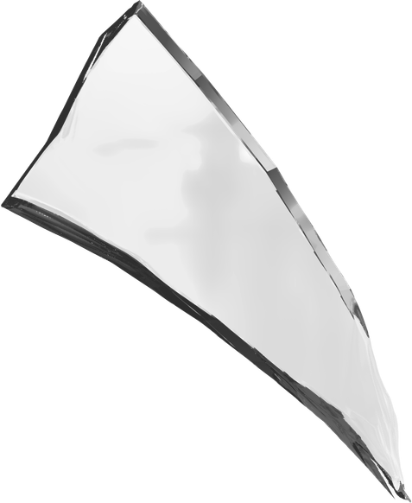
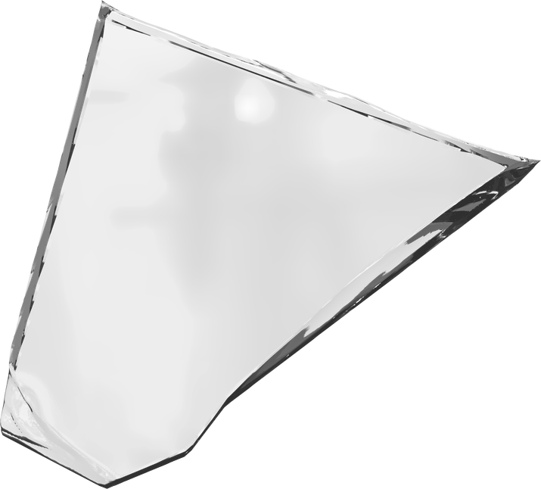
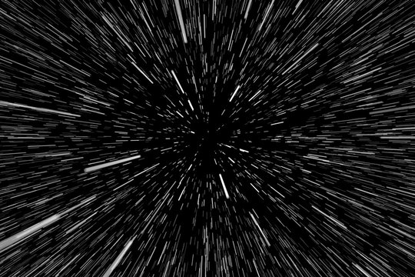







Slide 29
SHARD
Star Wars
Shards are smart crystals made of silicon that can talk using light and electricity. They come from a planet called Orax, where they grow in big groups in hot springs.
When humans arrived, they noticed the crystals were talking and made devices to understand them. Later, humans built robot bodies for the Shards. The Shards in these robots loved the freedom and excitement of moving around because their colonies usually took a very long time to make decisions. Some Shards could also use the Force. They created their own group of Jedi called the Iron Knights, but they were kicked out because they weren't organic.

Slide 30





Slide 31
GALLAXHAR’S SPECIES
Monsters vs. Aliens
This species is about 8 feet tall and looks mostly human above the waist. Instead of legs, they have six tentacles with clawed feet at the ends.
Their bodies seem soft and might not have bones inside. They have four eyes: the two in the middle work together, while the ones on the outside work more independently. They drink through their ear, which is connected to their mouth. They hear using "ear nubs," but it's not clear where these are on their bodies.

