Slide 1

Mars...or Arizona?
Notes:
1

Slide 2
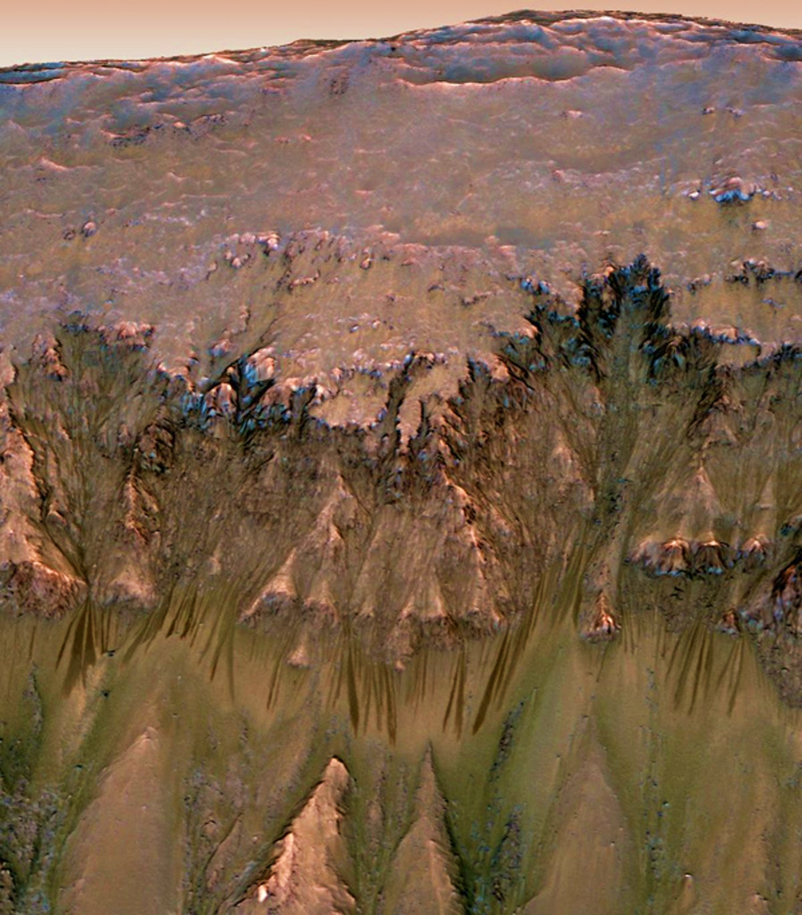
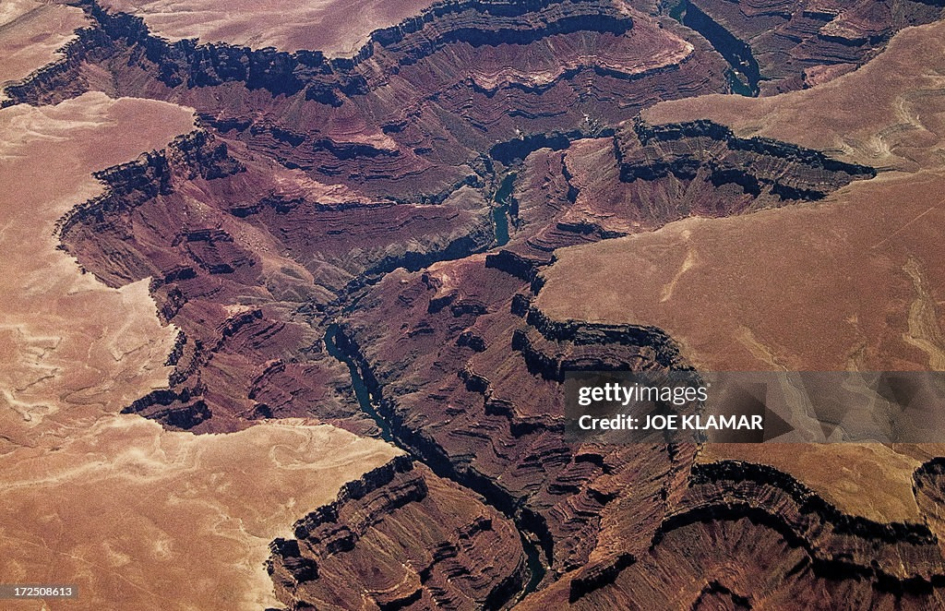
Mars or Arizona?
Notes:
1

Slide 3
Mars or Arizona?
Mars
Arizona
Notes:
1

Slide 4
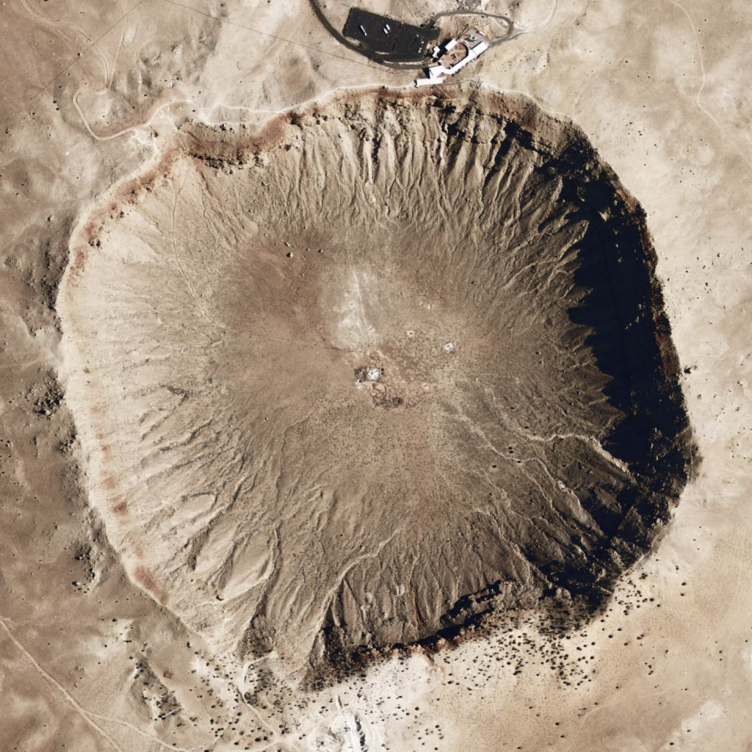
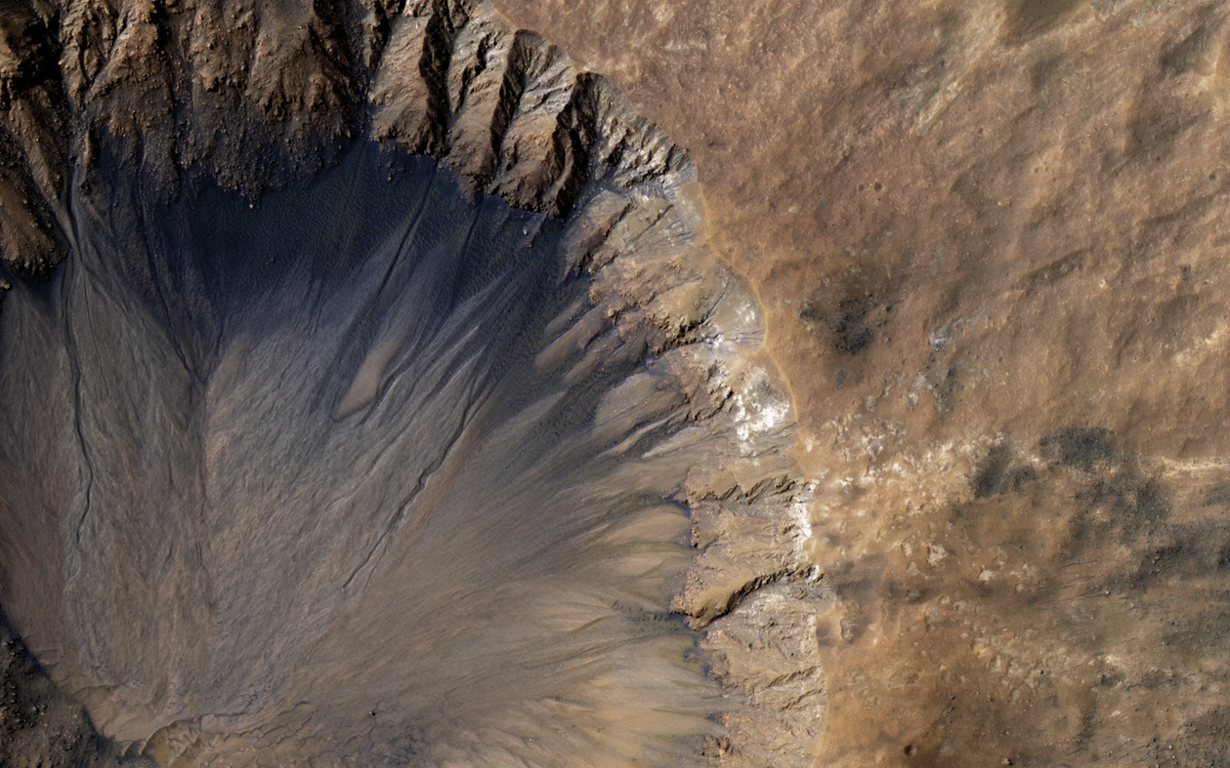
Mars or Arizona?
Notes:
2

Slide 5
Mars or Arizona?
Mars
Arizona
Notes:
2

Slide 6
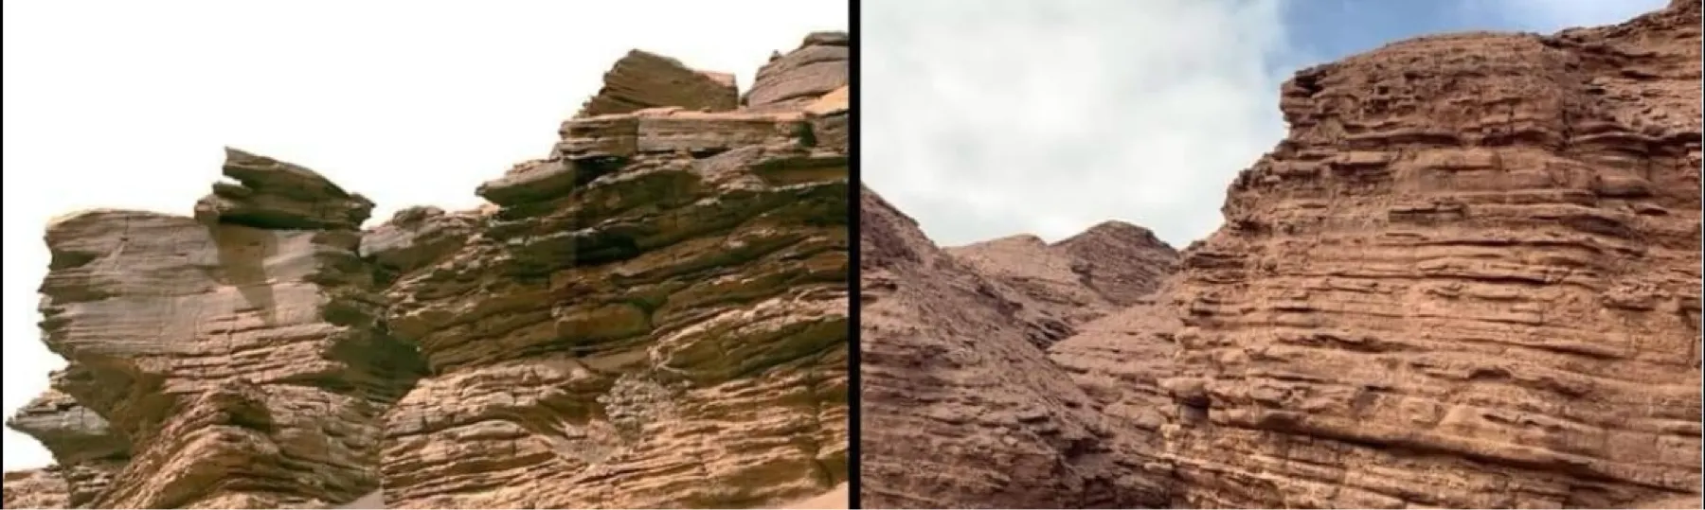
Mars or Arizona?
Notes:
3

Slide 7
Mars or Arizona?
Arizona
Mars
Notes:
3

Slide 8
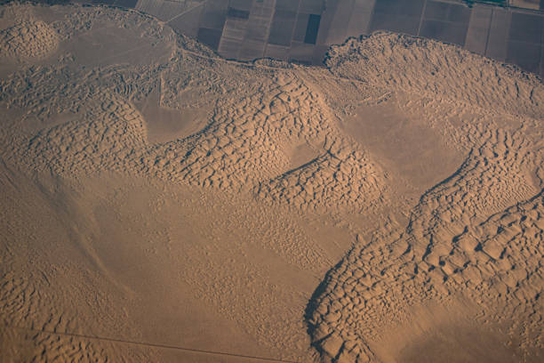

Mars or Arizona?
Notes:
3

Slide 9
Mars or Arizona?
Arizona
Mars
Notes:
3

Slide 10
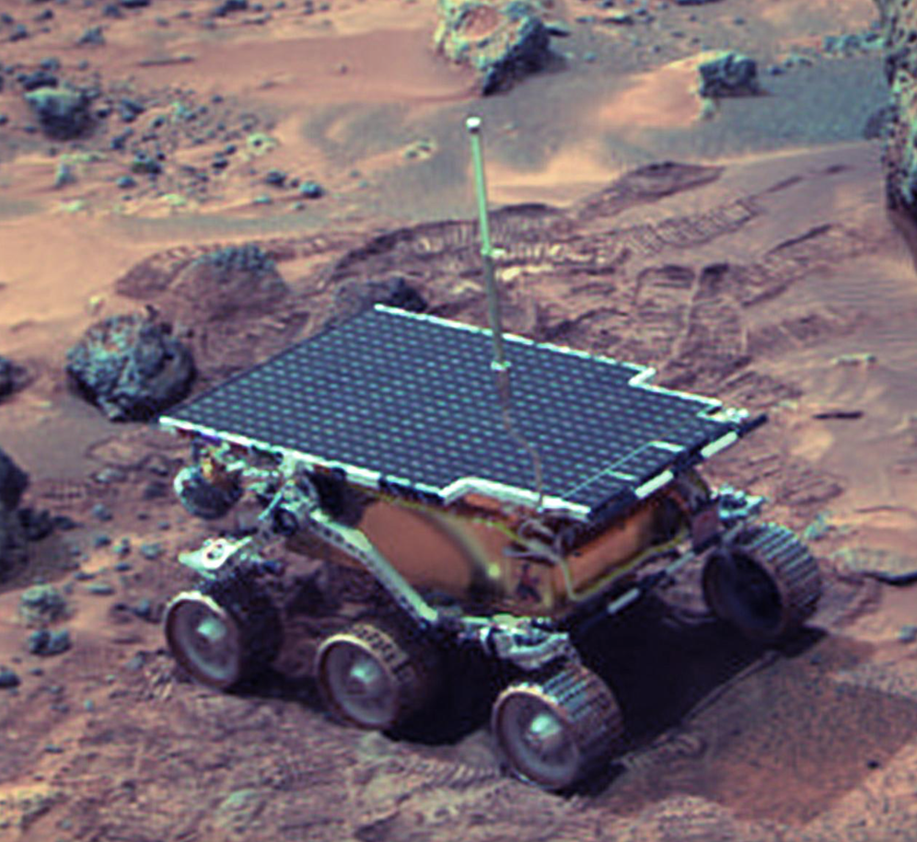
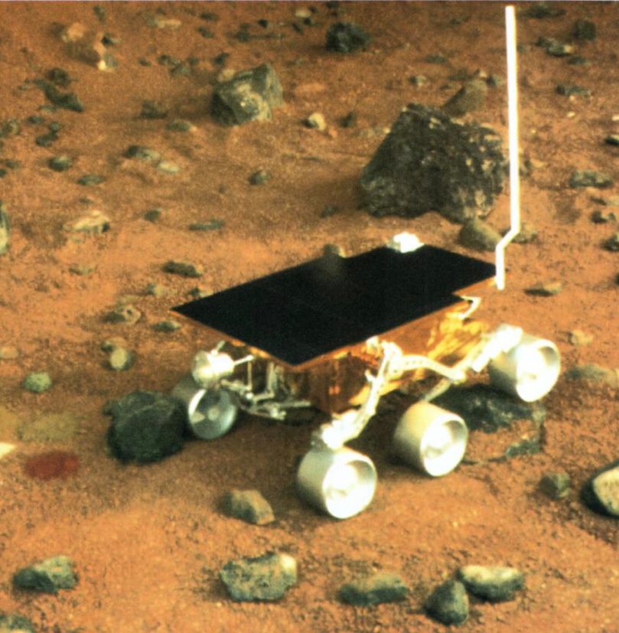
Mars or Arizona?
Notes:
2

Slide 11
Mars or Arizona?
Mars
Arizona
Notes:
2

Slide 12


Mars or Arizona?
Notes:
3

Slide 13
Mars or Arizona?
Arizona
Mars
Notes:
3

Slide 14


Mars or Arizona?
Notes:
3

Slide 15
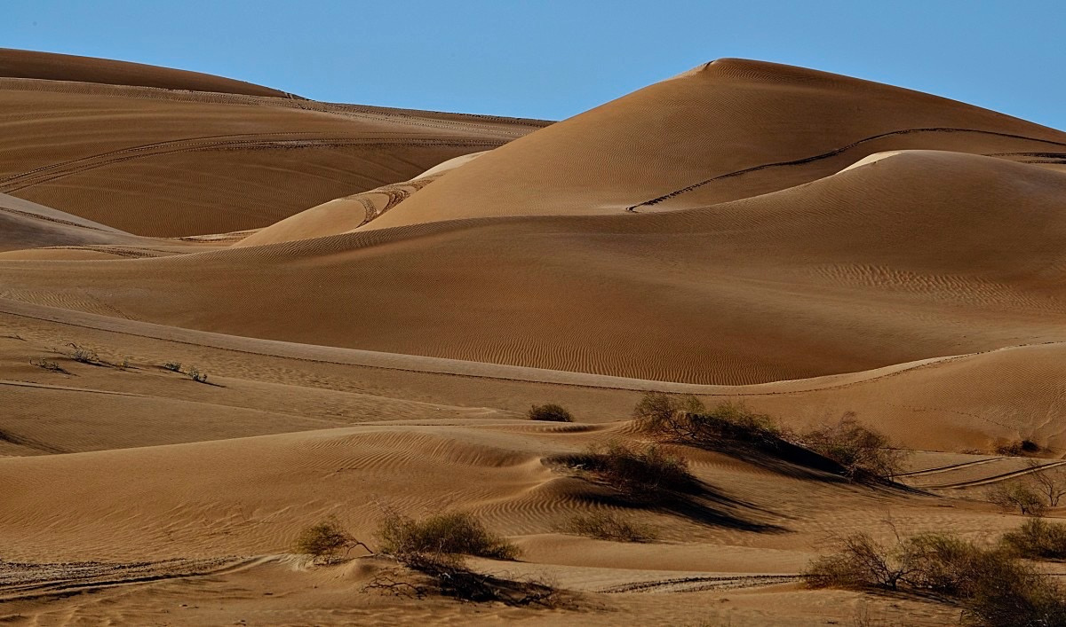

Mars or Arizona?
Arizona
Mars
Notes:
3

Slide 16


What is an analog?
  An analog is something that is similar to something else.
  Scientists use analogs to study places they can’t easily visit.
  Arizona sometimes used as an analog for Mars.

Slide 17
Why Use Arizona as a Mars Analog?
  It has dry desert conditions
  The ground can look like Mars
  It is much easier to visit than Mars
  Scientists can safely test ideas here

Slide 18
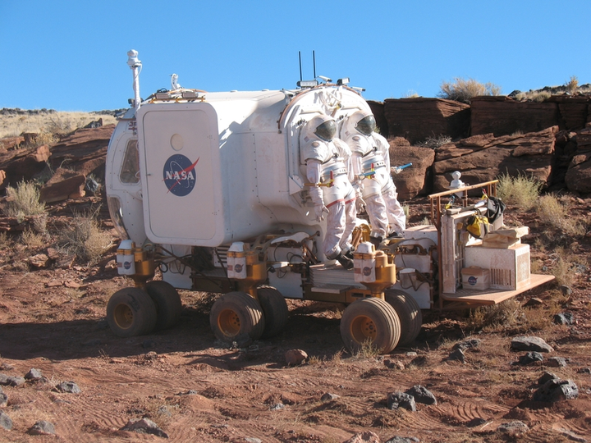
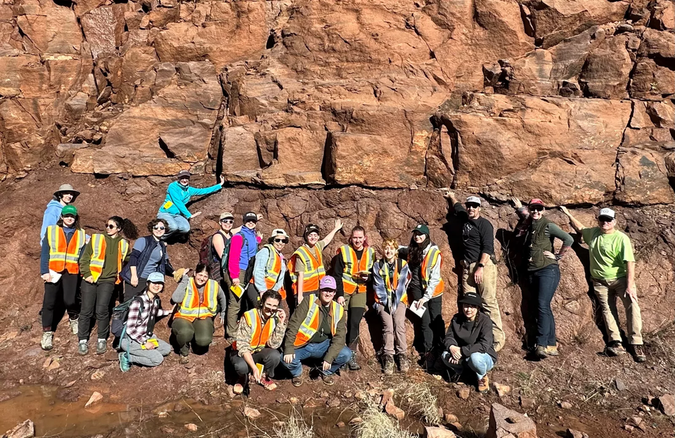
What Do Scientists Do in the Desert?
  Test Mars rovers and robots
  Practice exploring like astronauts
  Study rocks and soil
  Look for signs of life in extreme environments

