Slide 1
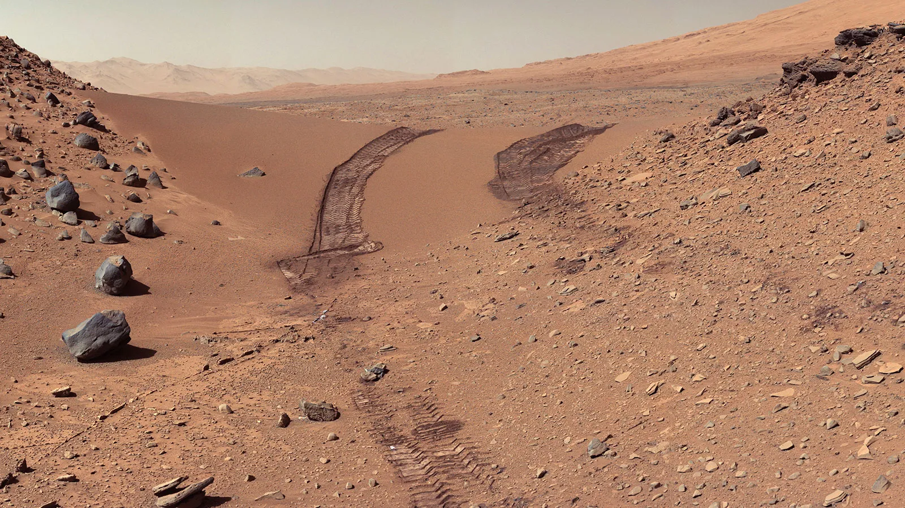
Mars - Air and Weather
  Mars has very thin air (about 100x thinner than Earth’s).
  There is almost no oxygen to breathe.
  It is very cold and dry.
  It never rains.
  Huge dust storms can cover the whole planet.

Slide 2
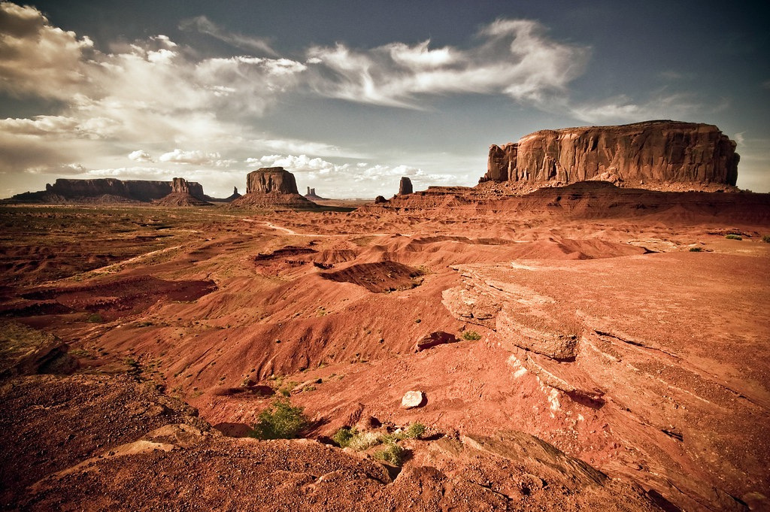
Arizona - Air and Weather
  Arizona has oxygen that humans and other animals need to survive.
  It is hot and dry most of the year.
  It gets some rain, especially during the summer monsoons.
  Dust storms can happen in the desert.

Slide 3
Mars - Temperature
  Mars is very cold.
  The average temperature is about -80°F.
  Nights can be even colder!
  Water freezes quickly. Only very salty water can stay liquid on the surface.

Slide 4
Arizona - Temperature
  Arizona deserts are very hot during the day.
  Summer temperatures can go above 100°F.
  Nights can be cooler.
  Water stays liquid most of the time.

Slide 5
Mars - Gravity
  Gravity on Mars is much weaker than Earth.
  You would weigh less there.
  You could jump higher and farther.

Slide 6
Arizona - Gravity
  Arizona has the same gravity as the rest of Earth.
  We cannot jump as high as we could on Mars.

Slide 7
Mars - Desert Environment
  Mars is a giant desert planet.
  It is dry and dusty everywhere.
  There are no plants or animals that we know of.

Slide 8
Arizona - Desert Environment
  Arizona has large desert areas, but it is not entirely a desert.
  It is dry, but not as extreme as Mars.
  Plants and animals live there.

Slide 9
Mars - Dirt
  Mars dirt is red because of iron oxide (rust)
    This is why Mars is called the “Red Planet”
  Mars dirt contains toxic chemicals called perchlorates. These chemicals can be harmful to living things.
  The dirt does not have organic matter (decomposed plants or animals).

Slide 10
Arizona - Dirt
  Arizona desert dirt can also be reddish - it contains iron oxide, just like Mars!
  Some areas look very similar to Mars.
  Arizona dirt can support plant life.
  It contains nutrients from decomposed plants and animals.
  Tiny organisms in the soil help recycle nutrients.

Slide 11
Mars - Terrain
  Mars has volcanoes, canyons, and craters.
  It has sand dunes and rocky plains.
  Some areas look like they were shaped by water long ago.

Slide 12
Arizona - Terrain
  Arizona has canyons, deserts, and rocky landscapes.
  It also has dunes and volcanic areas.
  Wind and water shape the land.

