Slide 1
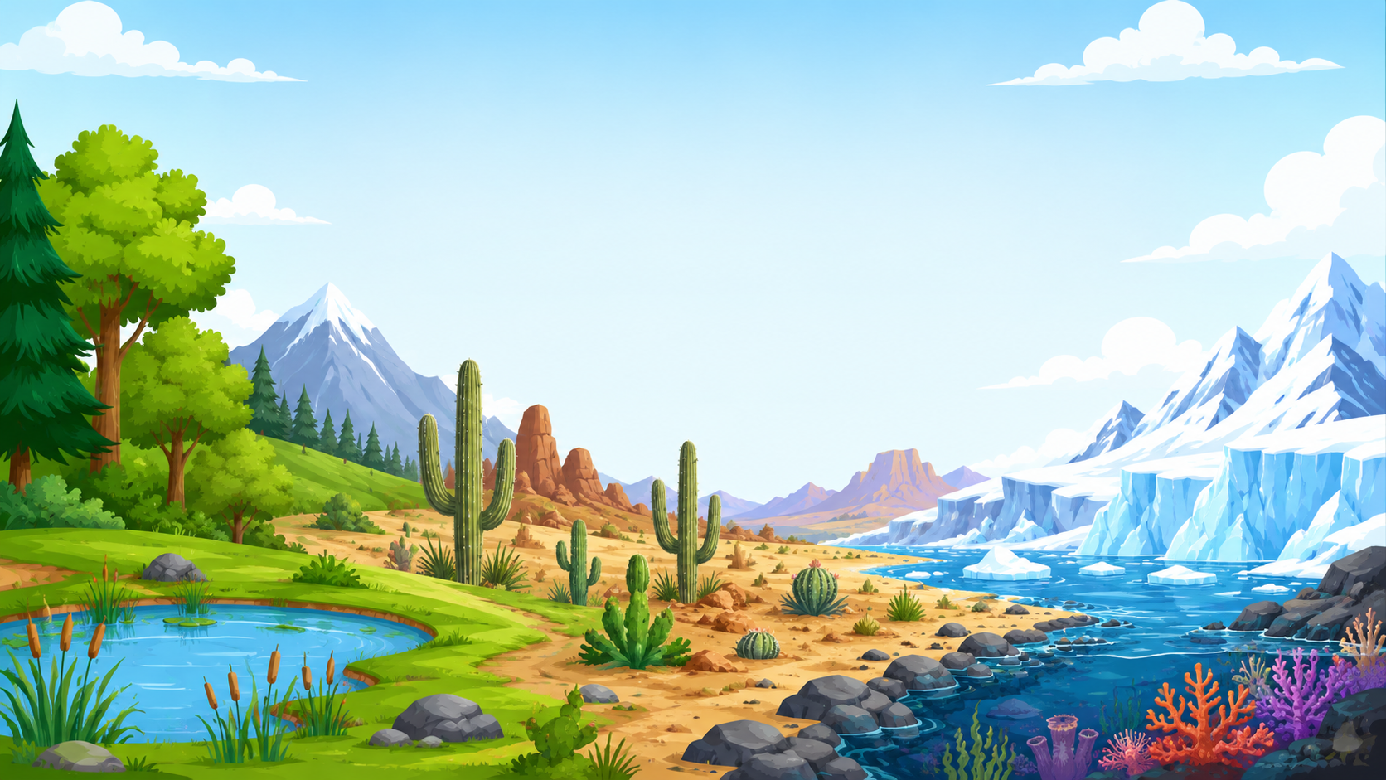

Extreme Life

Slide 2
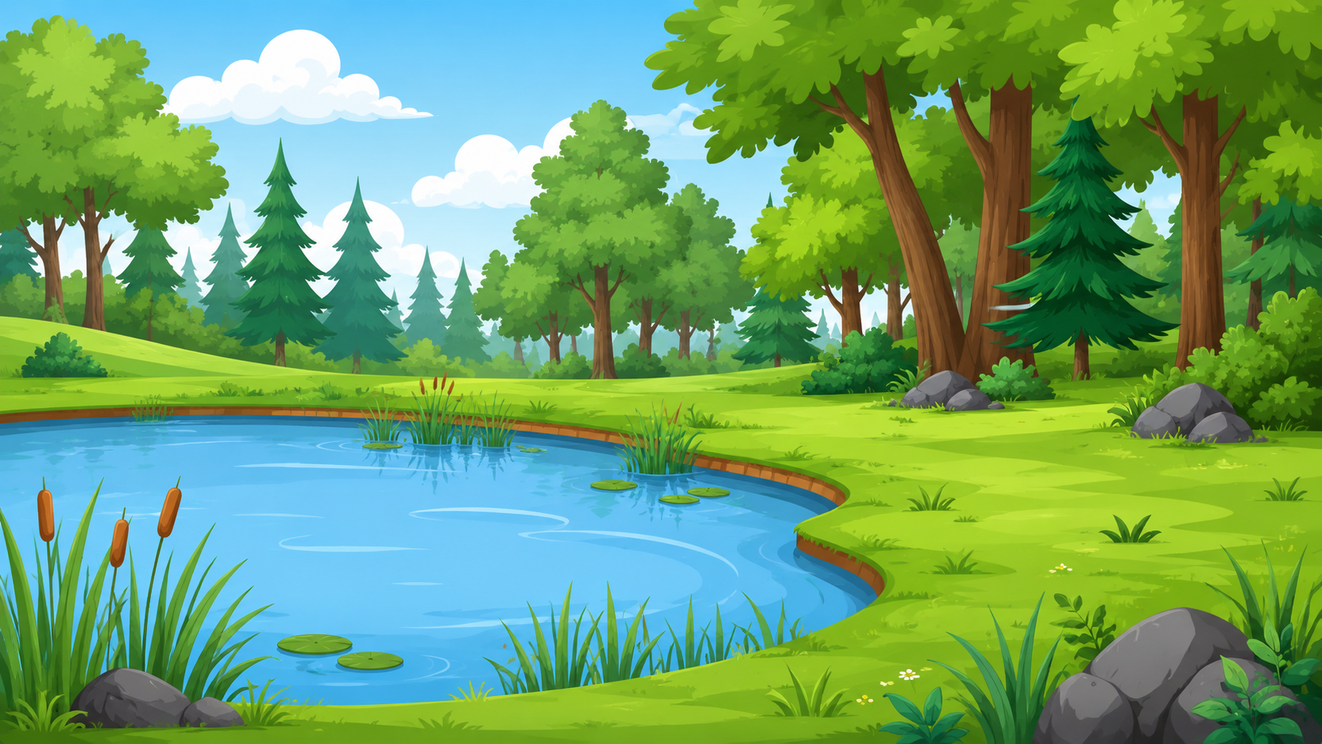
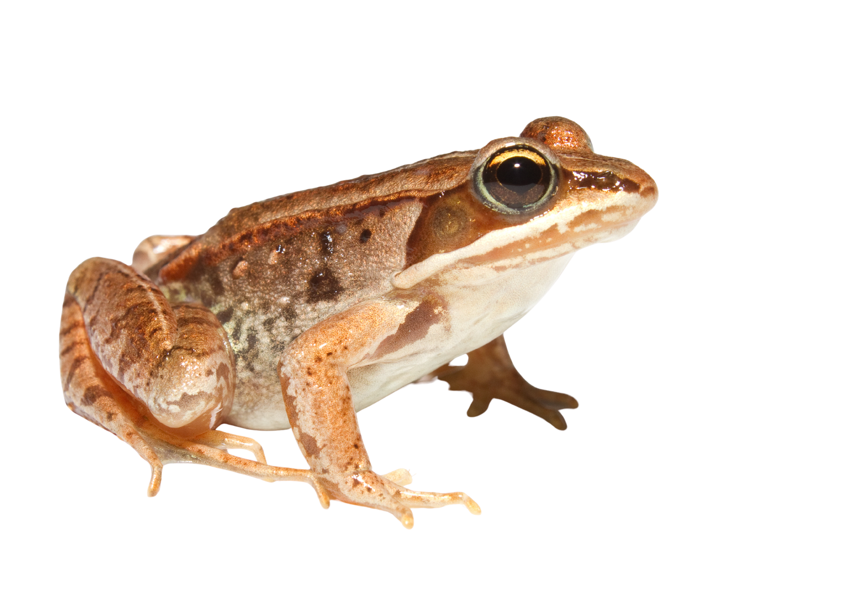
Wood Frog
Wood frogs live in forests and ponds that freeze in winter. They can freeze solid and wake up again in the spring.

Slide 3
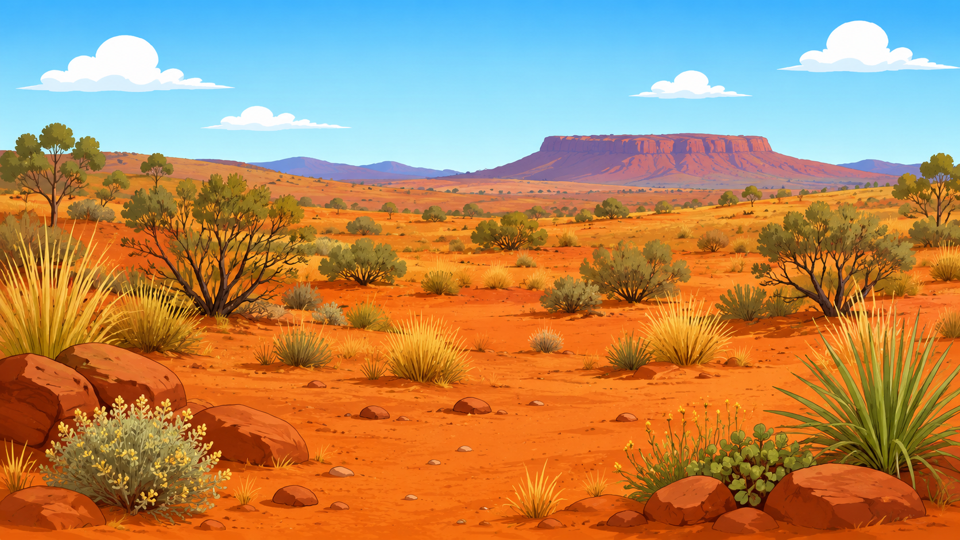
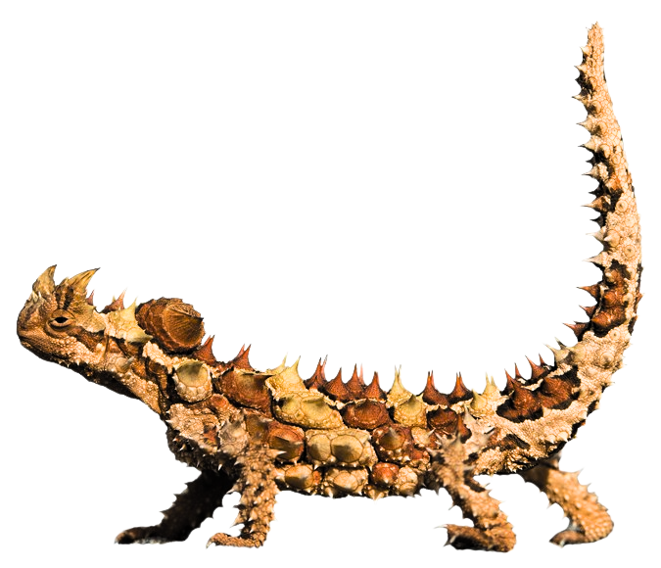
Thorny devil
Thorny devils live in deserts in Australia and get water using special grooves on their skin. If they step in a small puddle, the water moves to their mouth along their skin.

Slide 4
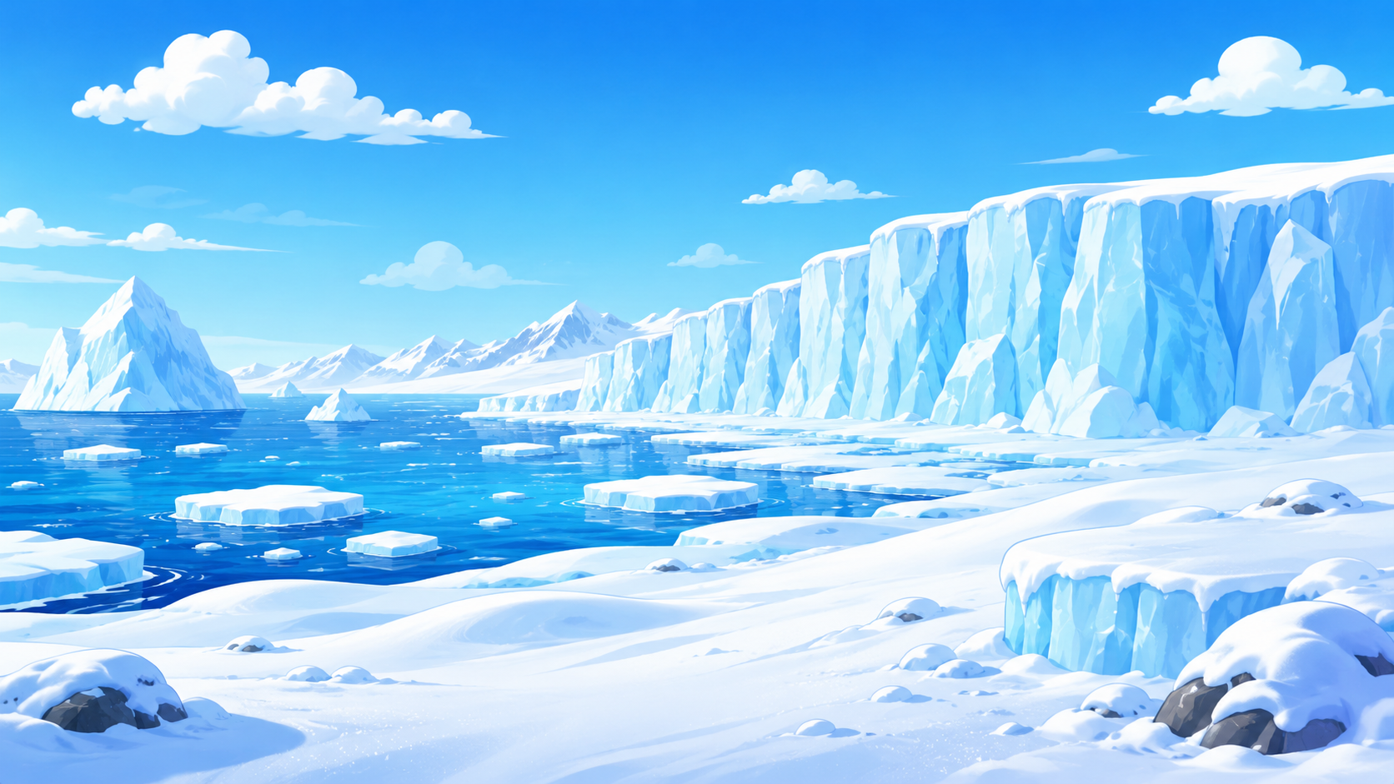
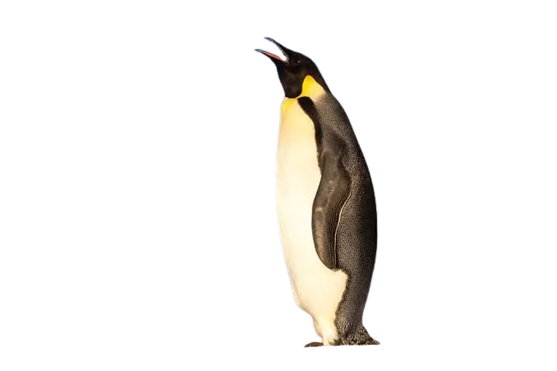
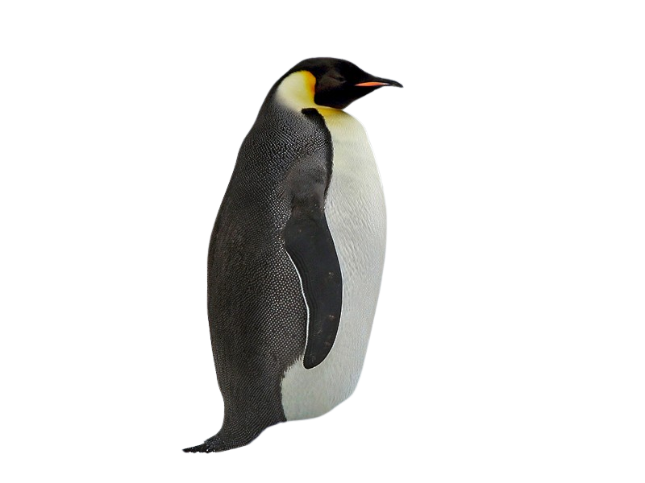
Emperor Penguin
Emperor penguins live in Antarctica, where it’s super cold all year. They stay warm using a thick layer of fat, warm feathers, and huddling together in groups.

Slide 5
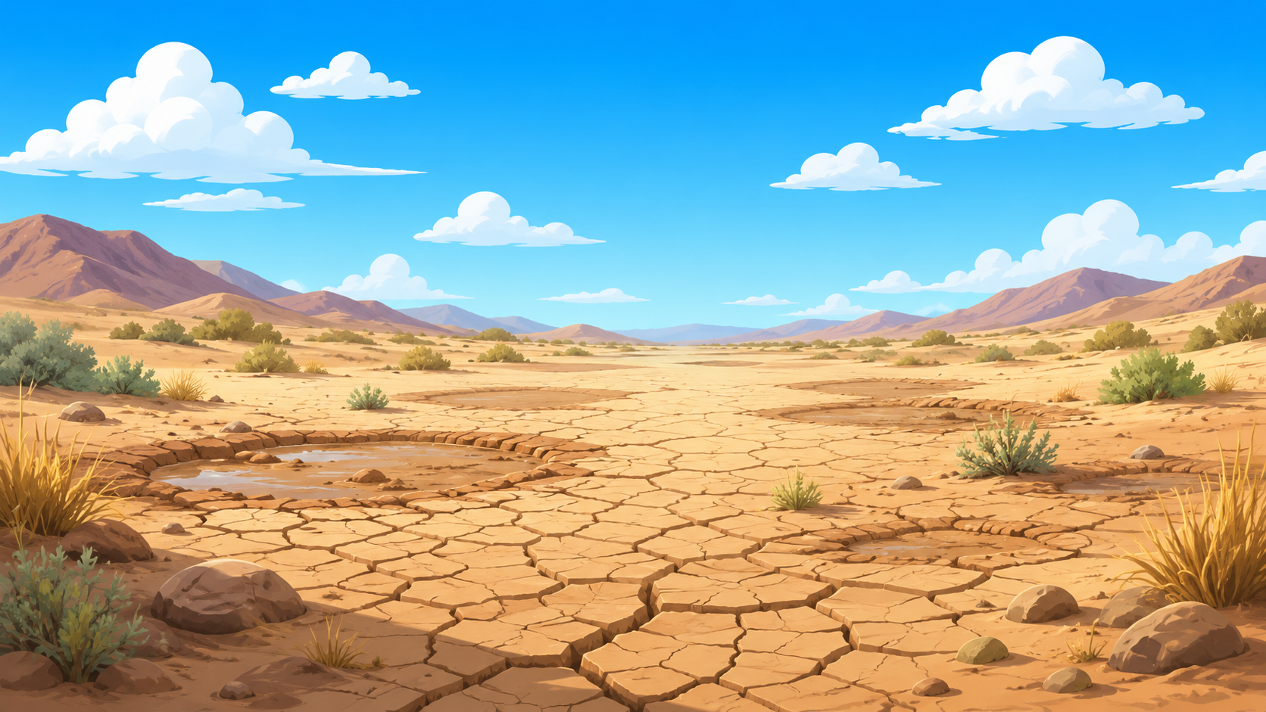
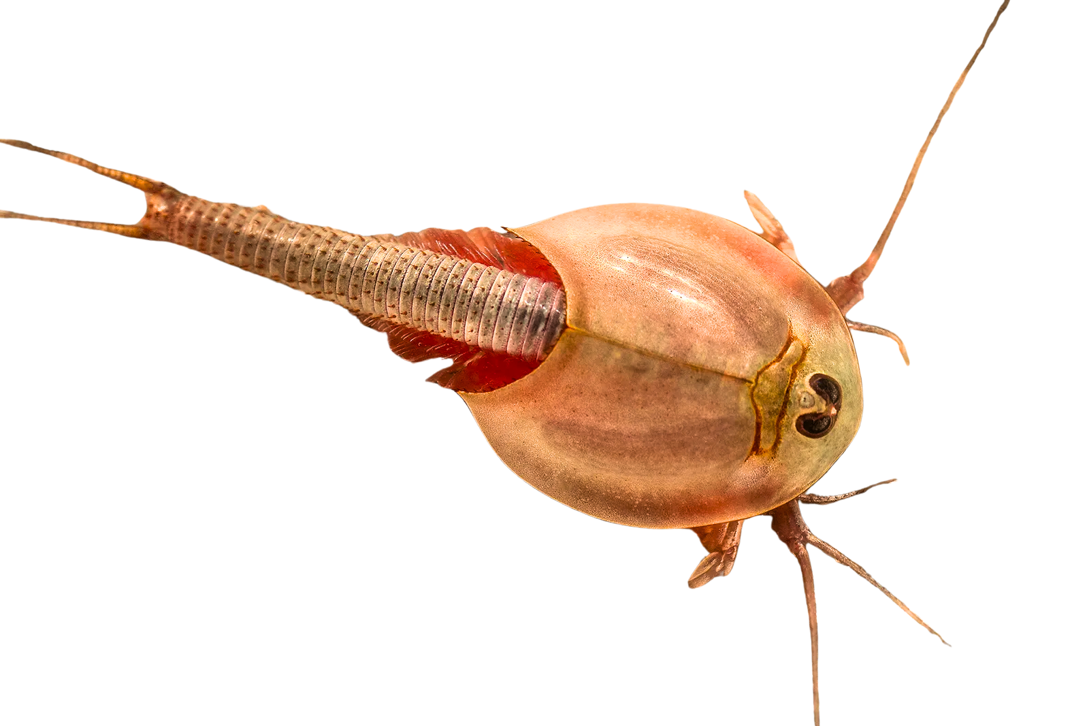
TadPole Shrimp
Tadpole shrimp live in deserts where water dries up very fast. They have special eggs that can dry out. The eggs will stay dry for many years until it rains again. When the rains come, they will hatch.

Slide 6
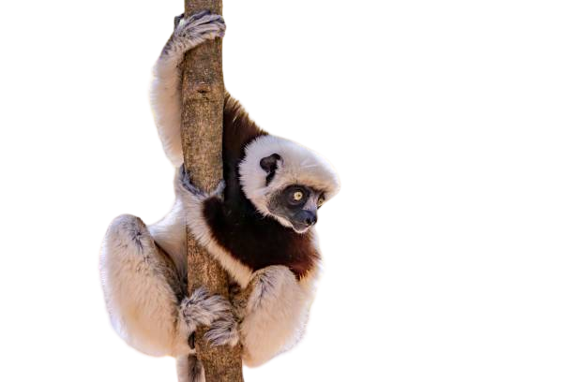
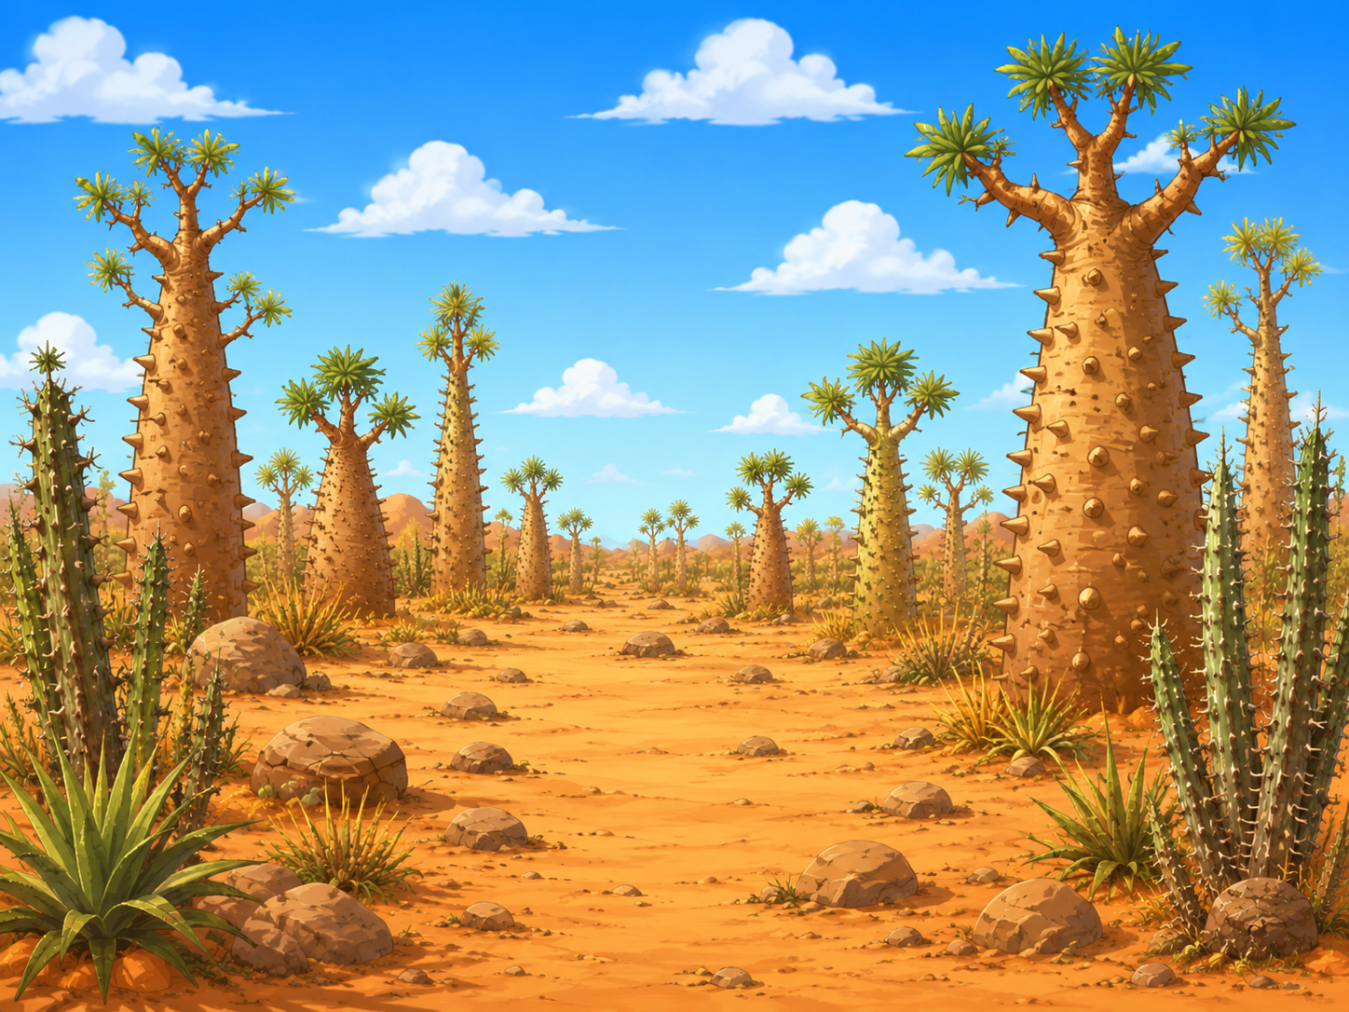
Sifaka Lemur
Sifakas live in forests where all the plants are very spiky. They can climb spiky trees that most other animals can’t climb. They have thick pads on their hands and feet to protect them from these spikes.

Slide 7
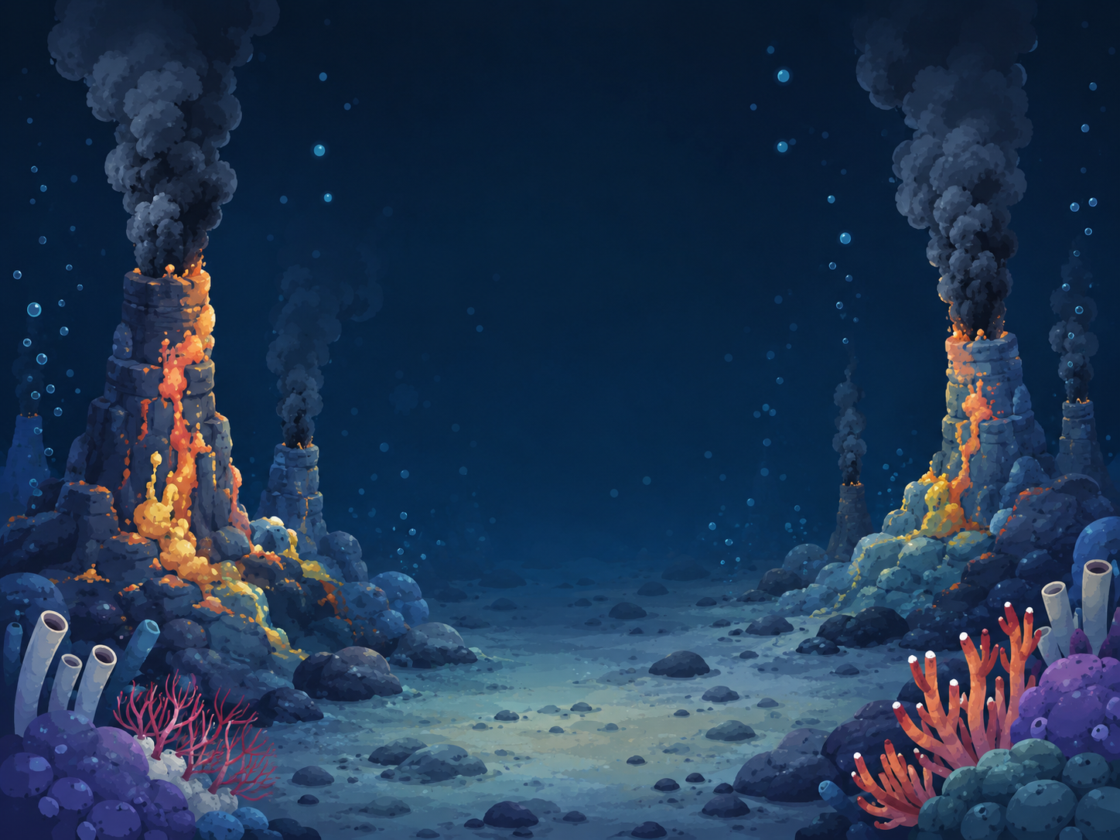
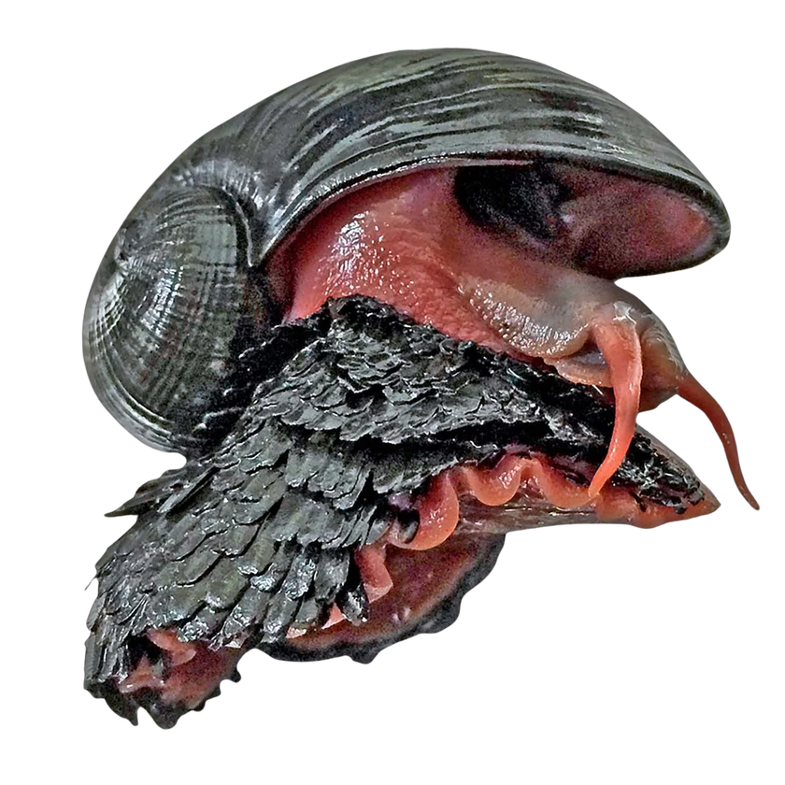
Volcano snail
At the bottom of the ocean, there's a lot of pressure from the water above. Volcano snails can handle it because they have very tough shells made of iron.

Slide 8
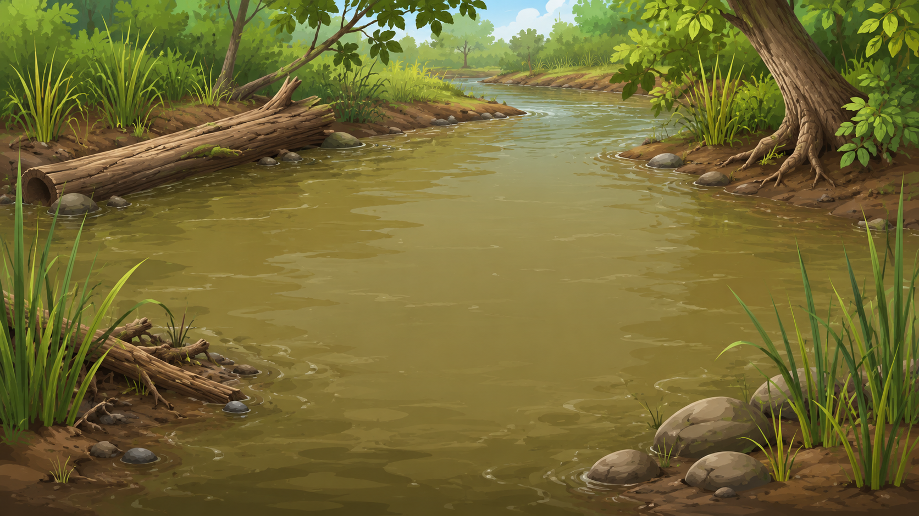
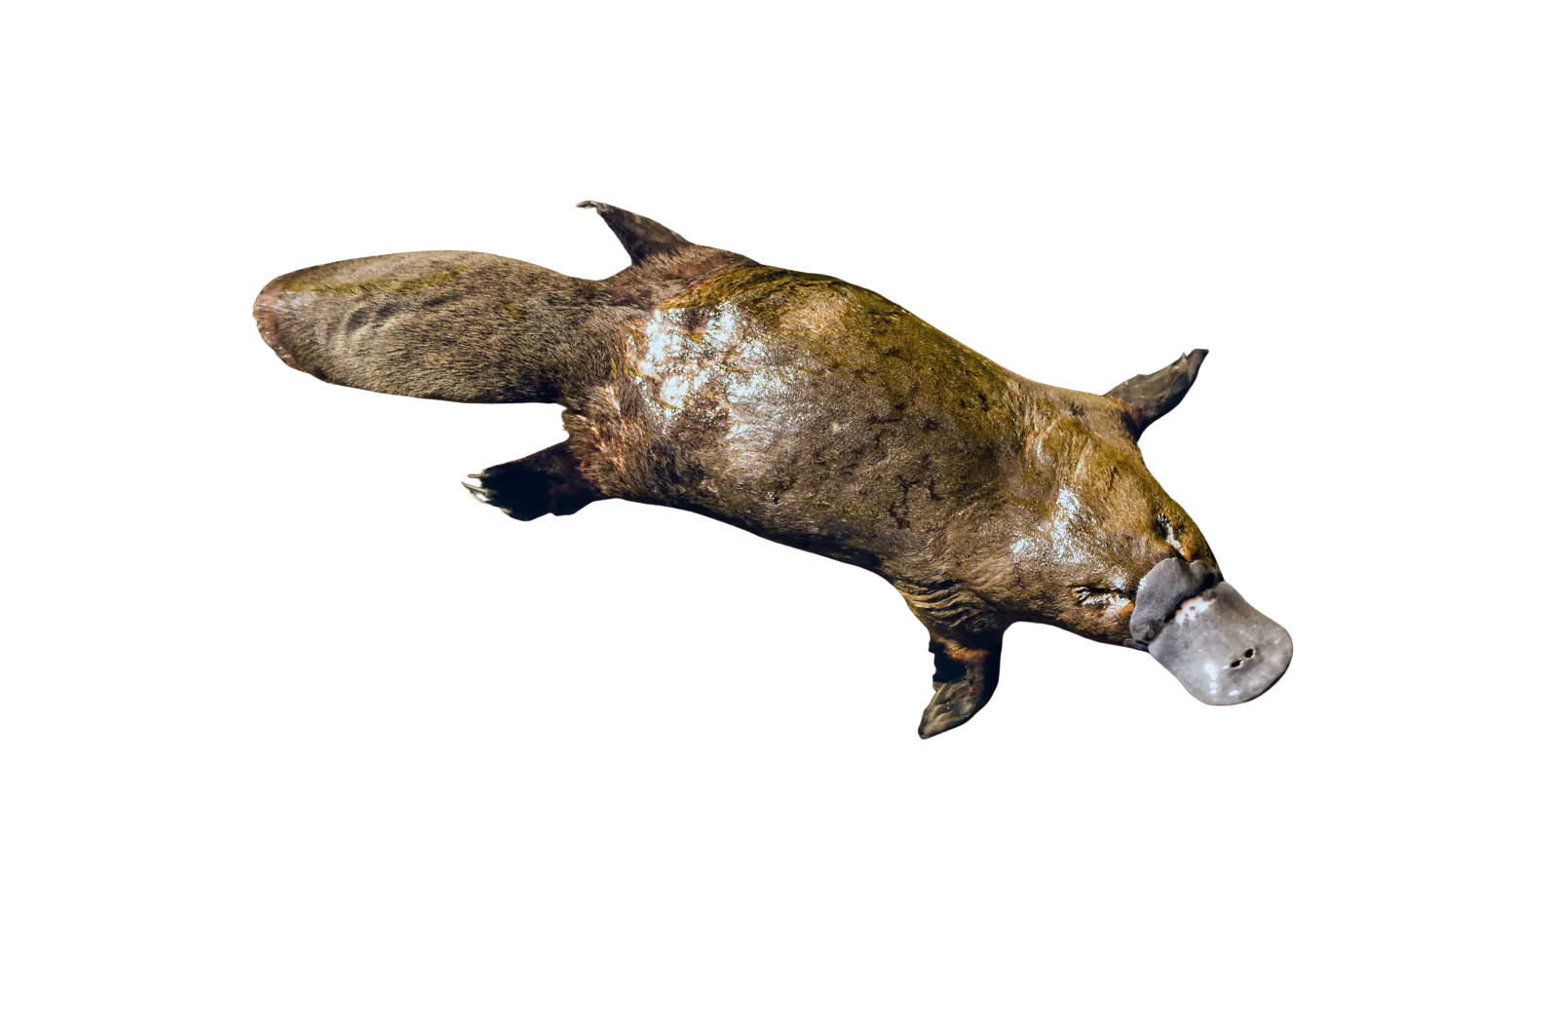
Platypus
The platypus lives in murky rivers and streams. It can be hard to see things. They find their food by sensing the electricity made by the small animals they eat. They have a special detector in their bill.

Slide 9
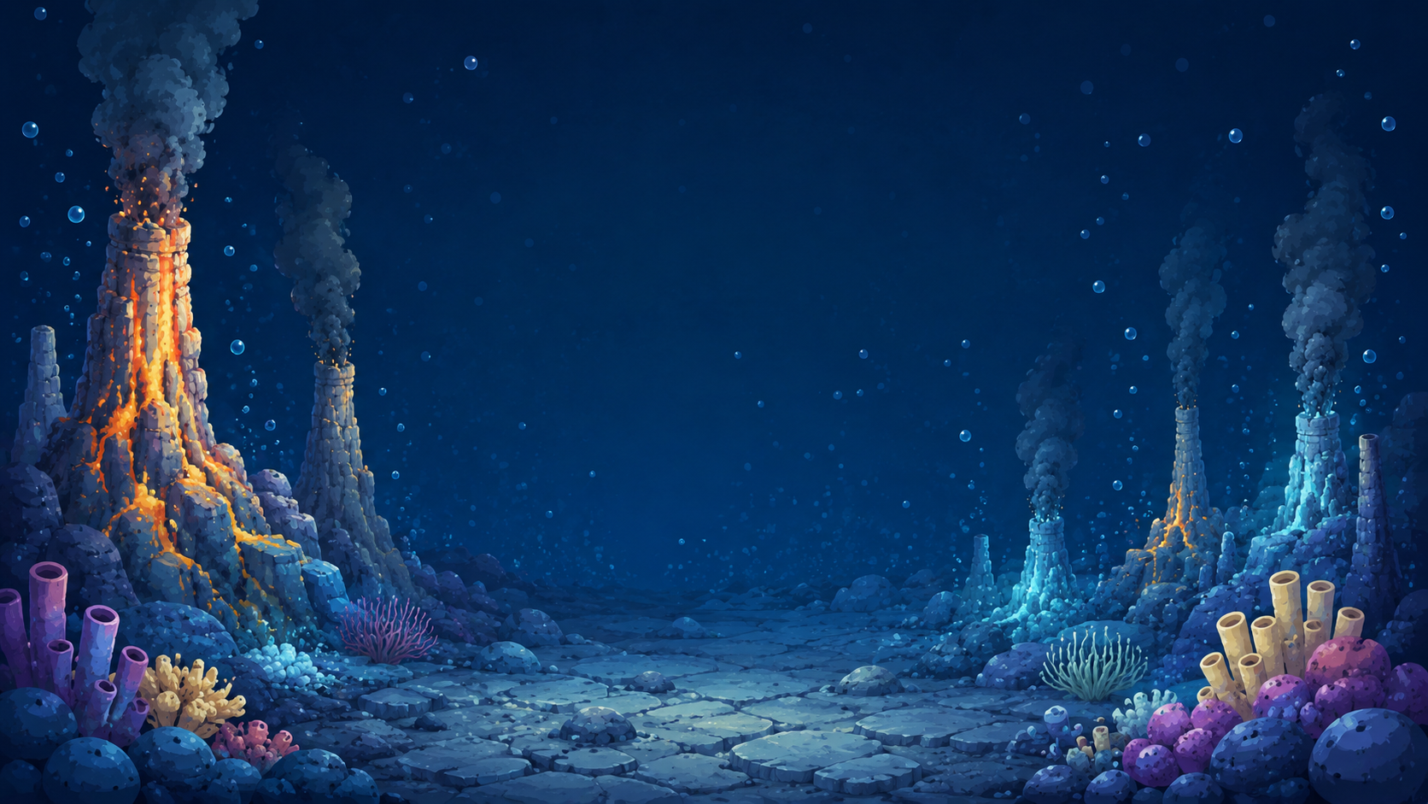
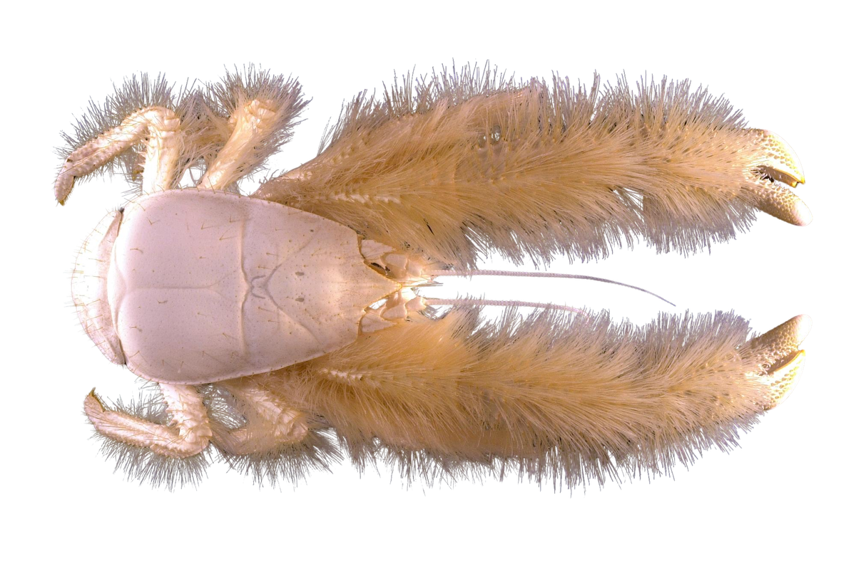
Yeti Crab
In deep parts of the ocean there are no plants because there is no sunlight. Some life in the deep ocean eat bacteria instead of plants. Yeti crabs grow bacteria on their long furry arms and eat it.

Slide 10
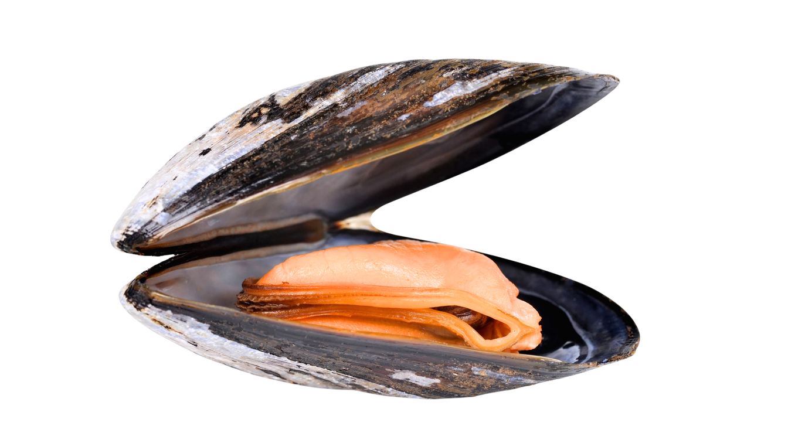
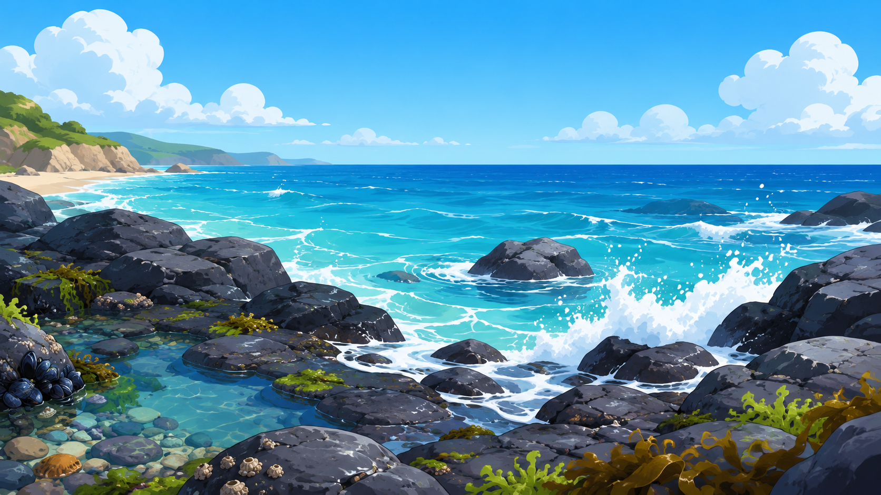
Mussels
Mussels live on the coast where waves crash on rocks. They use lots of thin threads to attach to the rocks so they don’t get knocked off by the waves. They also close their shells so they don’t dry out when they’re out of the water.

Slide 11
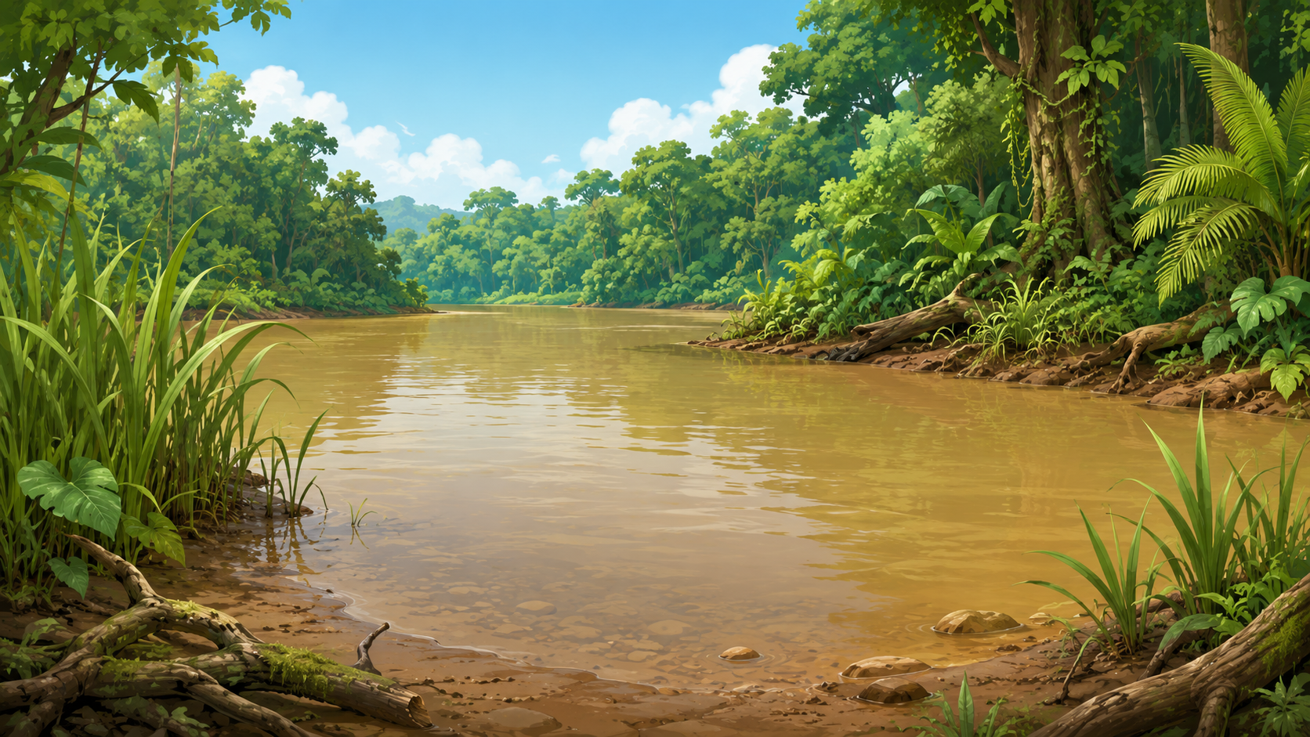
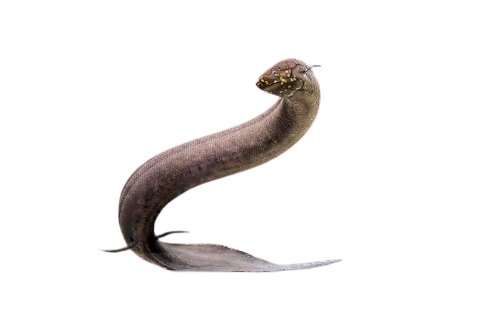
Lungfish
Lungfish live in tropical streams and lakes that sometimes dry out. Lungfish can burrow in the soil when it is dry, and have a lung to breathe air.

Slide 12
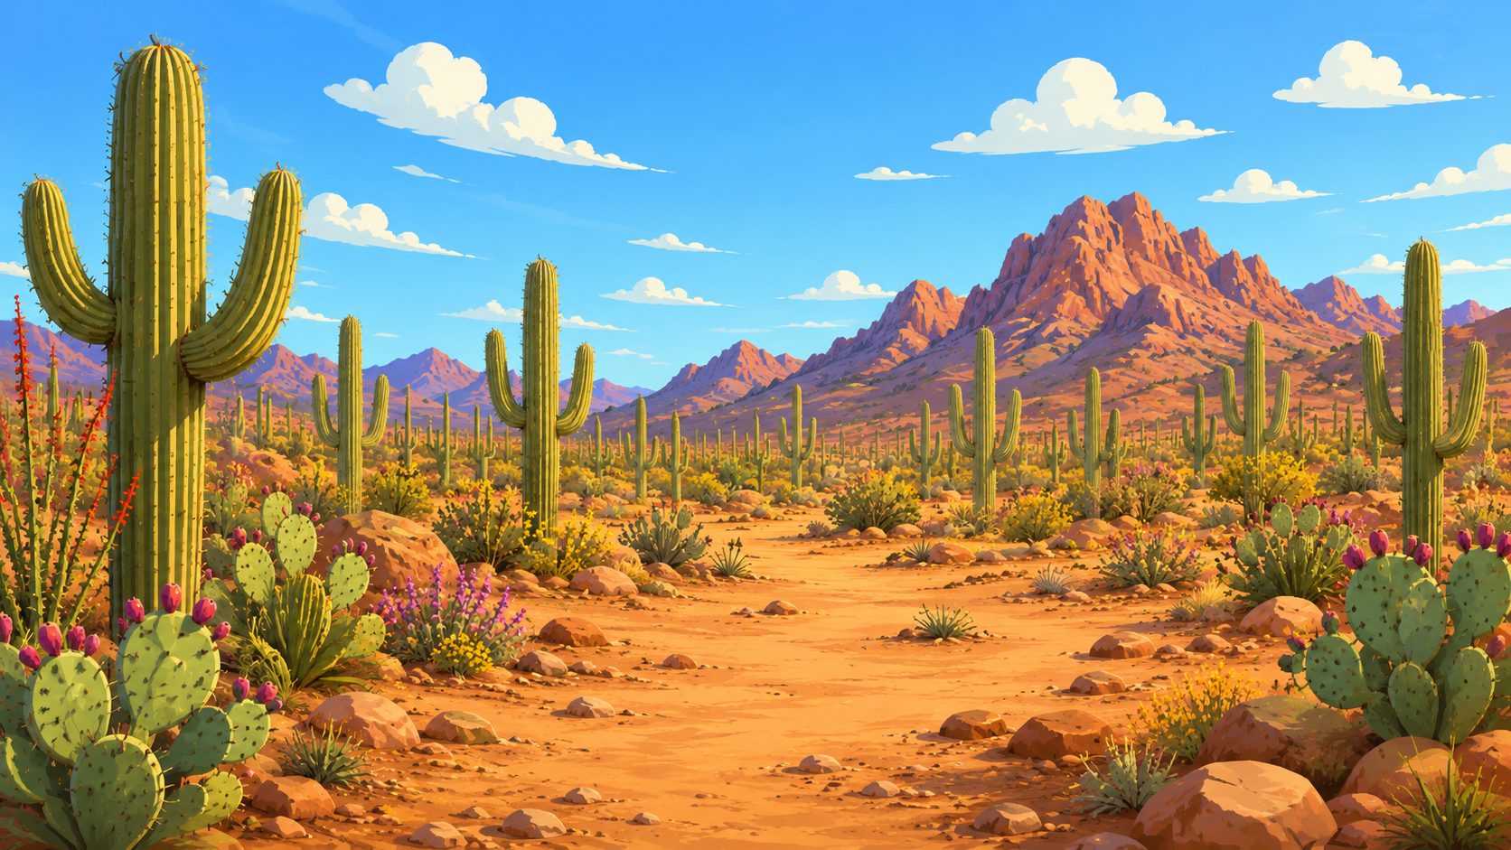
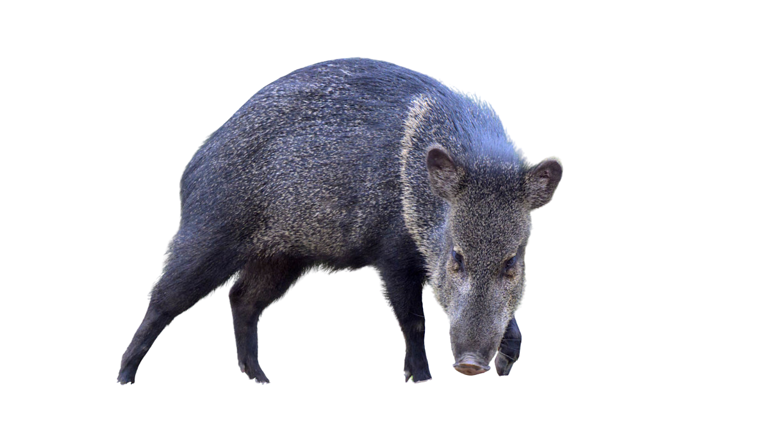
Javelina
The javelina lives in the Sonoran Desert. Cacti store lots of water, but they have sharp spines. Javelinas have big teeth and tough skin so they can eat cacti and get the water they need.

Slide 13
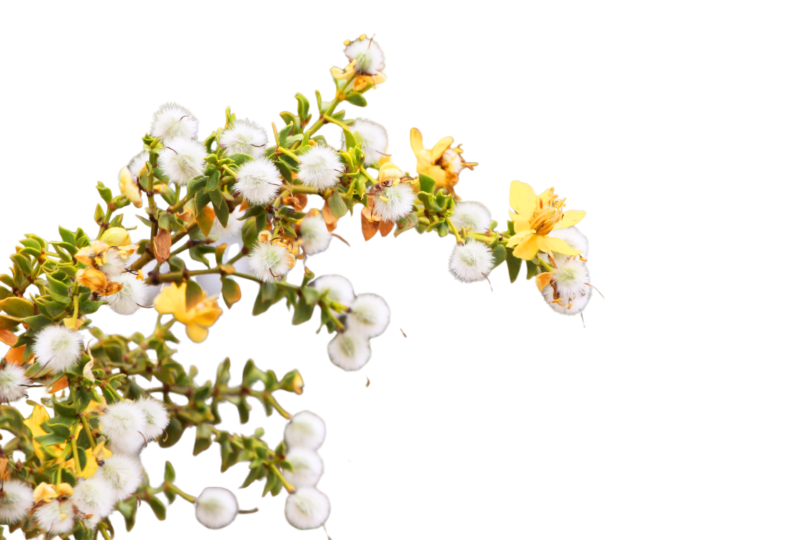
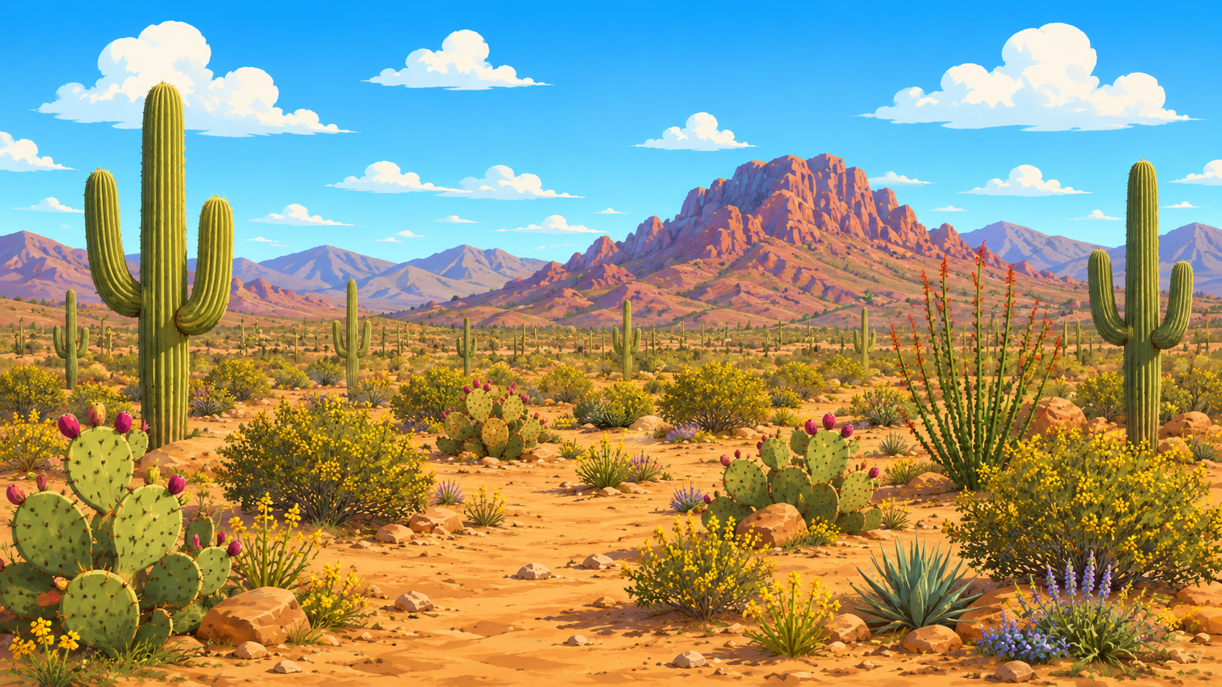
Creosote bush
Plants lose water through their leaves. Creosote bushes live in the Sonoran Desert and have small waxy leaves so they lose less water and don’t dry out.

Slide 14
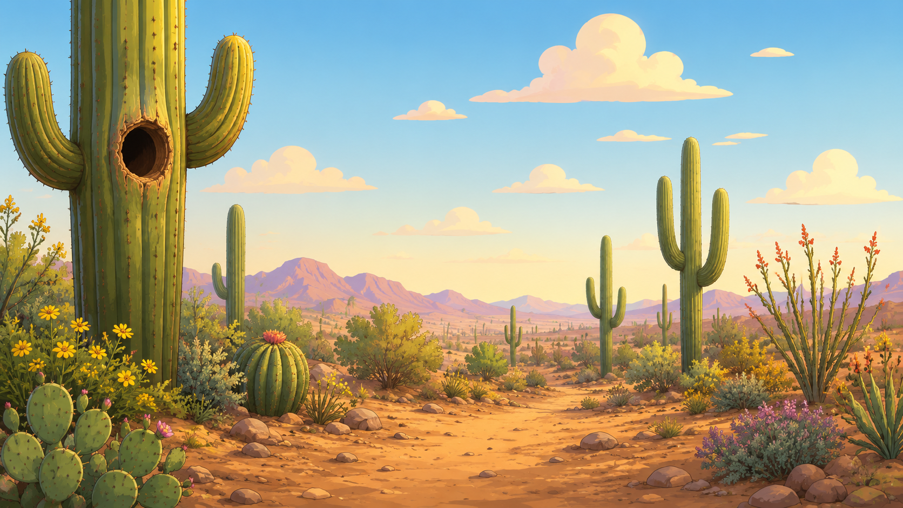
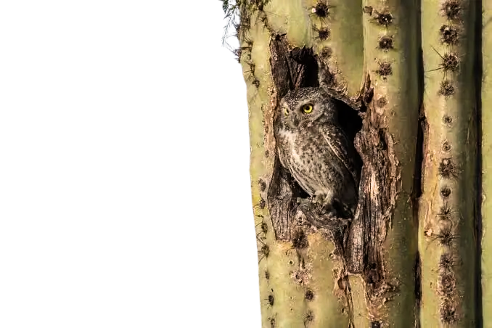
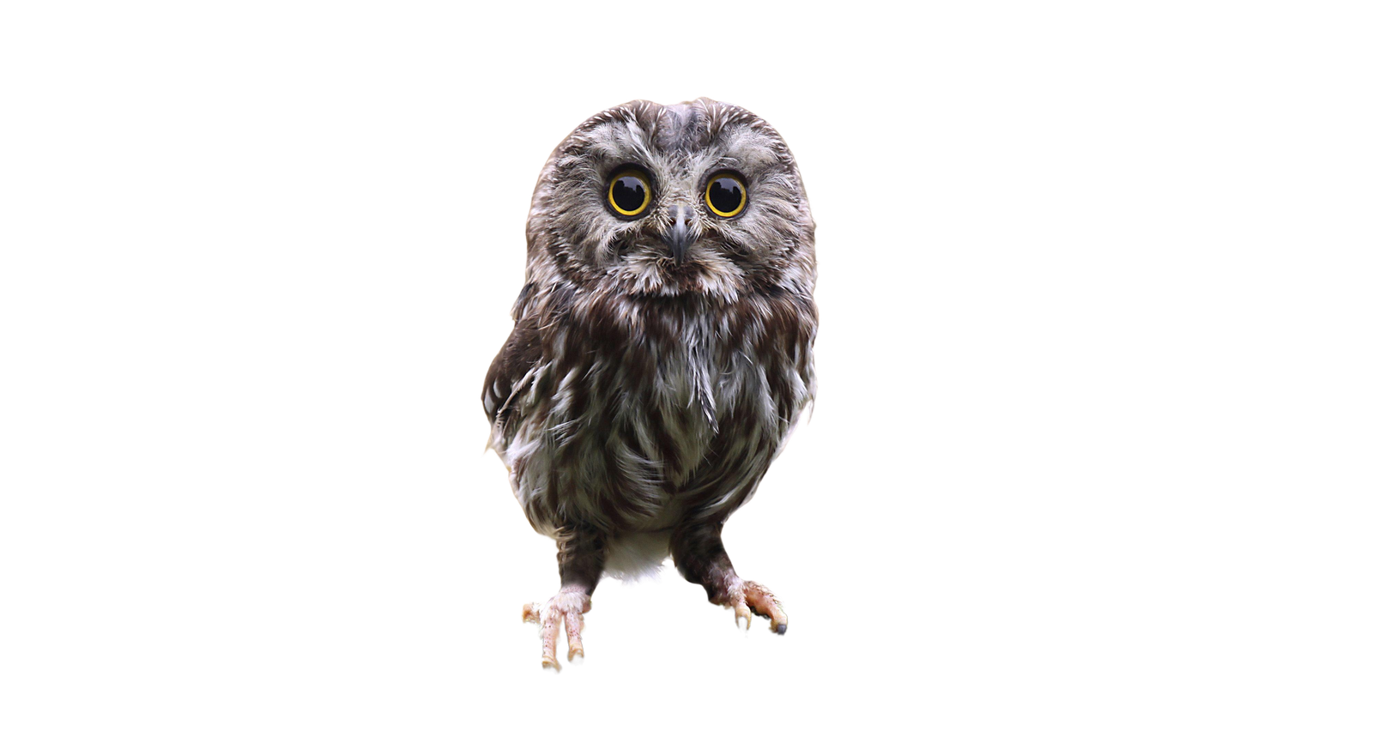
Elf Owl
Elf owls are tiny owls that live in the holes of a saguaro cactus in the Sonoran Desert. Inside the cactus is cooler and keeps them safe from the sun.

Slide 15
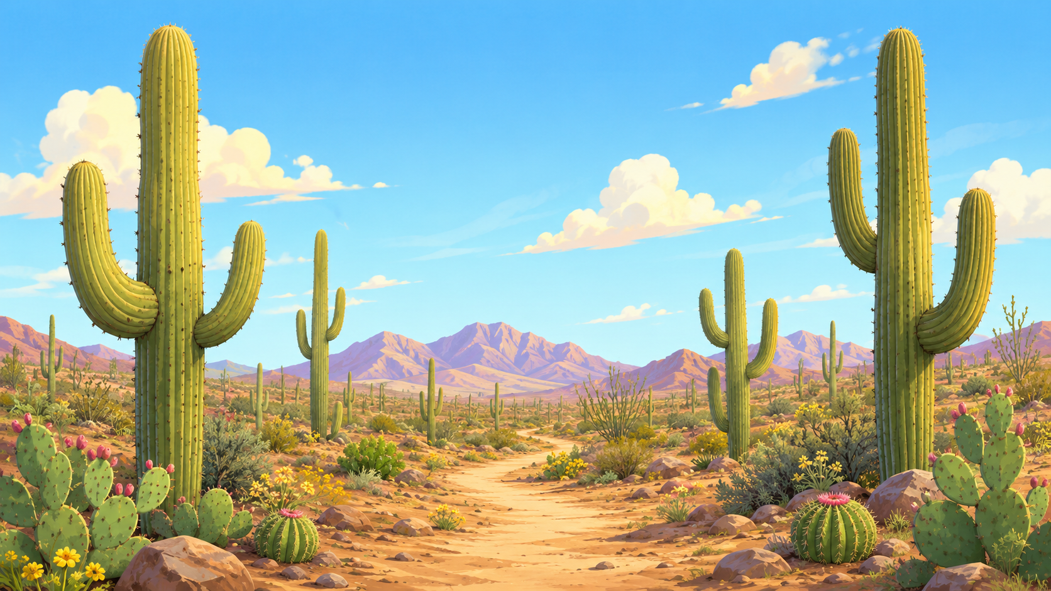
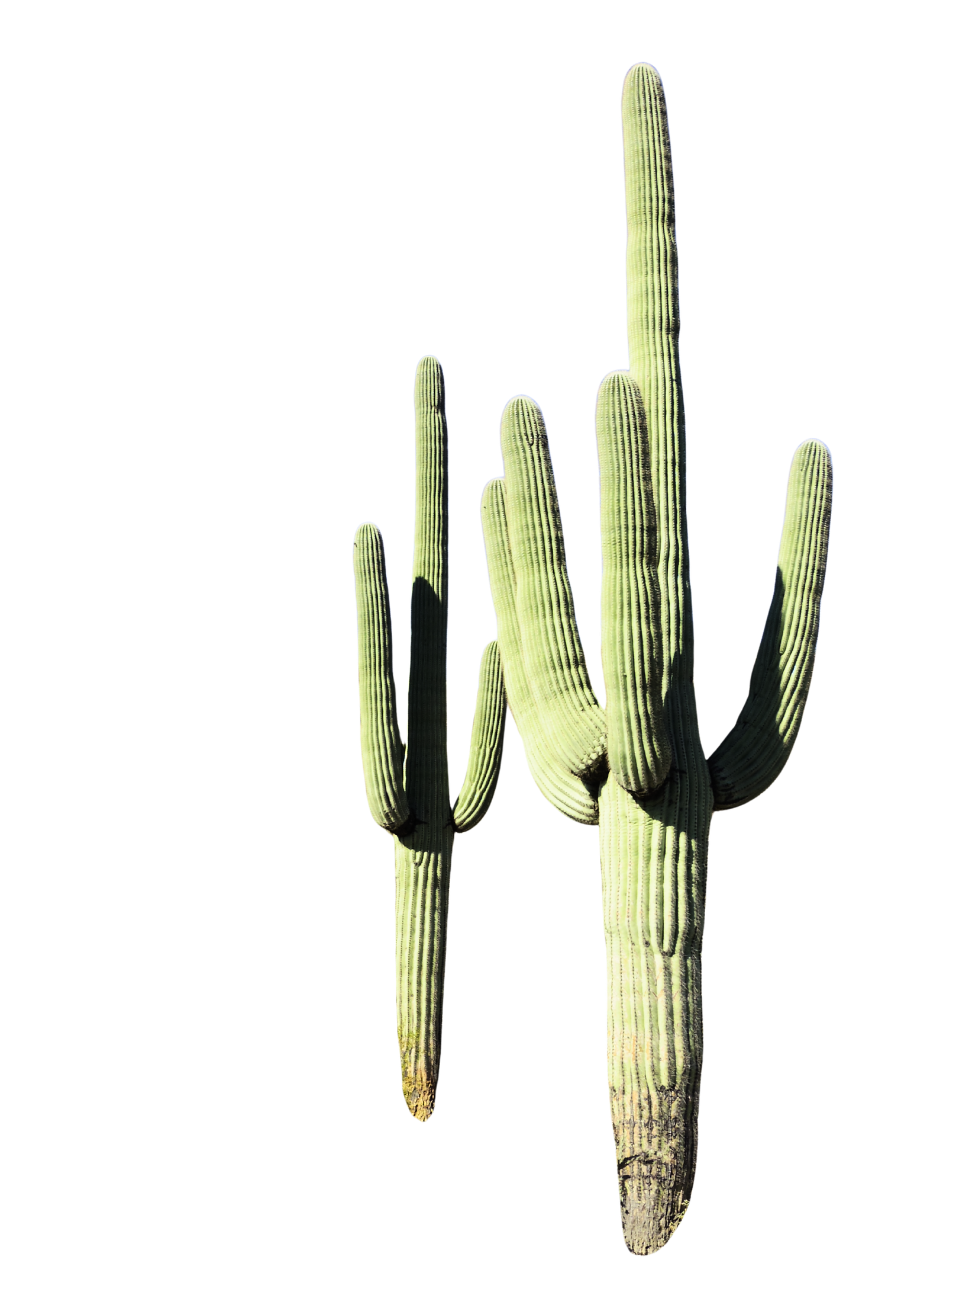
Saguaro cactus
The saguaro cactus lives in the Sonoran Desert. When it rains, saguaros can fill up like a sponge to store water for when it’s dry.

