Slide 1
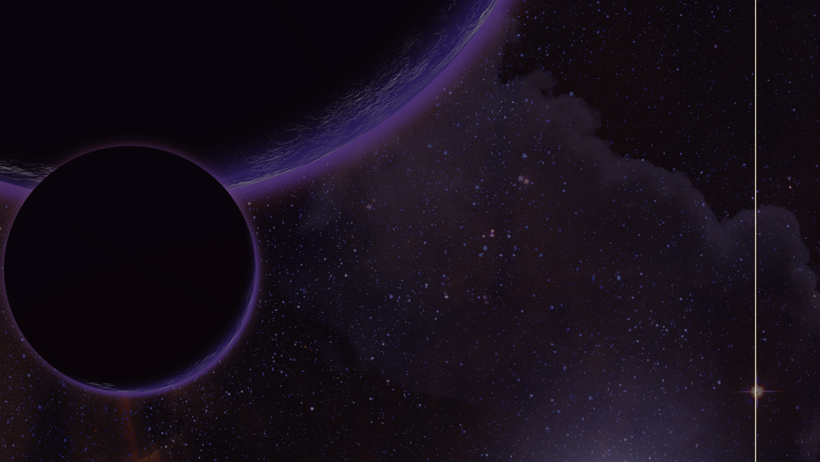
Exploring Astrobiology
Module 1: Ancient Storytellers
Arizona Astrobiology Center

Slide 2
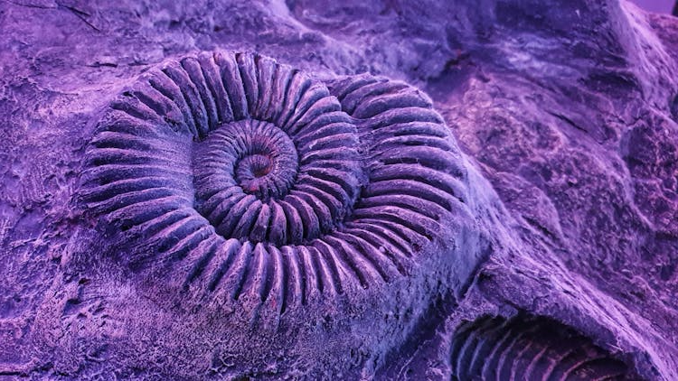
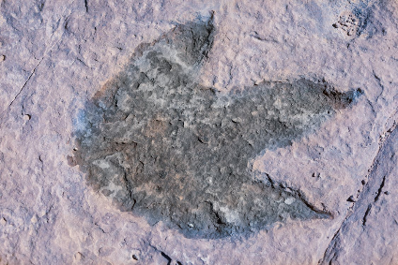
Warm Up Questions
Have you ever seen a fossil?
What are fossils? How did they form?
What are the different types of fossils?
What do fossils tell us about their past?
Where can we find fossils?
Are there different kinds of fossils?
How old are fossils?

Slide 3
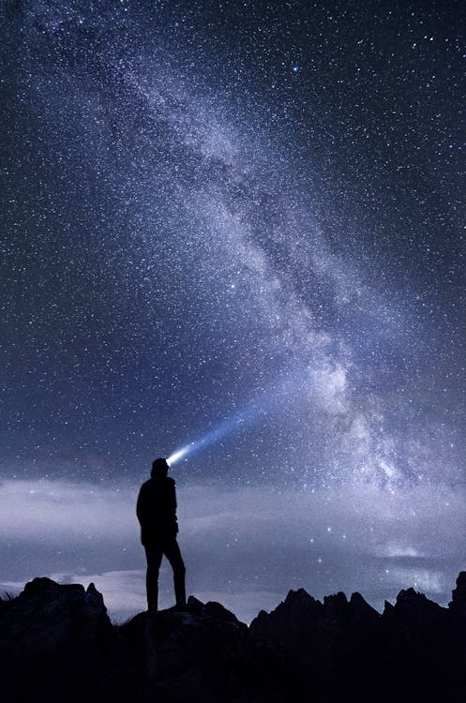
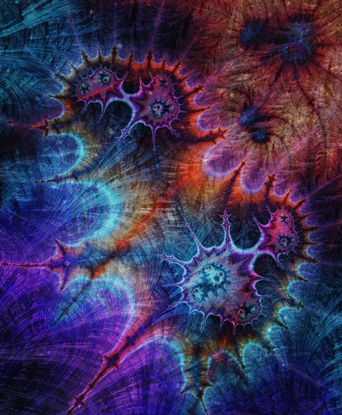
What is Astrobiology?
Astrobiology is the study of life in the universe, including its origins, evolution, distribution and future of life.

Slide 4
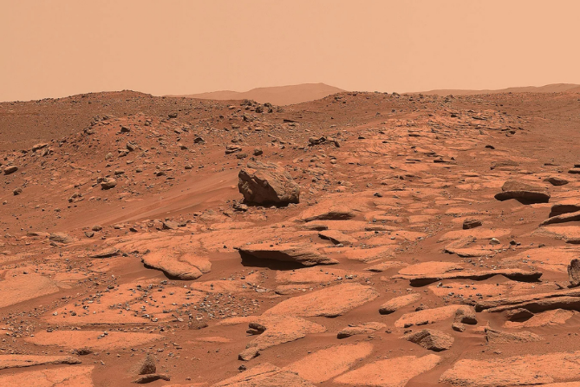
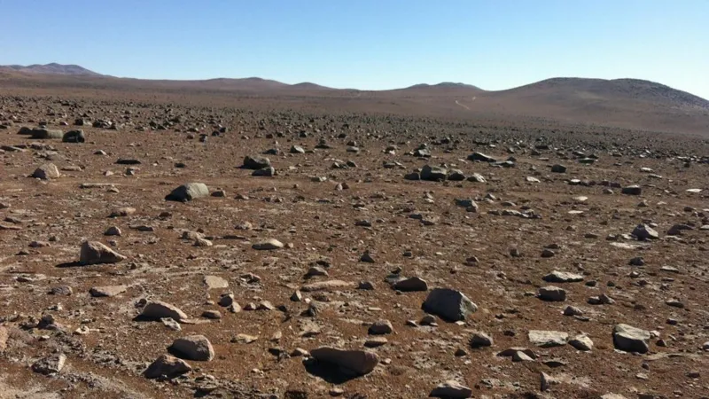
What is Astrobiology?
Astrobiology studies many things such as:
1. Extraterrestrial Environments
2. Analogs (Places on Earth that are like environments outside of Earth)
Extraterrestrial Environment
Earth Analog
Is there life on Mars?
How is the Atacama Desert (Chile) similar to Mars?

Slide 5
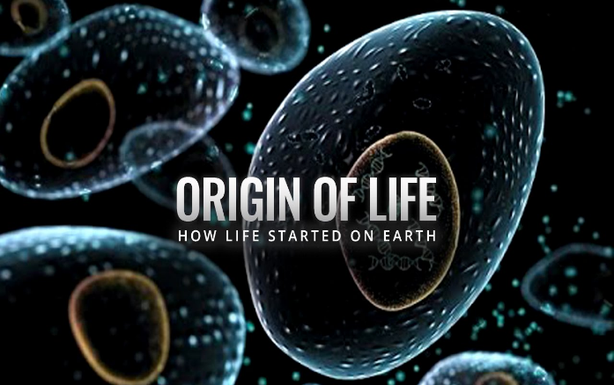
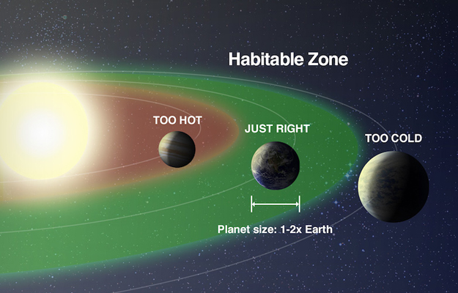
What is Astrobiology?
Astrobiology asks questions about…
3. Origin of life
4. Habitability
How did life start on Earth?
Is Earth the only livable planet?

Slide 6
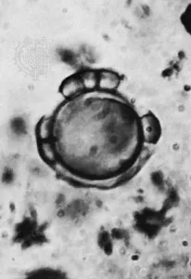
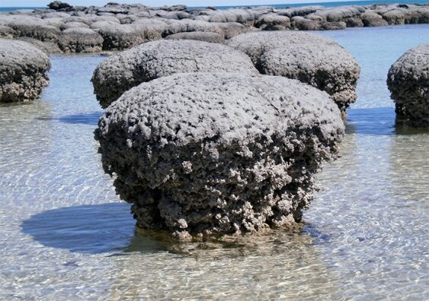
What is Astrobiology?
Astrobiology also studies…
5. Ancient Fossils
Ancient fossils give us clues about early life on Earth
Stromatolites
Microfossils
Oldest fossils on Earth
Ancient microbial fossil

Slide 7
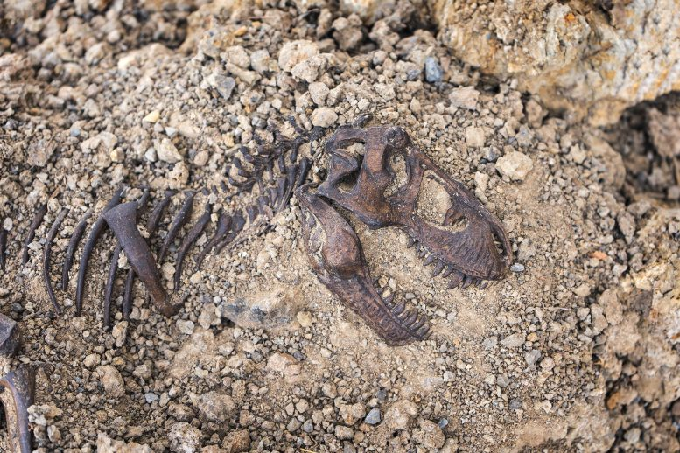
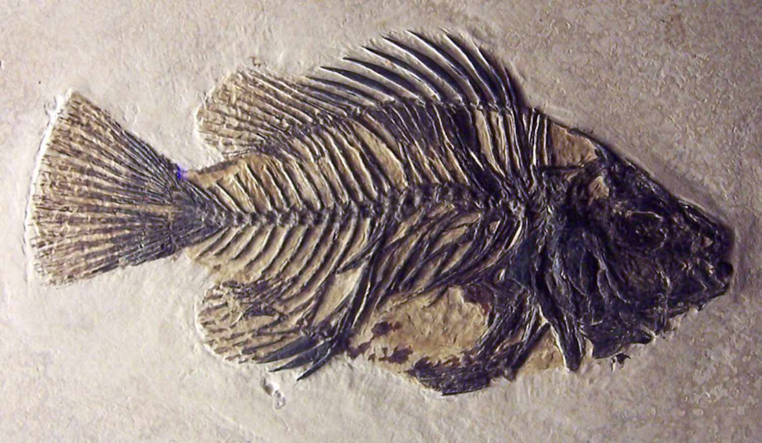
What are fossils?
Fossils are preserved remains or traces of ancient organisms.
Tyrannosaurus rex fossil
Fish fossil

Slide 8
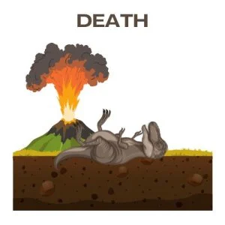
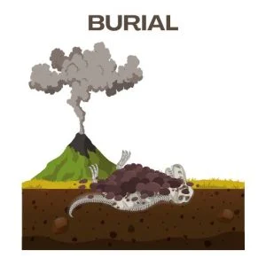
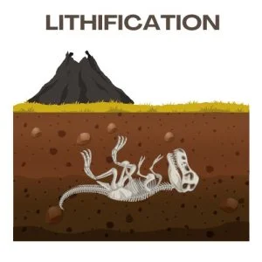
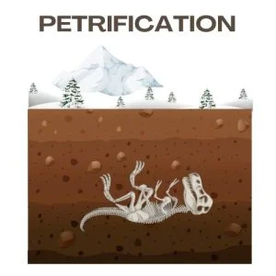
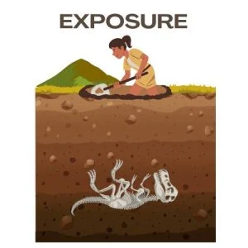
What are fossils?
Fossils form when organisms are quickly buried by sediment and mineralized over time.
Fossilization begins with death of an organism.
Burial is essential for the remains to fossilize.
Over time, the sediment around the organism turns into rock.
Minerals replace organic material cell by cell. Turning remains into a stone replica.
Natural processes like erosion can bring fossils to the surface and allow discovery.

Slide 9
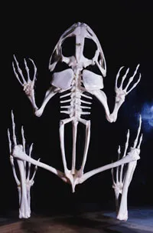
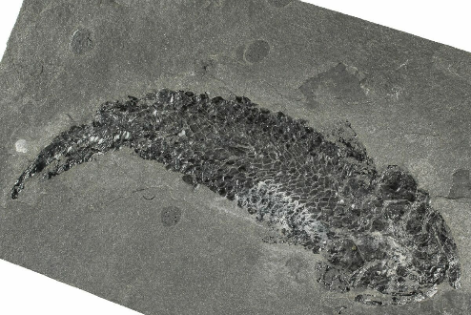
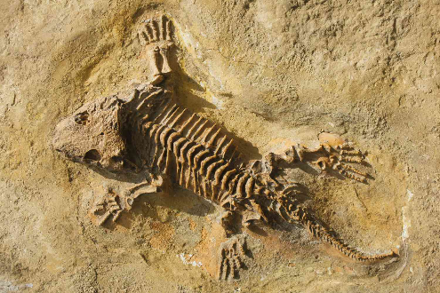
What are fossils?
Fossils provide evidence of how life evolved and adapted to different environments.
Lobe-finned fish fossil
Tiktaalik fossil
Frog skeleton
Lived in water
Fins were thicker and stronger than most fish
Had fins but also wrist bones
Could support body in shallow water
Can live in water and on land
Has elbow and fingers
No more fins
Evolution happens in small changes over millions of years.
Notes:
Lobe finned fish: 390 Million years ago
Tiktaalik: 375 Million years ago
Frog: modern

Slide 10
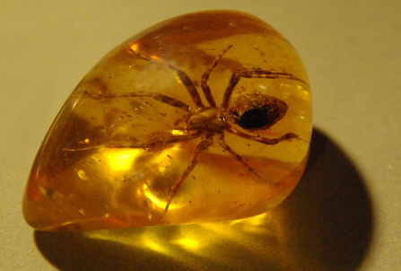
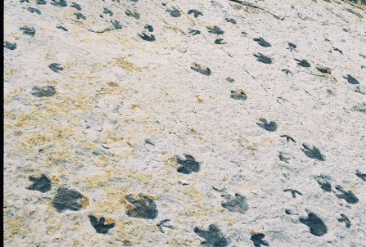
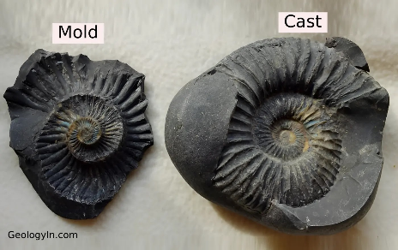
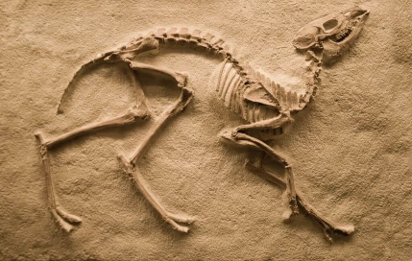
What are fossils?
Different types of fossils tell us different things
Preserved Remains
Trace fossil
Mold/Cast Fossil
Parts of the body
Can be in amber, ice or asphalt
Organism is trapped and protected
No body, just evidence of activity
Show organism behavior
Mold = empty imprint (shape)
Cast = minerals fill imprint and harden (copy)
Can be bone, tooth, shell or wood
Helps us study body structure

Slide 11
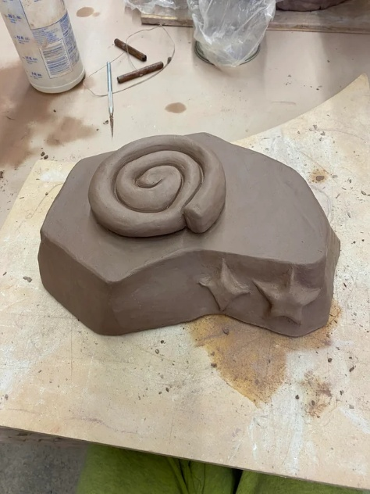
Clay Time
Let’s create some fossils

Slide 12
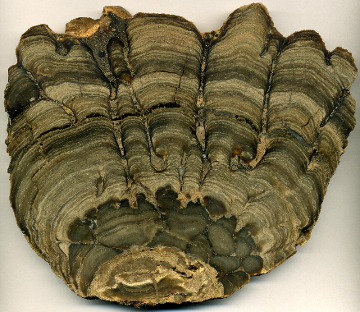
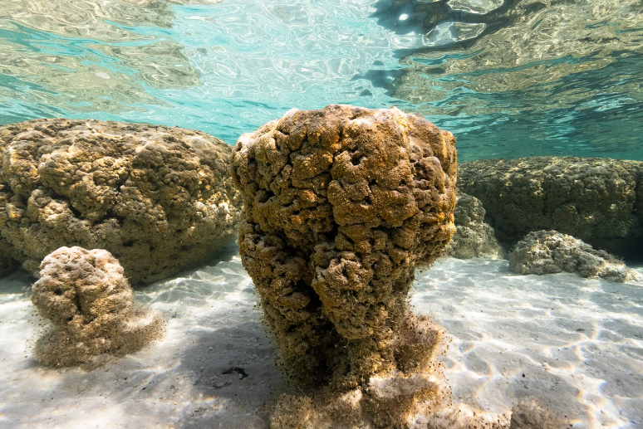
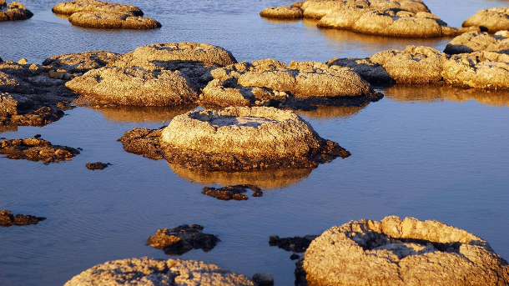
Fossils and Astrobiology
Stromatolites are layered rock structures built by ancient cyanobacteria in extreme environments billions of years ago. They are considered key biosignatures in astrobiology.
Lake Thetis, Australia
Shark Bay, Australia

Slide 13
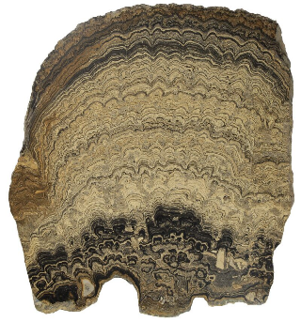
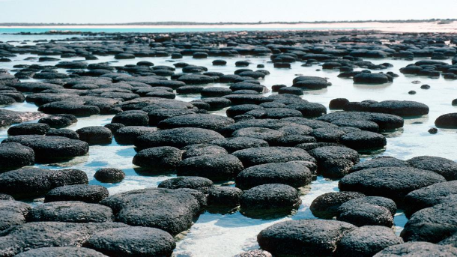
Fossils and Astrobiology
A biosignature is any feature that indicates past or present life. Stromatolites have several features that qualifies them :
Fine, repeated laminations
Upward growth pattern
Domes that compete for light
These patterns reflect biological behavior.

Slide 14
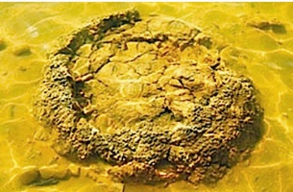
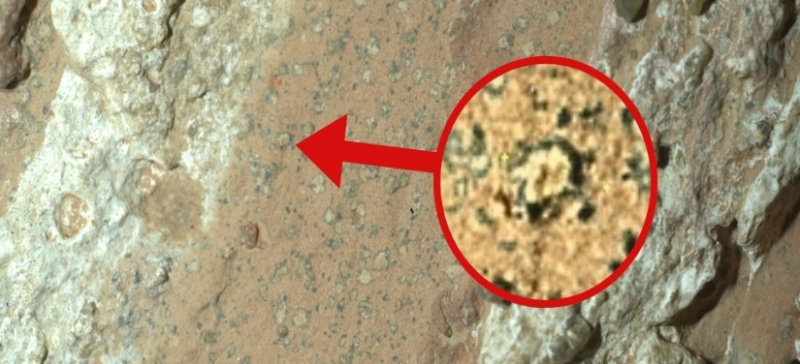
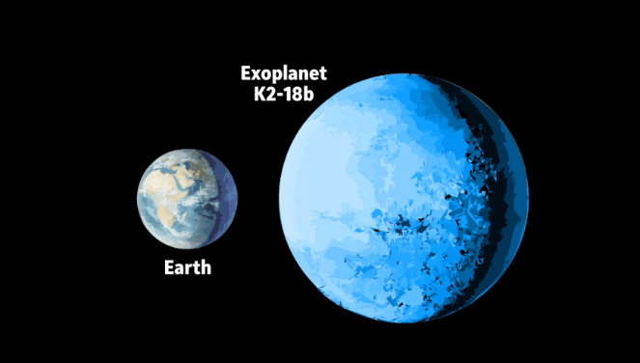
Fossils and Astrobiology
Stromatolites date back over 3.4 billion years. If similar structures were found elsewhere in our solar system, they could be evidence of past life.
Potential biosignatures?
Collapsed stromatolite on Earth
Potential surface-covering ocean?
In “Goldilocks” zone
Leopard spots on Mars
Exoplanet K2-18b

Slide 15
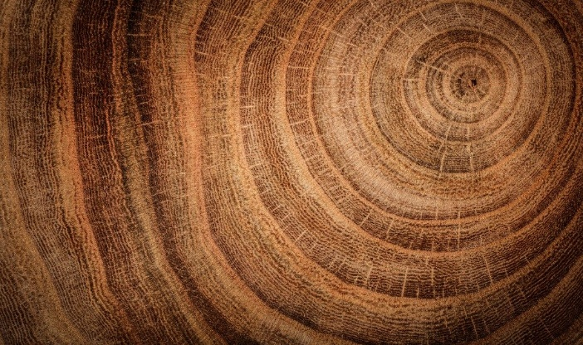
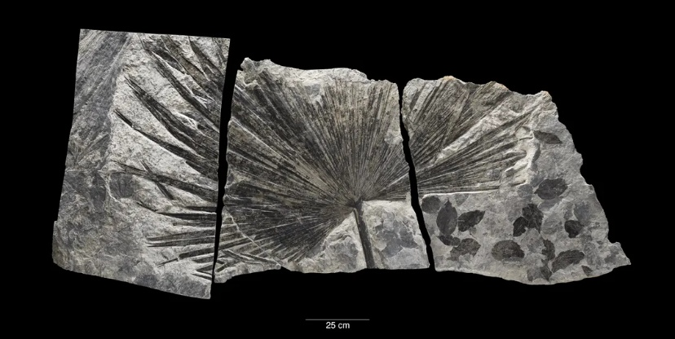
What story do fossils tell?
Fossils are clues from the past. They tell us what life was like millions of years ago and help us understand how plants and animals adjusted to changes in climate and their environment.
Thick rings = years with a lot of rain
Light areas = early summer growth
Dark areas = late summer/fall growth
Just like tree rings tell us about rainfall patterns…
A tropical plant fossil in a cold place like Alaska, tells us about what the weather in the area a long time ago.

Slide 16
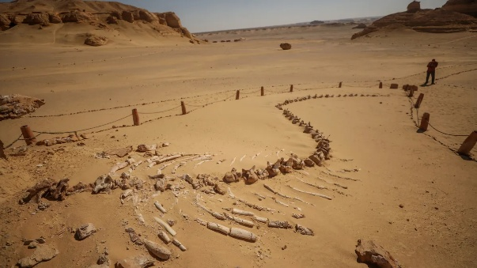
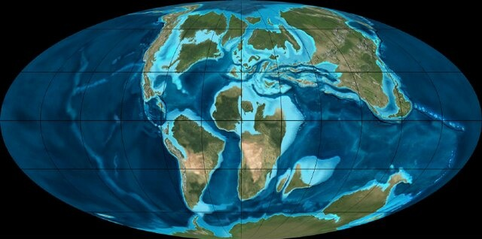
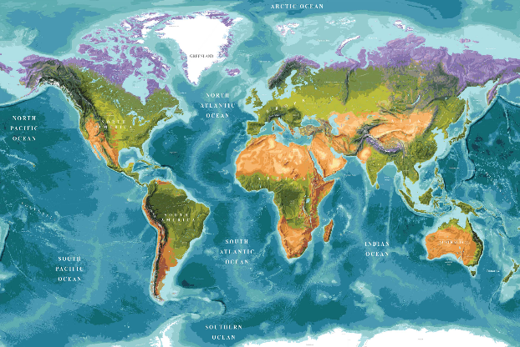
What story do fossils tell?
A fossilized fish in a desert tells us that the area was once underwater.
Earth 100 million years ago
Earth Today
Egypt region
Whale fossil in Egypt’s Whale Valley
Fossil age: ~55.8 - 33.9 million years ago

Slide 17
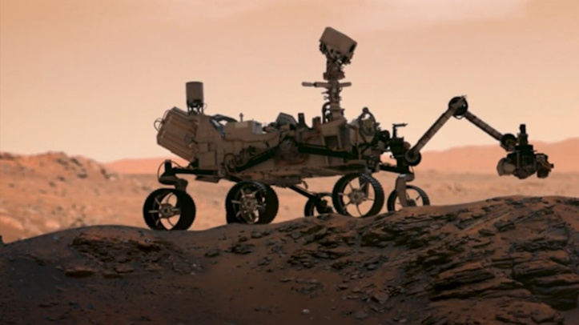
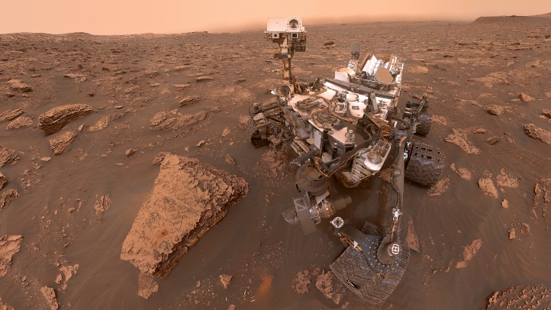
What story is astrobiology trying to understand?
Astrobiologists will continue to:
Look for signs of past or present life - biosignatures
Look for conditions that could support life - habitability
Perseverance rover is collecting Martian rocks that may hold ancient signs of life.
Curiosity rover confirmed that ancient Mars had the right ingredients for life.

Slide 18
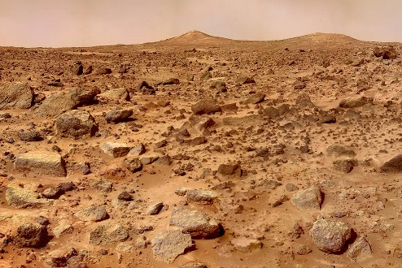
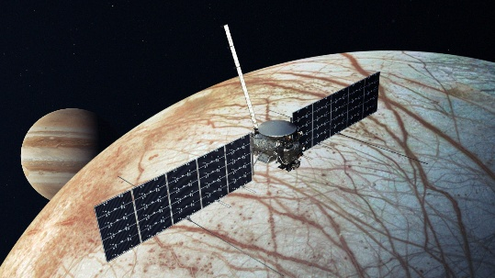
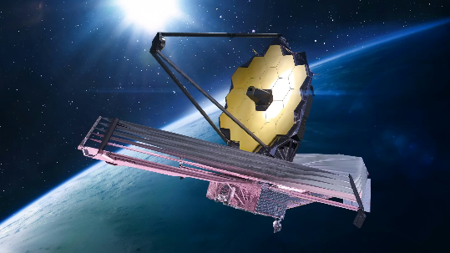
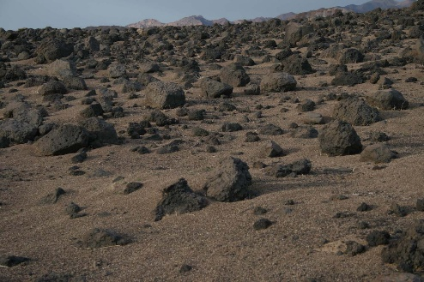
What story is astrobiology trying to understand?
And will continue to…
Study Earth to learn from it - research analogs
Send missions to gather more clues - explore
Europa Clipper
James Webb Space Telescope
Mars
Death Valley, California
On its way to the Jupiter’s moon, Europa to explore it’s subsurface saltwater ocean
JWST reads the atmospheres of distant planets, searching for the fingerprints of life.

Slide 19
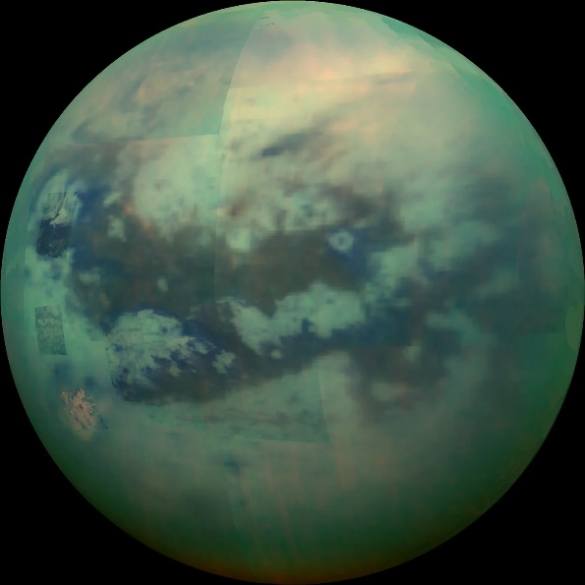
What story would a different world tell?
Imagine a different world…
What kind of life could exist there?
Bigger than the planet Mercury
Extremely cold
Has rivers, lakes and rain but not water, METHANE
Saturn’s moon Titan

Slide 20
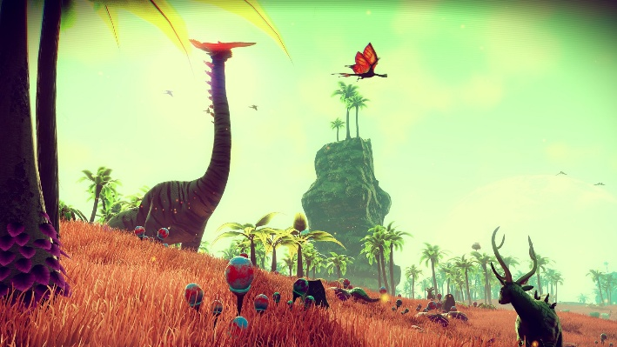
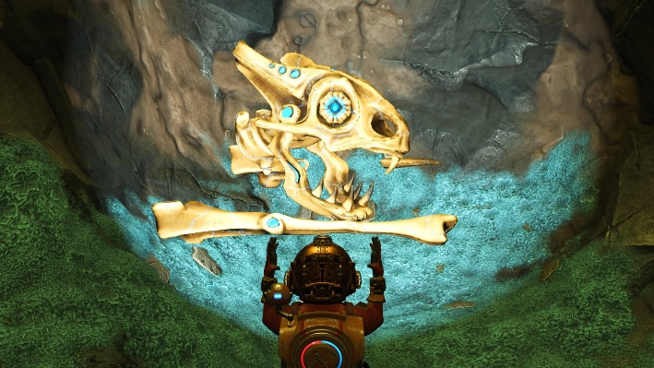
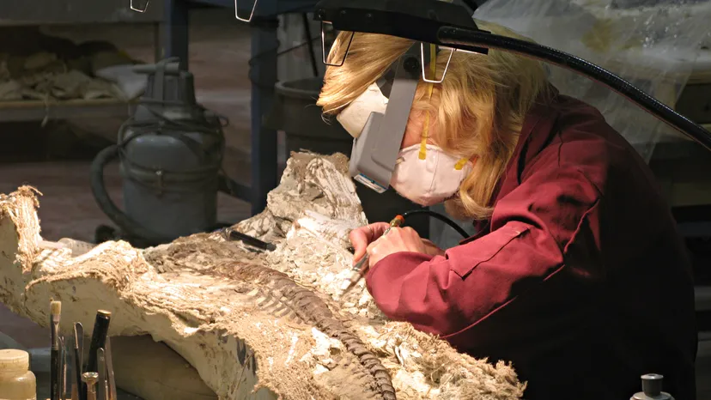
What story would a different world tell?
If humans visited another planet, what fossils would we find?

Slide 21
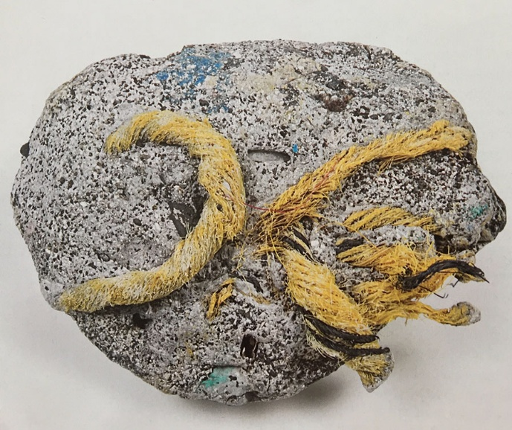


What story would a different world tell?
What will Earth’s fossil record say about us millions of years from now?

Slide 22

Clay Time II
Let’s create future fossils !

