Slide 1

Yes or No Game- Extreme Environments

Slide 2

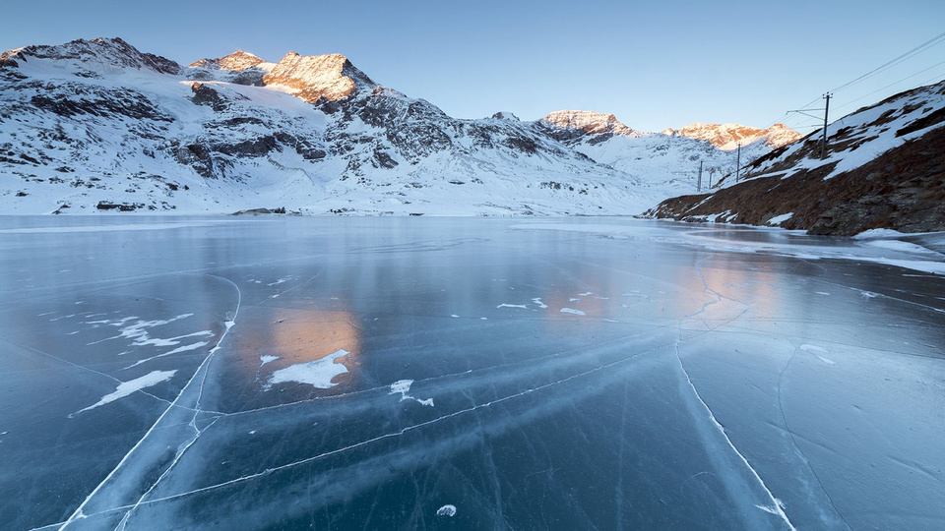
Can sunlight reach under the ice in frozen lakes?

Slide 3
Yes

Slide 4
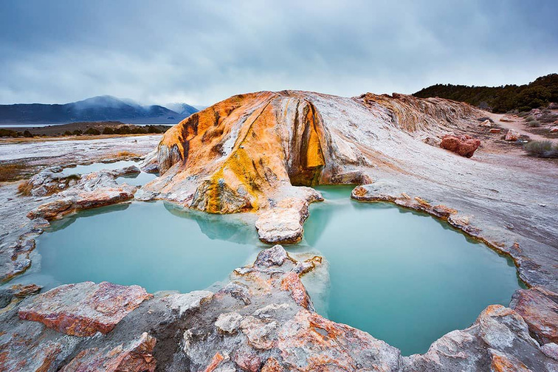
Do Hot Springs have low acidity?

Slide 5
No

Slide 6

Is the deep ocean completely dark?

Slide 7
Yes

Slide 8
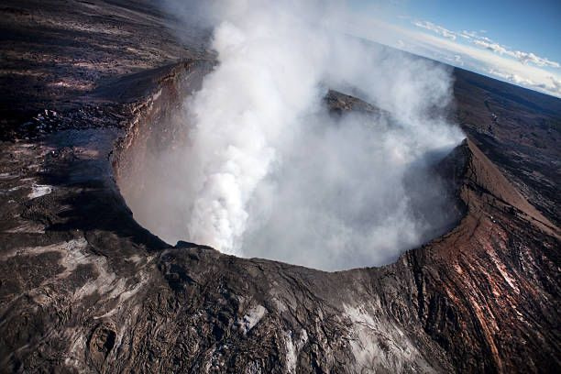
Do volcanic vents have medium pressure inside?

Slide 9
Yes

Slide 10
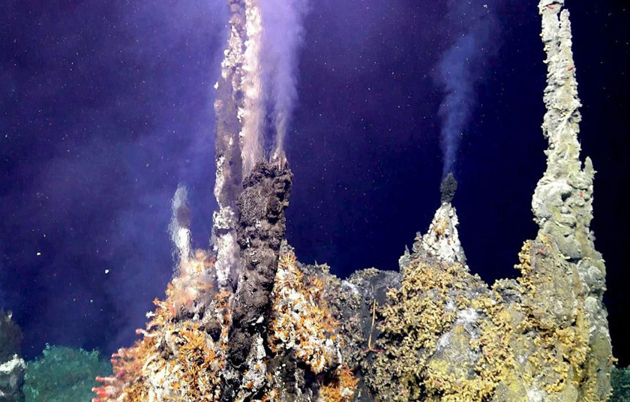
Are hot sea vents found on land?

Slide 11
No

Slide 12
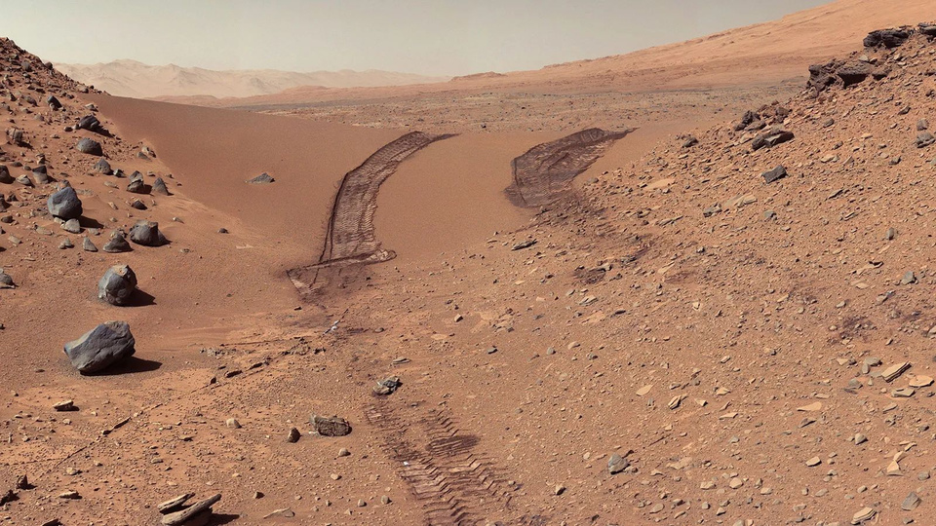
Is it cold on Mars?

Slide 13
Yes

Slide 14
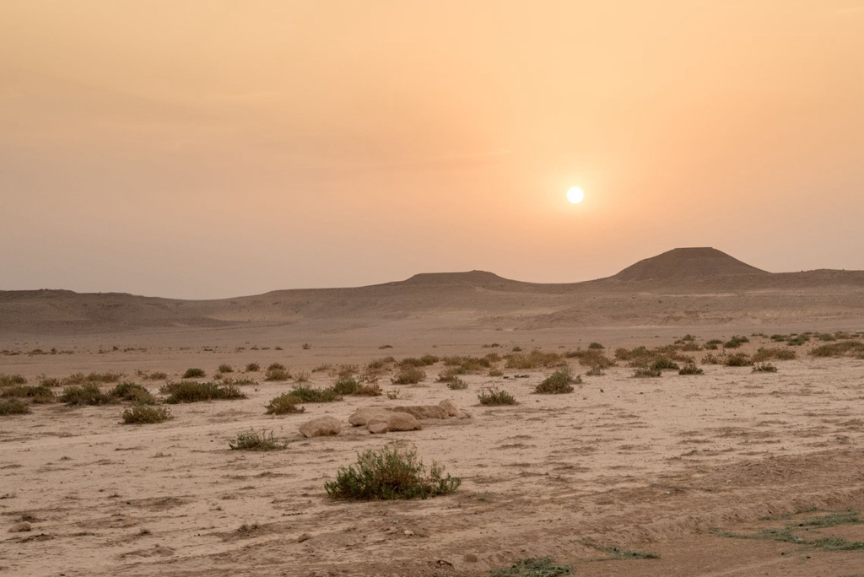
Would you often find lakes in the desert?

Slide 15
No

Slide 16
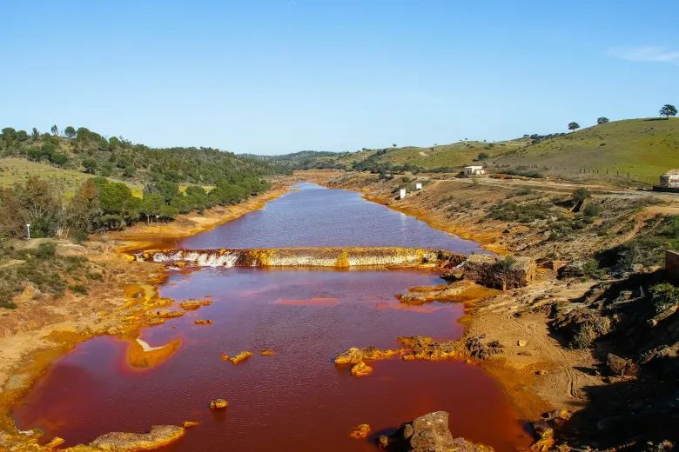
Are acid rivers often found near Grasslands?

Slide 17
No

Slide 18
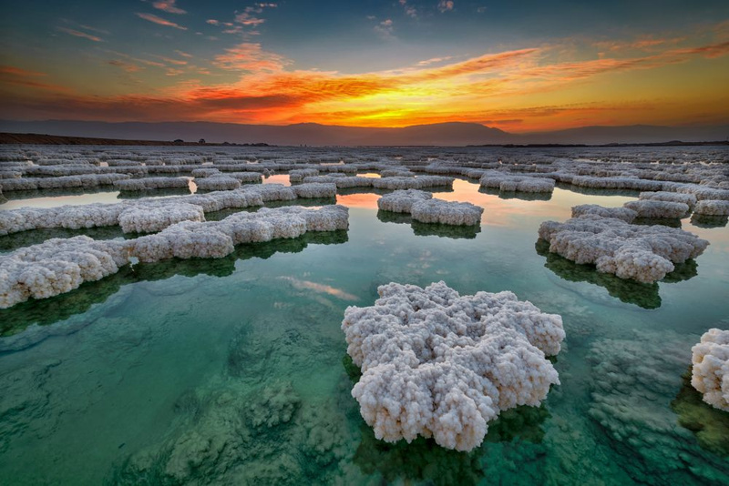
Can people float easily in saline lakes?

Slide 19
Yes

Slide 20
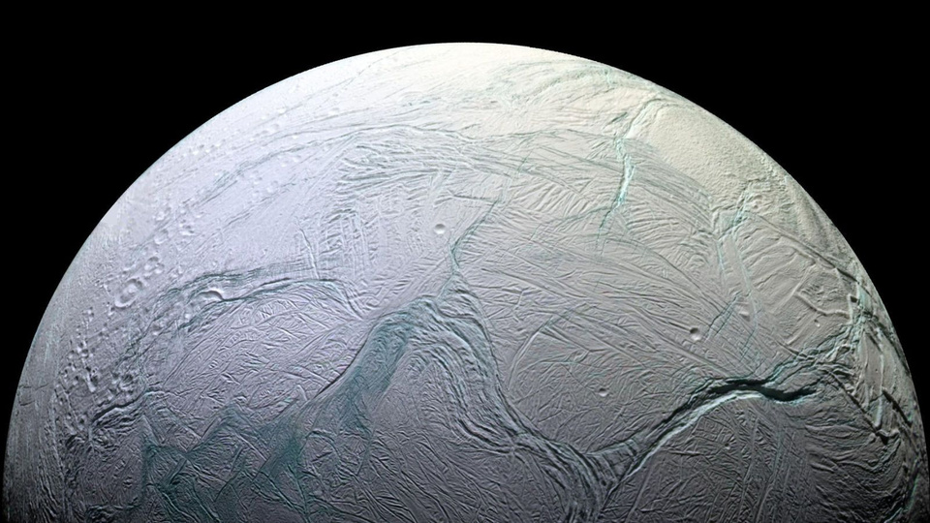
Are ocean worlds a place we are hopeful to find life?

Slide 21
Yes

Slide 22
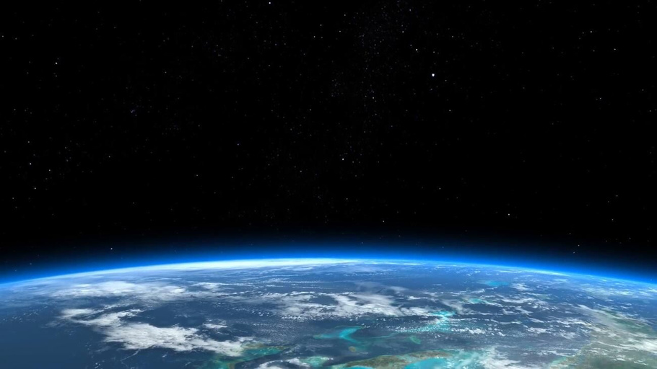
Is there air in space?

Slide 23
No

