Slide 1
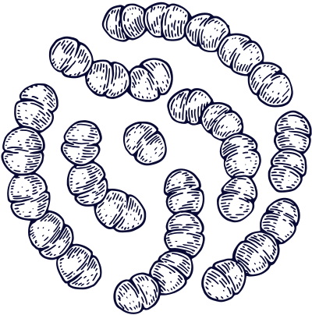
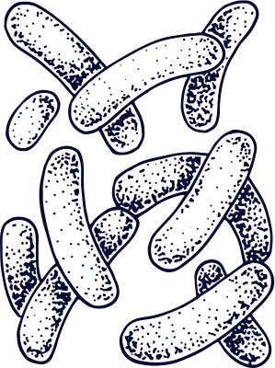







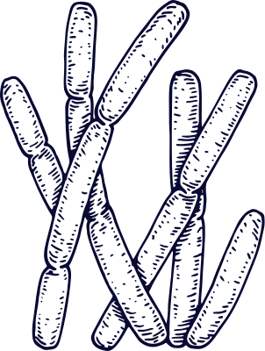
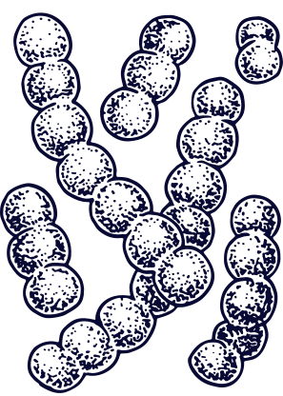
Extreme Life

Slide 2

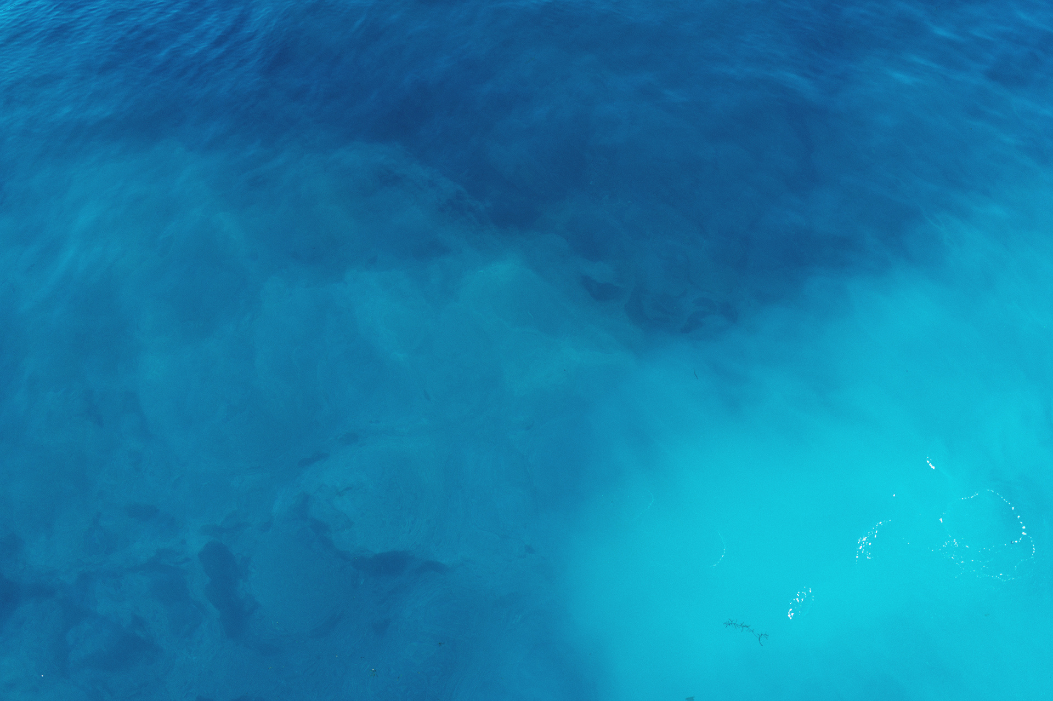
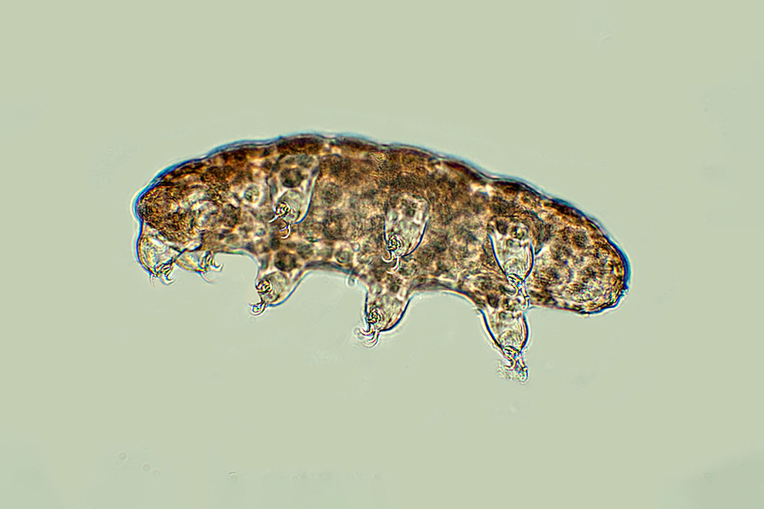
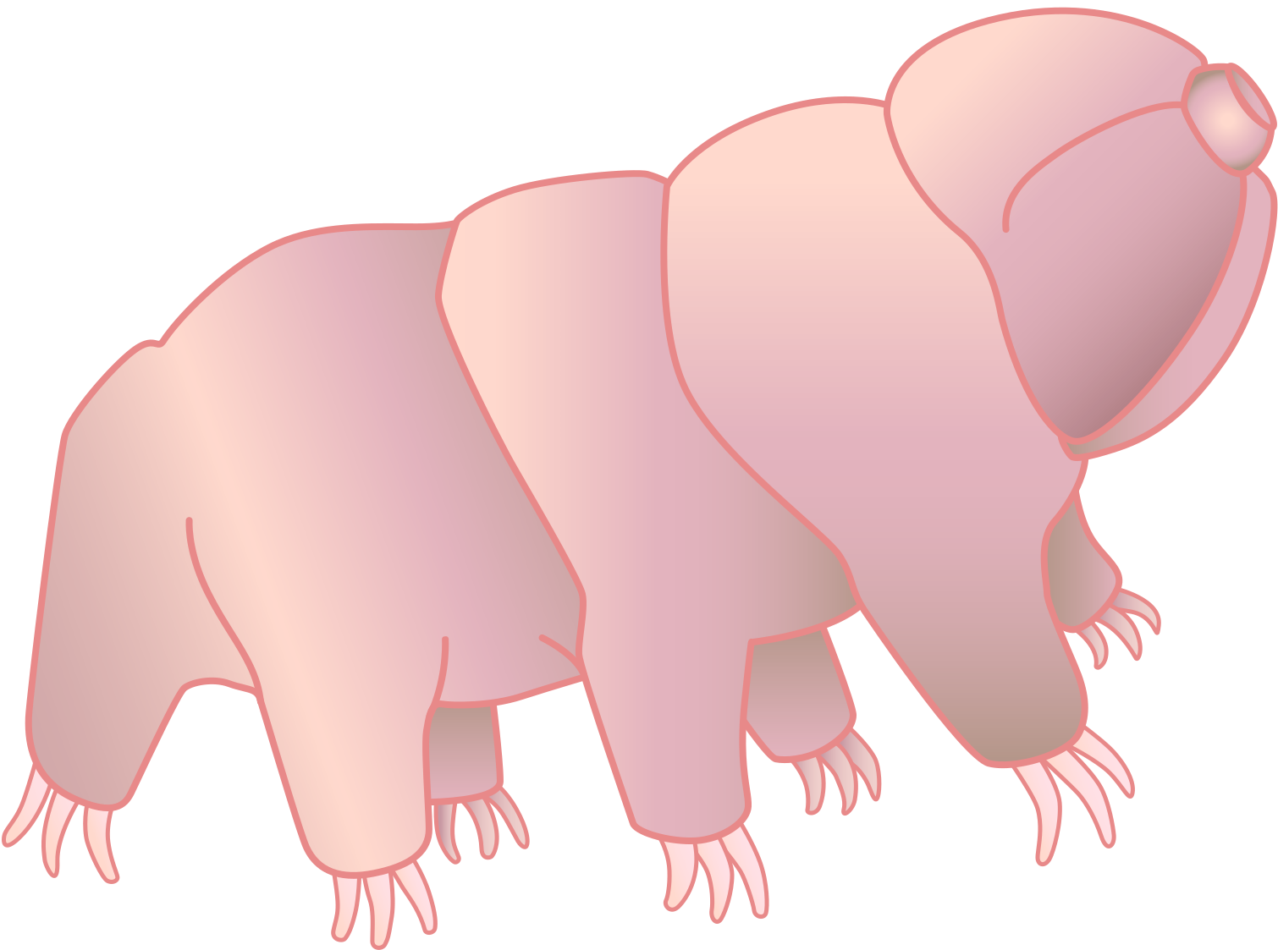
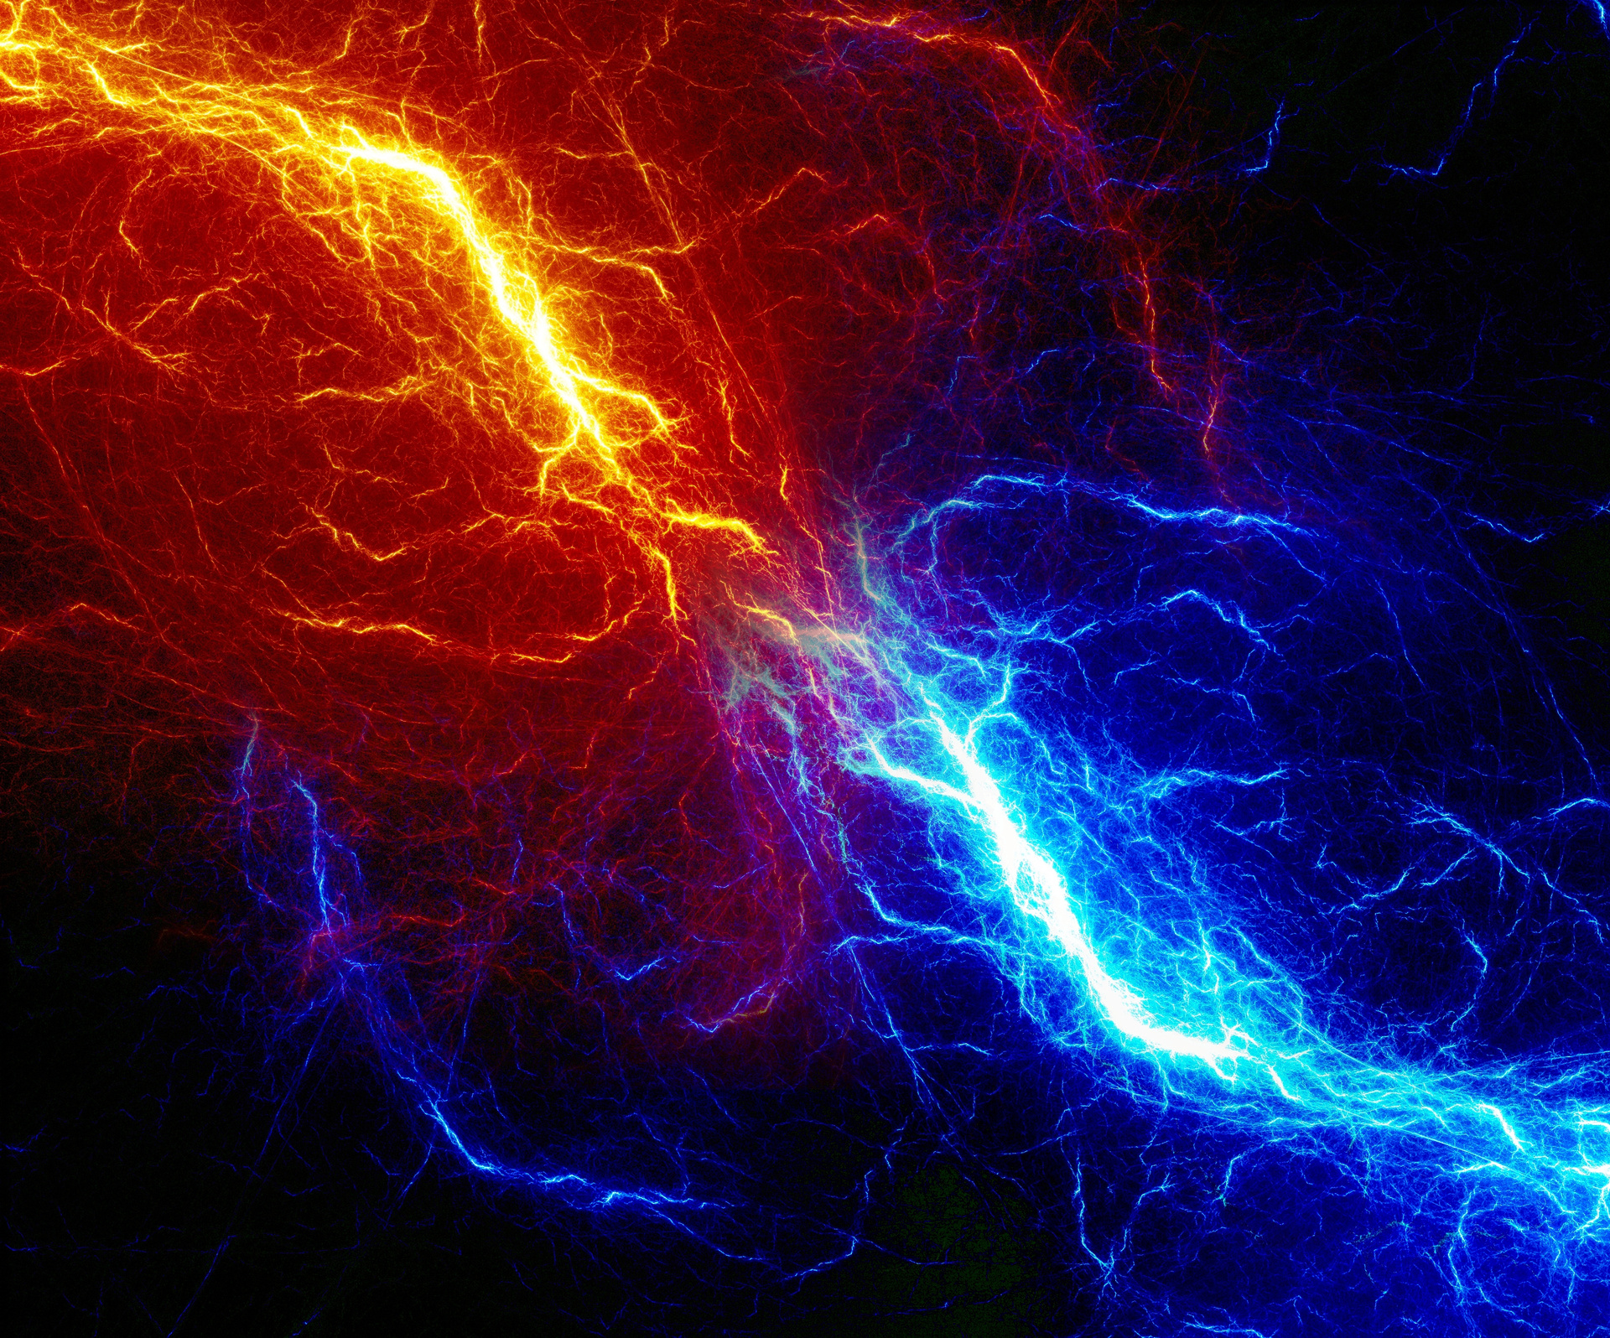

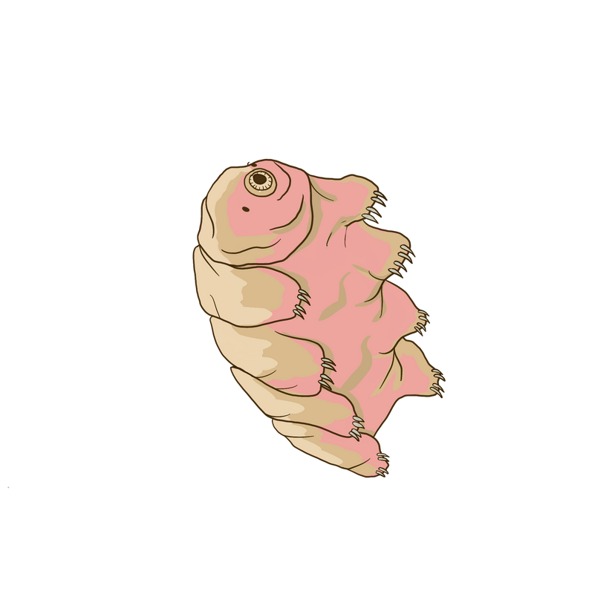



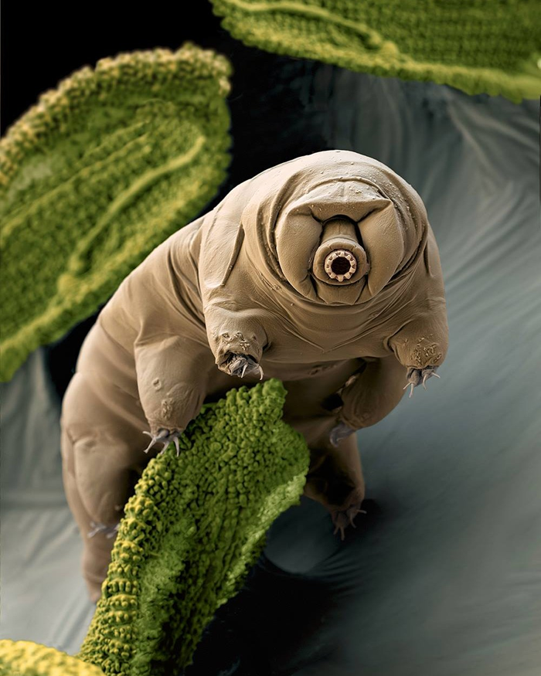





WATER BEAR
Tardigrades are so small that they’re about the size of a period at the end of a sentence .
They can survive radiation, high pressure, and extreme temperatures
They live in many extreme environments, like the deep ocean, hot deserts, frozen mountain tops, and volcanoes
Fun Fact: Tardigrades are the first known animals to survive direct exposure to outer space (radiation) and revive!
Tardigrade
Ultra Extremophile
Tardigrada; Water Bear
Ability
Survives high levels of radiation, pressure, and extreme temperatures
Microanimal
Type
Resistance

Slide 3
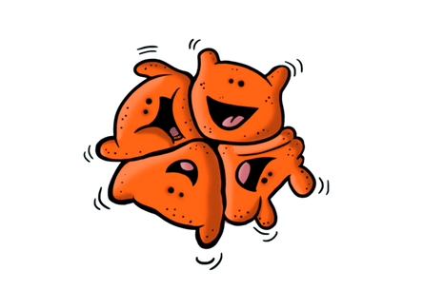
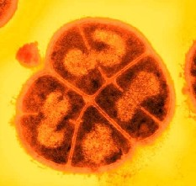



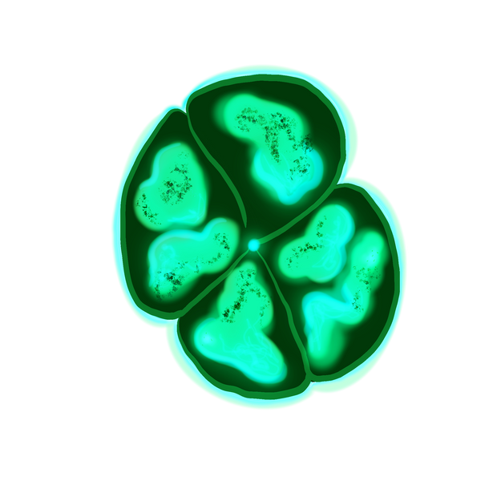
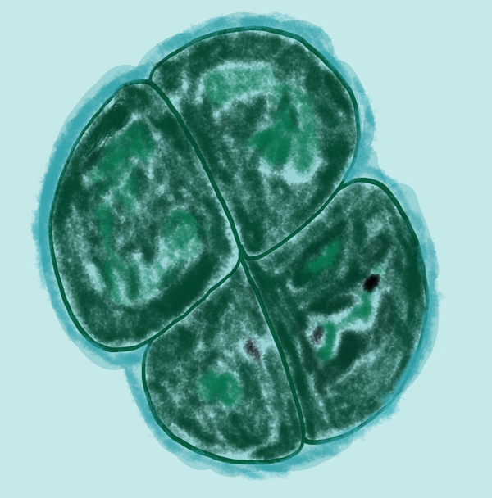

CONAN THE BACTERIUM
Lives in extreme places, such as nuclear reactors, deserts, and outer space
Can survive thousands of times more radiation than humans can
It can live in very cold and low pH environments
Fun Fact: It once survived for an entire year on the outside of the International Space Station!
D. Radiodurans
Ultra Extremophile
Deinococcus radiodurans
Ability
Thrives in bodies of high levels of radiation, cold temperatures and tolerates acid.
Bacterium
Type
Resistance

Slide 4

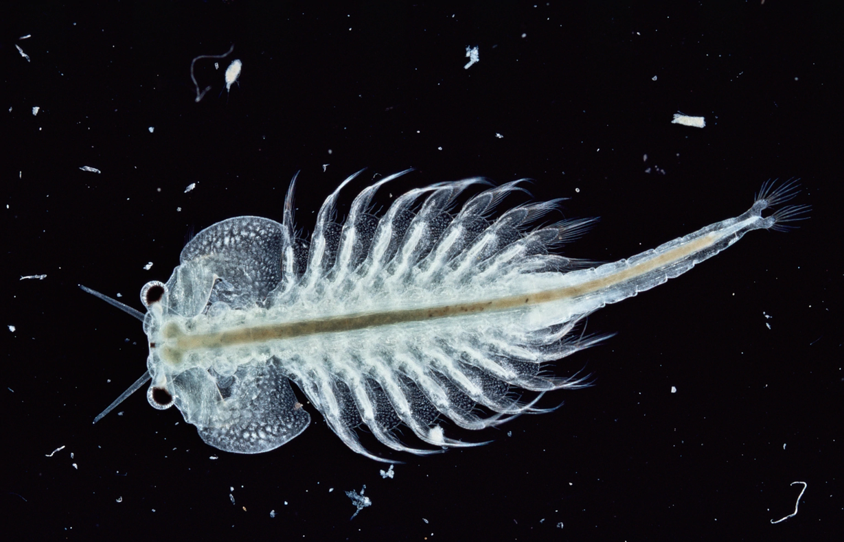

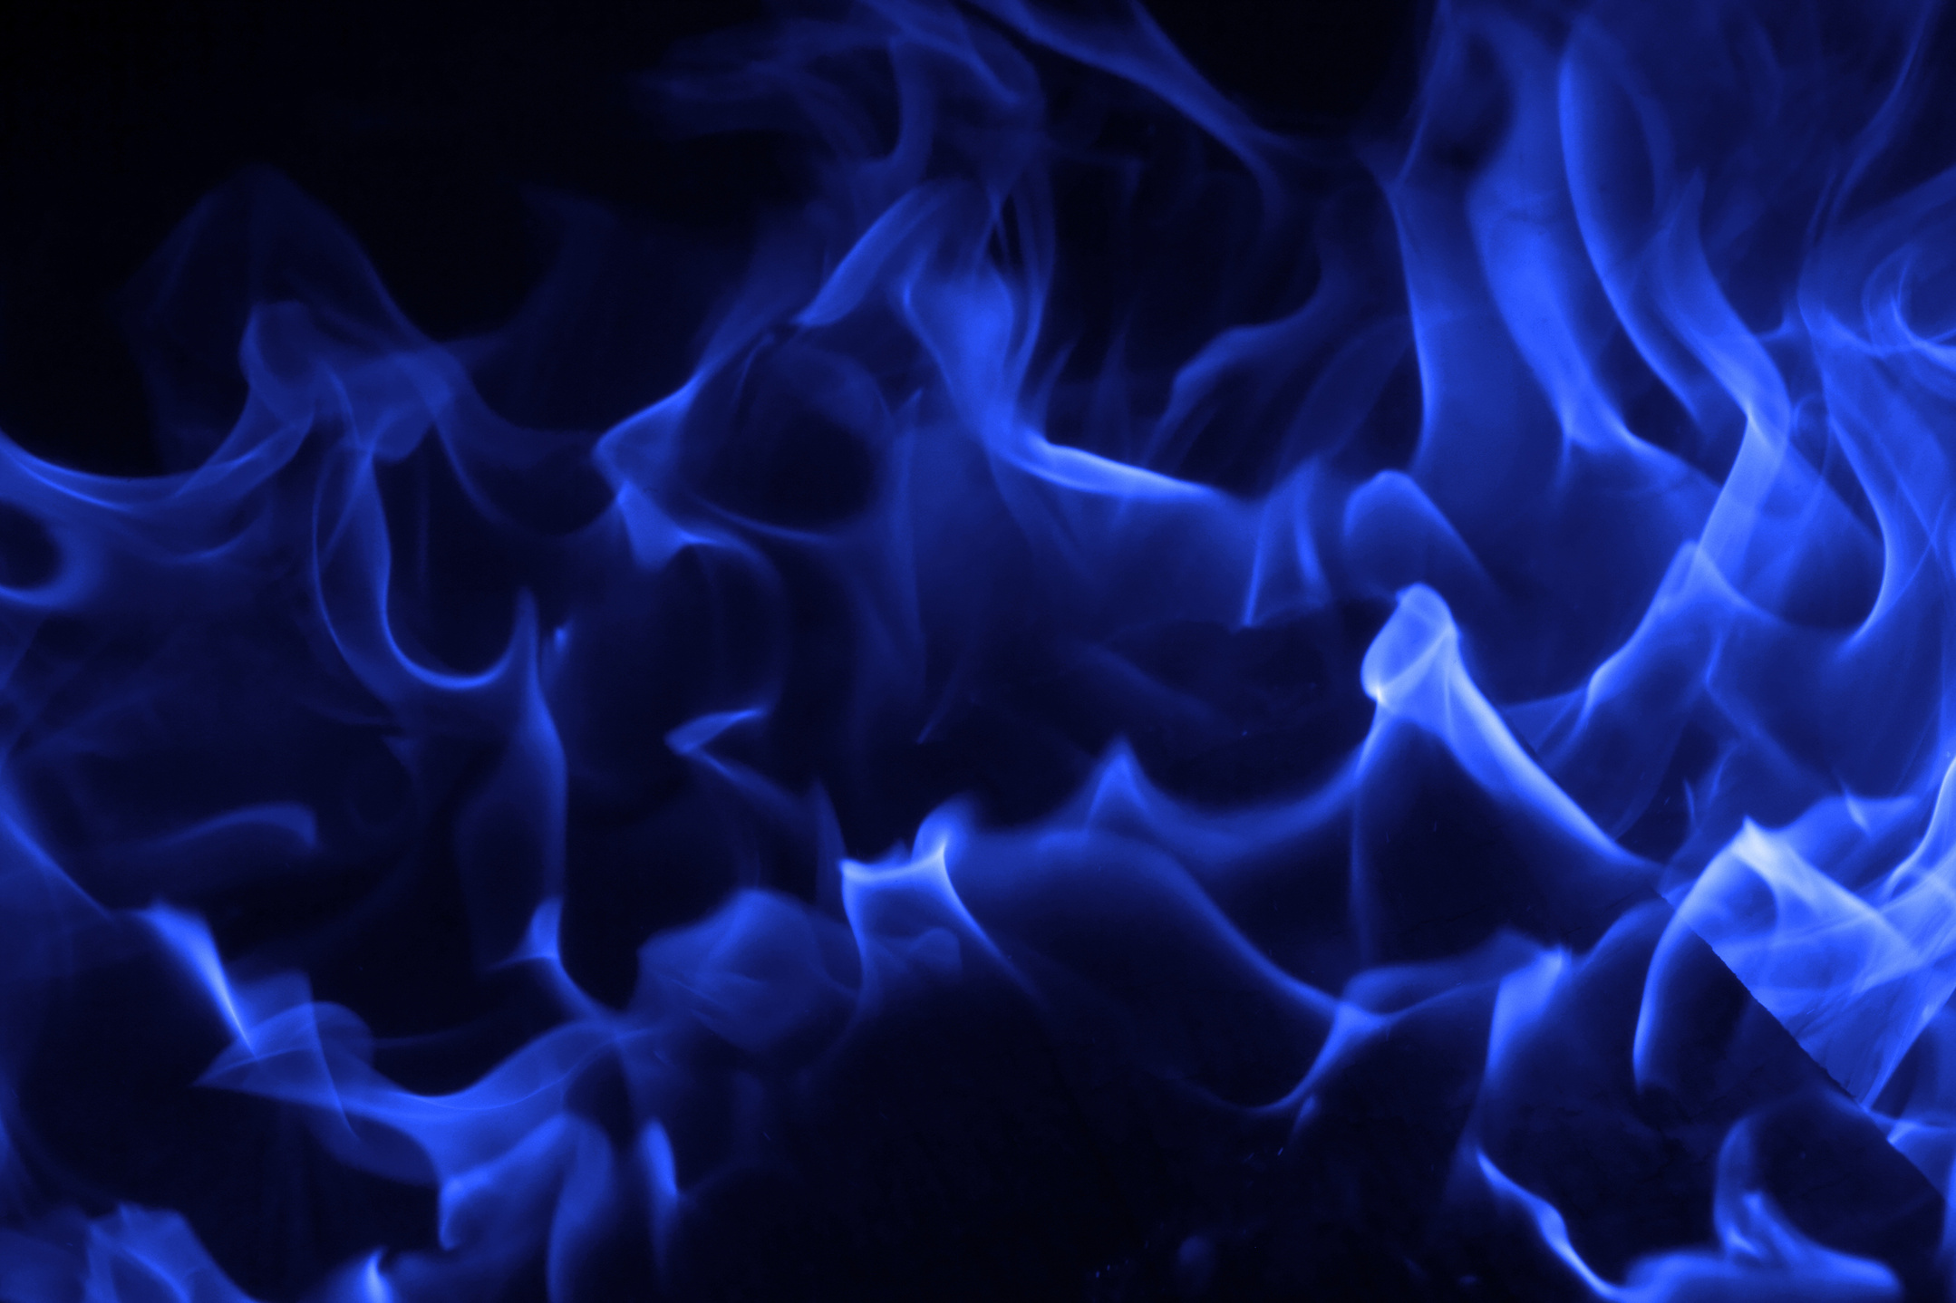
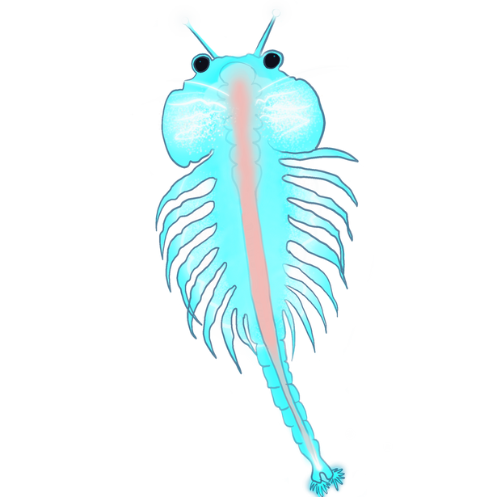

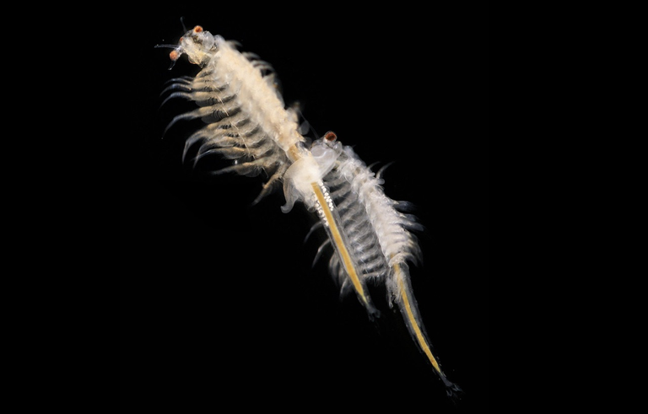

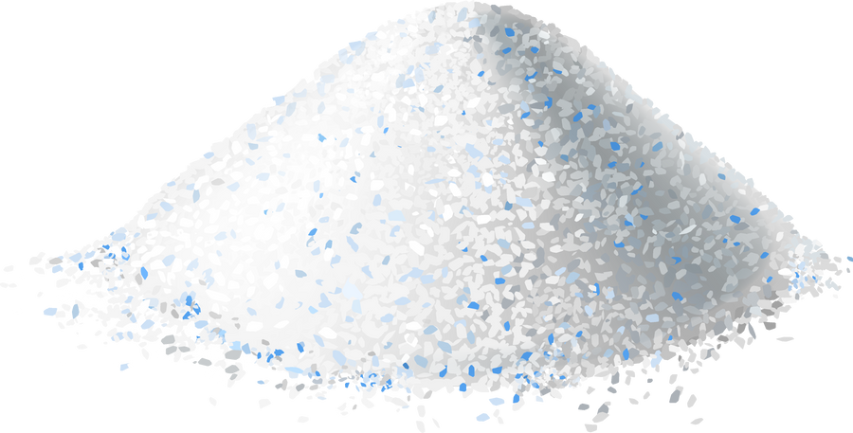
SEA MONKEY
Sea Monkey
Poly-
extremophile
Sea monkeys are tiny animals that live in warm salt water
They’re found in places like the Great Salt Lake in Utah
Their eggs can survive for years in a dormant state called cryptobiosis
Fun fact: some people keep them as pets!
Artemia Salina
Ability
Thrives in bodies of water with high salt concentrations.
Enjoys warm temperatures!
Crustacean
Type
Resistance
Bonus Fact:
Swims up-side down

Slide 5
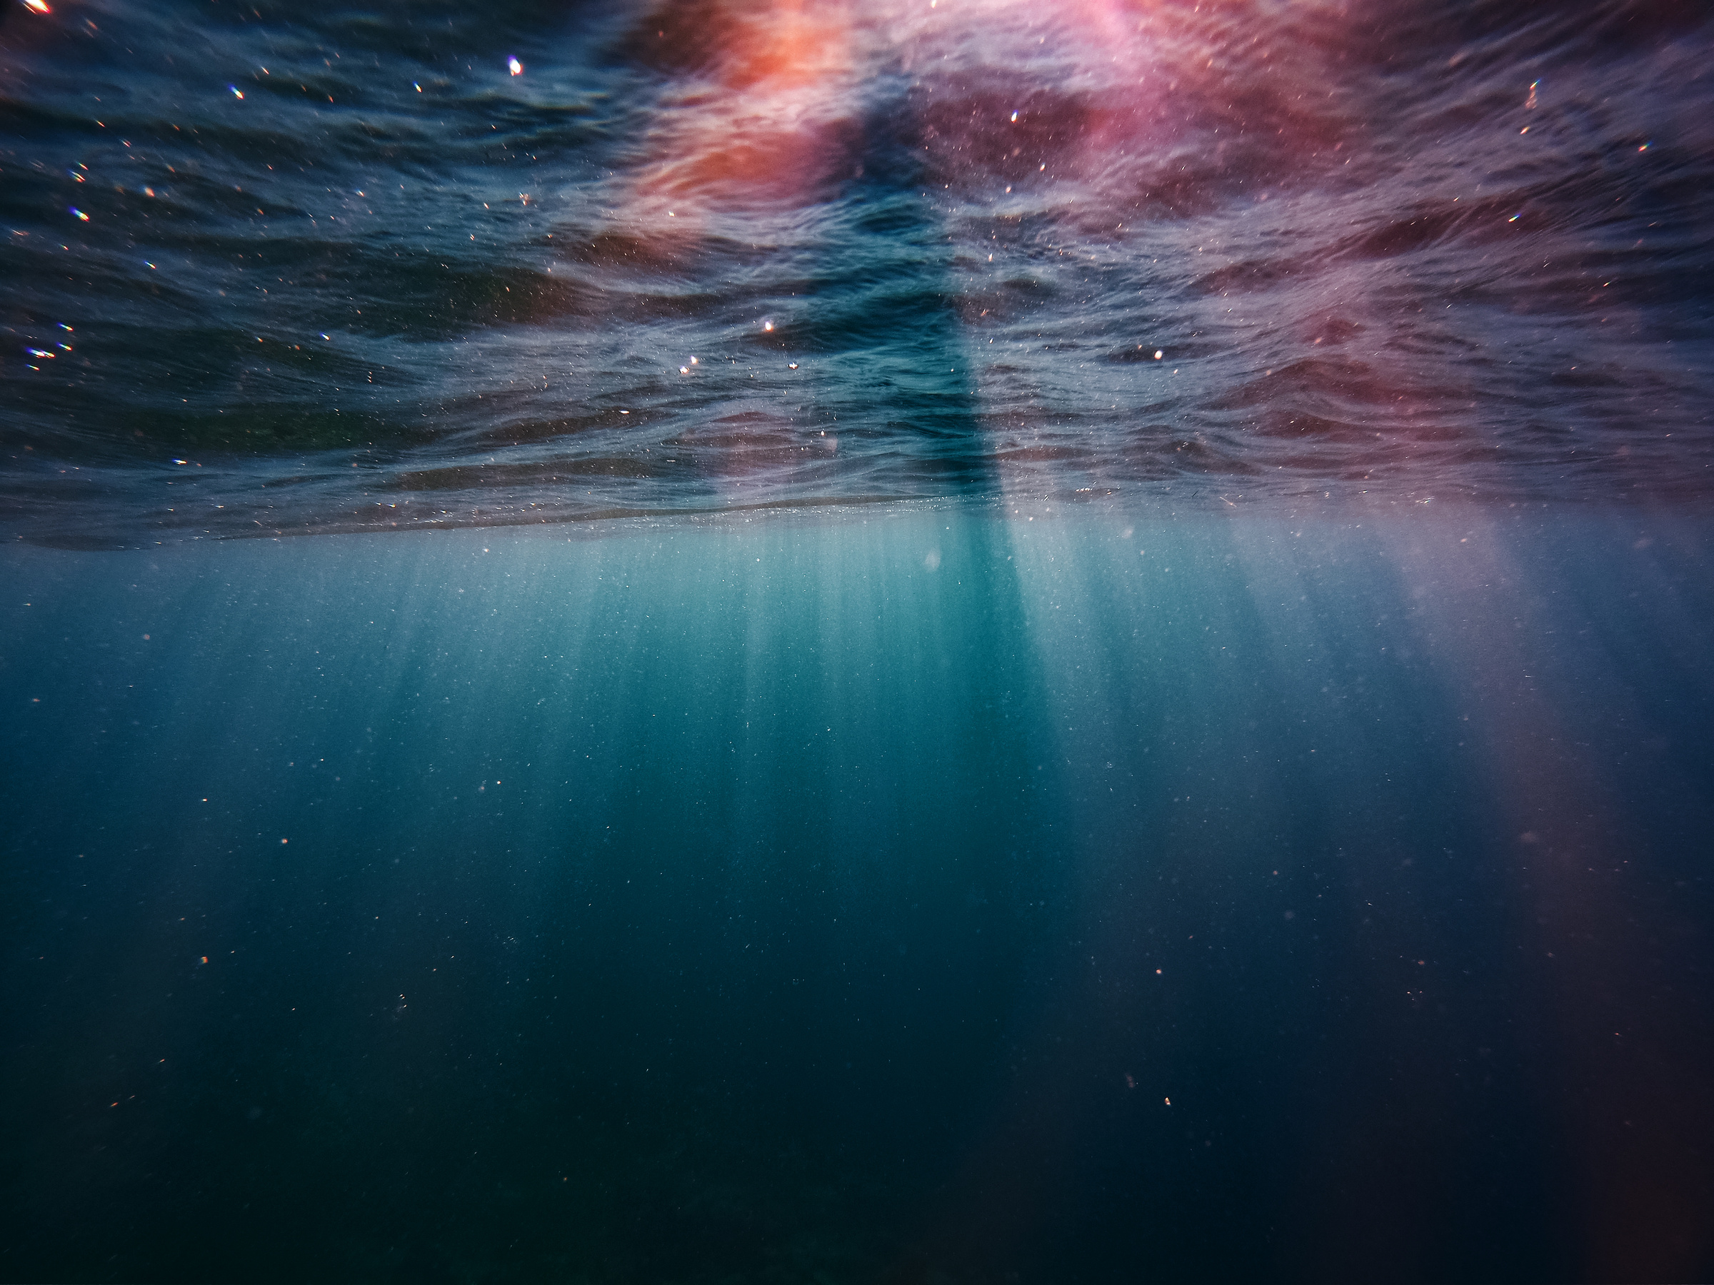


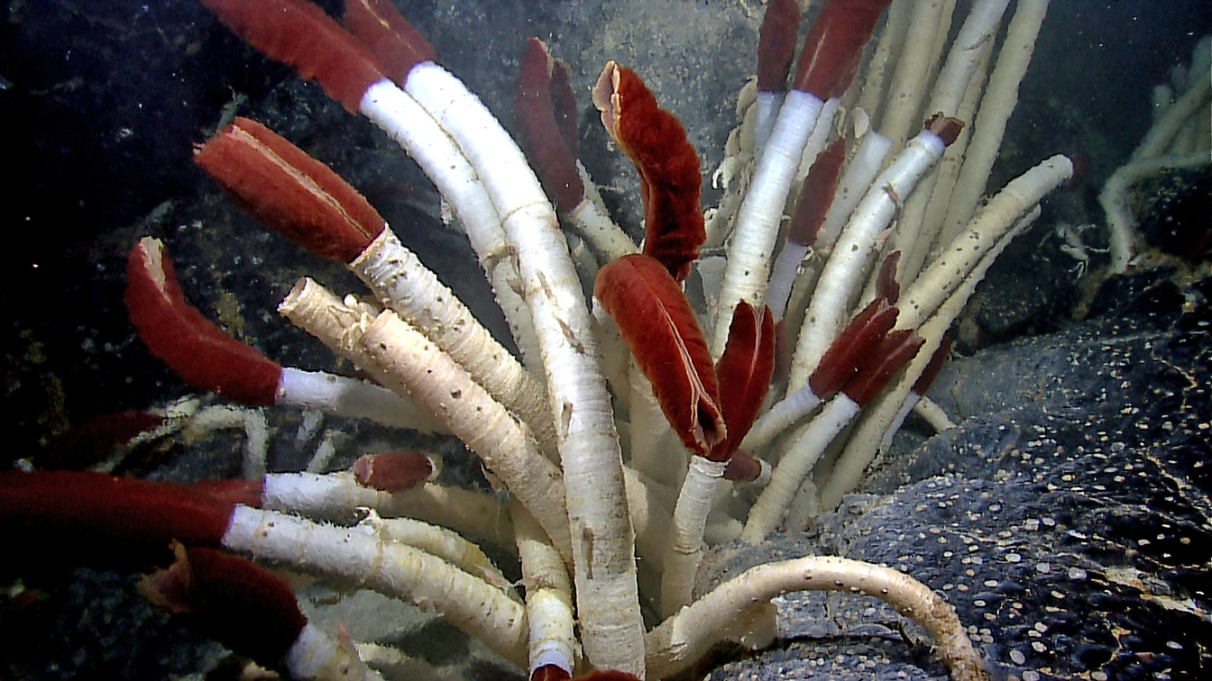

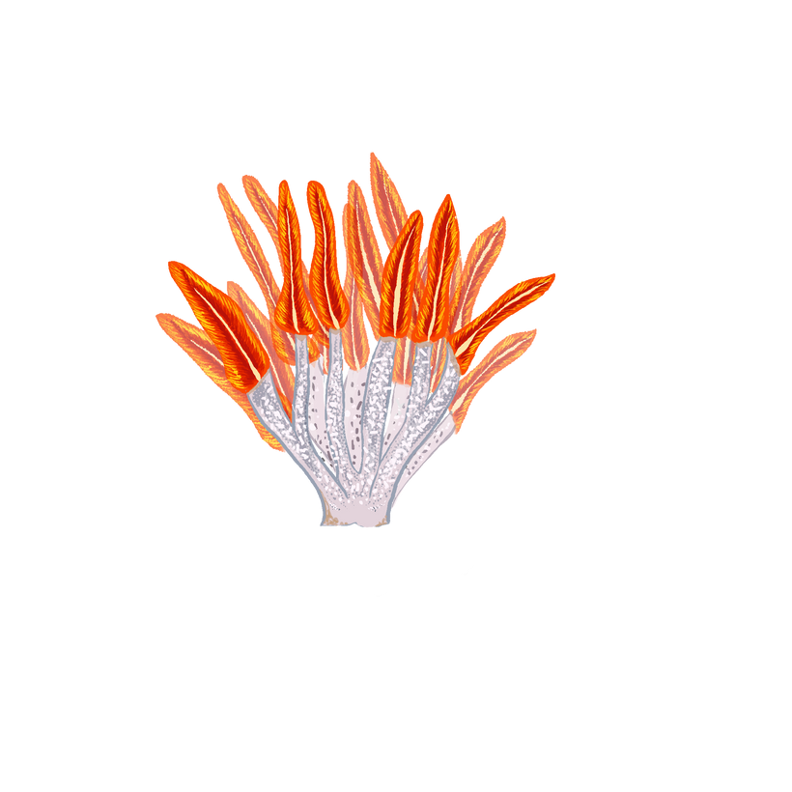
GIANT TUBE WORM
They have special bacteria inside them that make food from chemicals in underwater volcano vents
Their red top carries oxygen safely to their bacteria friends
They live in total darkness and can handle super hot, high pressure water where almost nothing else can live
Fun Fact: They have no mouth or stomach!
Giant Tube Worm
Ultra Extremophile
Riftia pachyptila
Ability
Thrives in deep bodies of water with high temperatures and pressures.
Invertebrate
Type
Resistance

Slide 6
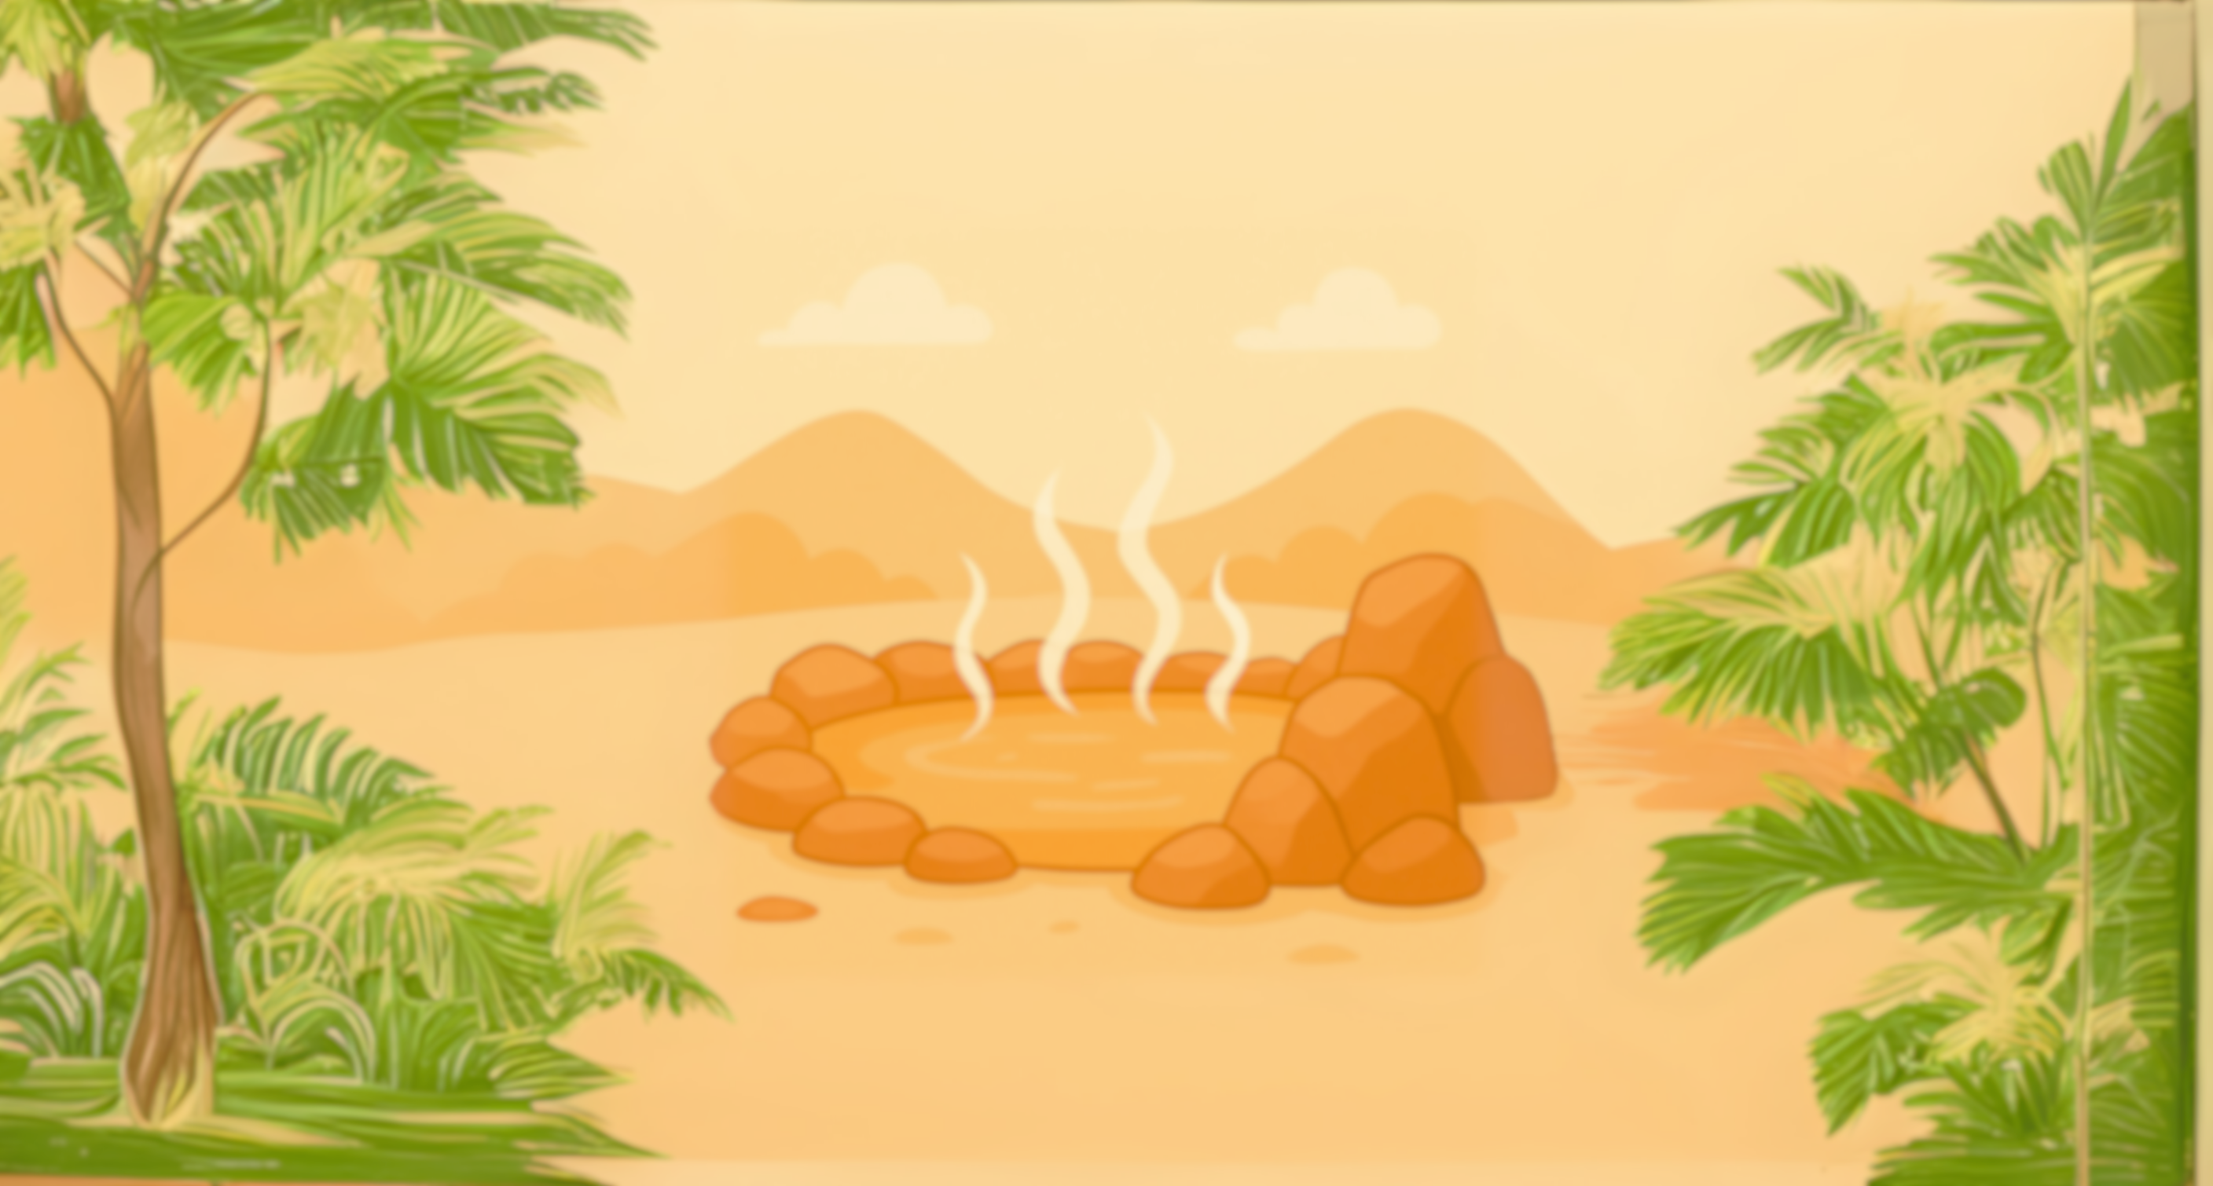
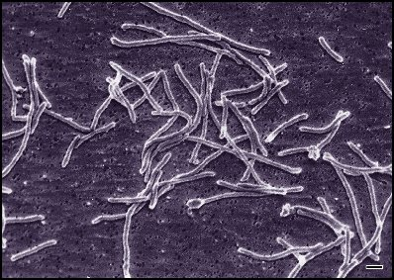
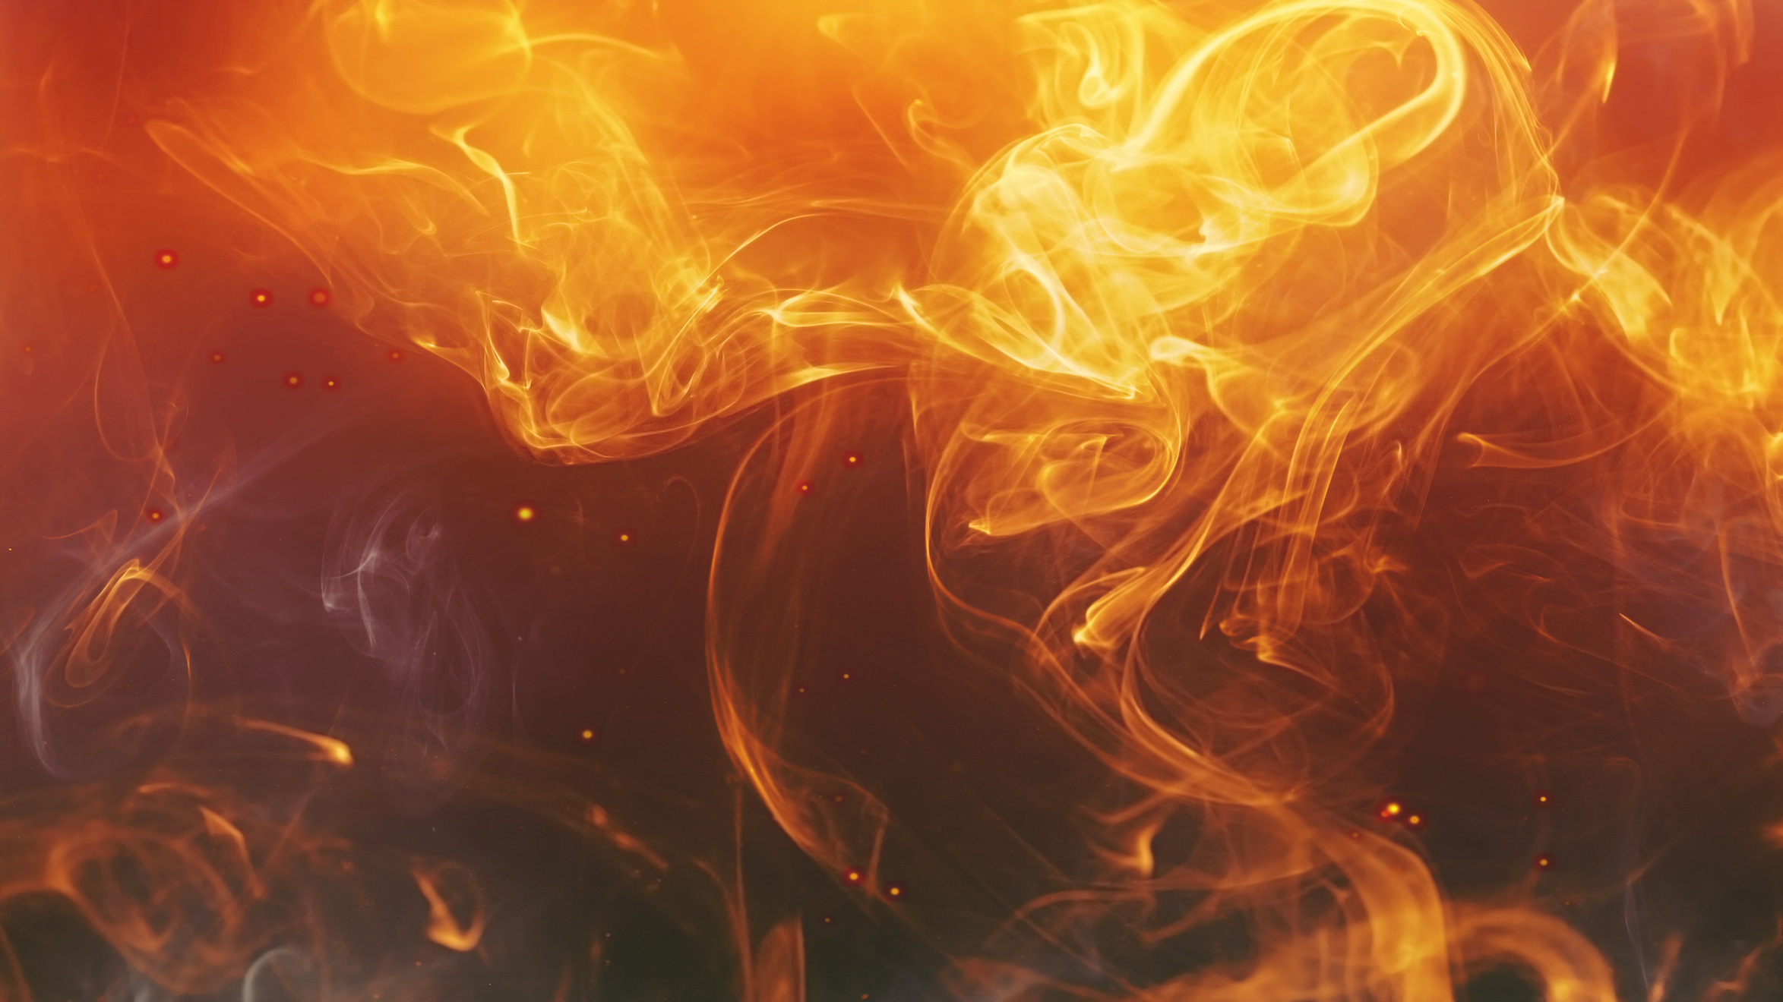

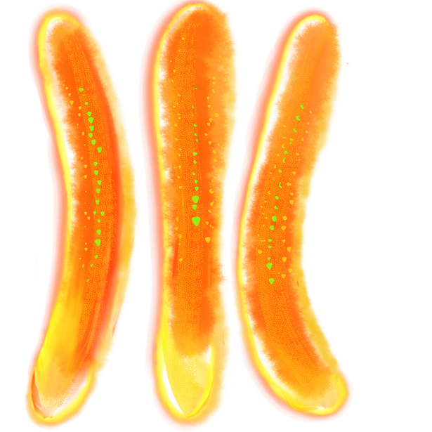

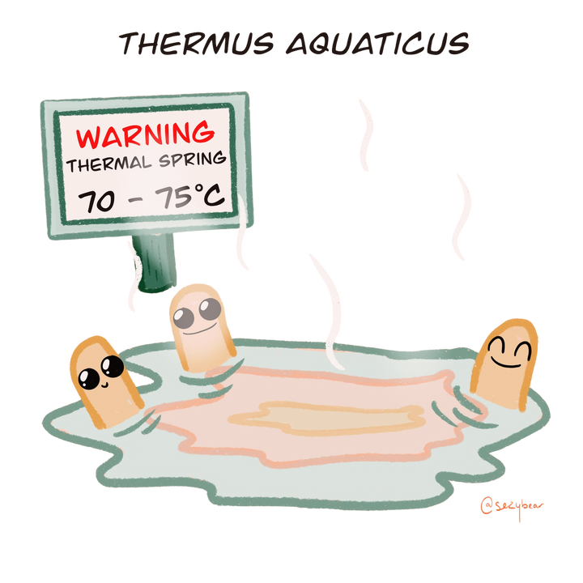
T. AQUATICUS
Type of Bacteria
T. Aquaticus
Extremophile
Lives in hot springs that are around 160°F
It was discovered in Yellowstone National Park hot springs
It has a heat-proof enzyme that helps copy DNA
Fun Fact: This organism produces a special enzyme that helped scientists create COVID-19 tests and crime scene DNA tests!
Thermus aquaticus
Ability
Thrives in very hot temperatures. Really likes heat and steam!
Bacterium
Type
Resistance

Slide 7



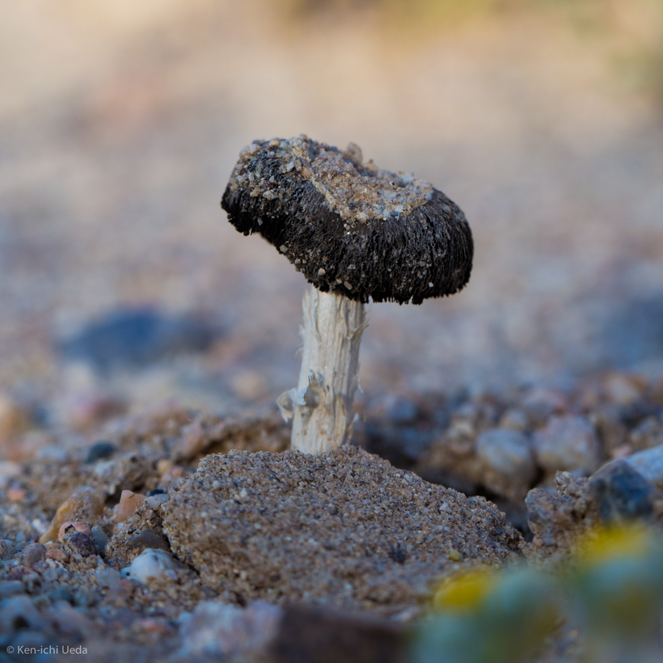
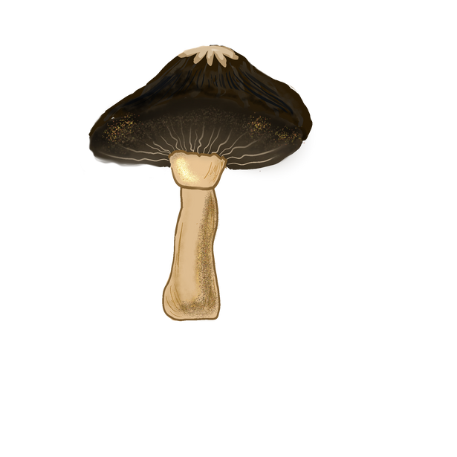




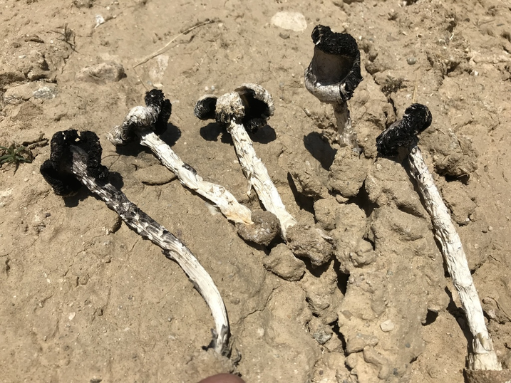







DESERT INK CAP
This mushroom lives in hot, dry deserts
It grows in sandy soil and survives with very little water
The cap can turn into inky black goo as it gets older
Fun Fact: It can be found right here in Arizona!
Montagnea
Extremophile
Montagnea arenaria
Ability
Survives in hot temperatures and low humidity.
Fungi
Type
Resistance

Slide 8

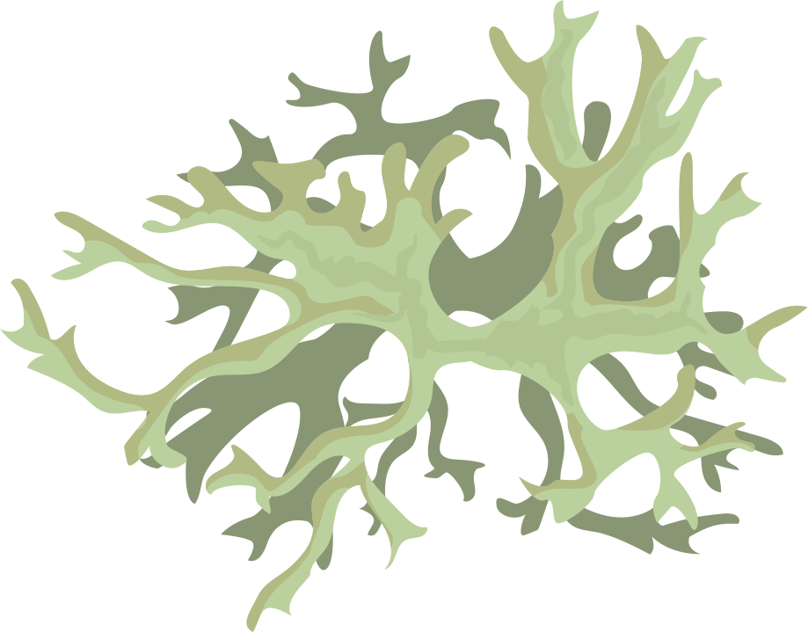
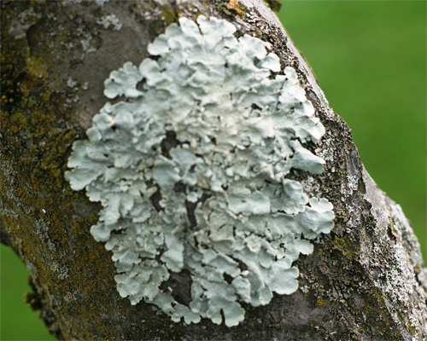
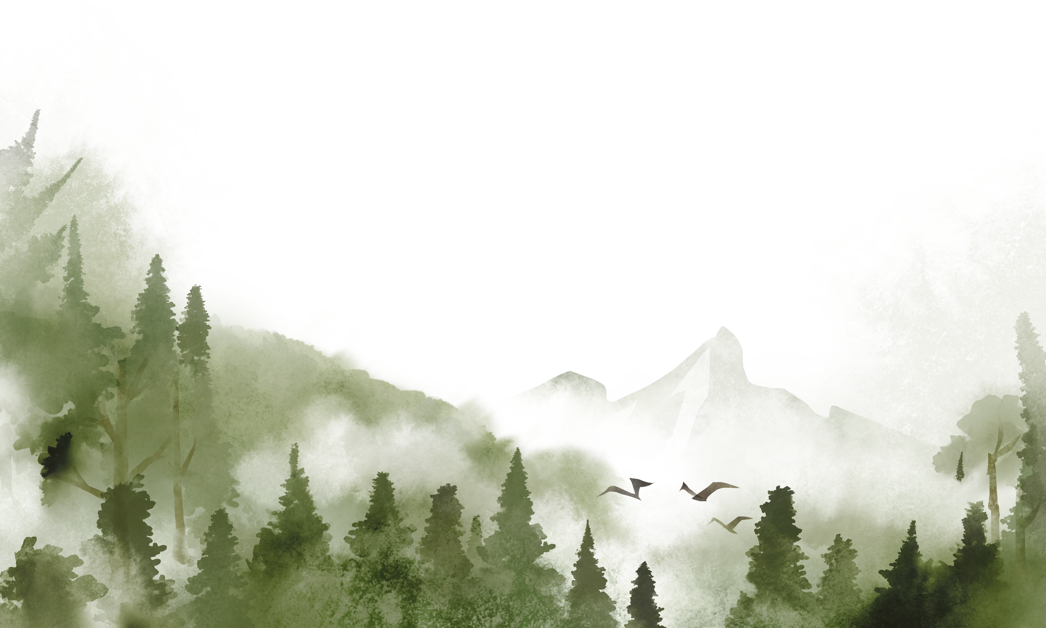

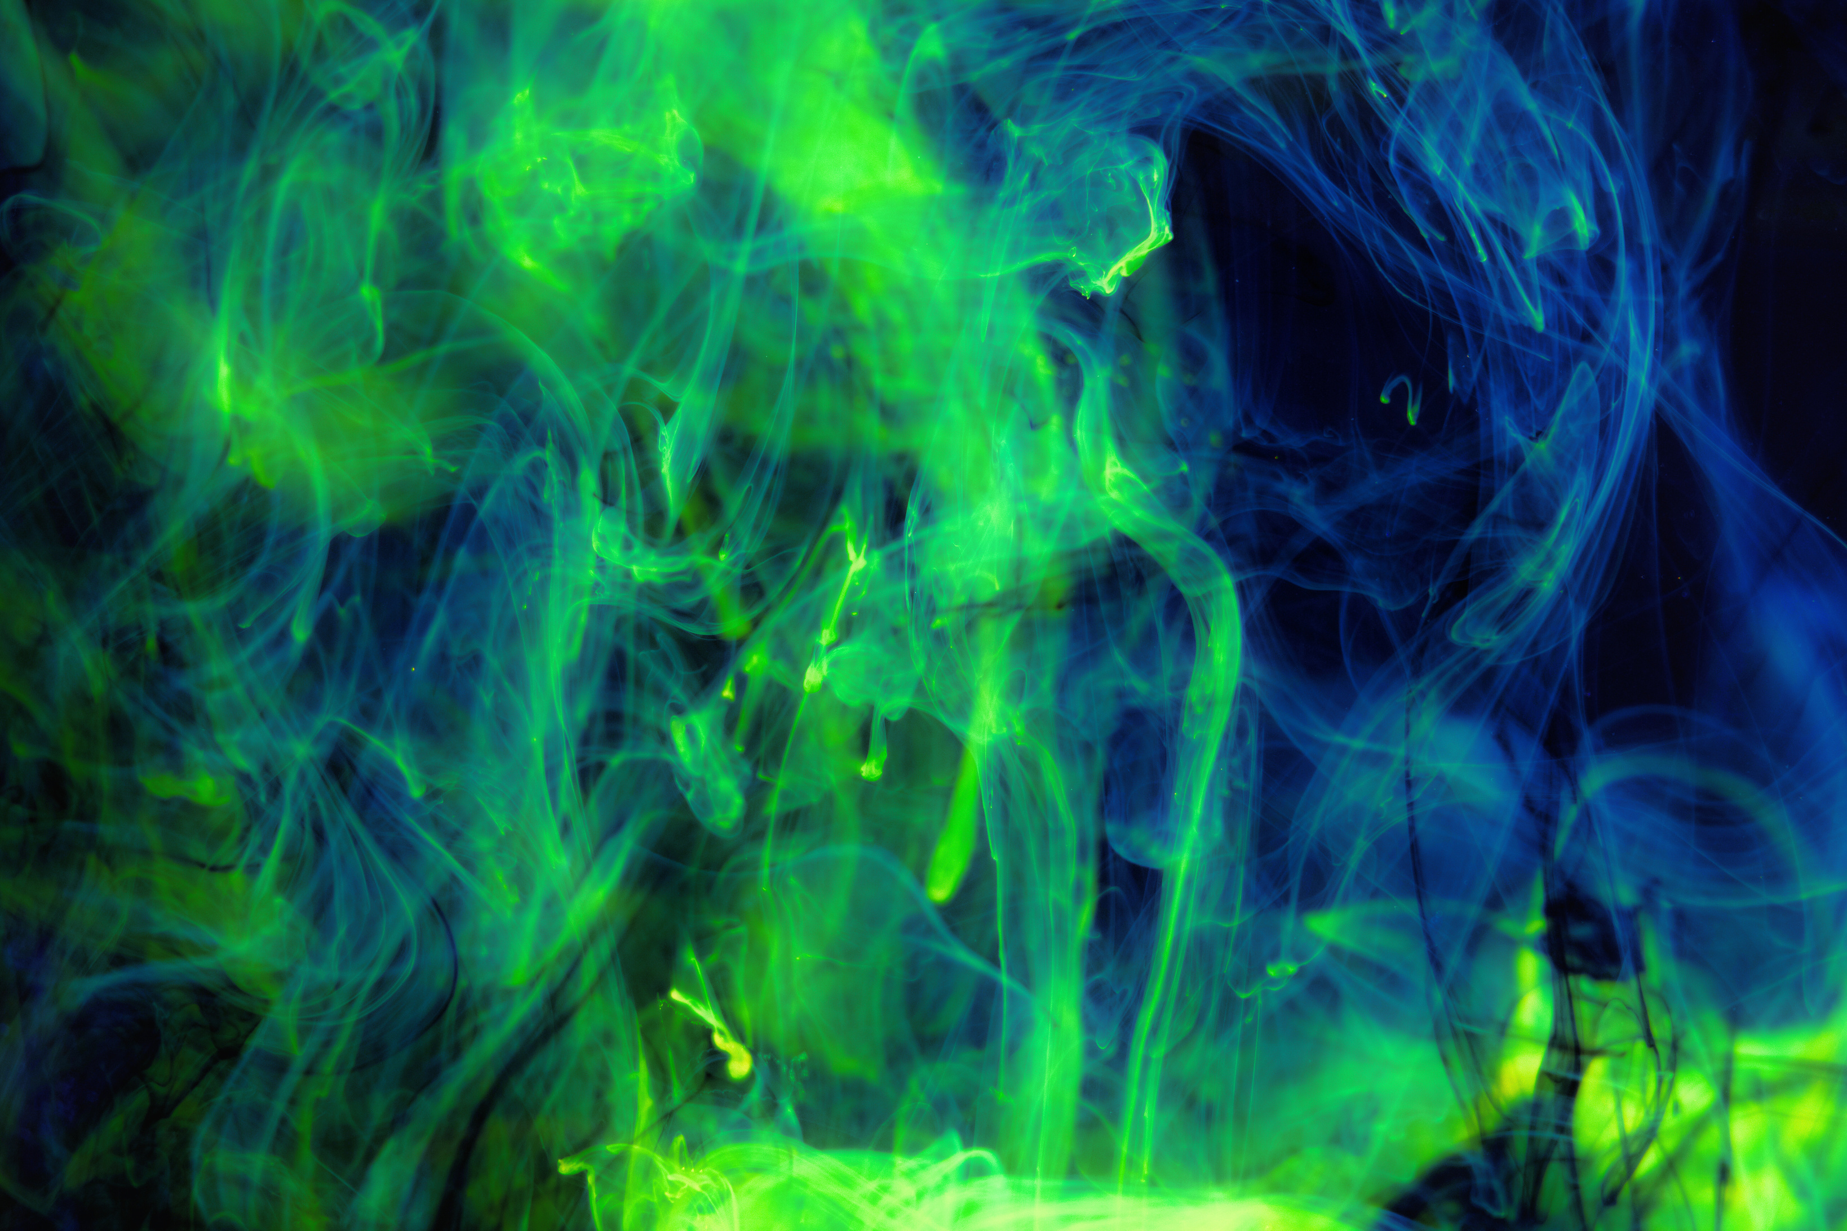
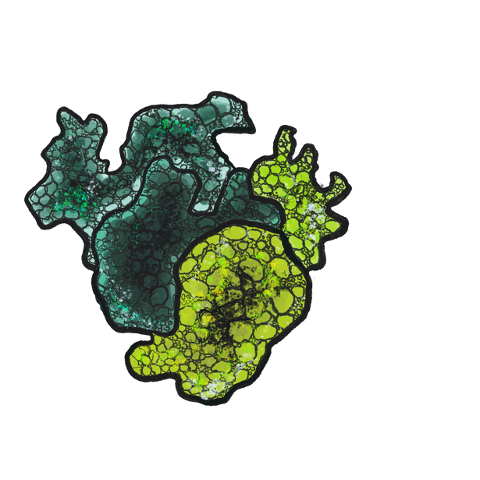
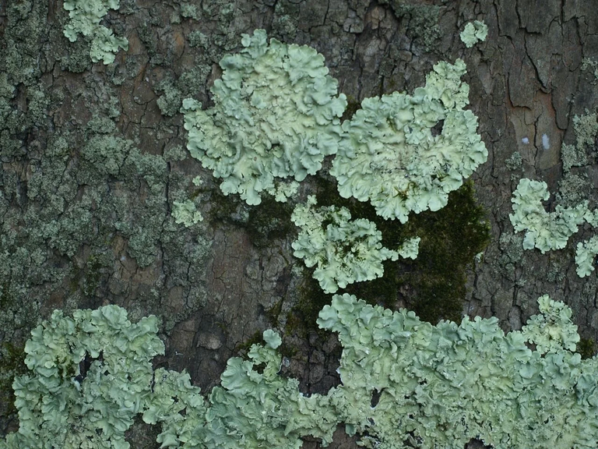

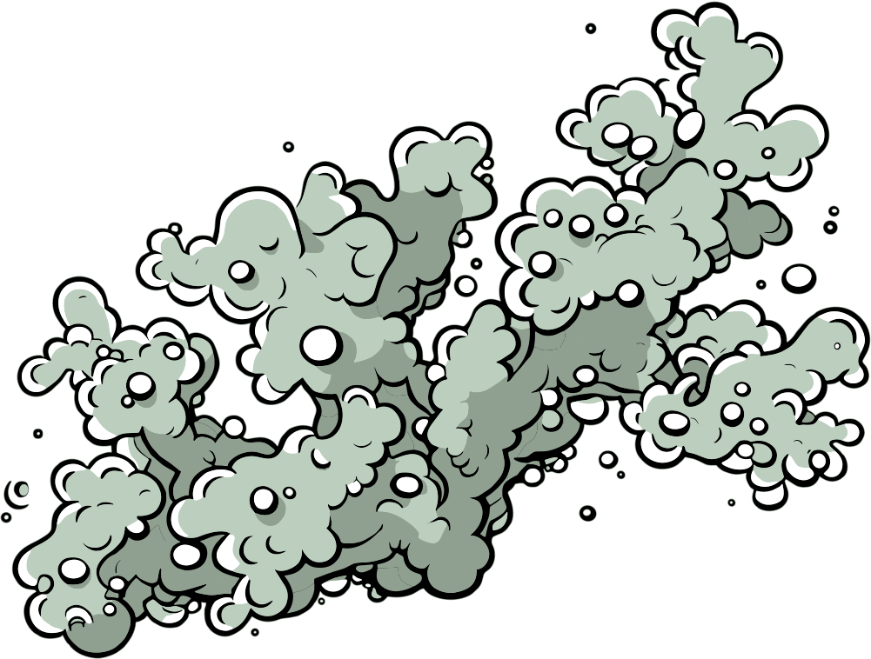
LICHENS
Lichens are part fungus, part algae
They grow on rocks, trees, and even sidewalks
They can survive in very hot temperatures and low humidity
Fun Fact: They are some of the first things to grow after a volcanic eruption!
Lichens
Extremotolerant
Acarospora socialis
Ability
Survives in hot temperatures and low humidity.
Fungi
Type
Resistance

Slide 9
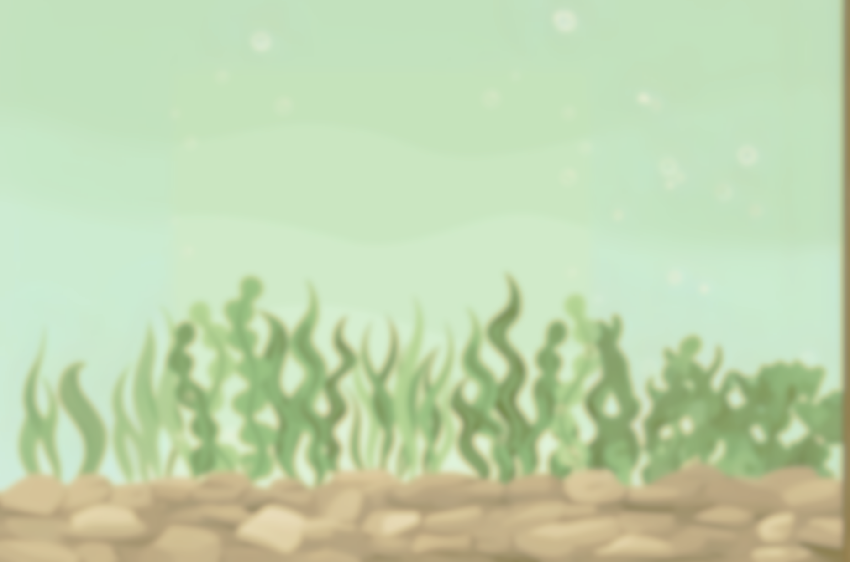
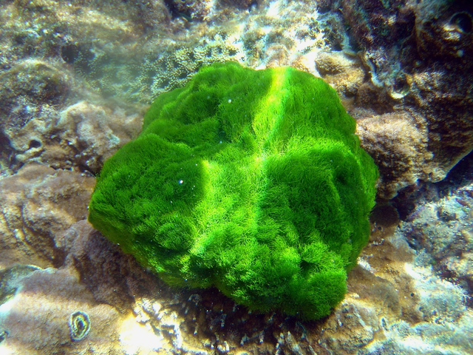
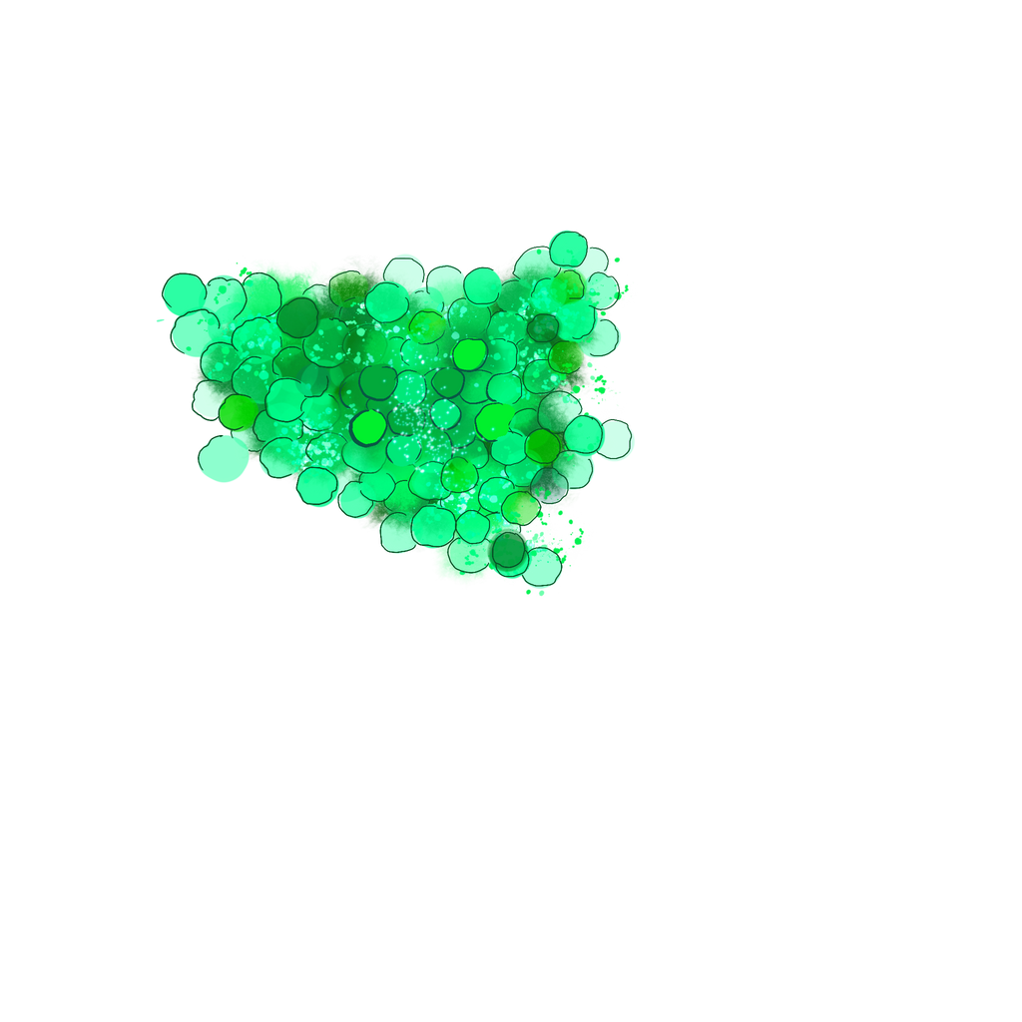


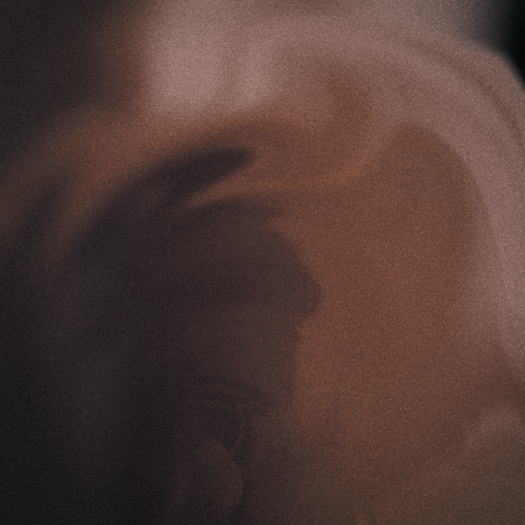
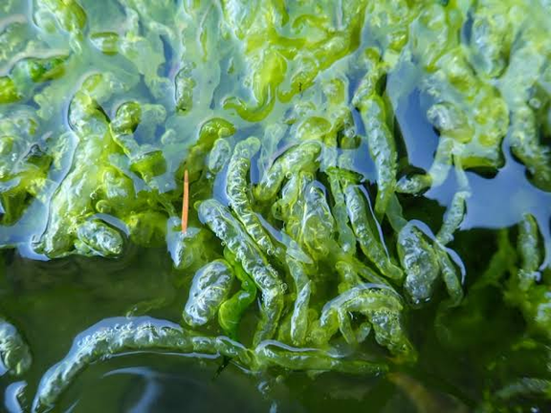


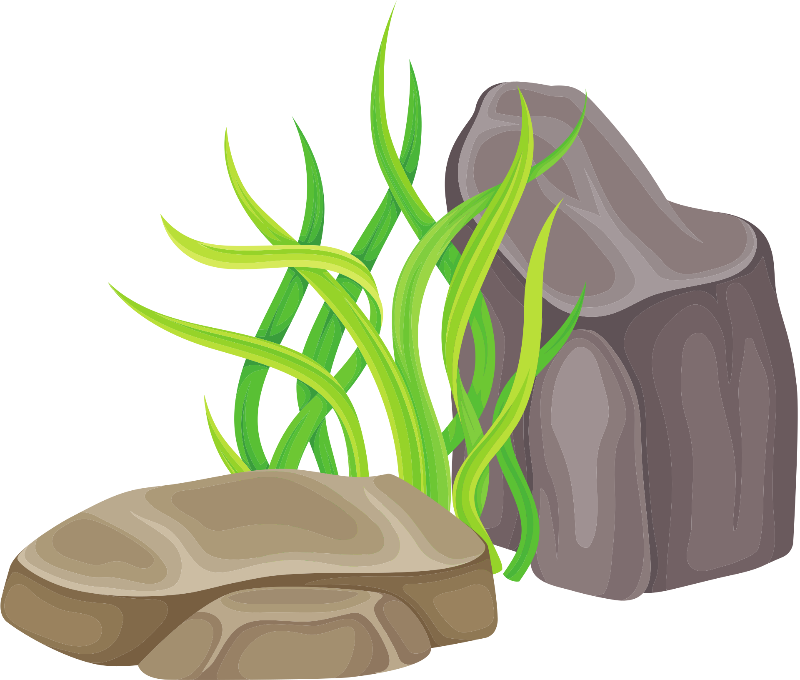
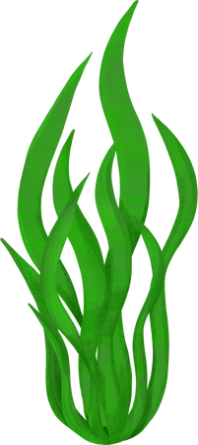
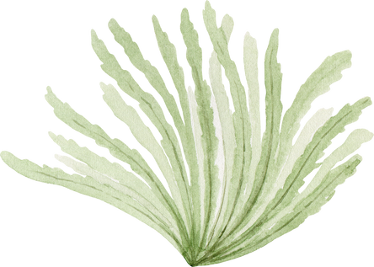
GREEN ALGAE
Chlorophyta
Extremophile
These plants can live in super acidic places, like volcanic lakes and toxic water near old mines
They make oxygen and feed lots of creatures like tiny water animals
Fun Fact: In acidic lakes, some green algae turn red or orange by making special pigments that protect them from acid and sunlight!
Chlamydomonas acidophila
Ability
Thrives in extremely acidic conditions.
Fungi
Type
Resistance

Slide 10
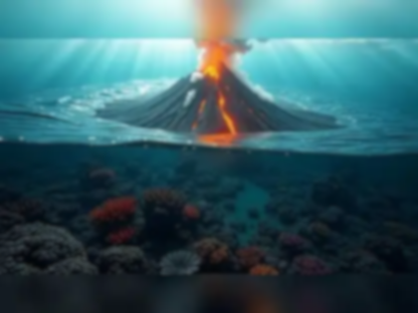
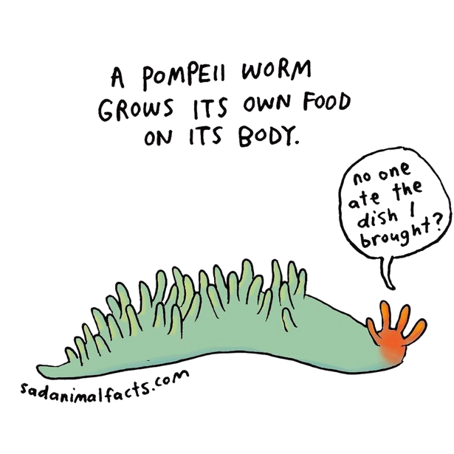
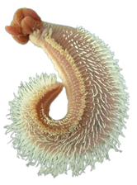
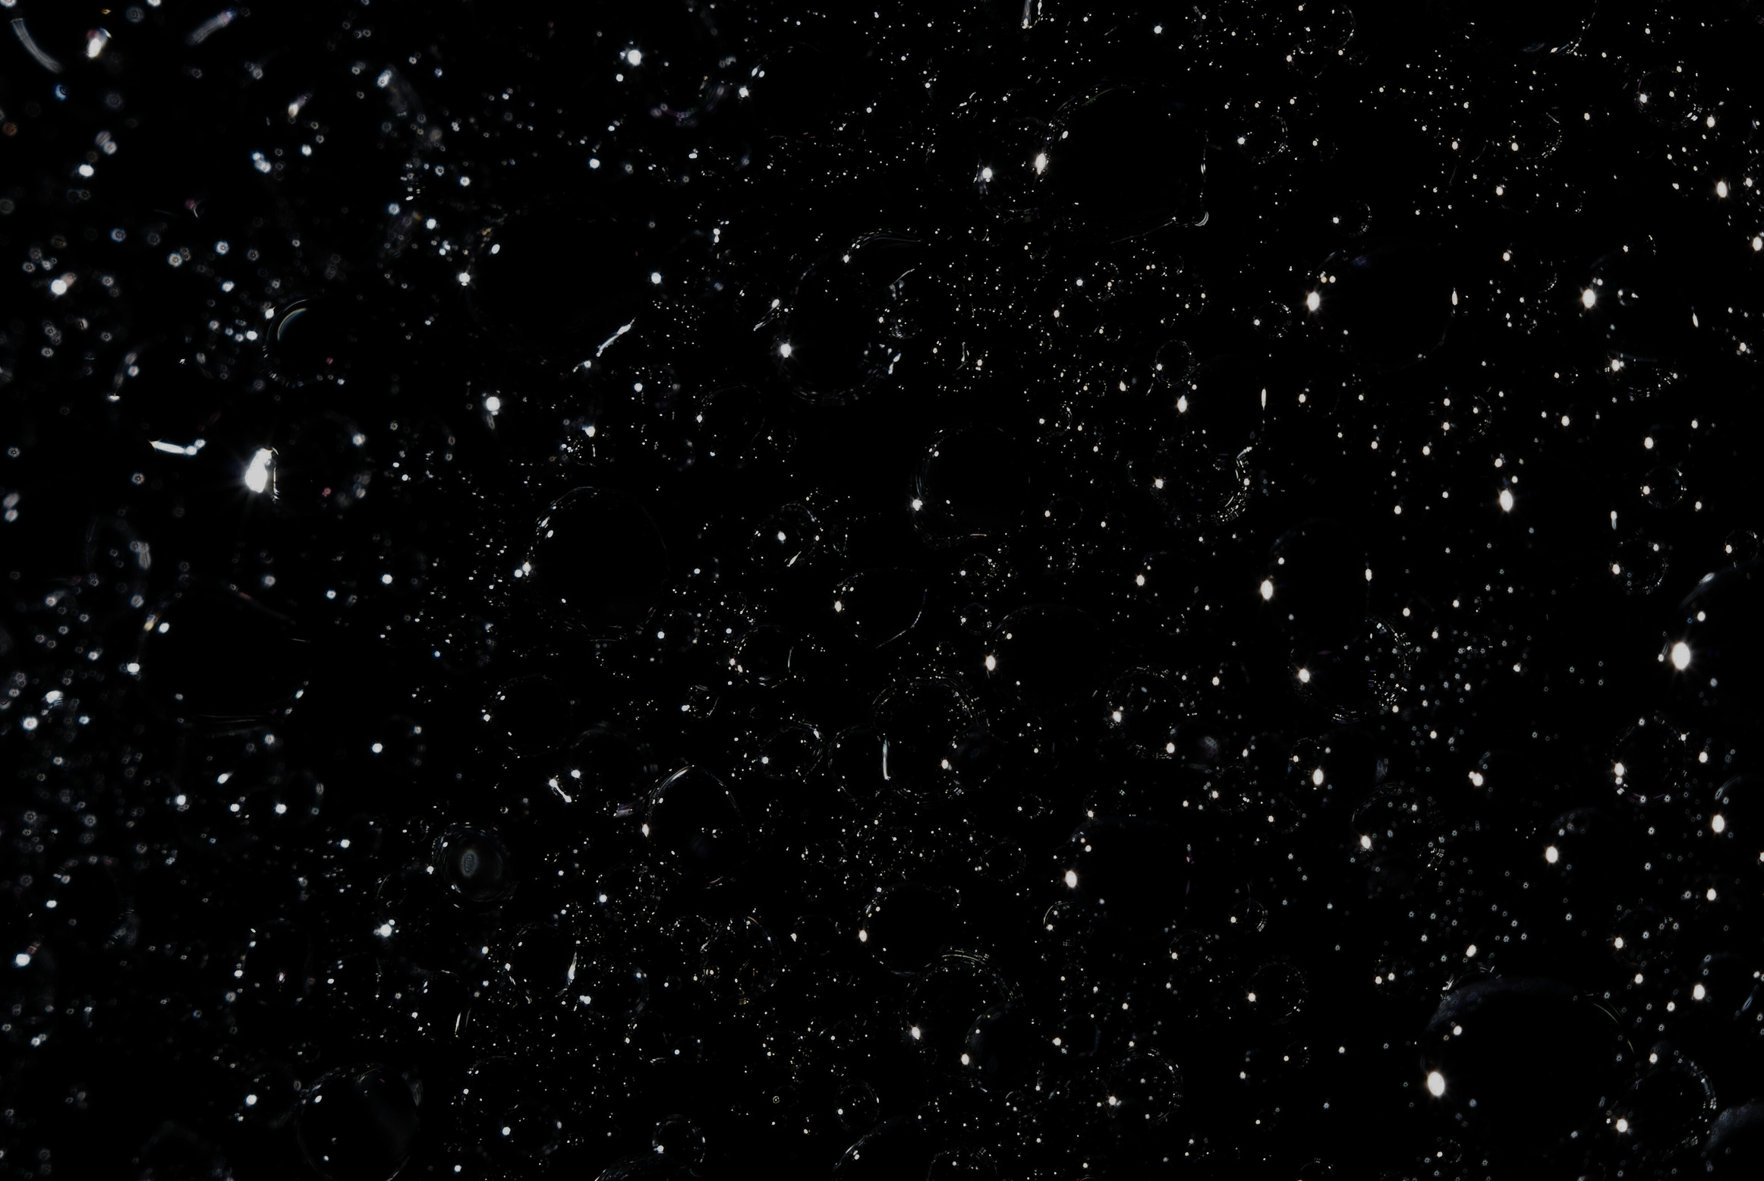

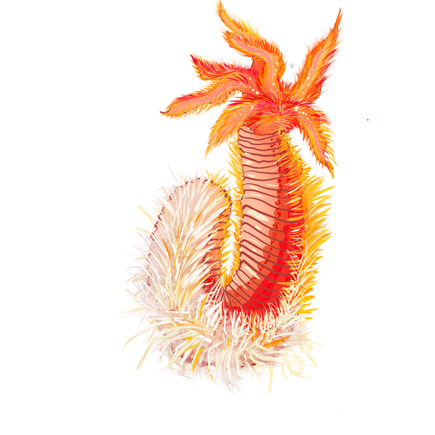


POMPEII WORM
These worms live at the bottom of the ocean near extremely hot underwater volcano vents
They can survive extremely high pressure
They’re covered in fuzzy bacteria on their backs that keep them cool, even in boiling water
They’re among the most heat-tolerant animals known!
Pompeii Worm
Poly-extremophile
Alvinella pompejana
Ability
Survives in deep hot waters.
Invertebrate
Type
Resistance

Slide 11











DUMBO OCTOPUS
Lives really deep in the ocean where there’s high pressures and cold temperatures
It’s named after the Disney character Dumbo because it uses its big “ear” fins to swim, just like the flying elephant!
Fun Fact: The dumbo octopus can swim deeper than Mount Everest is tall!
Dumbo Octopus
Poly-extremophile
Grimpoteuthis
Ability
Thrives in deep bodies of water with high pressures and cold temperatures.
Octopod
Type
Resistance

Slide 12
















CULEX MOSQUITO
This species of mosquito only lives around hot thermal pools in New Zealand.
These mosquitos lay eggs in very hot pools. Their larvae also live in these hot pools.
The pools are often as hot as 93 degrees Fahrenheit (34 °C) - much too hot for most insect eggs to survive! But, Culex survives the heat just fine.
Culex
Poly-extremophile
Culex Rotoruae
Ability
Survives in high altitudes and hot steamy temperatures.
Insect
Type
Resistance

