Slide 1



Extreme Environments

Slide 2
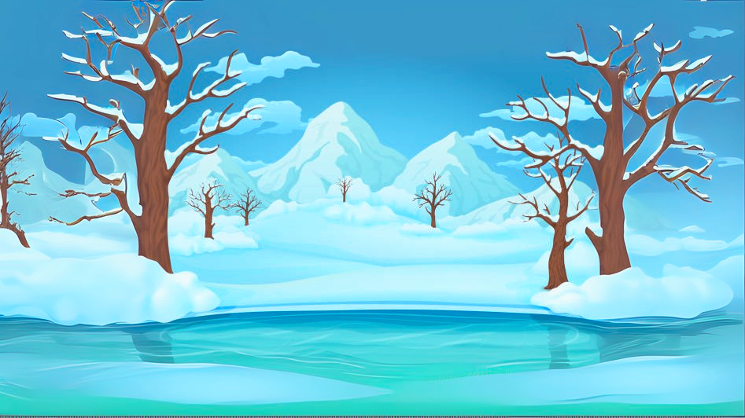
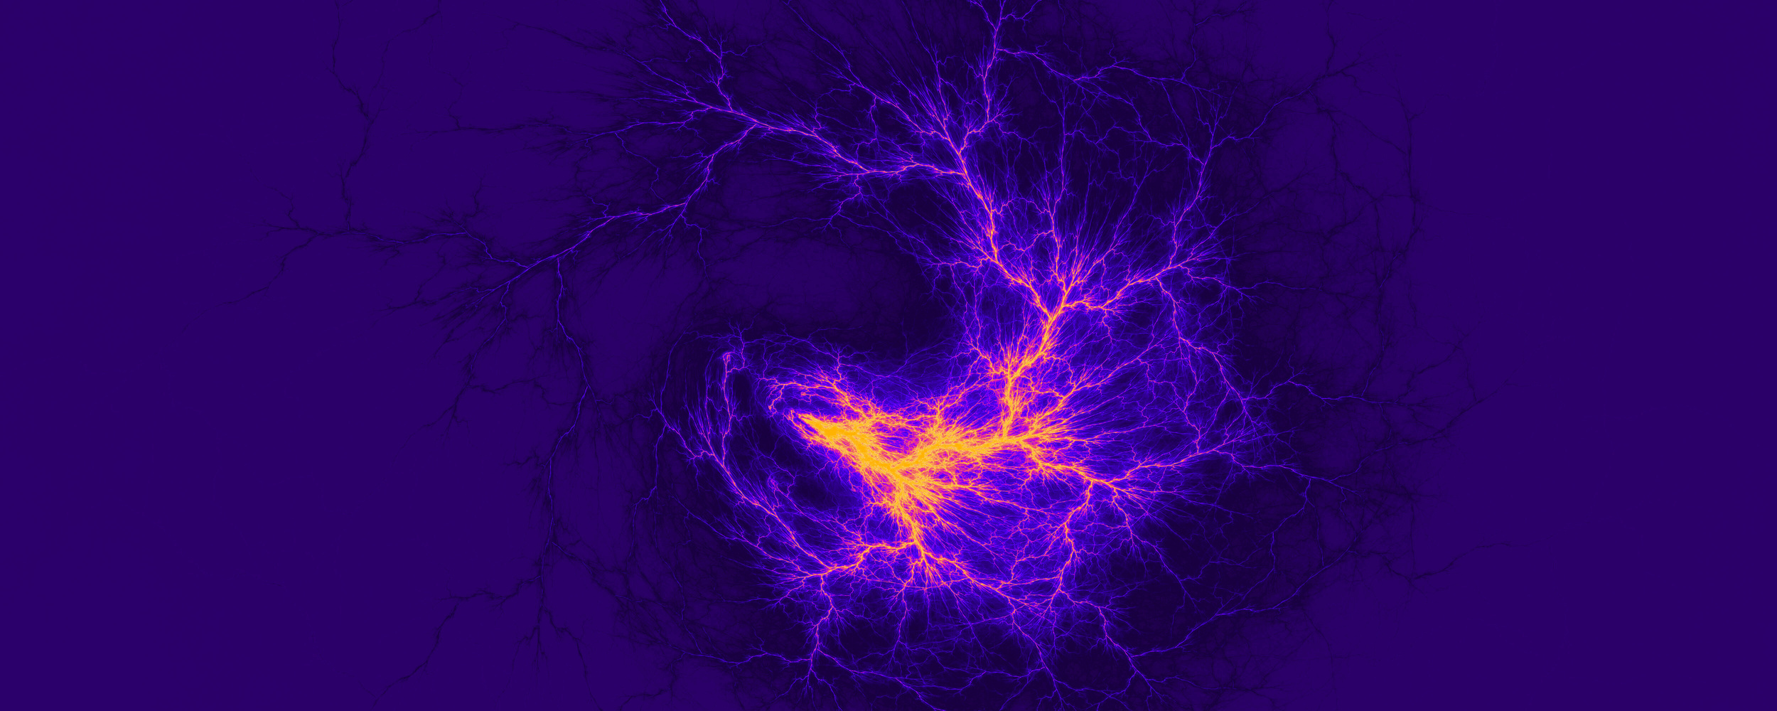
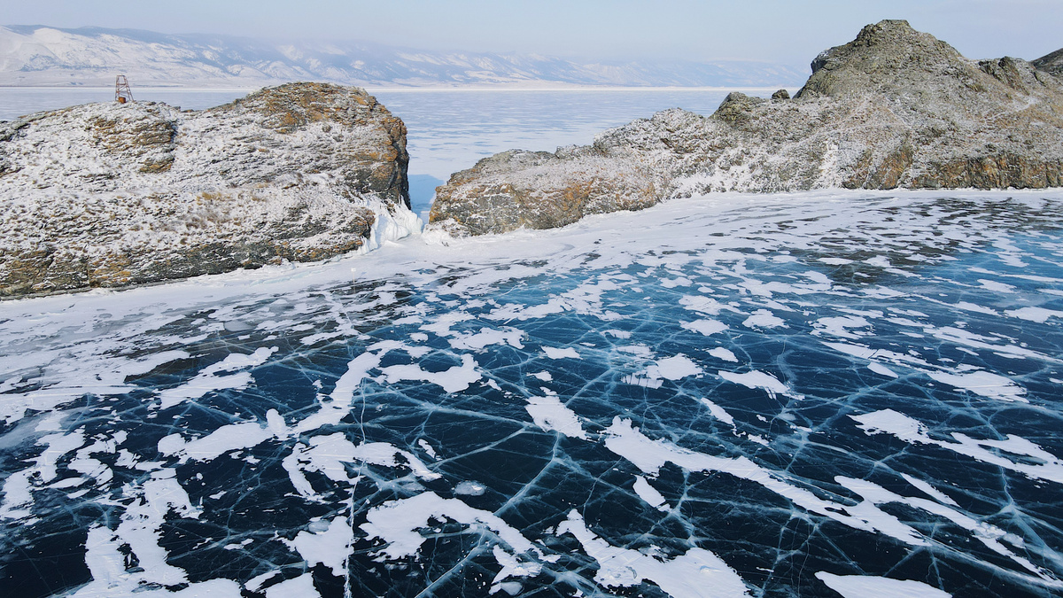
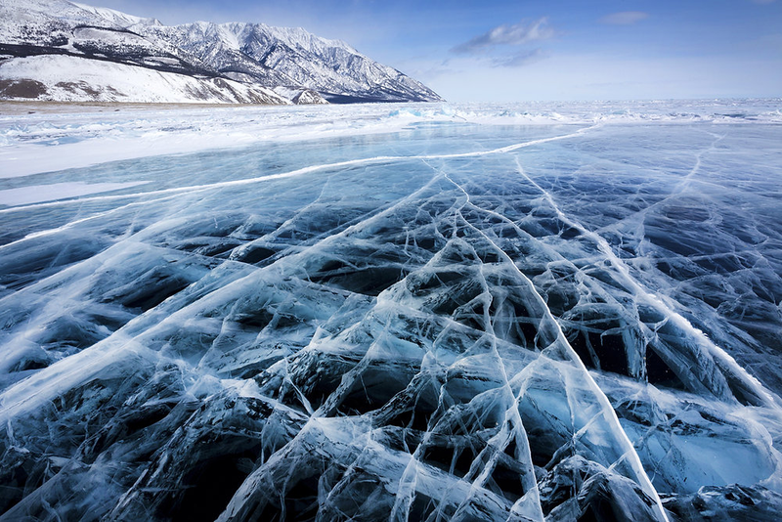



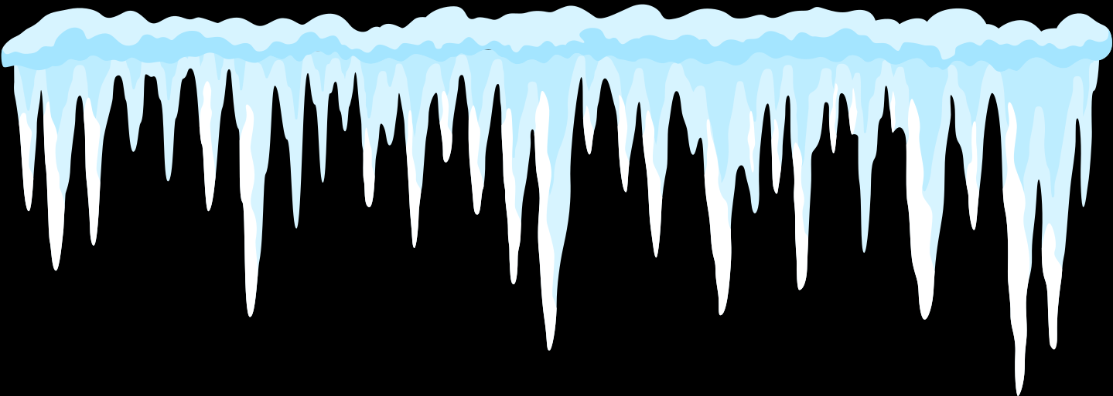
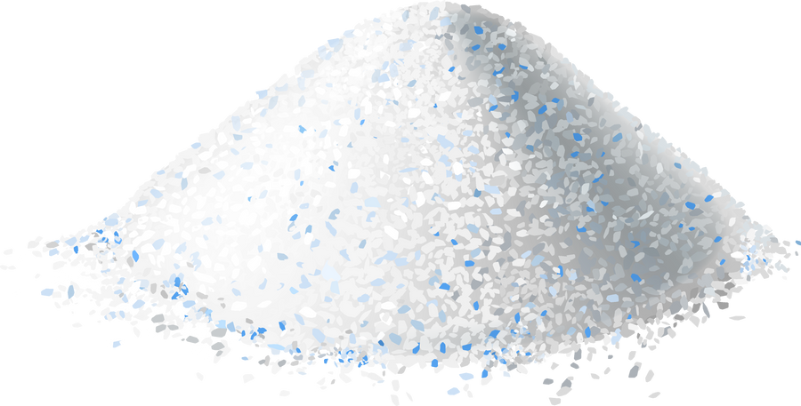

Frozen Lakes
FROZEN LAKE
FROZEN LAKE
Frozen lakes form when water freezes in cold seasons or polar regions.
The ice can be several feet thick. However, cold liquid water will still be underneath.
Fish, algae, and microorganisms can survive under the ice, since it’s not solid all the way through.
Fun Fact: In some places, the ice is so clear that you can see the fish swimming below your feet!
CONDITIONS

Slide 3
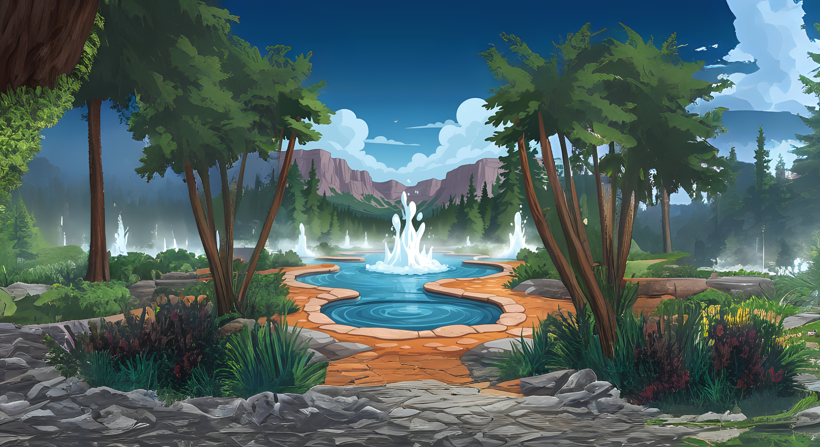
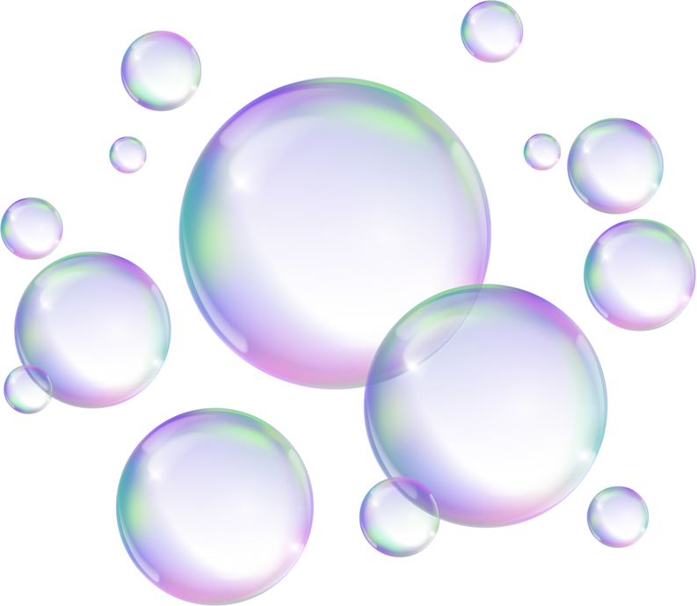
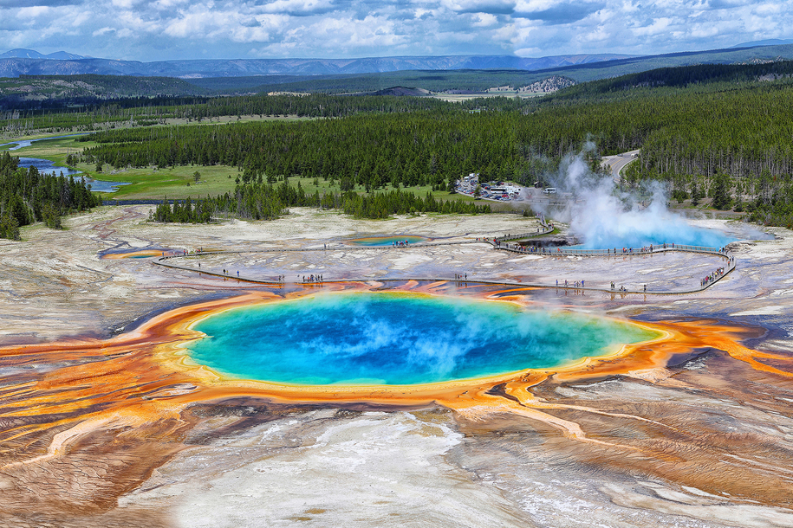
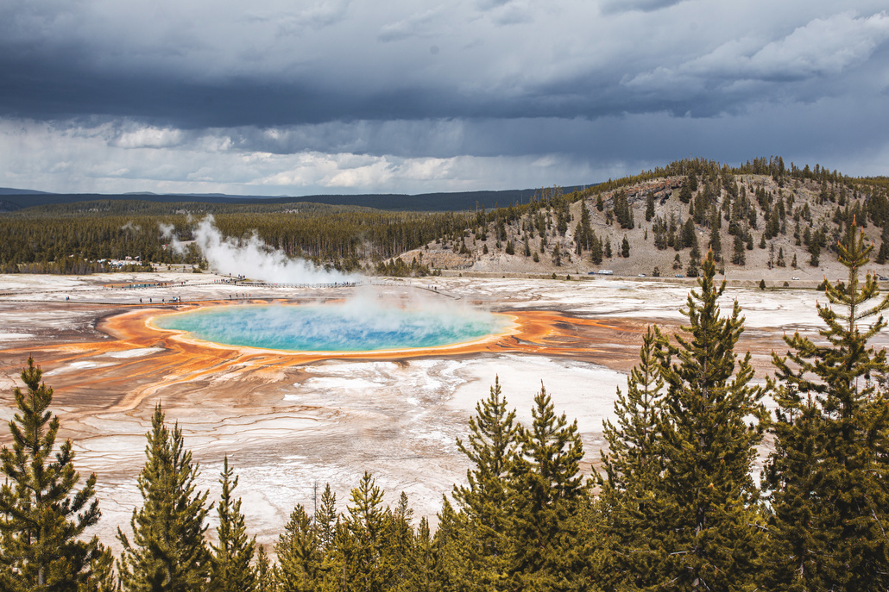
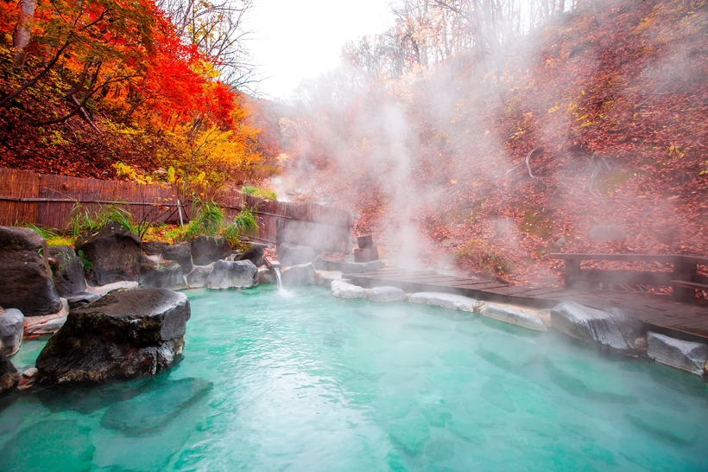

Hot Springs
Hot springs are pools of hot water that get their temperature from Earth’s underground heat.
The water can be hotter than 200°F.
Hot springs can be so acidic that they can dissolve rocks!
Fun Fact: Some are rainbow-colored from heat-loving bacteria!
HOT SPRINGS
CONDITIONS

Slide 4
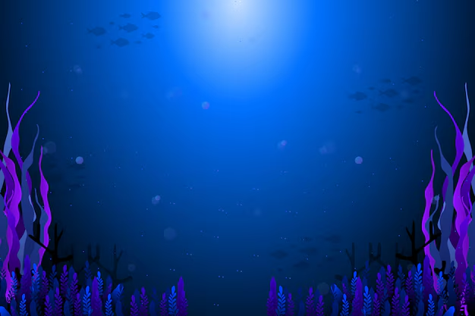

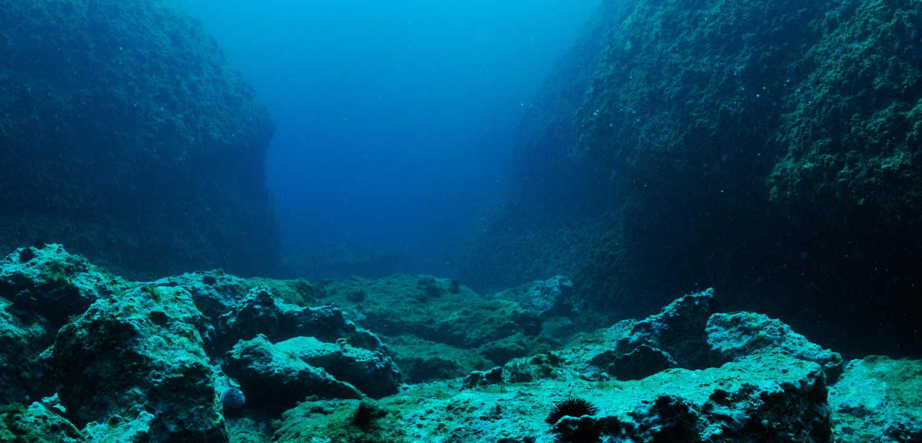
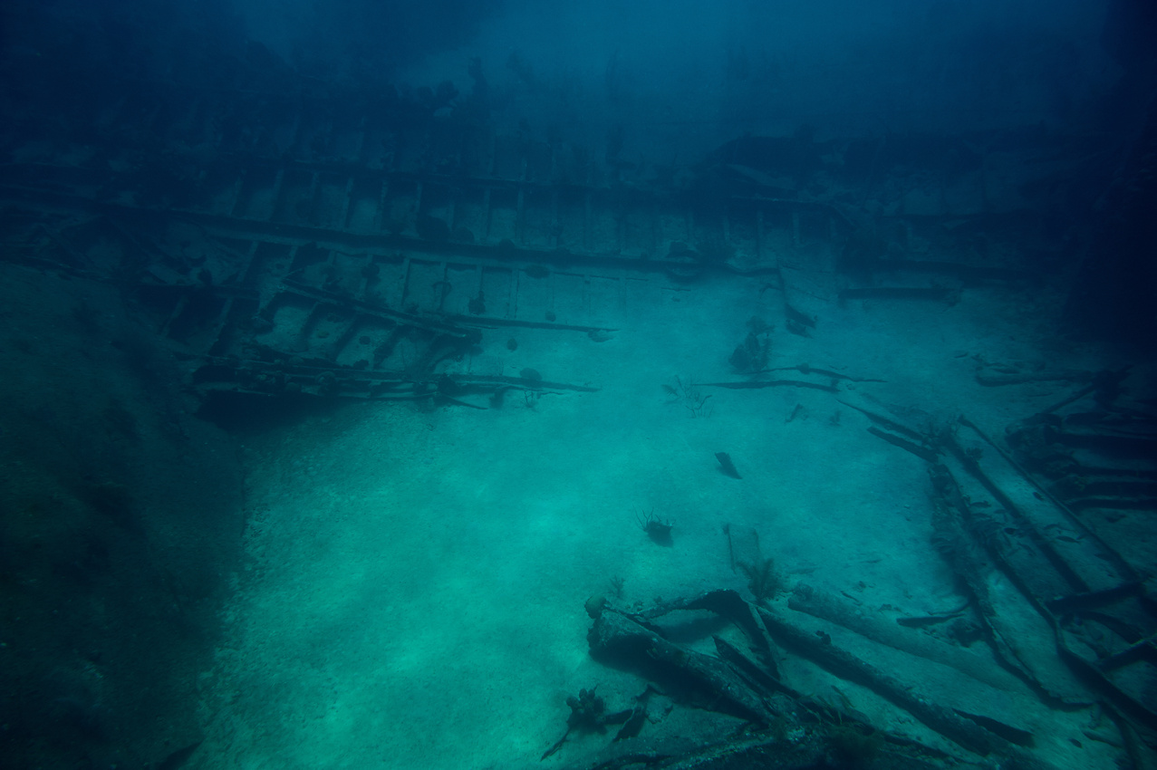
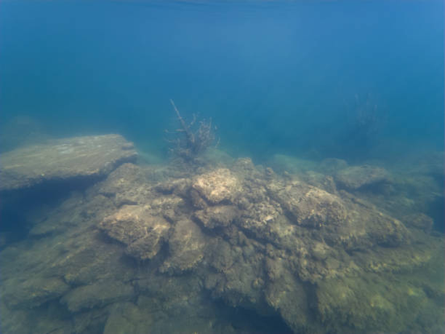
DEEP OCEANS
In the deepest parts of the ocean, pressure can be over 1,000 times what we feel at the surface.
The temperatures are near freezing, usually around 39°F.
Even in the deepest parts of the ocean, the water is still salty.
Fun Fact: Since it’s so dark, many deep sea animals are capable of producing their own light, meaning they can glow in the dark!
DEEP OCEAN
CONDITIONS

Slide 5

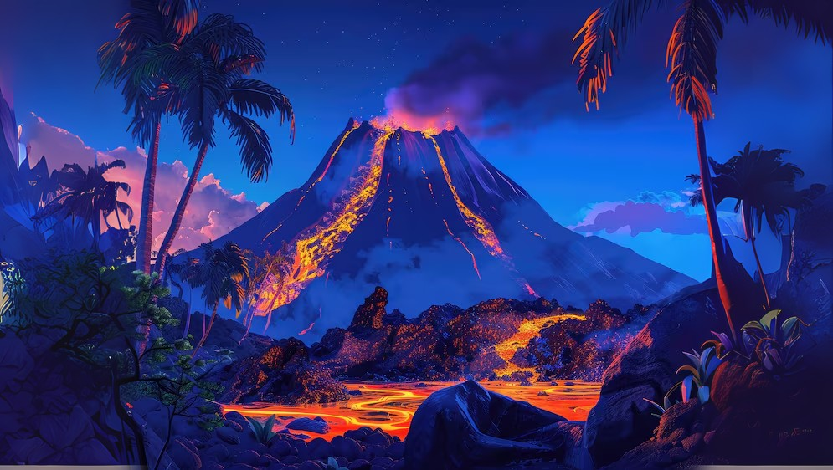
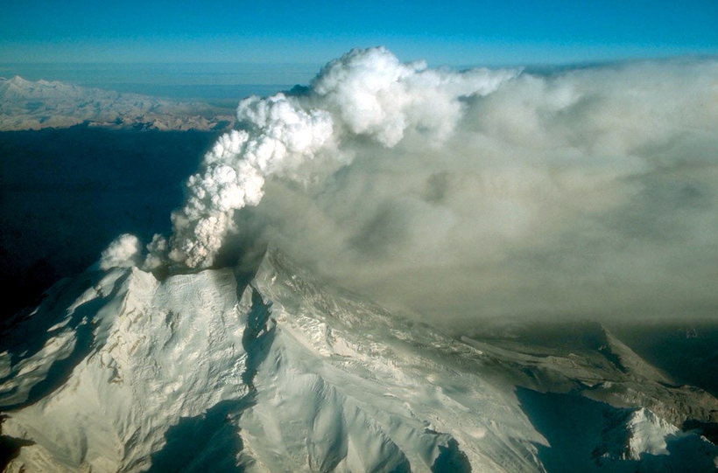

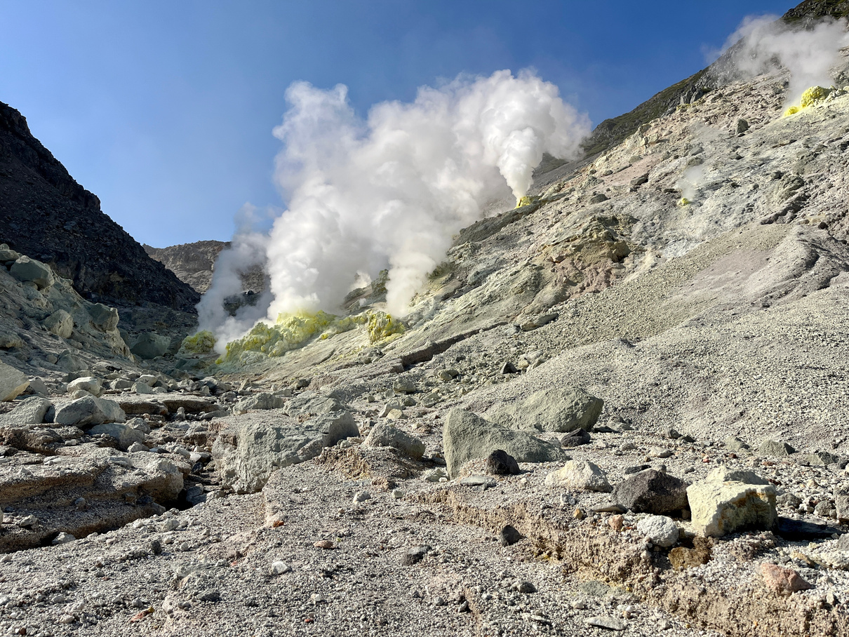
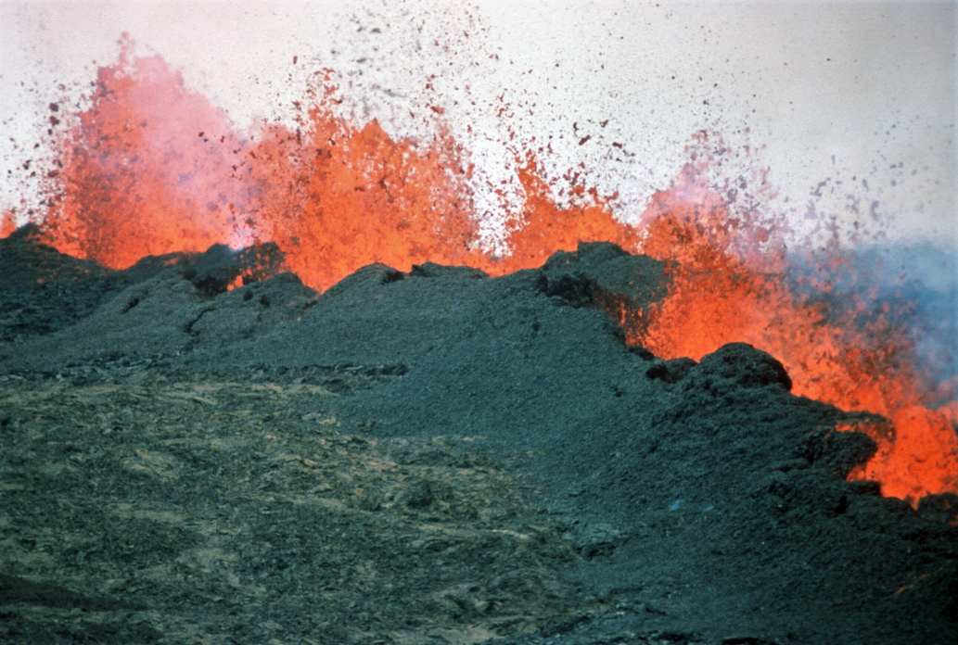



Volcanic Vents
Volcanic vents are openings in Earth’s surface that release heat, gases, or lava.
Magma and gas building up under the surface cause pressure in the vents.
Io, one of Jupiter’s moons, has hundreds of volcanic vents.
Fun Fact: Lava from these vents can build mountains and islands!
VOLCANIC VENT
CONDITIONS

Slide 6

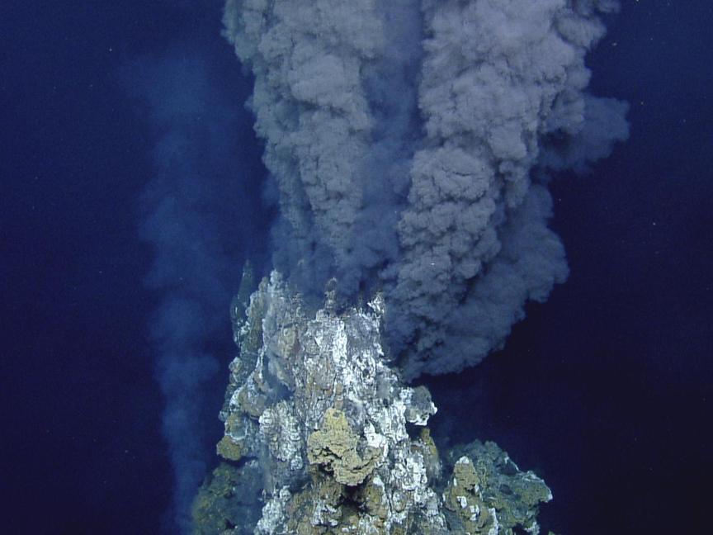
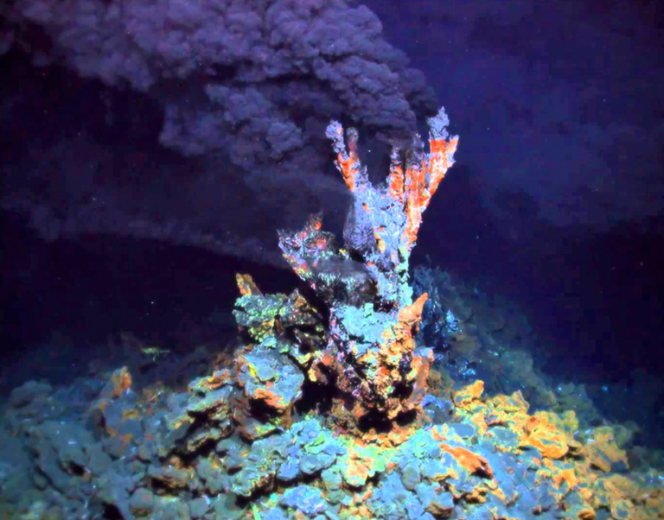




HOT SEA VENTS
This kind of volcanic vent is found at the bottom of the ocean.
The water is heated by magma and has a lot of minerals that make it look like smoke.
The pressure in these vents is extremely high, due to them being miles under the ocean.
Fun Fact: Some scientists believe that life on Earth started in hot sea vents!
HOT SEA VENT
CONDITIONS

Slide 7
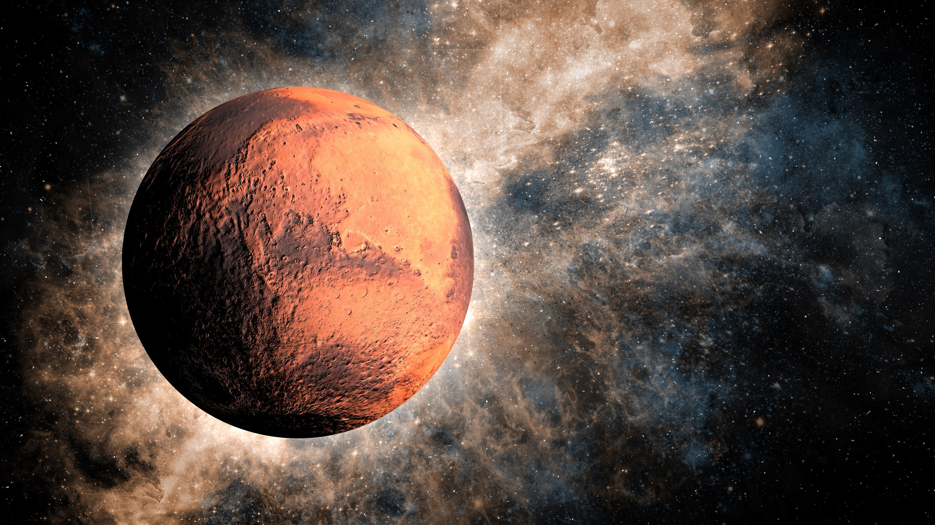
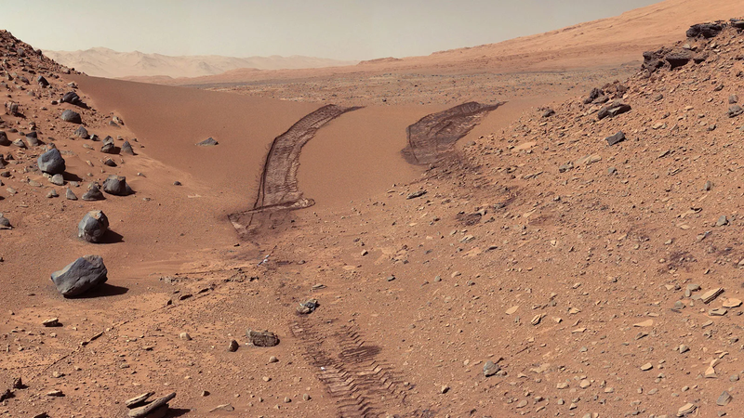
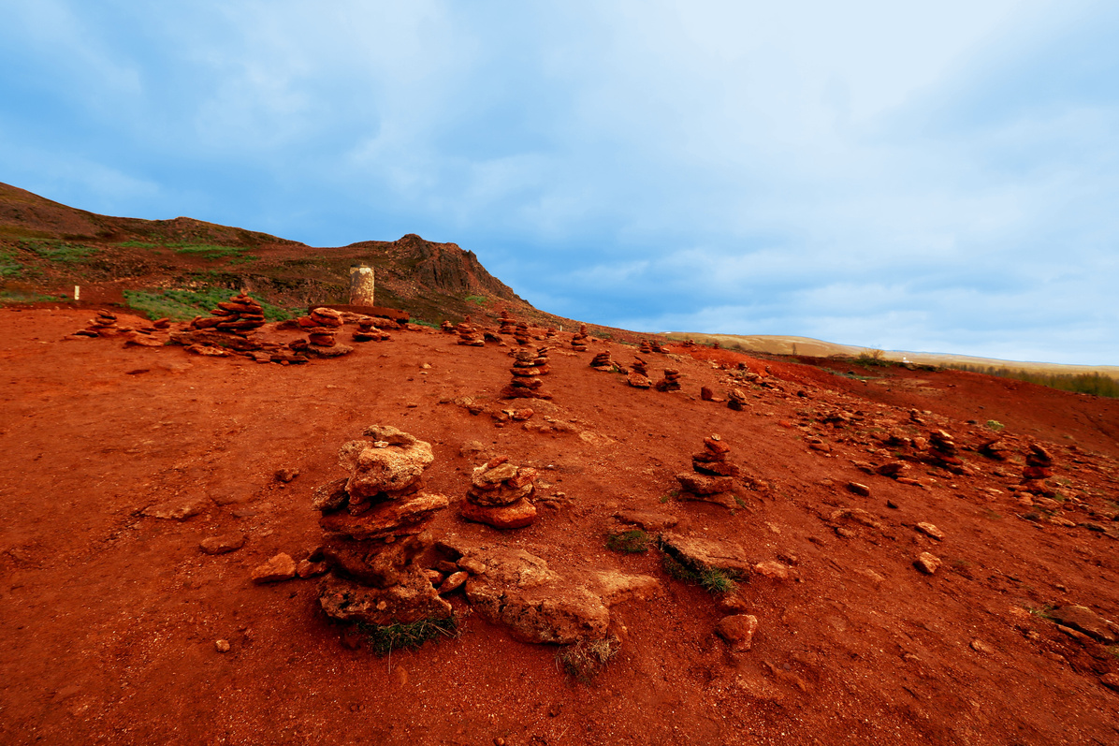

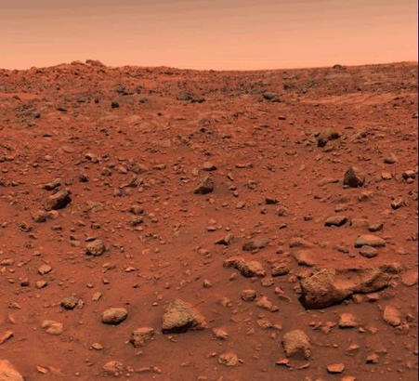
MARTIAN SURFACE
MARTIAN
SURFACE
Mars is very cold, with the average temperature being -85 °F.
Evidence suggests that salty, liquid water exists on Mars
Because it has no thick atmosphere, high radiation hits the surface.
Fun Fact: Scientists believe that ice beneath the surface of Mars could have microbial life!
CONDITIONS

Slide 8




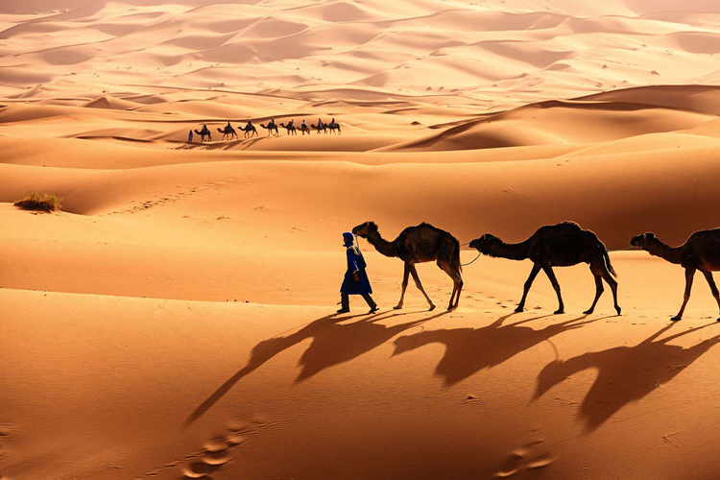
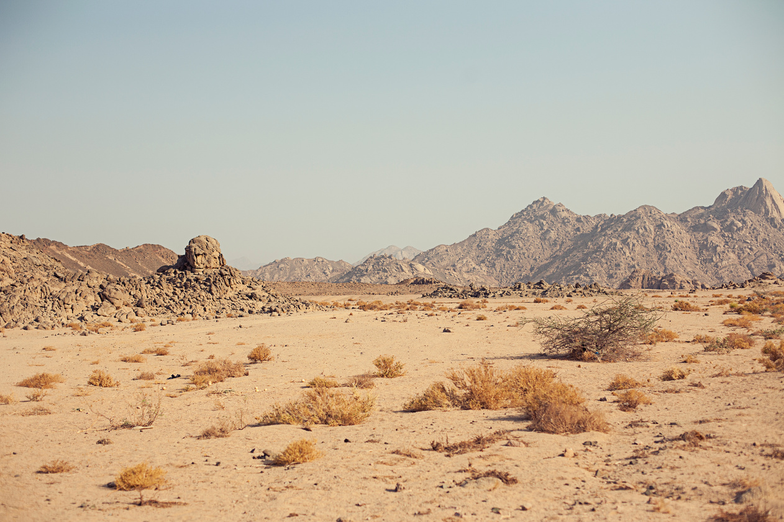
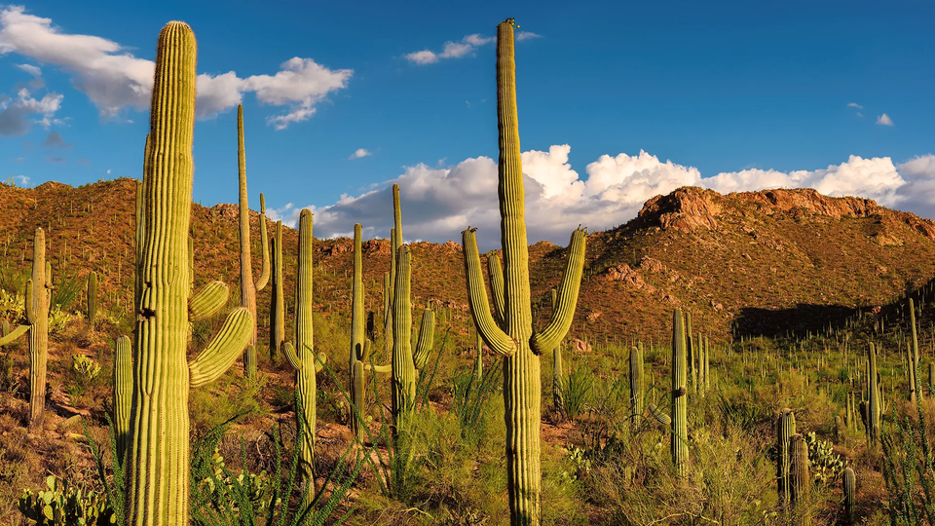


Deserts
Deserts are the driest environments to exist. They only get around 10% of the rain that rainforests get.
Many deserts are known for having very high temperatures, and some on Earth have gotten as hot as over 150 °F.
Fun Fact: Some desert plants, like cacti, store water inside of them in order to stay alive!
DESERT
CONDITIONS

Slide 9
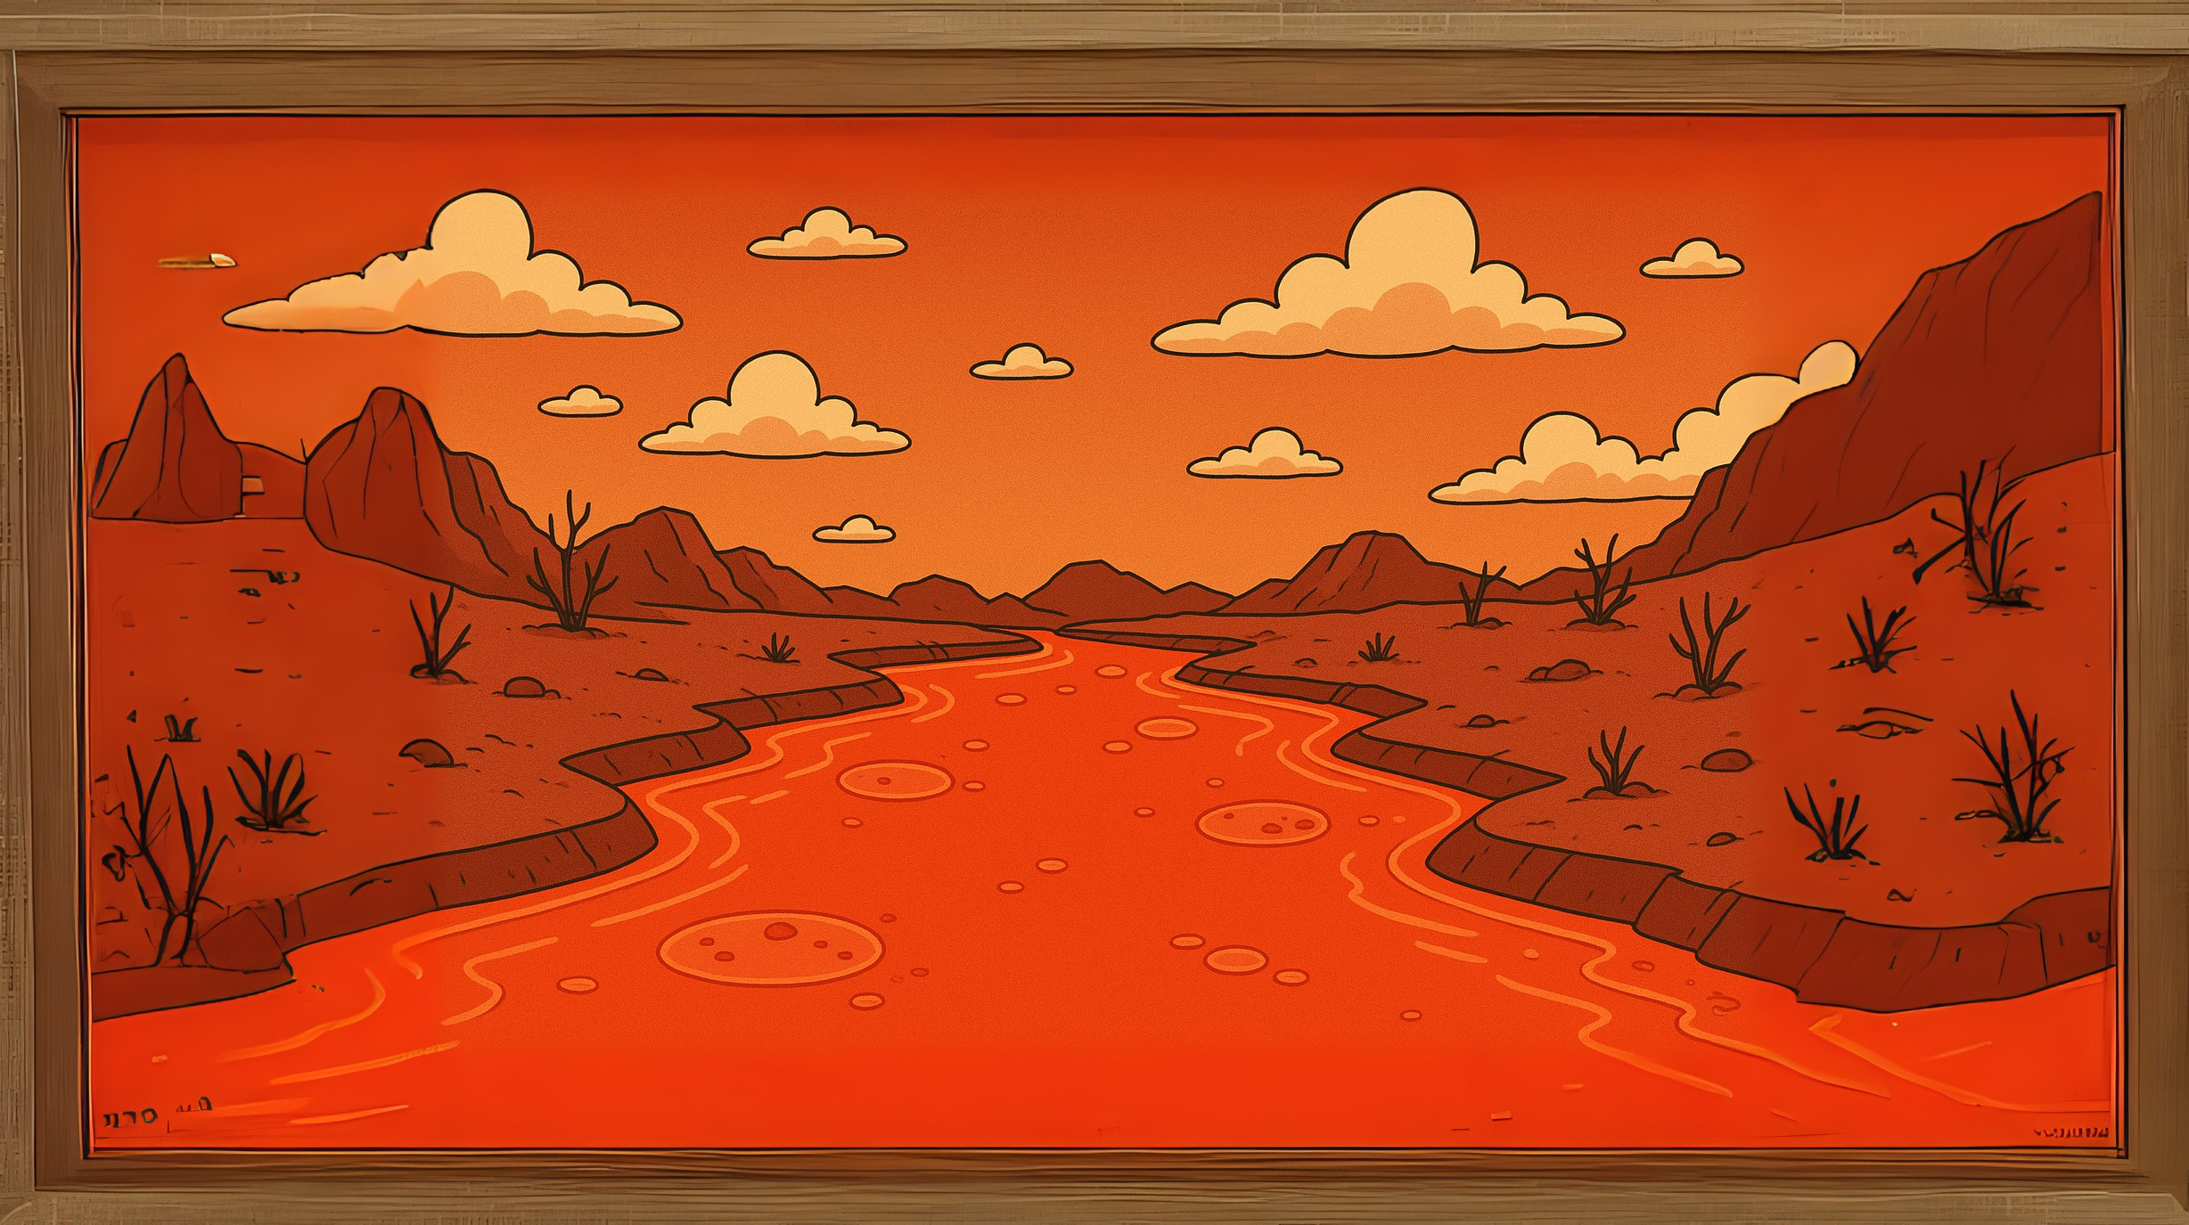

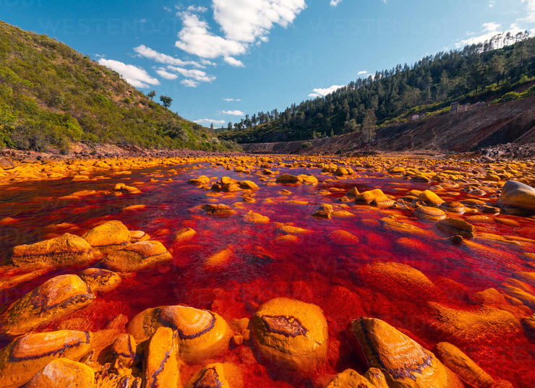
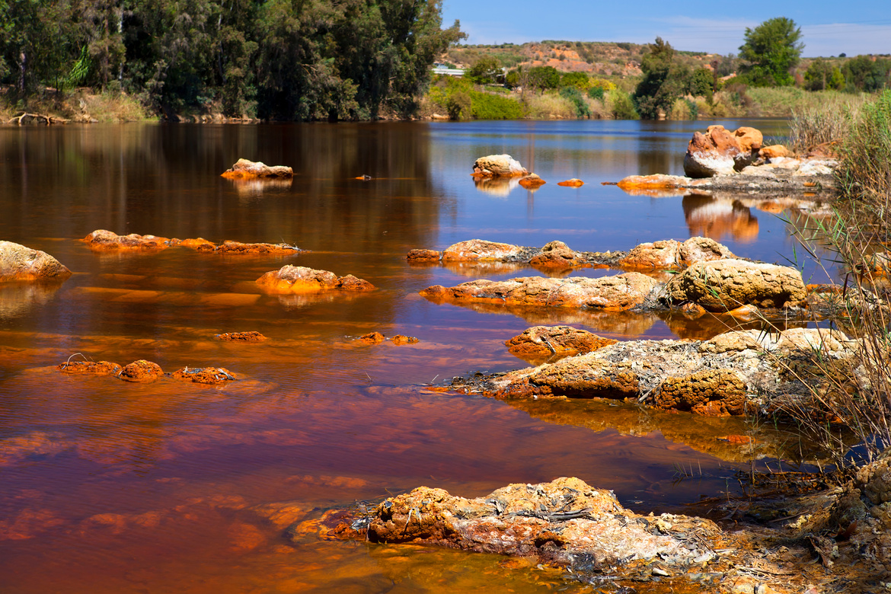
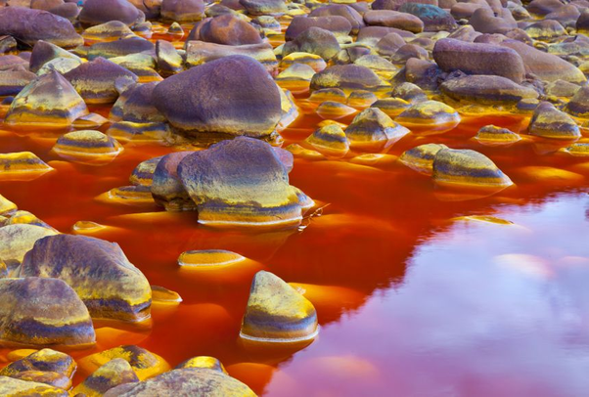
Acid Rivers
Acid rivers have water that is more acidic than normal water because volcanoes and mines have released chemicals into the water.
Even though these rivers are at a temperature and salt level that many organisms like, the acid in the water makes it very hard to survive in.
Fun Fact: Scientists study the Rio Tinto acid river in Spain because it’s similar to Mars!
ACID RIVER
CONDITIONS

Slide 10



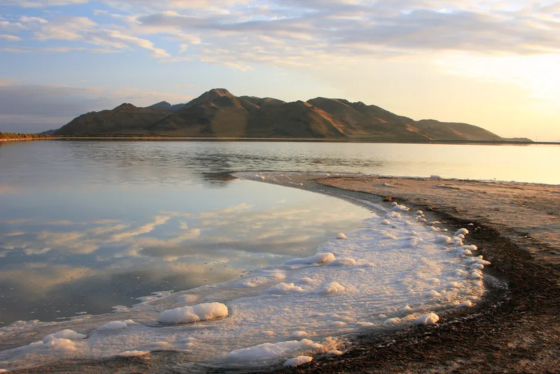
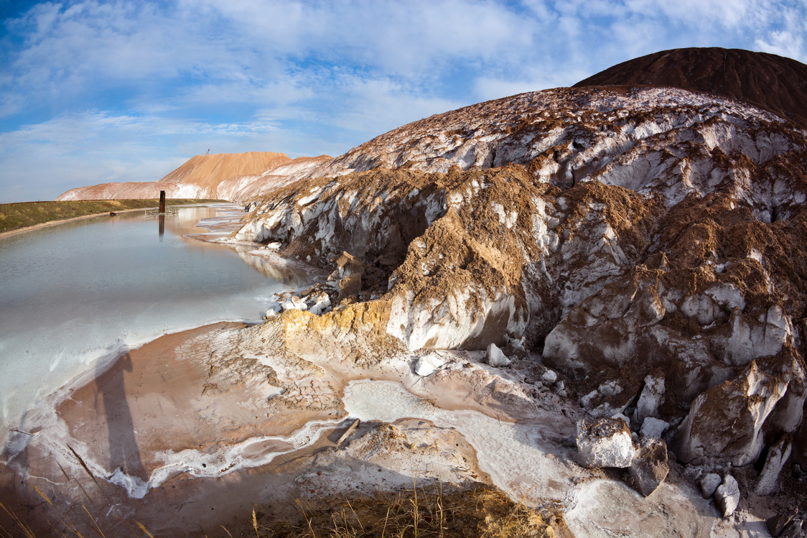
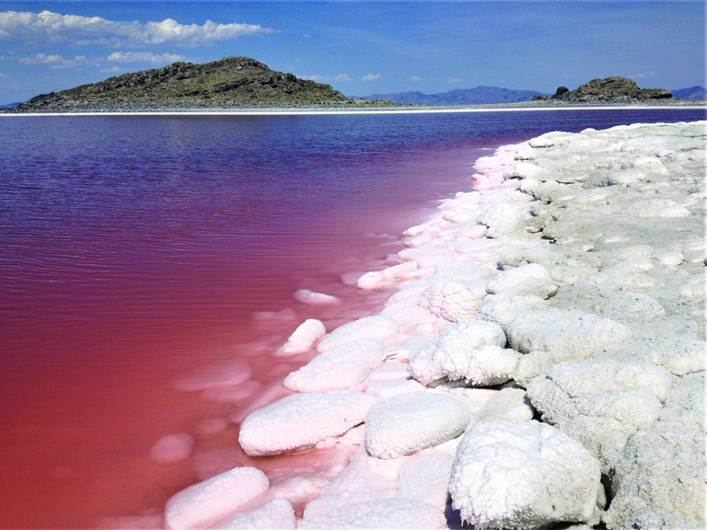




Saline Lakes
Saline lakes are lakes that contain a lot of salt in them, often even more than the ocean.
They form when water evaporates and leaves the salt behind.
Sometimes the water is so salty that people can float easily near the surface.
Fun Fact: Bacteria in the water can sometimes make the lakes pink in color!
SALINE LAKE
CONDITIONS

Slide 11



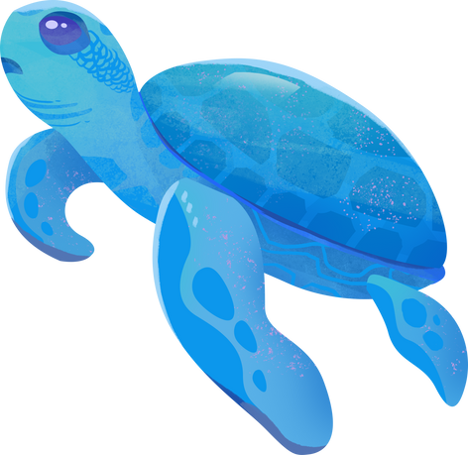

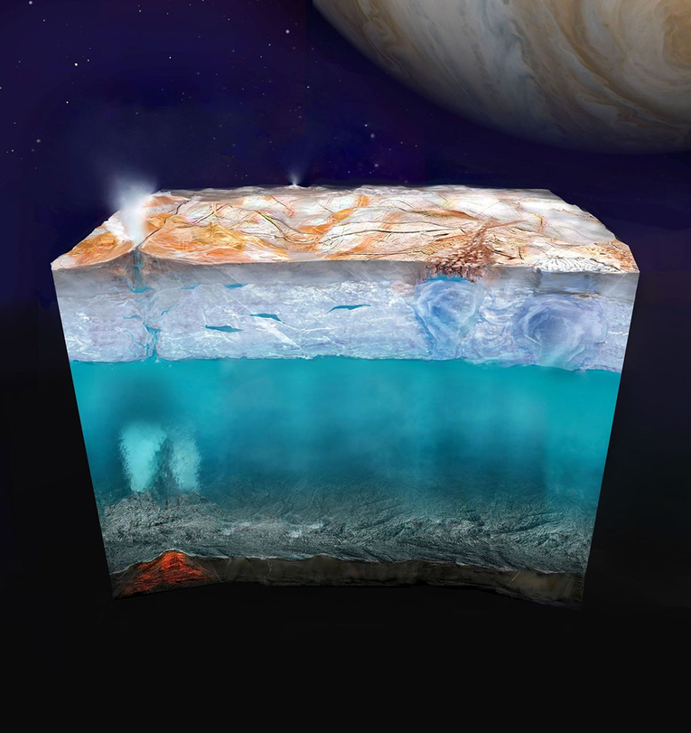
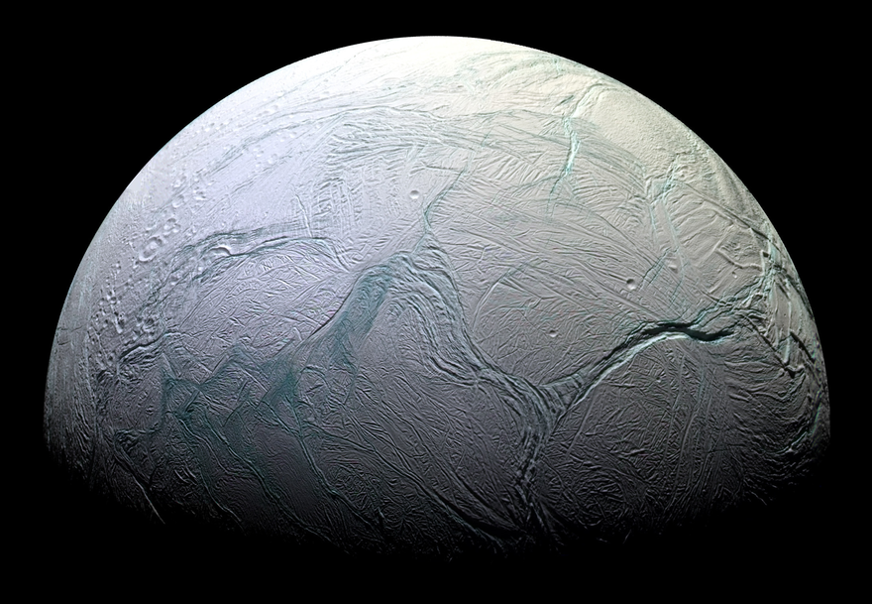
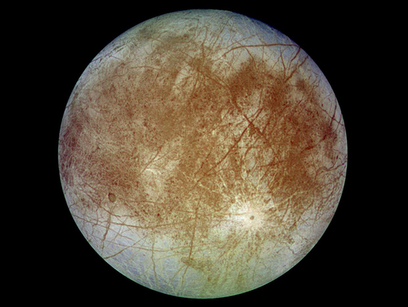
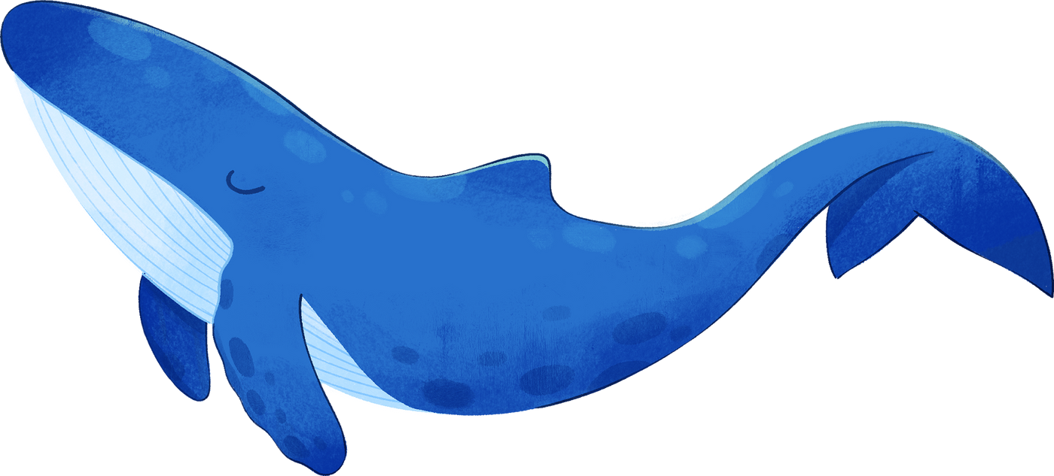
OCEAN WORLDS
Some planets and moons are called ocean worlds because they have a lot of liquid water.
Scientists think these deep oceans would be great places to look for life.
Same examples of ocean worlds are Europa (moon of Jupiter) and Enceladus (moon of Saturn). They are far from the Sun so the water is very cold!
Fun Fact: Earth’s oceans hold over 97% of all the water on our planet!
OCEAN WORLD
CONDITIONS

Slide 12
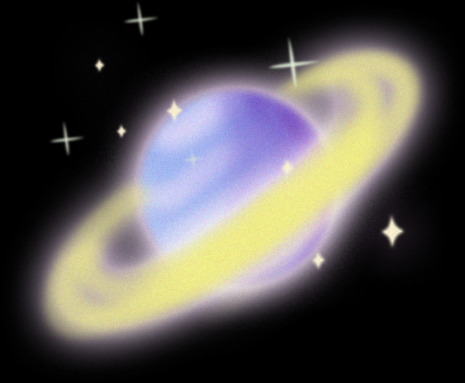
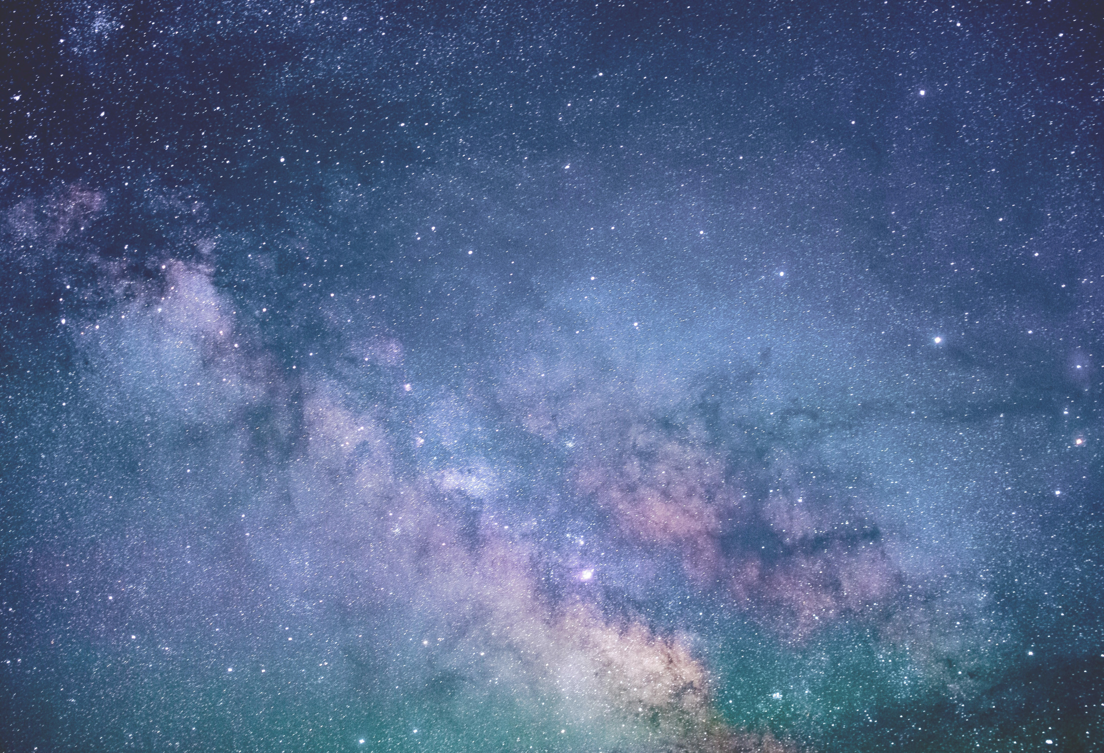

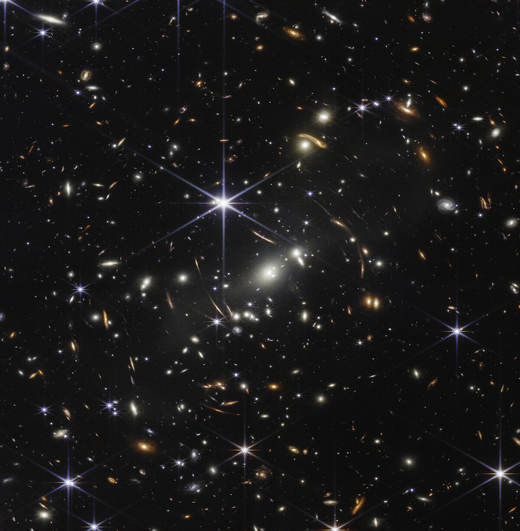
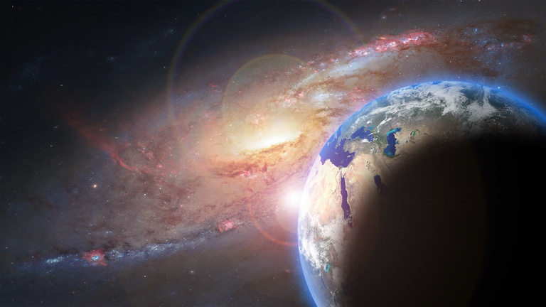
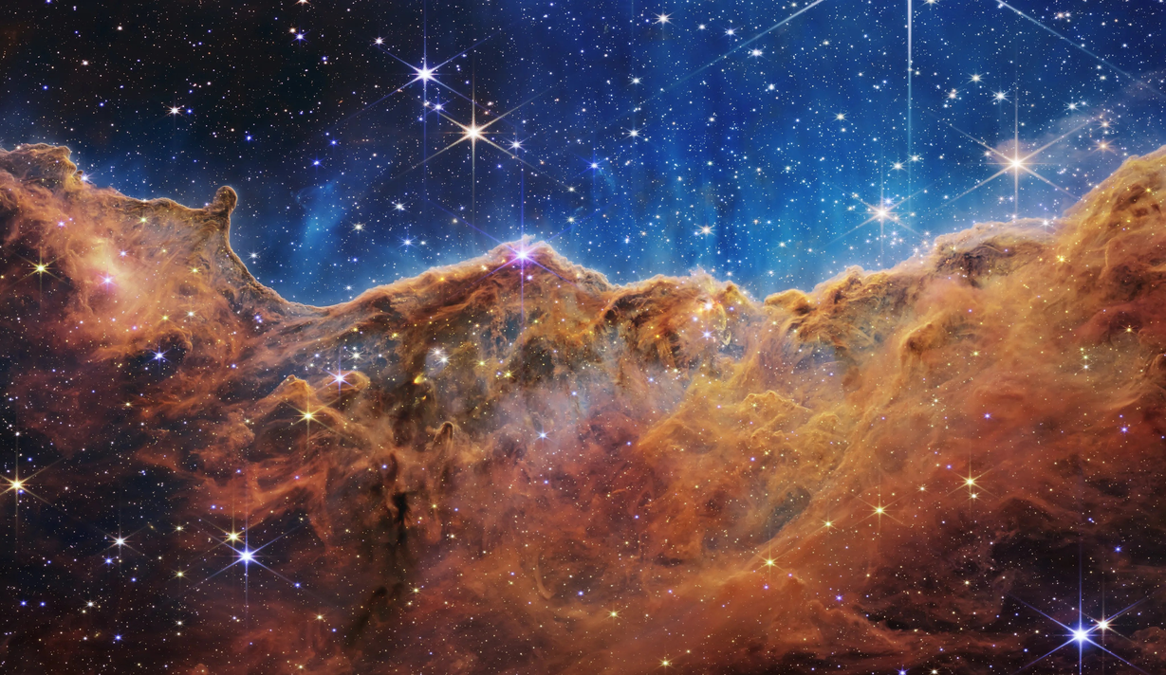
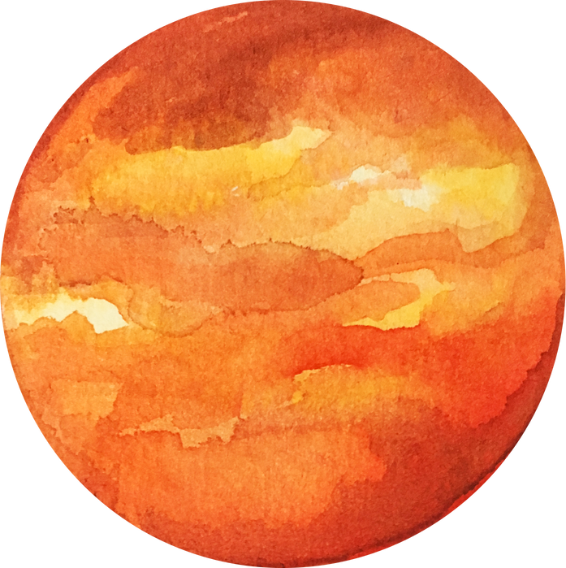
OUTER SPACE
Outer space is everything outside of Earth’s atmosphere. Because there is no atmosphere, there is also no protection from the Sun’s radiation.
It has no air, wind, or sound, and the extremely low pressure makes it nearly a perfect vacuum.
Outer space is very cold, at around -455 °F
Fun Fact: Since there’s no air to scatter sunlight, the sky is always black!
OUTER SPACE
CONDITIONS

