Slide 1


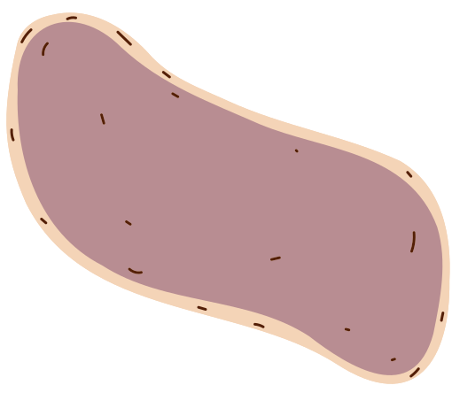
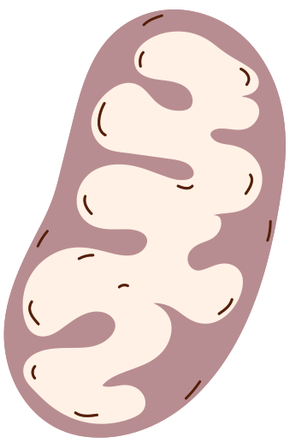






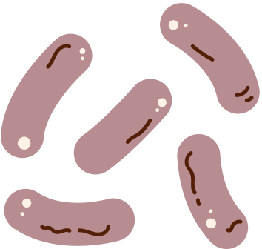
ALL ABOUT TARDIGRADES
ARIZONA ASTROBIOLOGY CENTER
© 2025 Arizona Board of Regents on behalf of the University of Arizona. Licensed under CC BY 4.0

Slide 2
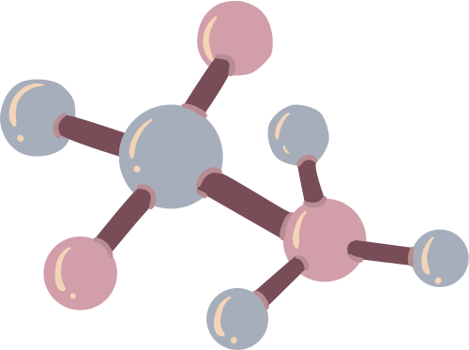
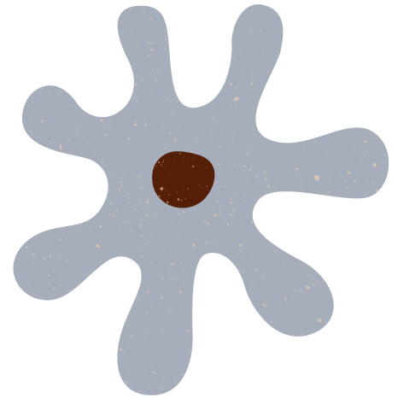
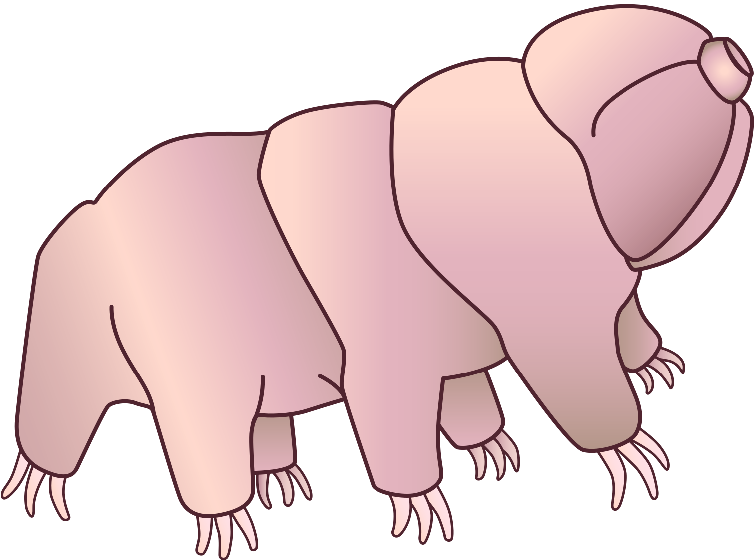
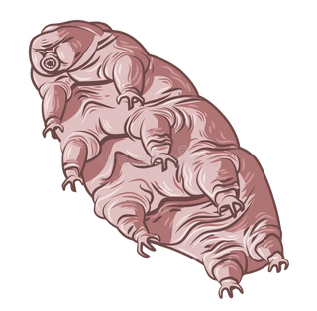


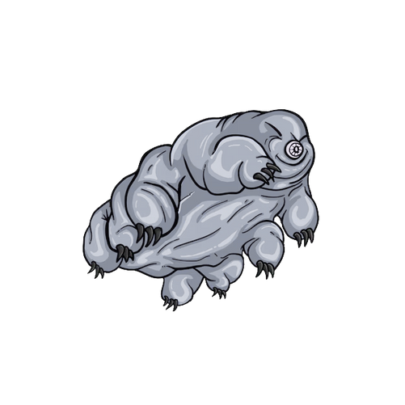
FIRST FACTS
1
Tardigrades are about 1 millimeter long.
2
They’re nicknamed “water bears”.
3
Scientists have identified over 1100 species.

Slide 3








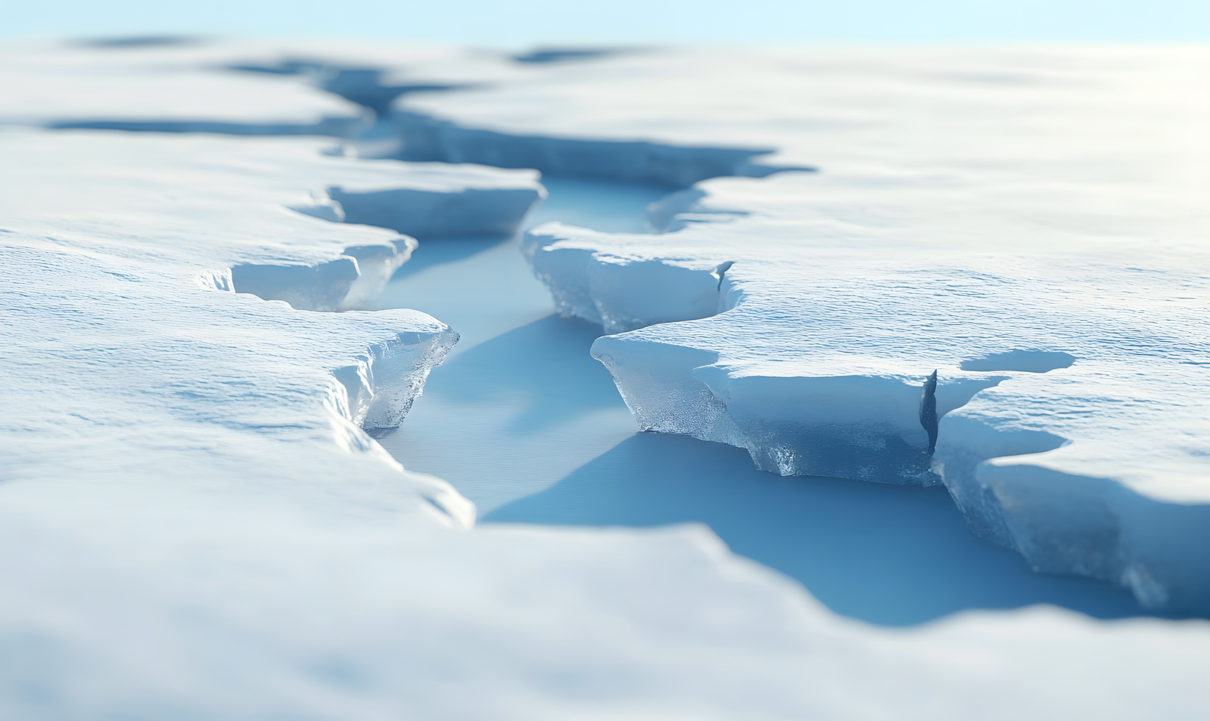
WHERE THEY LIVE
Tardigrades are found all over the world: in oceans, freshwater, deserts, and polar ice.
They live on every continent, including Antarctica.
You might find them in moss and lichen in your backyard, with a microscope and some patience.
Their ability to survive harsh conditions makes them one of the most widespread animals on Earth.

Slide 4
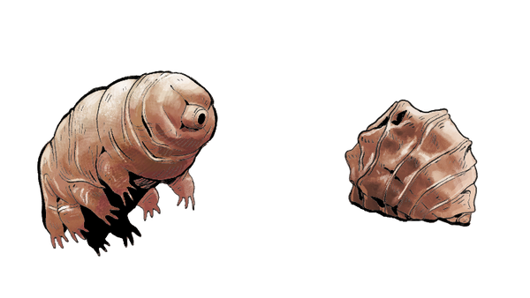


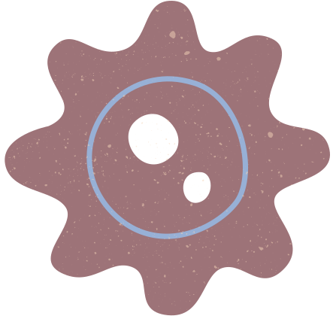
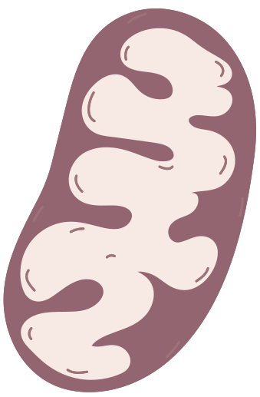

SURVIVAL WITHOUT WATER
All living things need water to survive.
Tardigrades can survive for decades without water!
When water is scarce, they enter a "tun state" by curling into a dry, inactive ball.
In this state, their cells are protected by special molecules that replace water and prevent damage.
Once the water comes back, tardigrades can “come back to life” and move around again!

Slide 5
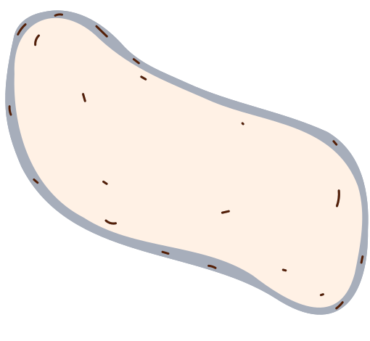

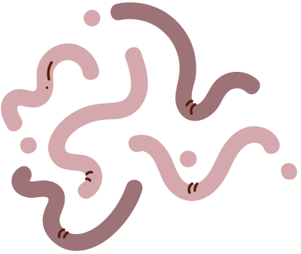



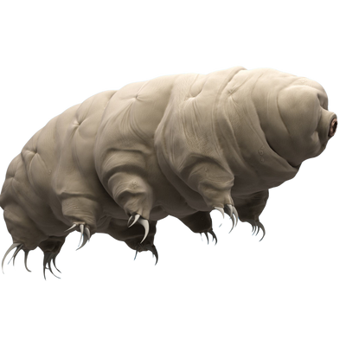

TOUGH IN EXTREME ENVIRONMENTS
Tardigrades can survive extreme temperatures, from below freezing to above the boiling point of water.
They can handle high levels of radiation that would be deadly to humans.
They’ve survived the vacuum an radiation of outer space during experiments, and they even had babies in space!
This is NOT a real image. Tardigrades are microscopic and have been added to the image.
Image Credit: Gale Blog

Slide 6

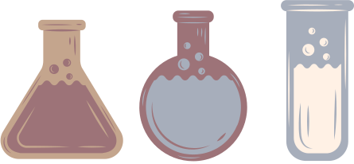
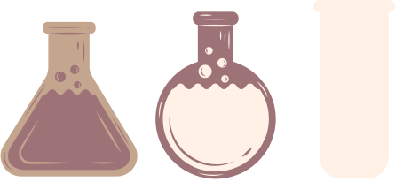
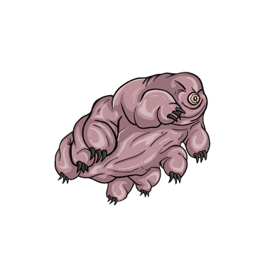
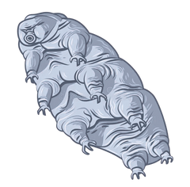




WHY SCIENTISTS STUDY TARDIGRADES
Scientists hope to learn how tardigrades protect their cells in extreme conditions.
This research could help improve how we store vaccines or food without refrigeration.
It might also help us grow crops that survive drought and other extreme weather.
Astrobiologists are also very interested in tardigrades!

Slide 7


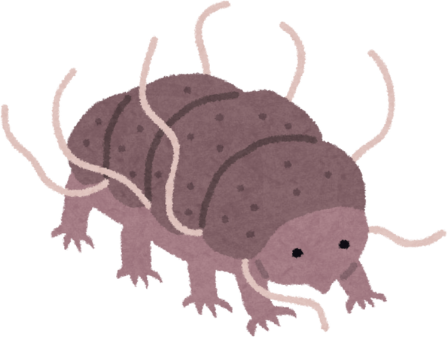



WHY ASTROBIOLOGISTS STUDY TARDIGRADES
A lot of places beyond Earth are extreme environments where only extreme life (like Tardigrades!) could survive.
Mars (cold, dry, high radiation)
Jupiter’s moon Europa (extremely cold icy ocean)
Astrobiology is the study of life beyond Earth.
Some astrobiologists think that life on Earth originally came from space (Panspermia). Tardigrades can survive in space for short periods!
Space travel is tough on cells (maybe tardigrades can help!)

Slide 8


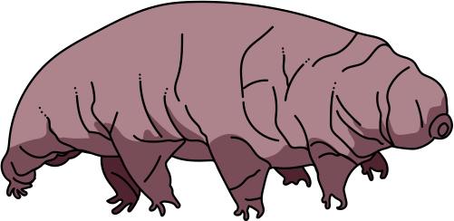


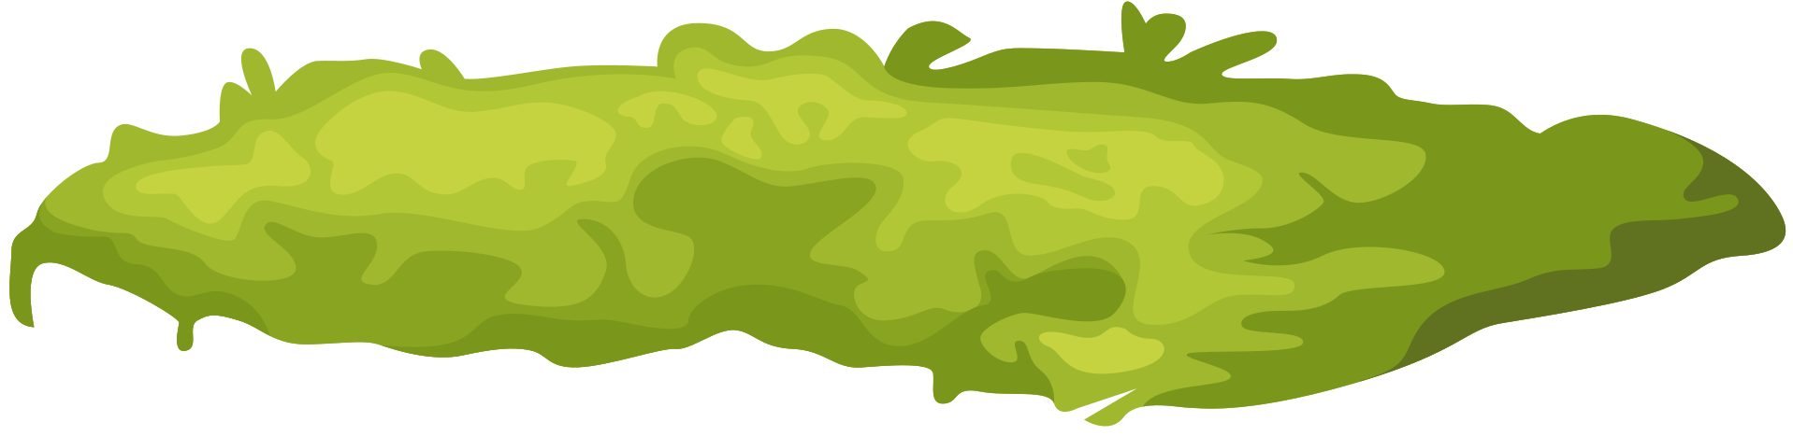
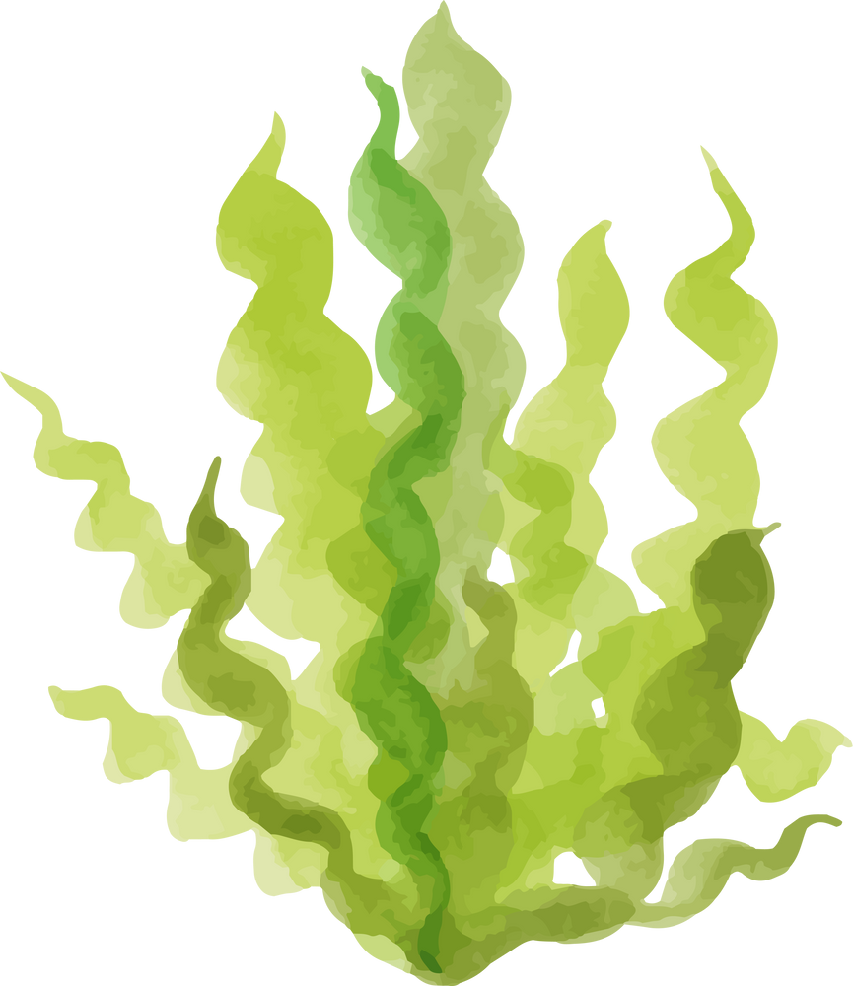
MICROSCOPE OBSERVATION OF TARDIGRADES
1
Use a pipette to place a small drop of water from the tardigrade sample onto the slide. Look for algae clumps.
2
Carefully set the slide on the microscope stage.
3
Start with the lowest magnification to help find them more easily.
4
Look for movement around the algae.
5
Be patient: tardigrades may need a minute to start moving again after being disturbed.
6
Once you’ve found some tardigrades, you can move the magnification to a higher setting.

Slide 9
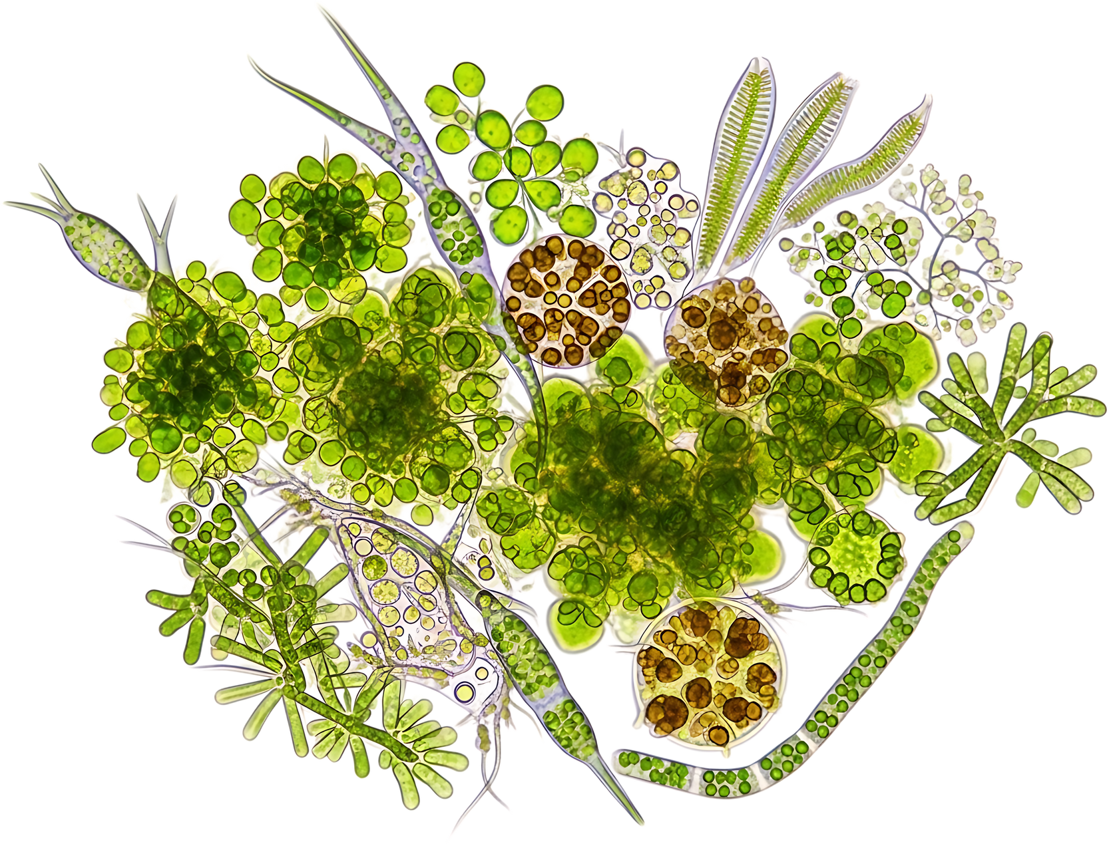
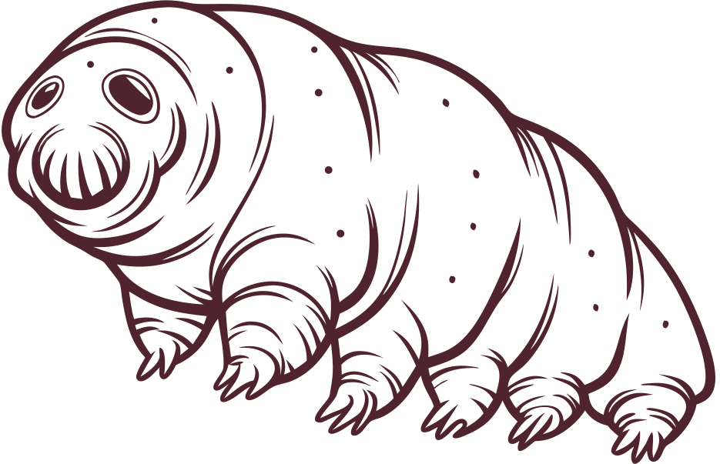


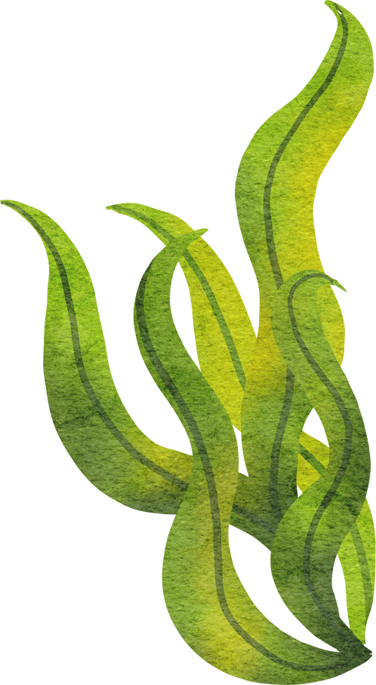




SLIDE CLEAN-UP
7
When finished, gently return the tardigrades and water back to their container. Rinse the slide by adding a few drops of water, tilting it back into the container, and using the pipette to collect the rest. Repeat this until the slide is clean with no water or algae visible.
8
DO NOT wipe off or throw away the tardigrades: this will kill them. They are living creatures and should be handled with care.

