Slide 1

Astrobiology, OSIRIS-REx and
The Search for Life

Slide 2
Lesson Objectives
Understand how Astrobiology can help humans understand the origins of life on Earth.
Learn how astrobiologists study life beyond Earth.
Use data to select where and why we might explore astrobiology questions in space and plan missions.
Learn about the role of the NASA and University of Arizona’s OSIRIS-Rex asteroid sample return mission and its possible contributions to Astrobiology research.

Slide 3
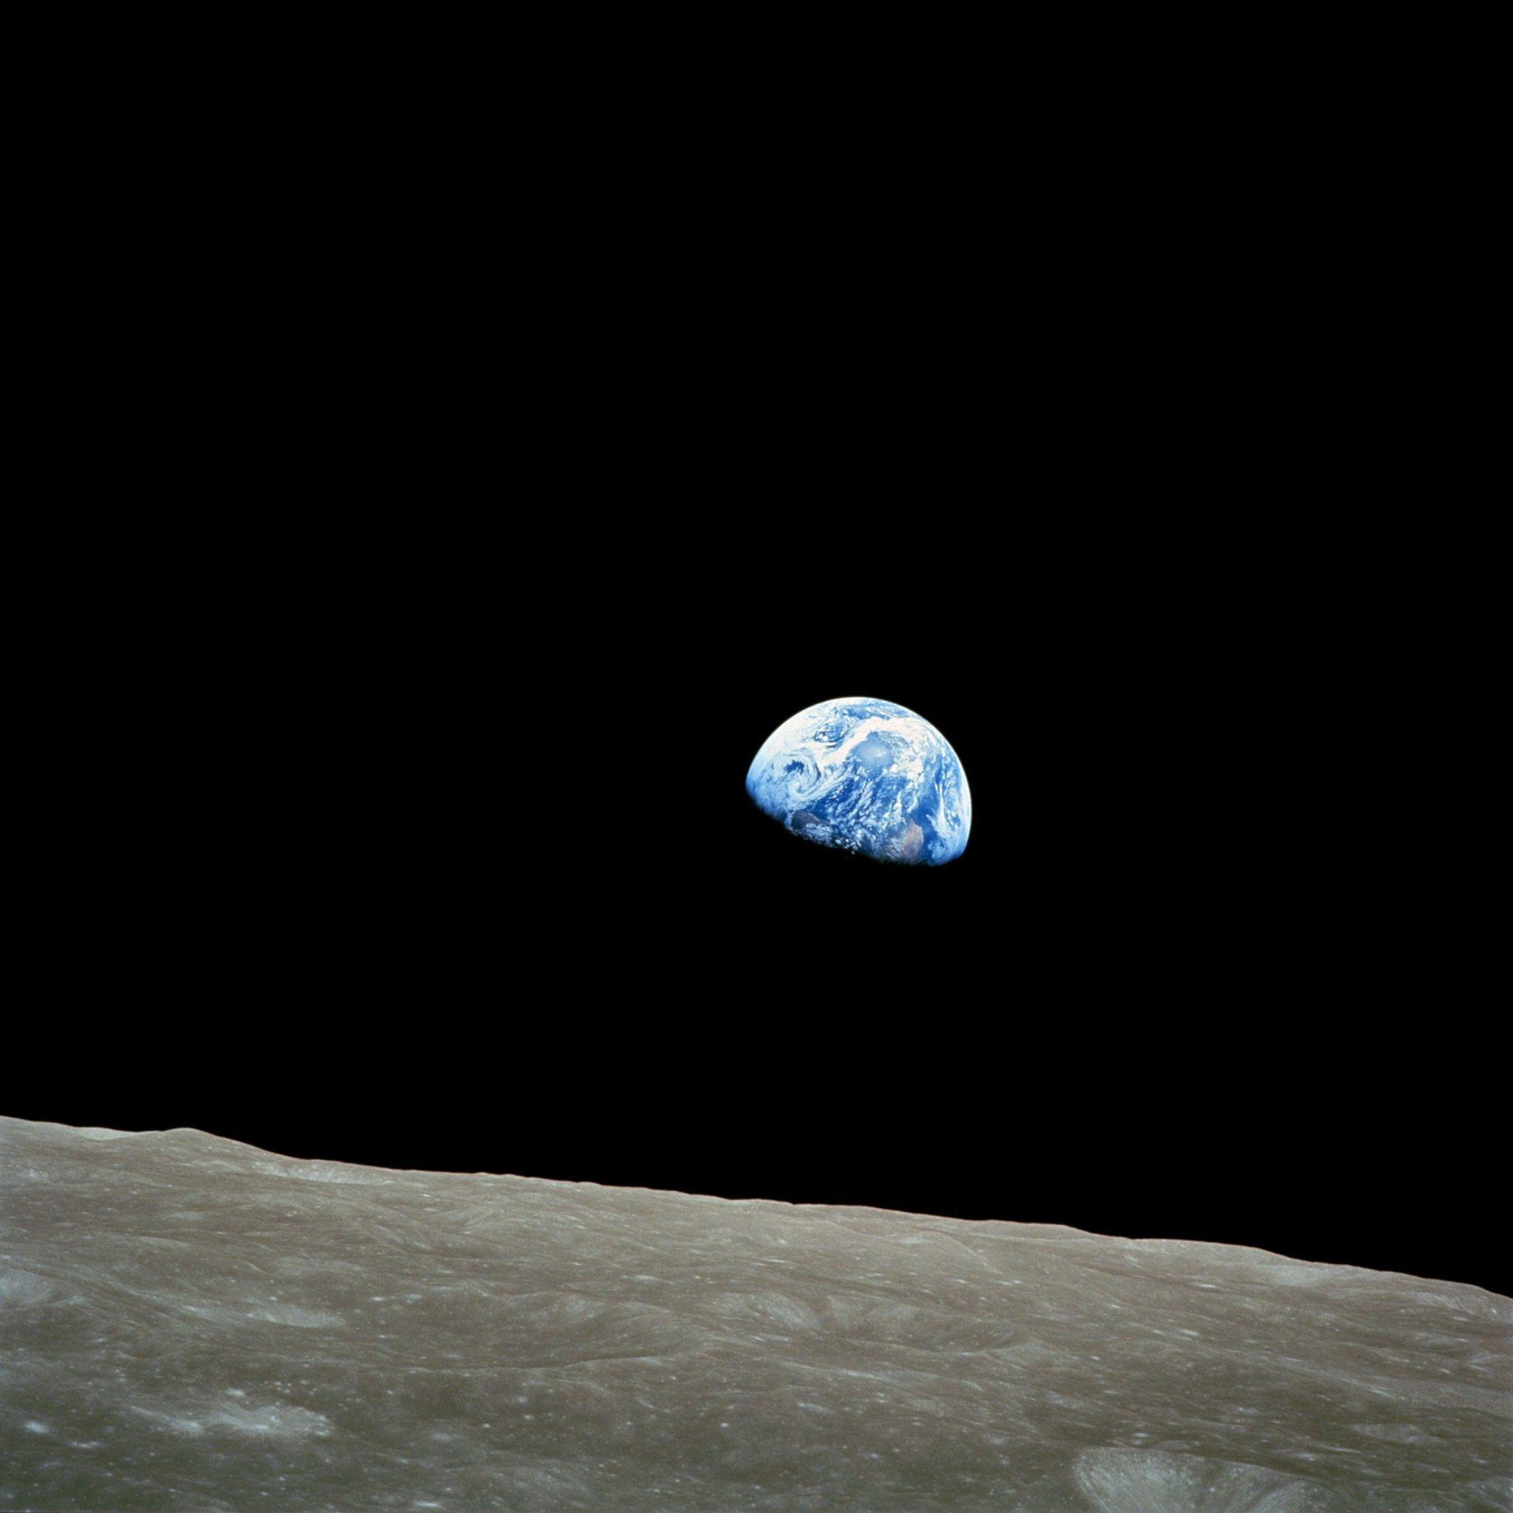
Lesson Outline
1) Looking at Earth: What things does life need on Earth?
2) Looking to Space: What types of evidence or clues support Astrobiologists’ search to understand life’s origins and existence?
3) Determine where we should be searching for the clues and evidence about life in the Universe
4) Compare student findings with actual NASA missions
5) Learn about the OSIRIS-REx Sample Return Mission

Slide 4
Important Vocabulary
Astrobiology: (noun) the branch of biology concerned with the origins, nature, and evolution of life on earth and in space.
Evolution: (noun) the process by which different kinds of living organisms are thought to have developed and diversified from earlier forms during the history of the earth.
Asteroid: a small rocky object that orbits the Sun, mostly found in the asteroid belt between Mars and Jupiter. They vary in size, from tiny particles to larger bodies, and are remnants from the early days of our solar system.
Meteorite: a piece of rock or metal that falls from space and lands on Earth's surface. It comes from asteroids or other celestial bodies and can vary in size from tiny fragments to larger masses.

Slide 5
Important Vocabulary-continued
Biosphere: refers to all the places in the Universe where life exists, including Earth and any other planets, moons, or celestial bodies that may support living organisms.
Organic compounds (noun): type of molecule that contains carbon atoms bonded together, often combined with other elements like hydrogen, oxygen, nitrogen, or sulfur. Organic compounds are the building blocks of living things and play essential roles in many chemical processes.
Carbonaceous chondrites: special rocks from space that contain carbon, which is a key ingredient for life. They're like time capsules from the early solar system, helping scientists learn about how planets formed and how life might have started.
OSIRIS-REx mission: a NASA spacecraft mission led by the University of Arizona designed to study and collect a sample from an asteroid named Bennu. One of its main goals is to learn more about the origins of our solar system and the potential for life on other celestial bodies.

Slide 6
Earth as a model
What can Earth tell us about the conditions needed for life beyond earth?

Slide 7

Evolution & Natural Selection Review
The environment causes life to evolve over time!
Living organisms need certain environmental conditions to survive and reproduce.
Earth has an environment that has allowed life to evolve to its current state!

Slide 8
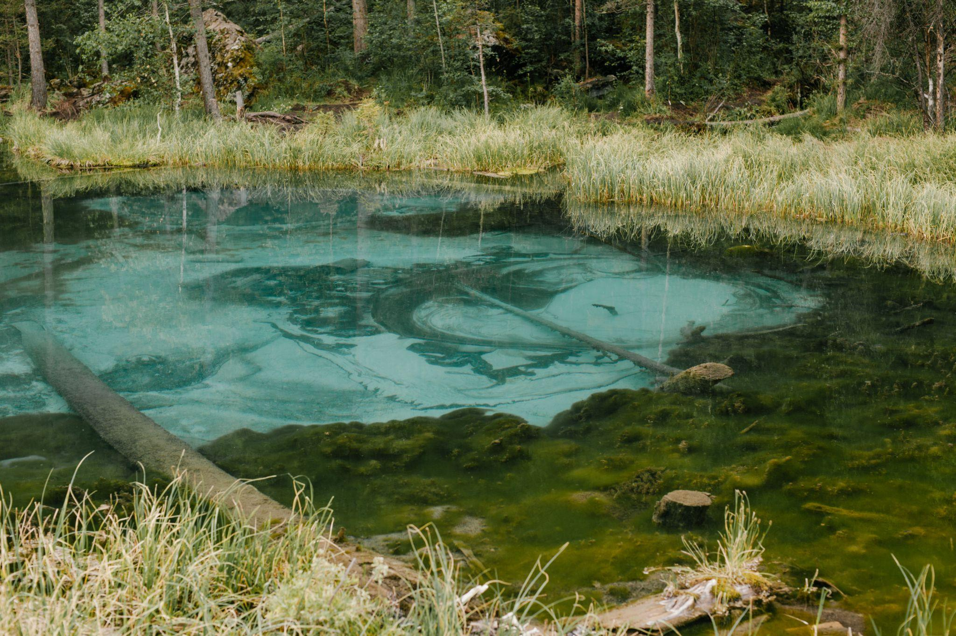
Group Activity
With your partners, brainstorm ideas about what things are needed on Earth for life to exist!
As you complete this activity, think about the following:
  What things do you already know about Earth’s environment?
  Which environmental factors might be influencing natural selection and the evolution of life?
Each group will share at least 2 ideas.

Slide 9






What Does Earth Have That Helps Life Exist?
Liquid Water!
Oxygen!
The Perfect Temps!
Right Air Pressure
Not too much gravity
Sunlight or other Energy Sources

Slide 10
Looking to Space
What Should Astrobiologists Be Looking For?

Slide 11
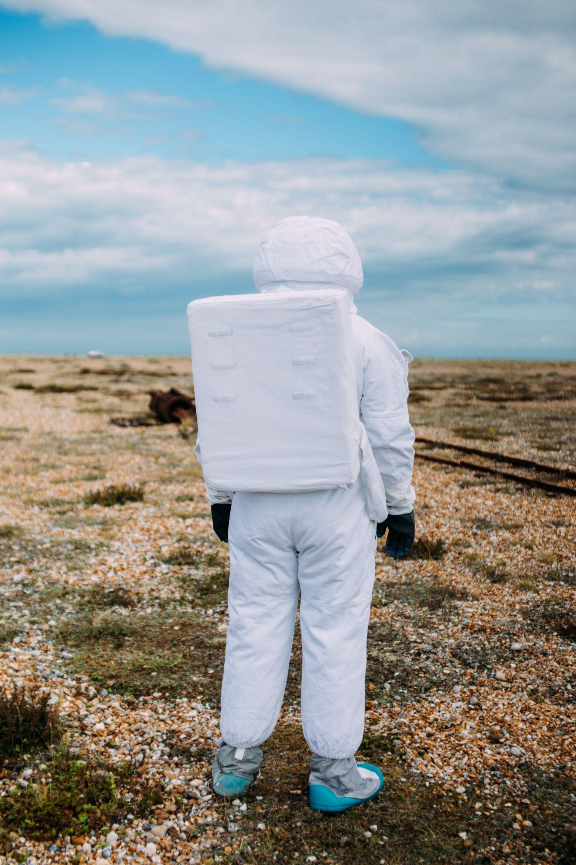
Group Activity & Share
With your group, decide what Astrobiologists should be looking for when they search for life!
Be sure to keep in mind the things that we know help life on Earth.
You should also consider the fact that missions cost money and time!
You will use the things you come up with in the next part of the lesson.

Slide 12
Be an Astrobiologist!
Use Real NASA Data and Decide Where to Look!

Slide 13
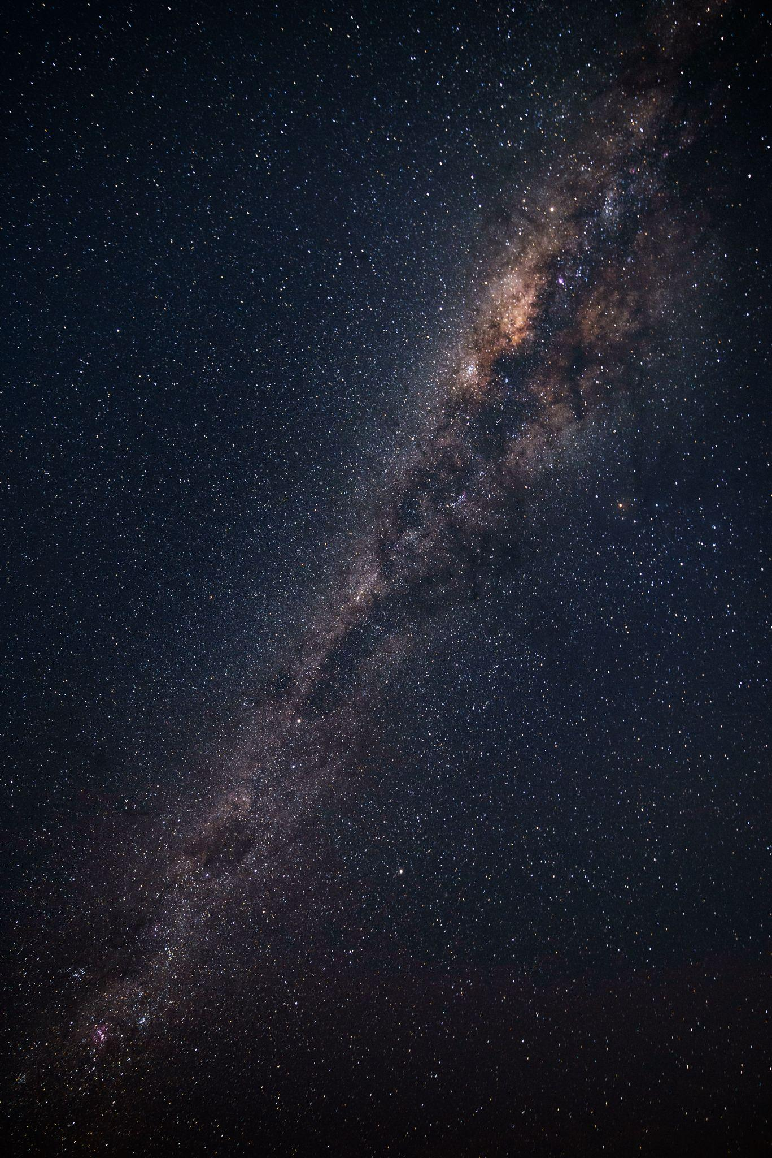
Be an Astrobiologist!
With your group, analyze real data from NASA!
Out of the possible targets in the data, your group will select which ones make the most sense to study.
Remember, missions to these targets are expensive and take a lot of work, so you must choose wisely!

Slide 14
Be an Astrobiologist! Group Activity Instructions: With your group, analyze the data provided. Out of the 11 possible targets, choose the 3 you would propose as mission targets for searching for signs of life or clues about the origins of life on earth. Use the information from the previous part of the lesson to help you think about what to look for!
Target | Object Type | Possible Water | Habitable zone? | Oxygen | Temperature* | Gravity** | Estimate Travel Time***
Mercury | Planet | Yes (frozen at the poles | No | Yes | 800 F to -230 F | 38% | 6.5 years
Venus | Planet | No | No | No | 900 F | 91% | 100-200 days
Mars | Planet | No | Yes | Yes (trace) | 70 to -225 | 38% | 6-9 months
Ceres | Dwarf Planet | Yes | No | No | -100 to -225 | 3% | 3-4 years
Europa | Moon | Yes | No | Yes | -225 | 1.3% | 5-7 years
Ganymede | Moon | Yes | No | Yes | -171 to -297 | 2.5% | 5-7 years
Enceladus | Moon | Yes | No | No | -330 | 1% | 7-12 years
Pluto | Dwarf Planet | Yes (frozen in mantle) | No | No | -387 | 16% | 9.5 years
Bennu | Asteroid | No | No | No | 240 to -100 | >1% | 2.25 years
Saturn | Planet | No | No | No | -288 | 9500% | 6-7 years
Kepler 186f | Exo-Planet | Yes (possibly on surface) | Yes | Possible | −121 °F | ? (could be similar to Earth) | ~771,000 years****

Slide 15
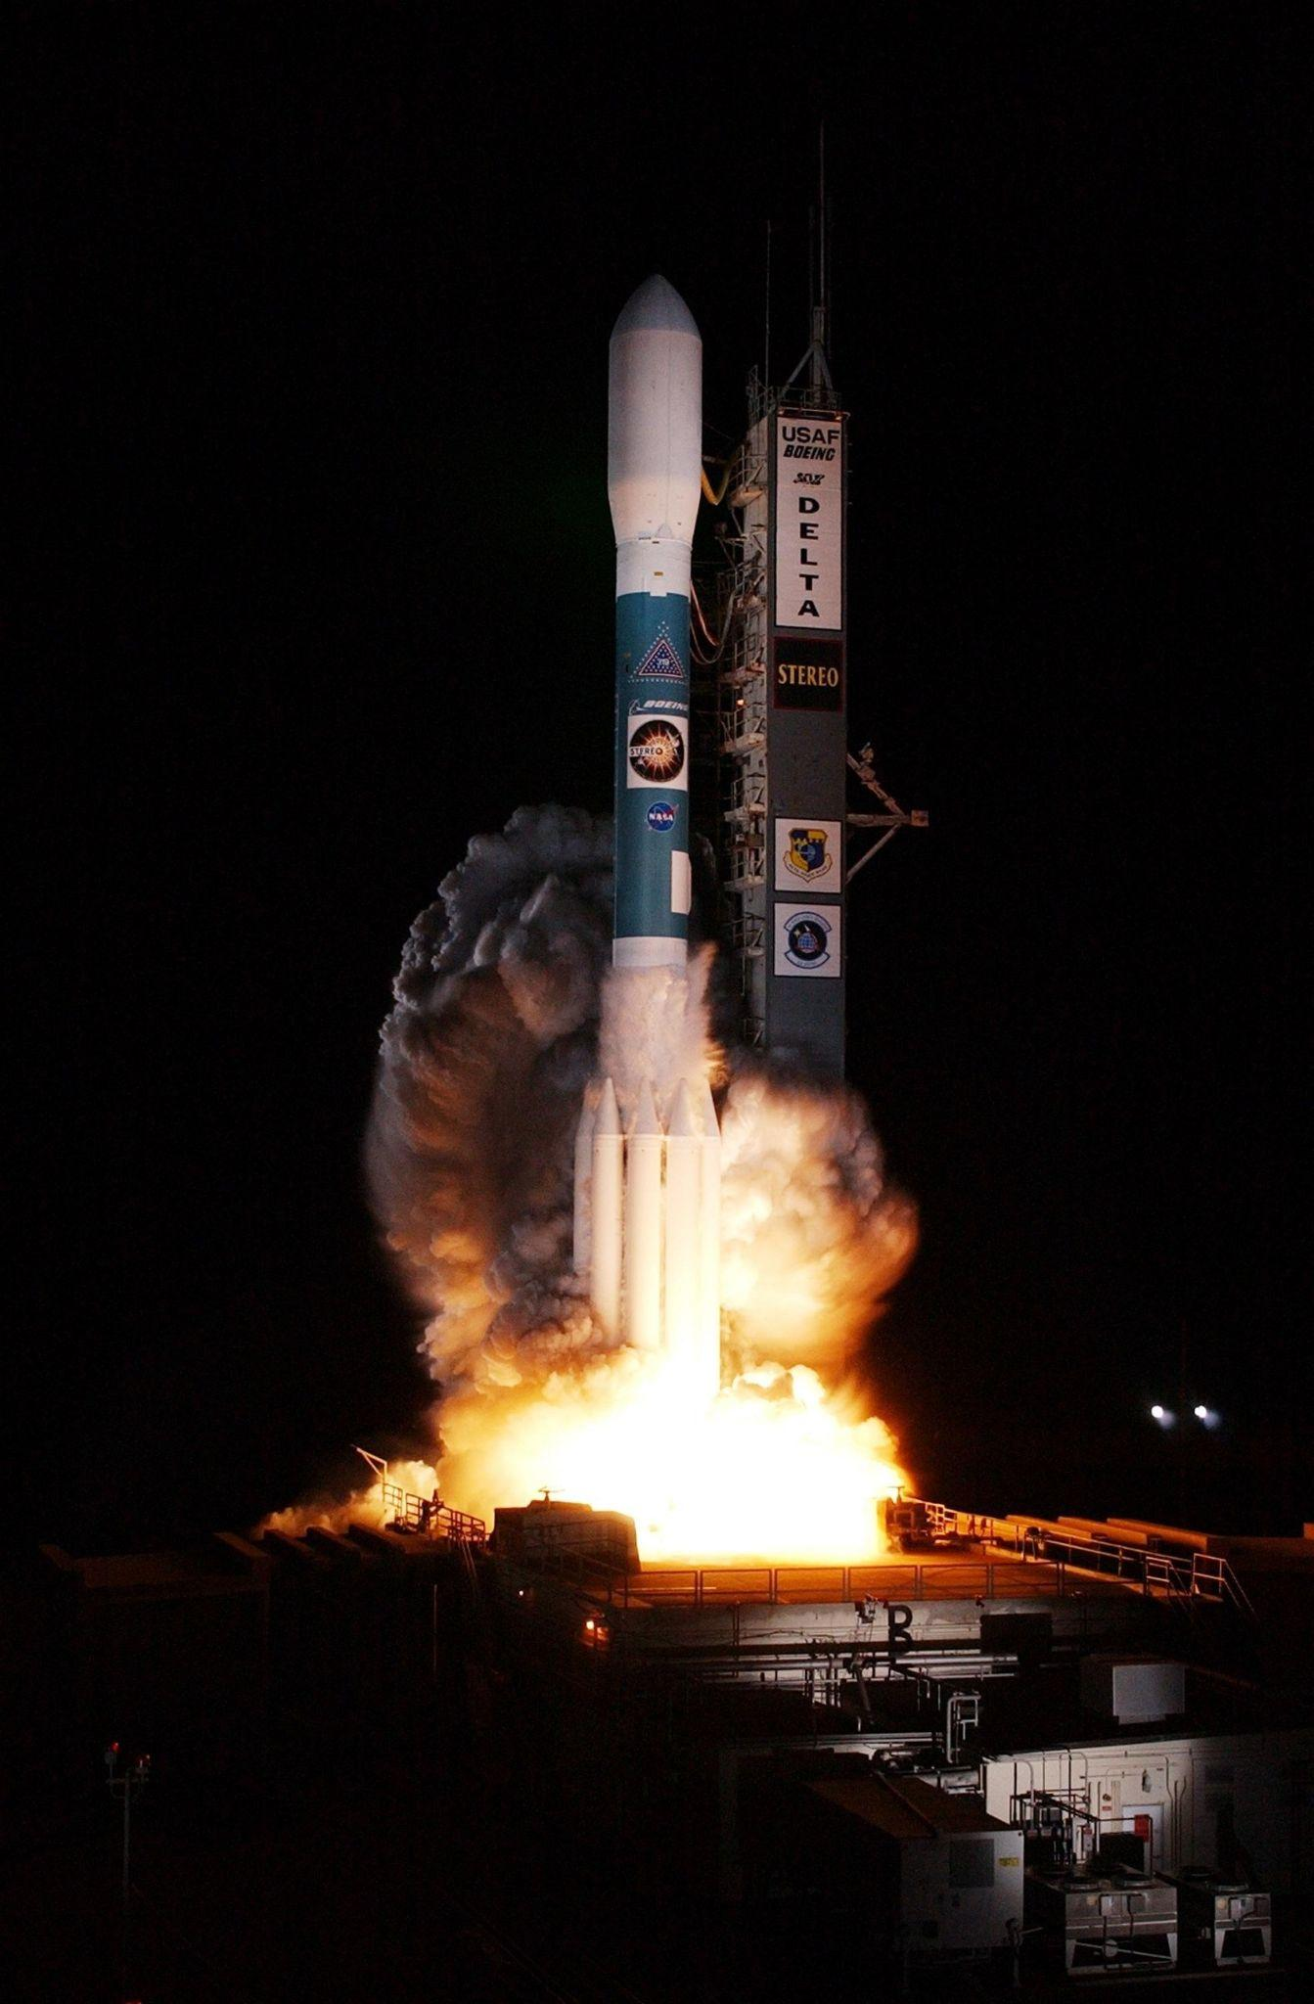
Your Results!
What targets did you pick and why?
What makes a target more likely to have life or evidence of life?
What factors do you think NASA uses to decide where to send missions?

Slide 16
NASA Space Missions
How does your analysis compare to current and past NASA missions?

Slide 17

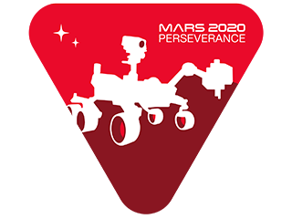
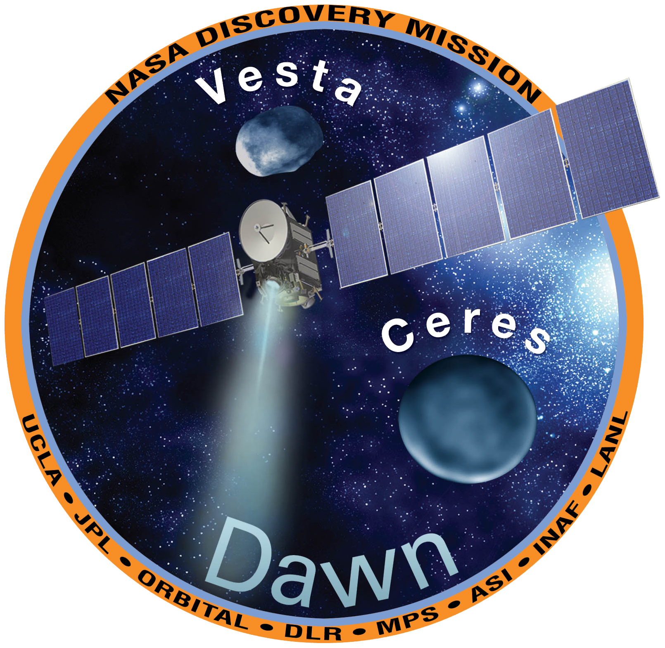
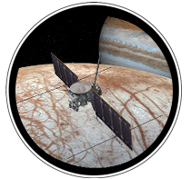
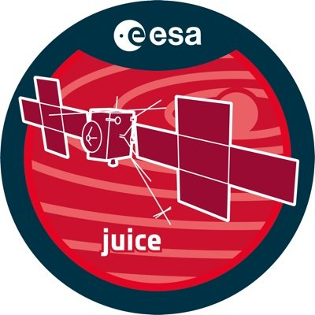
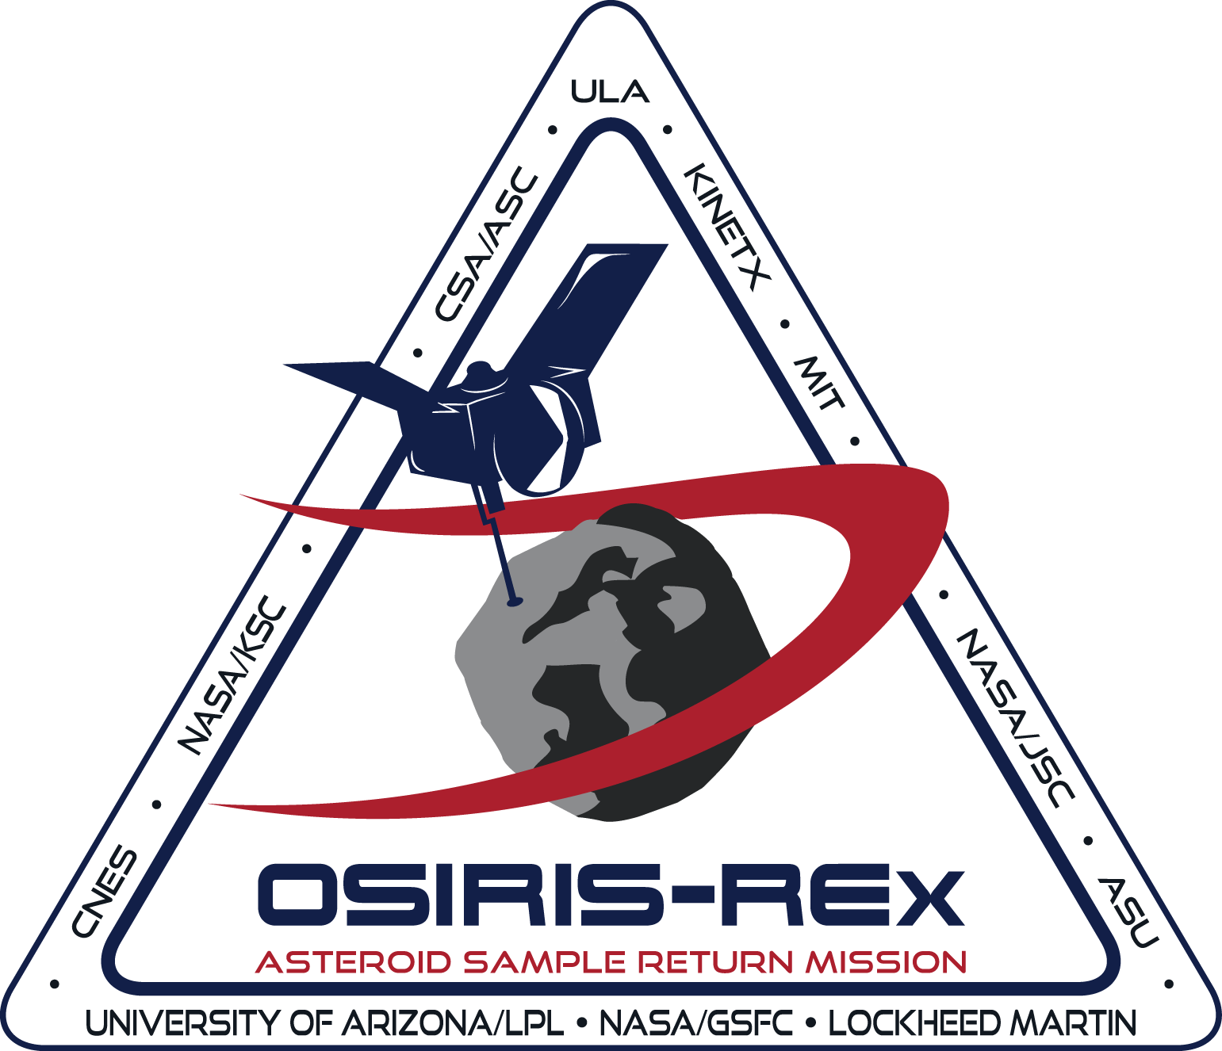
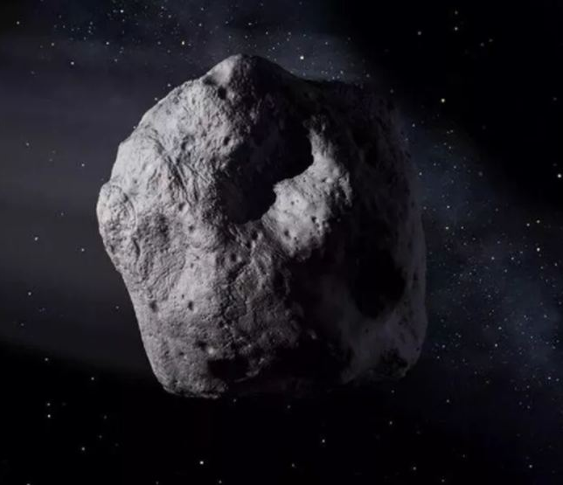
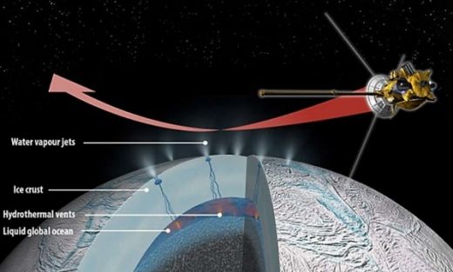
Some Space Missions
Venus Life Finder Mission
Perseverance Mars Mission
Ceres Dawn Mission
Europa Clipper Mission
Ganymede JUICE Mission
OSIRIS-Rex Mission
OSIRIS-Apex Mission
Enceladus Life Finder Mission

Slide 18
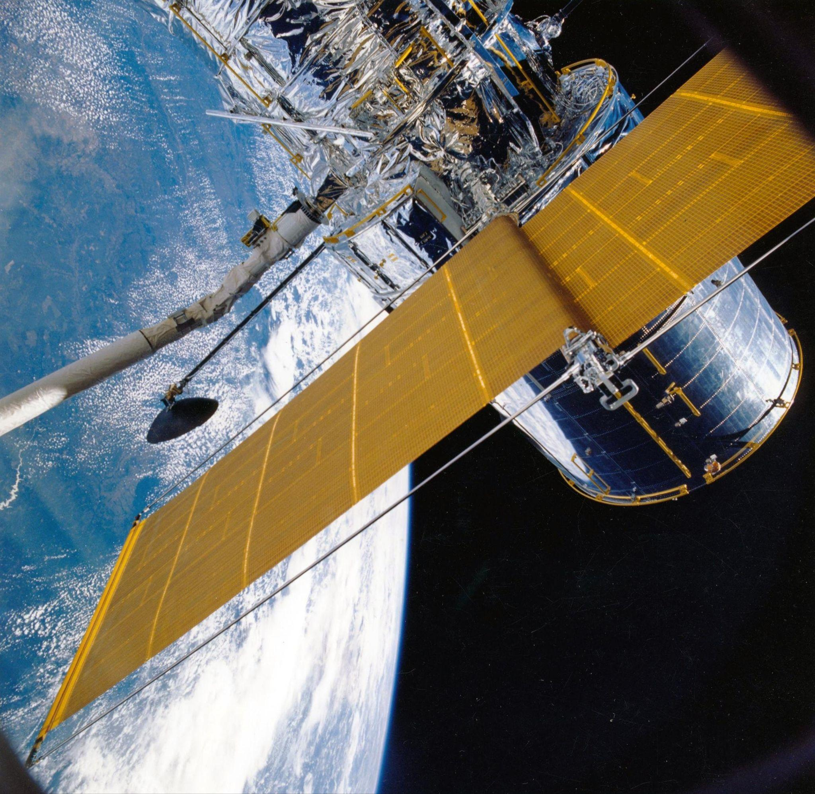
Space Missions
Many actual missions to research the origins of life have happened or been planned for the same places you selected!
You can see how Astrobiologists have decided where to focus their research.
The same skills you and your group members used are exactly the same as real-life Astrobiologists!

Slide 19
The OSIRIS-Rex Mission
NASA mission launched in 2016 led by scientists at the University of Arizona and returned samples of asteroid Bennu on September 24th, 2023
OSIRIS-Rex was the first U.S. mission to collect and return an asteroid sample to Earth.
NASA Finds Ingredients of Life in Fragments of Lost World
https://youtu.be/hwrV7X69ucI
OSIRIS-REx: NASA's First Mission to Deliver Asteroid Samples to Earth
https://www.youtube.com/watch?v=cYi-WRBTPho

Slide 20
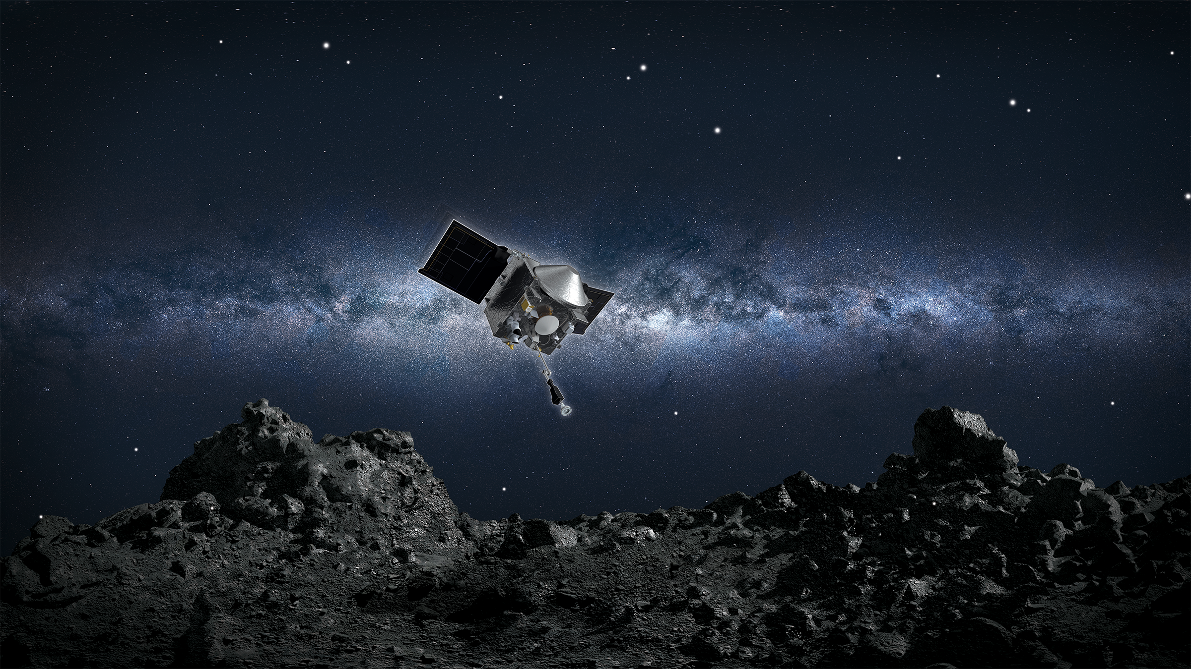
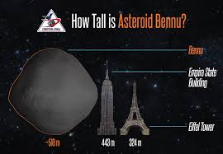
The OSIRIS-Rex Mission
The sample from Bennu returned to Earth on September 24, 2023.

Slide 21
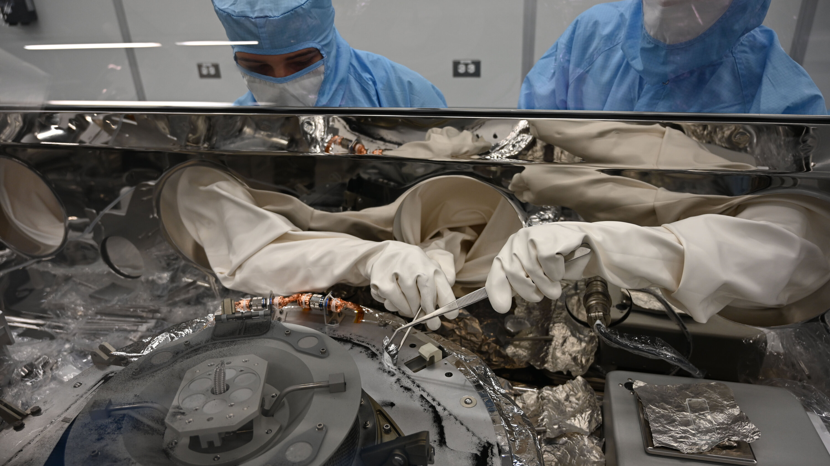
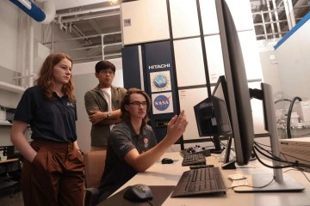
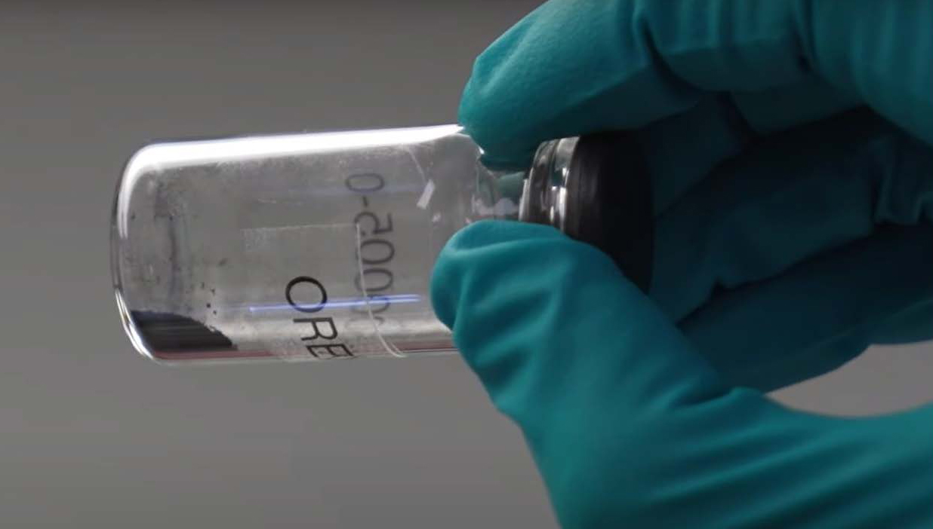
The OSIRIS-Rex Mission
Some of the sample was returned to Tucson and are being studied at the University of Arizona.

Slide 22
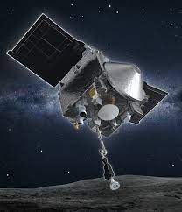
Discussion/Closing Questions
Why did scientists, including astrobiologists, choose the Asteroid Bennu as a mission target?
What could we learn about the origins of life on Earth and life in the universe from Bennu?
What factors or reasons do you think should guide NASA and mission designers in choosing mission targets?

