Slide 1
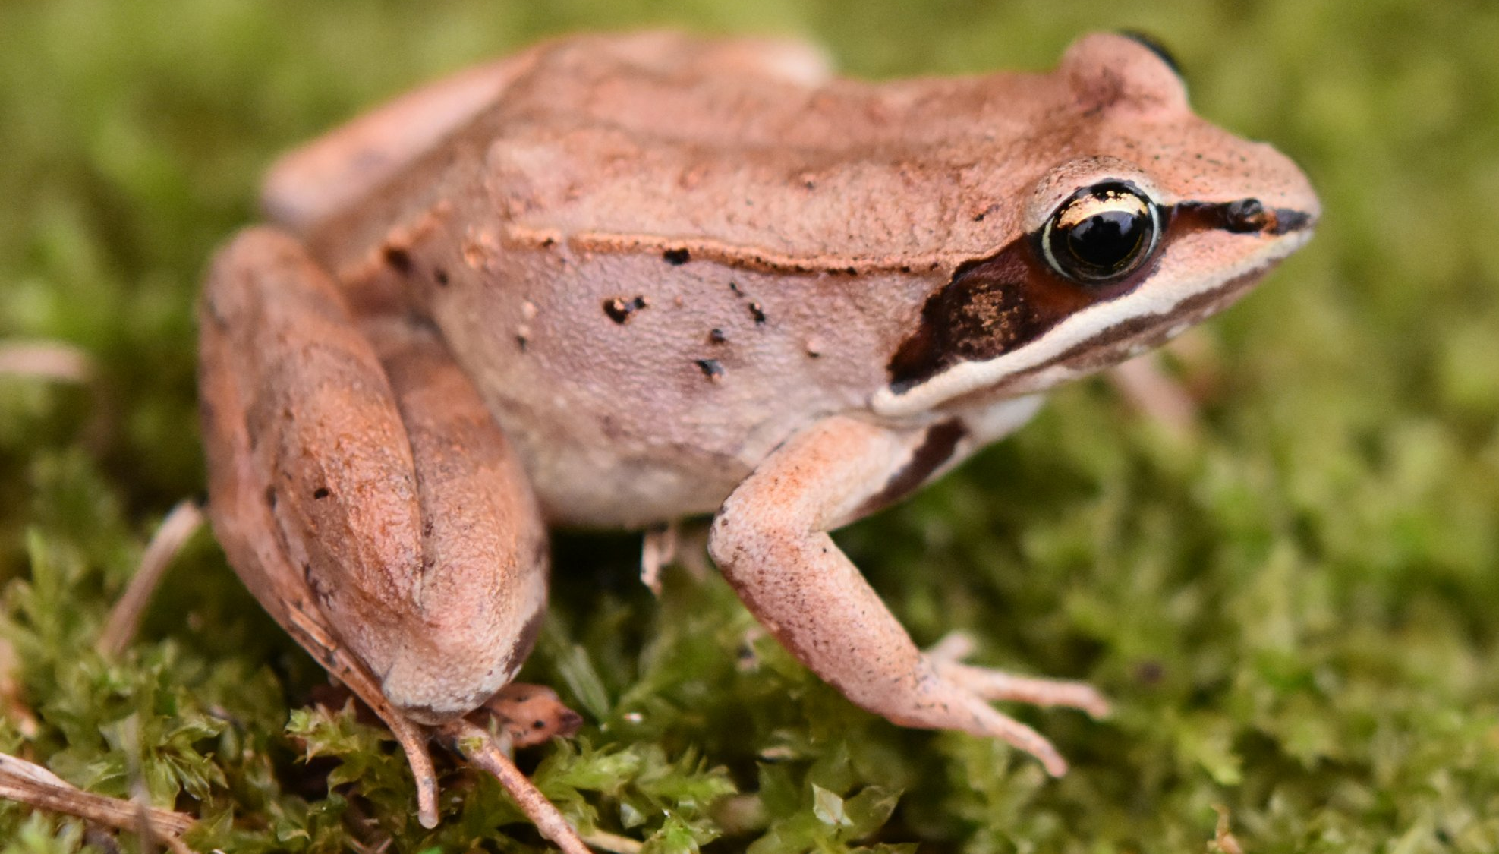
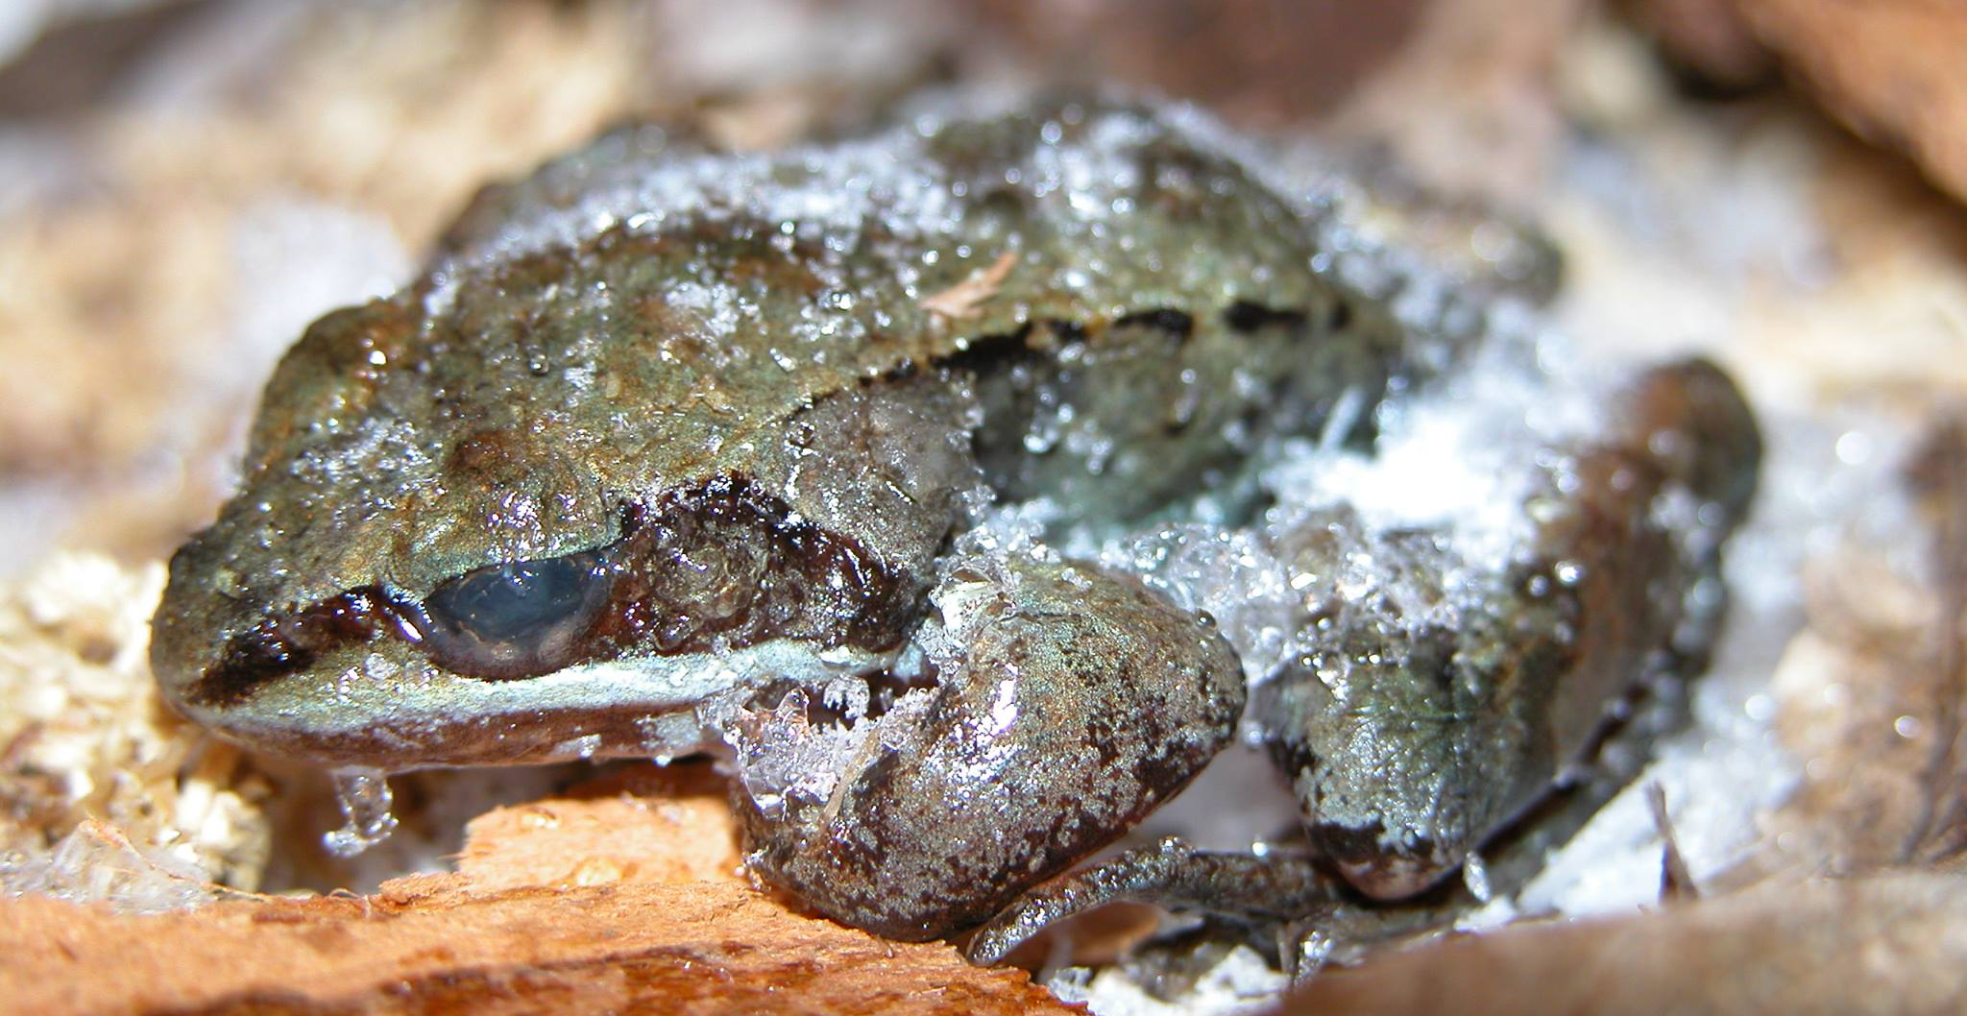
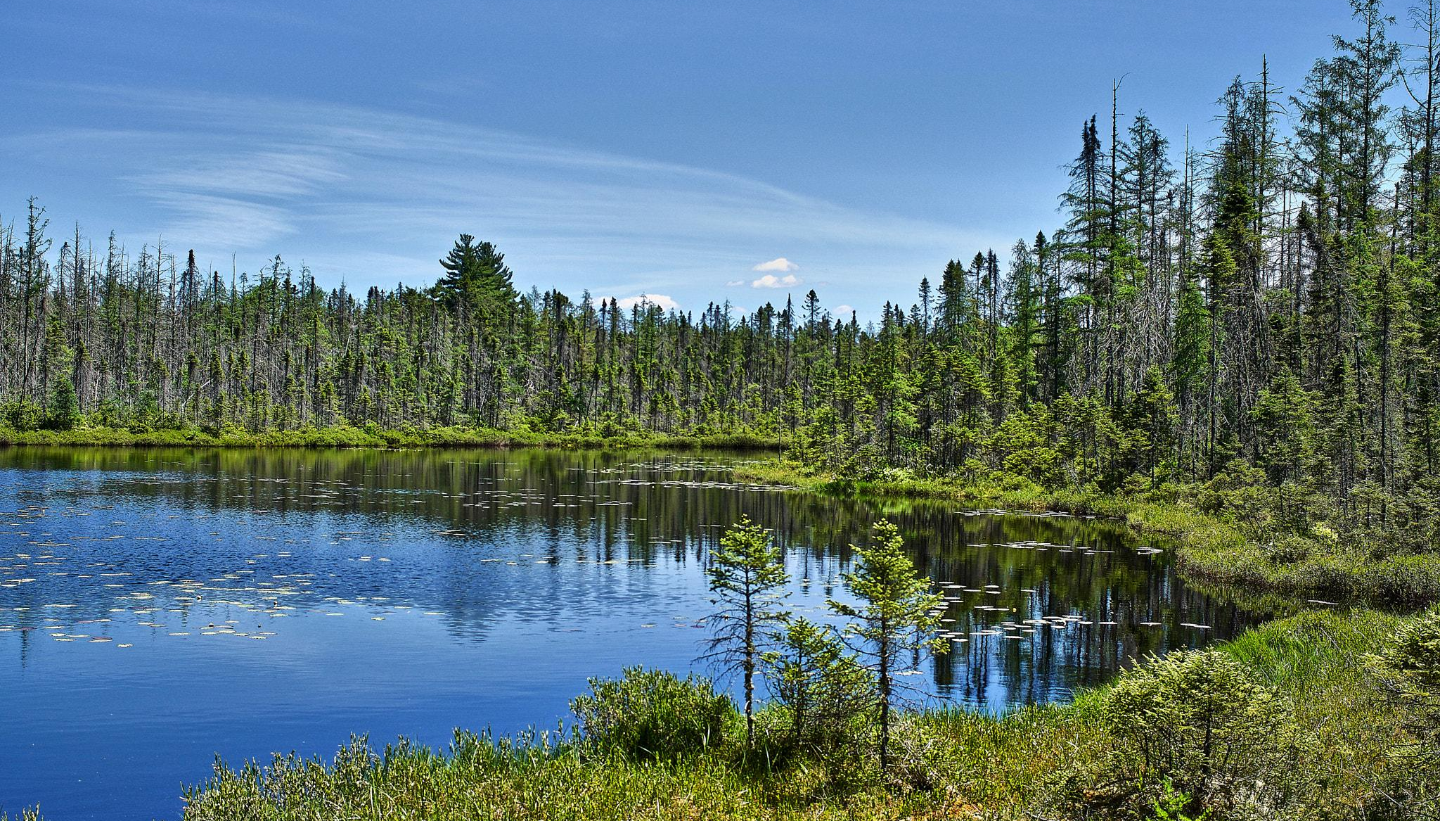
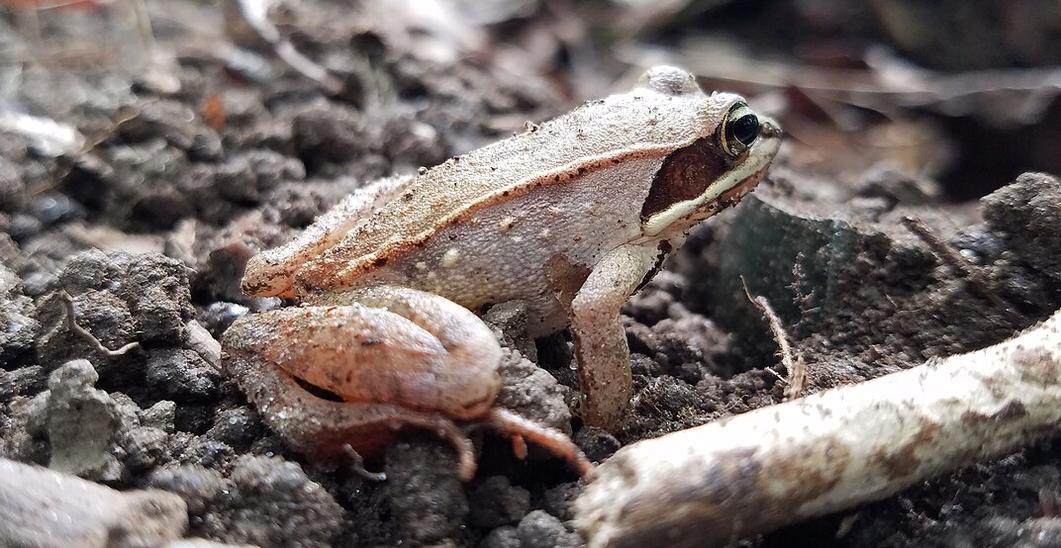
This is a wood frog.
It lives in forests and ponds.
Wood frogs live in forests and ponds that freeze in winter. They can freeze solid and wake up again in the spring.
© 2025 Arizona Astrobiology Center

Slide 2
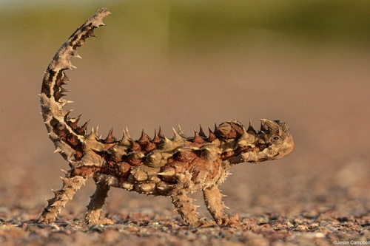
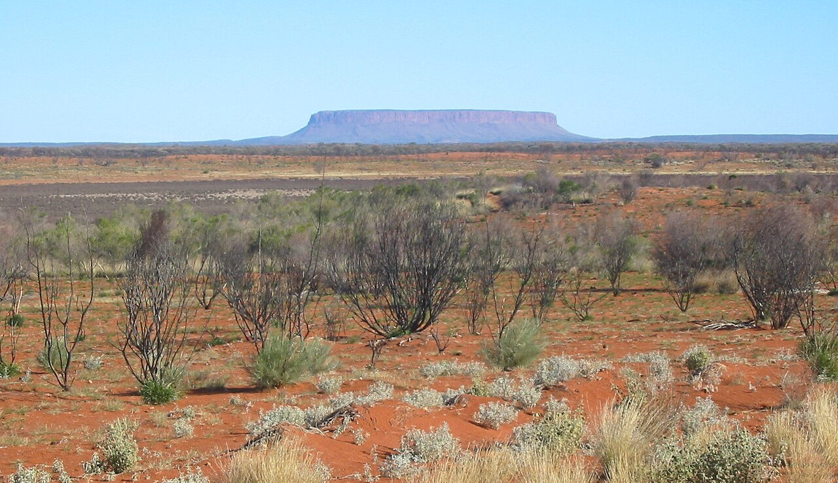
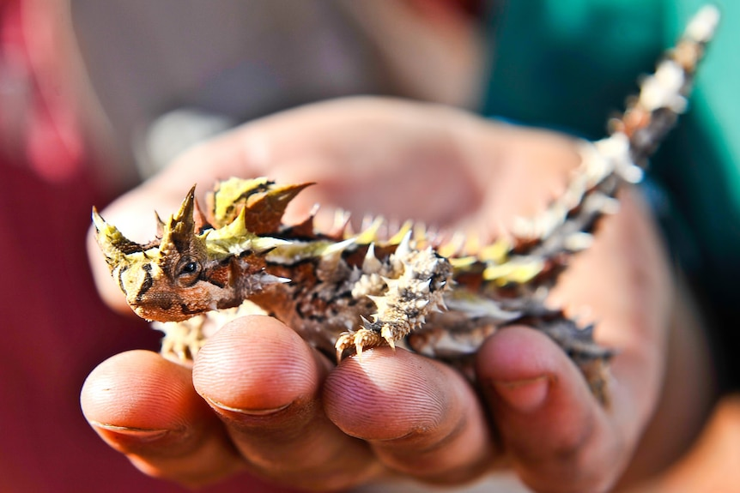
This is a thorny devil.
It lives in deserts in Australia.
Thorny devils get water using special grooves on their skin. If they step in a small puddle, the water moves to their mouth along their skin.
© 2025 Arizona Astrobiology Center

Slide 3
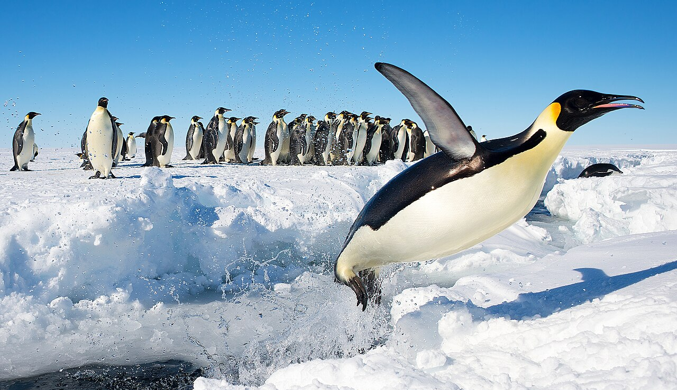
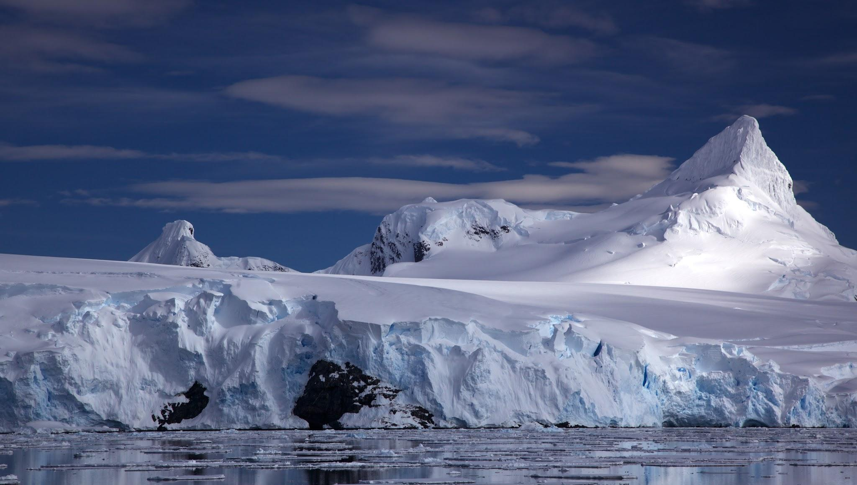
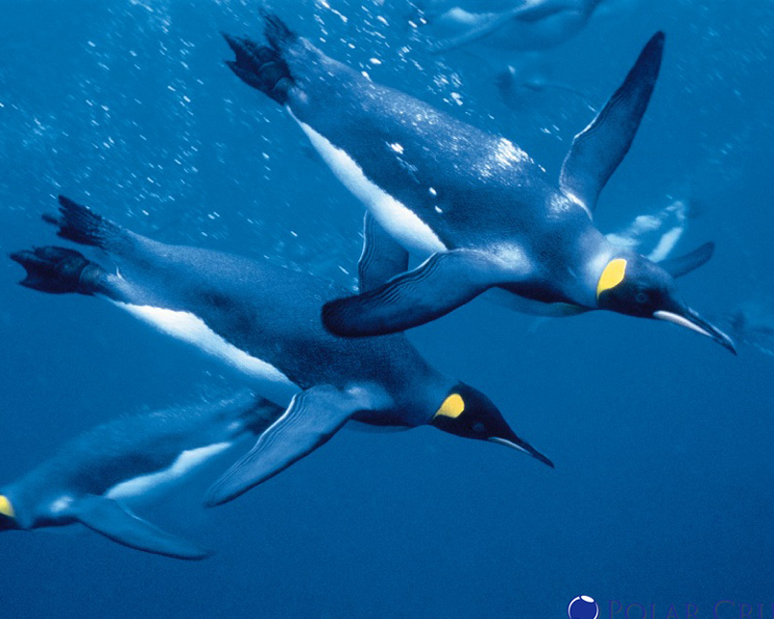
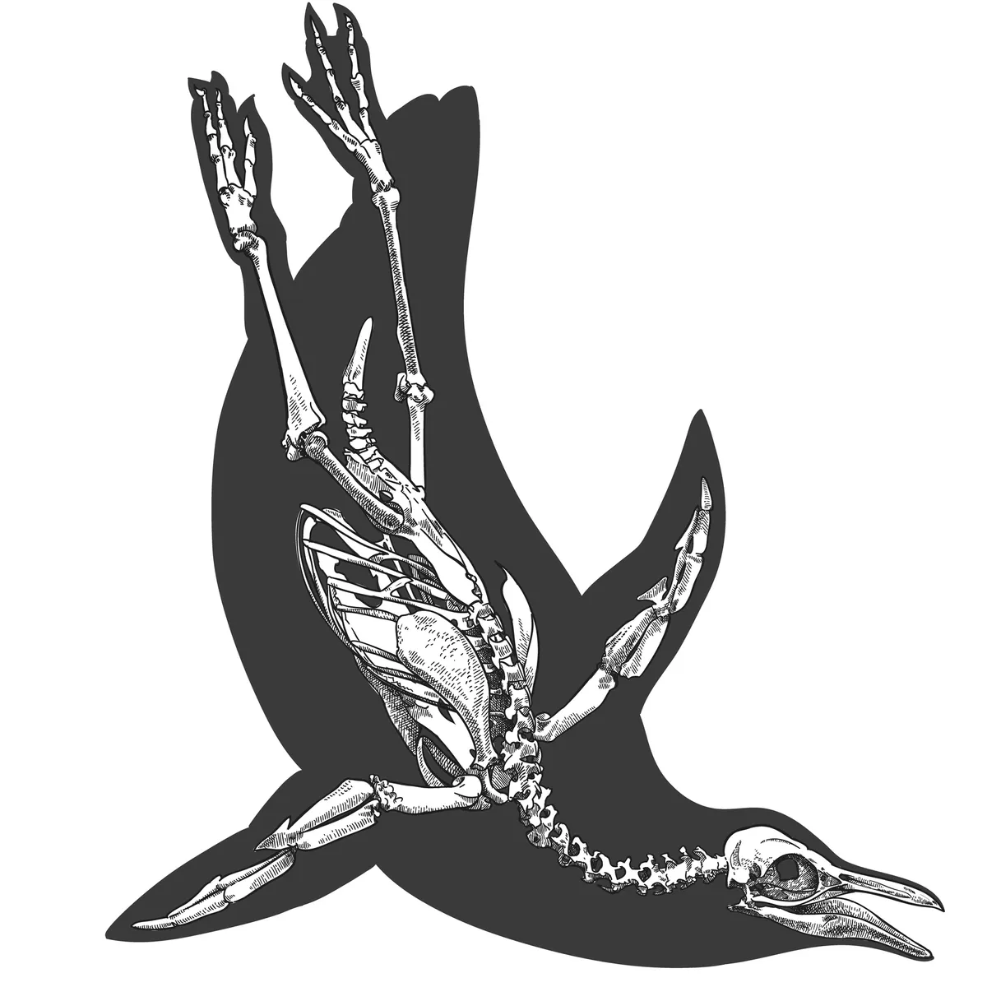
These are emperor penguins.
They live in Antarctica.
Emperor penguins live in Antarctica, where it’s super cold all year. They stay warm using a thick layer of fat, warm feathers, and huddling together in groups.
© 2025 Arizona Astrobiology Center

Slide 4
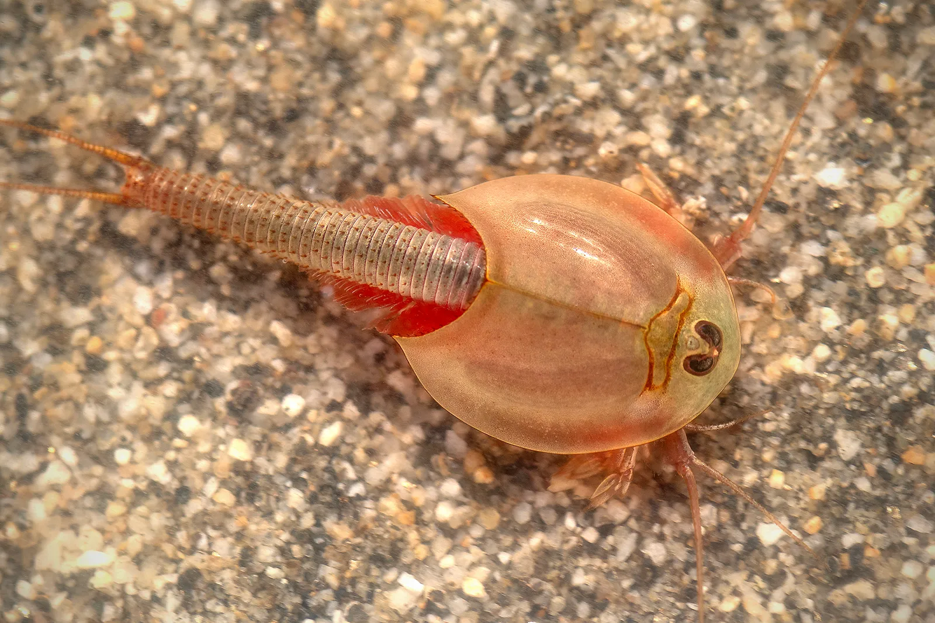
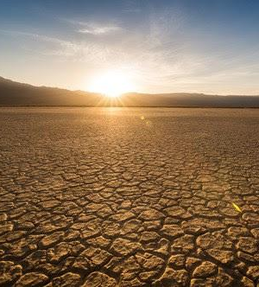
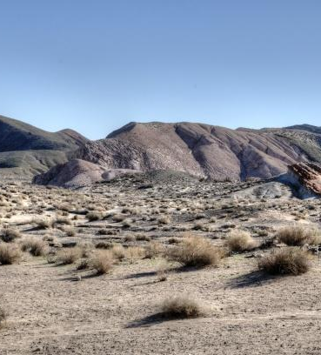
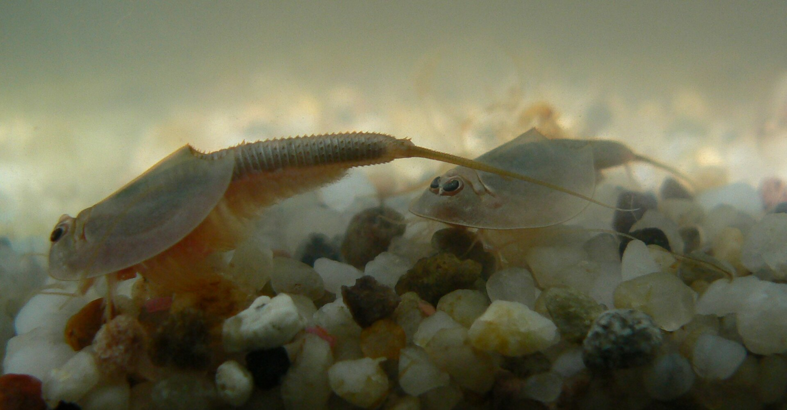
This is a tadpole shrimp.
It lives in deserts where water dries up very fast.
Tadpole shrimp have special eggs that can dry out. The eggs will stay dry for many years until it rains again. When the rains come, they will hatch.
© 2025 Arizona Astrobiology Center

Slide 5
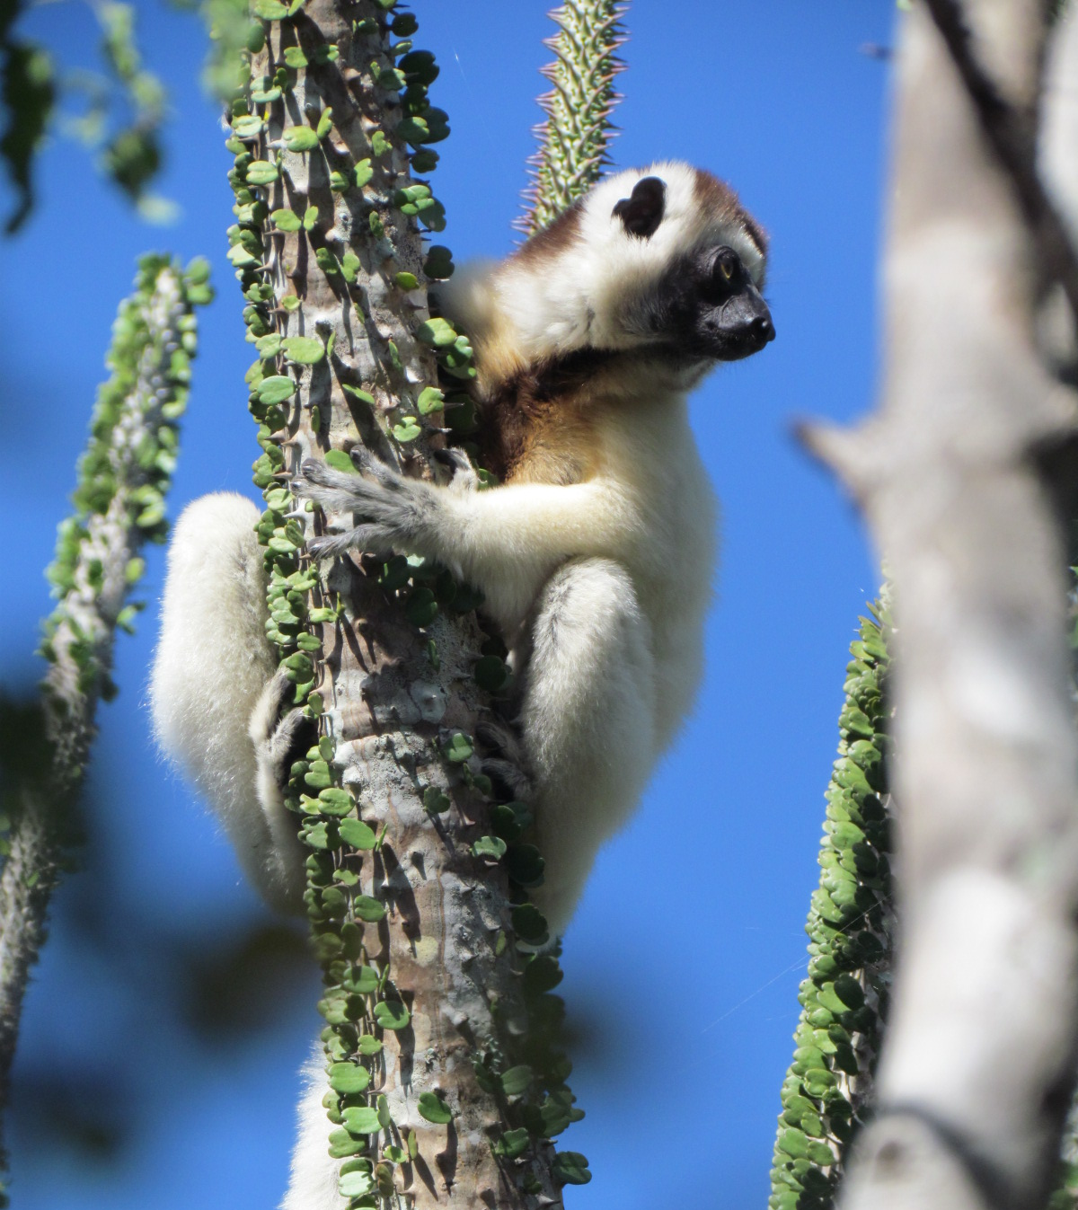
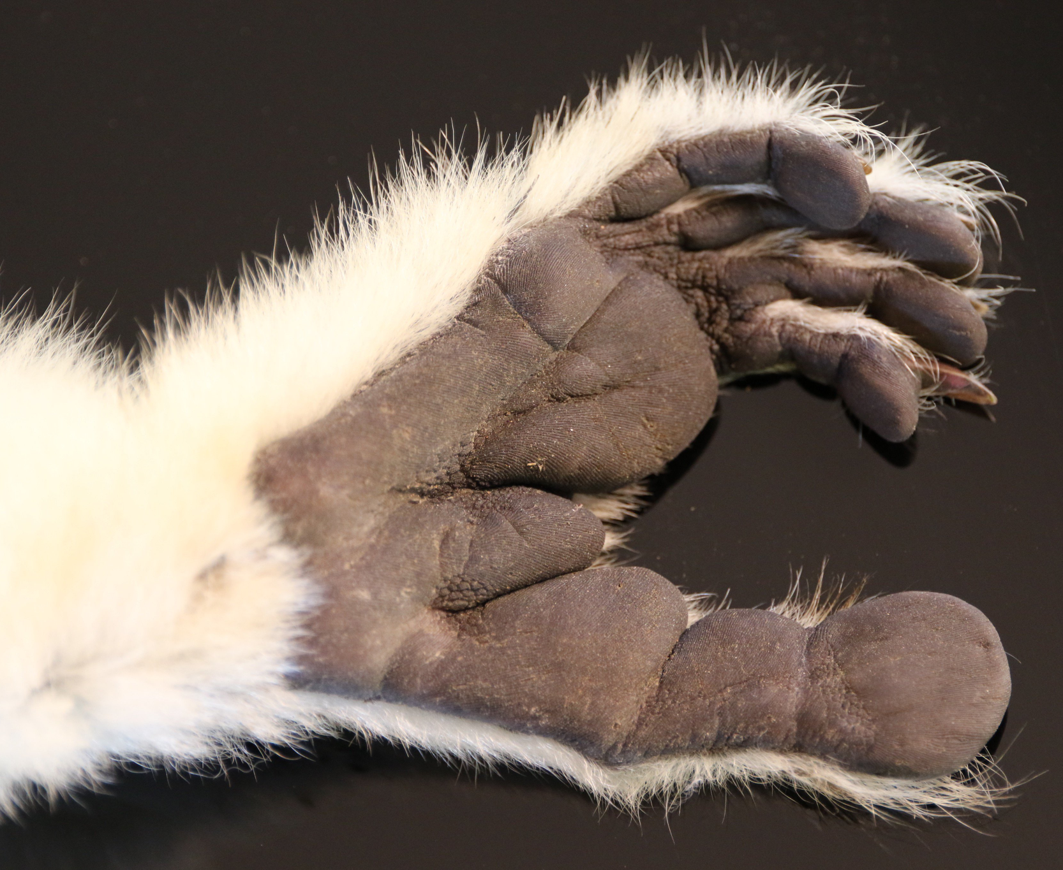
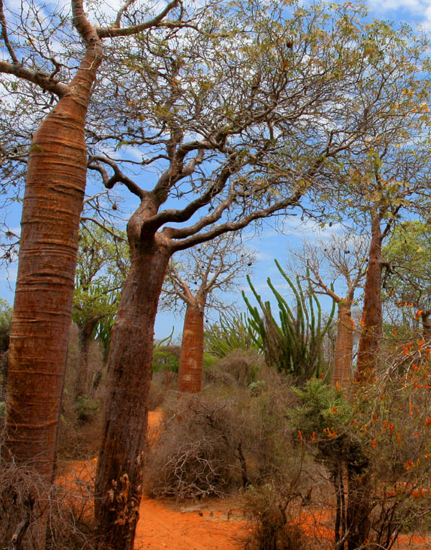
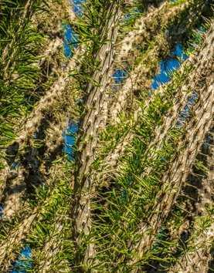
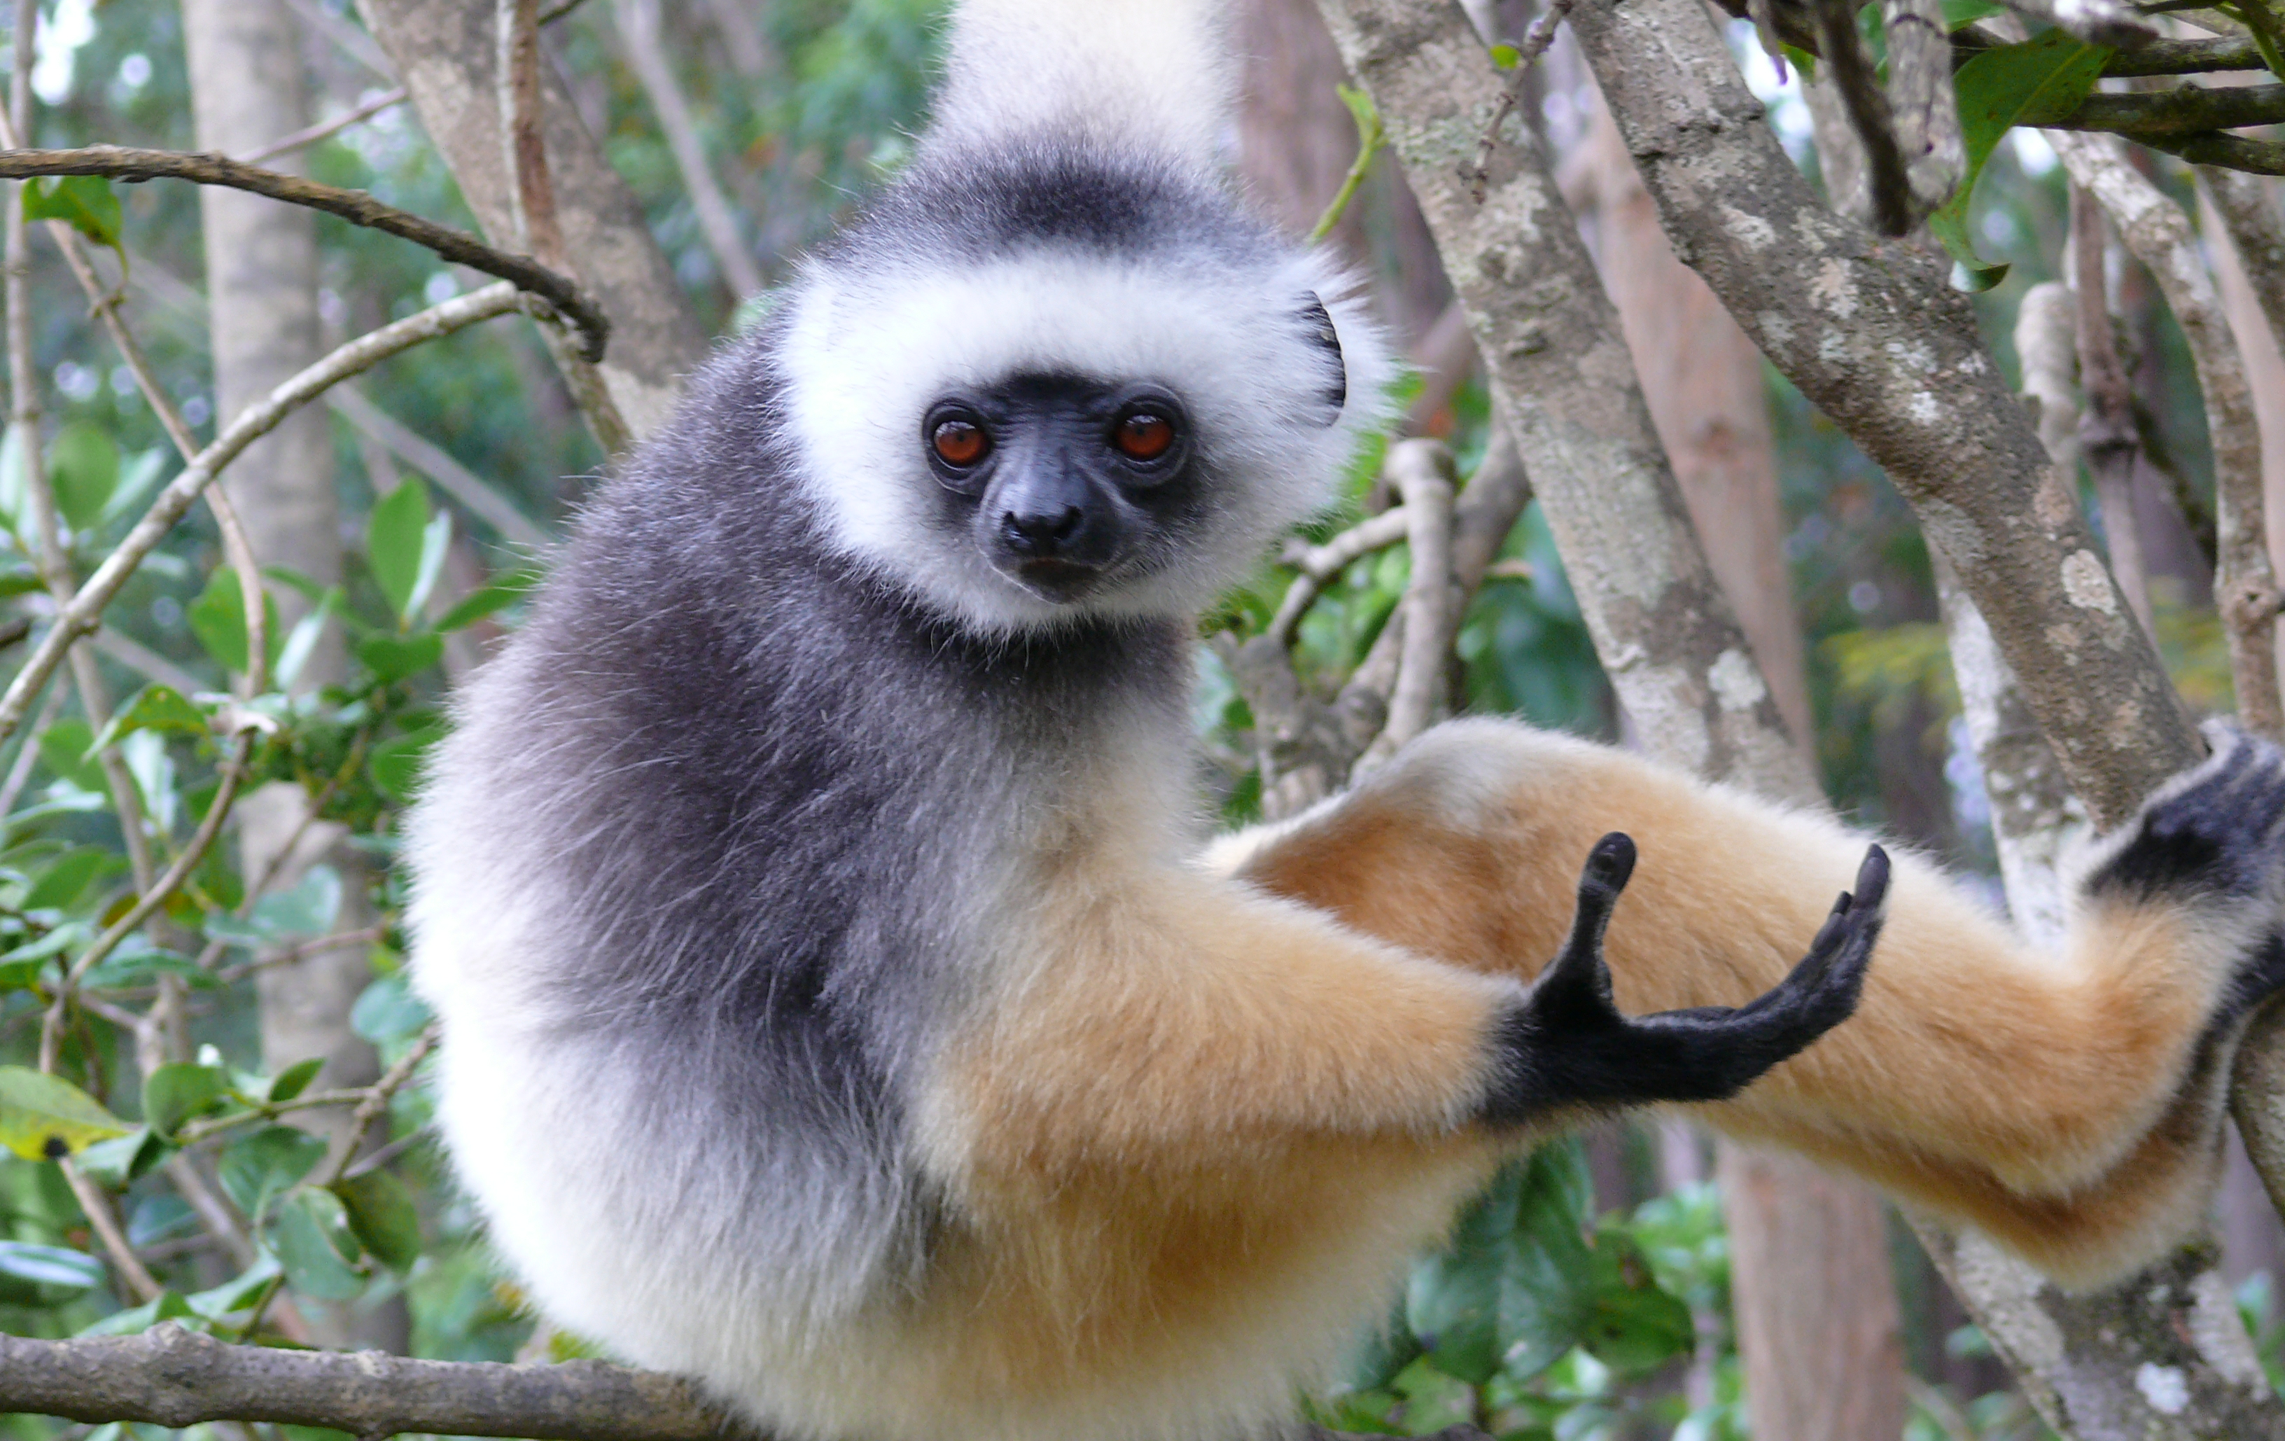
This is a sifaka lemur.
It lives in forests where all the plants are very spiky.
Sifakas can climb spiky trees that most other animals can’t climb. They have thick pads on their hands and feet to protect them from spikes.
© 2025 Arizona Astrobiology Center

Slide 6
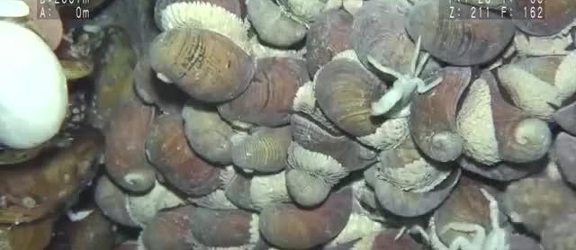
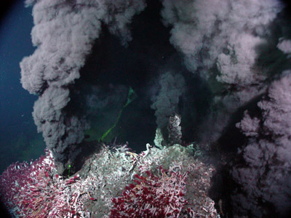
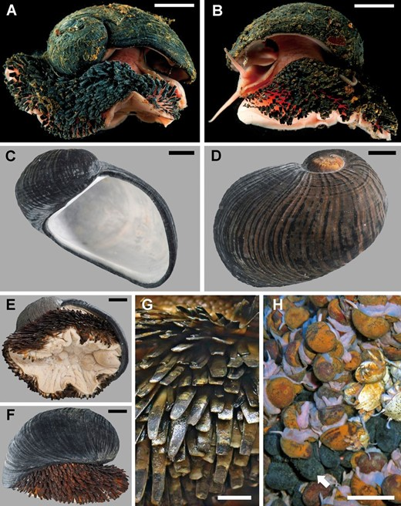
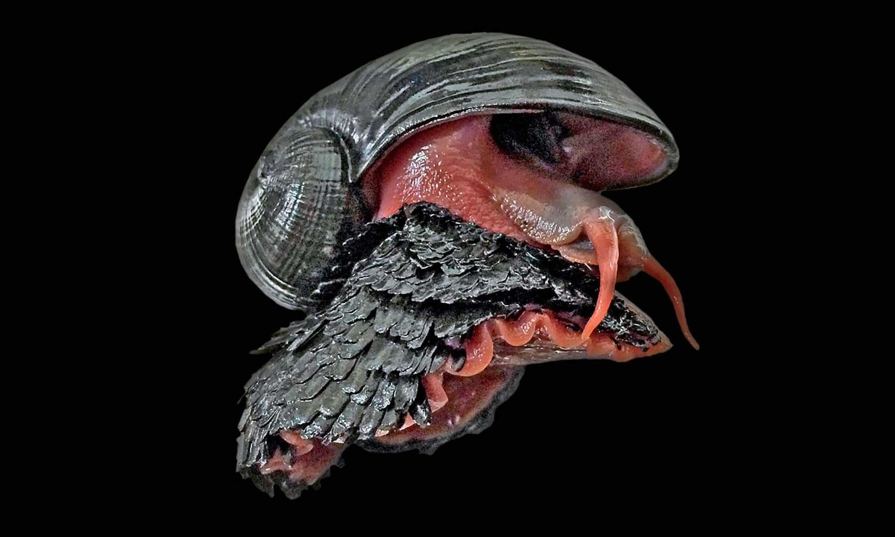
This is a volcano snail.
It lives deep at the bottom of the ocean.
At the bottom of the ocean, there's a lot of pressure from the water above. Volcano snails can handle it because they have very tough shells made of iron.
© 2025 Arizona Astrobiology Center

Slide 7
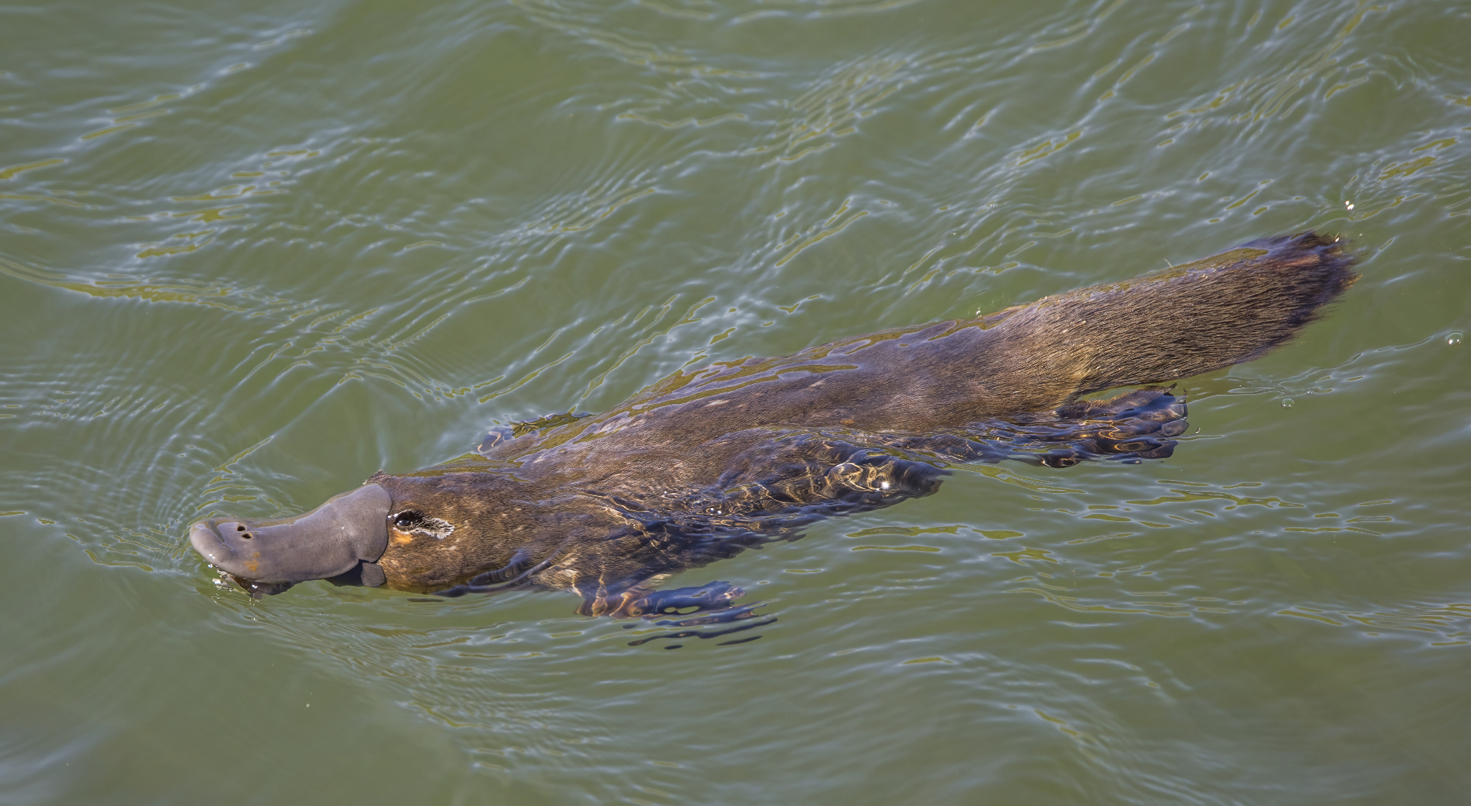
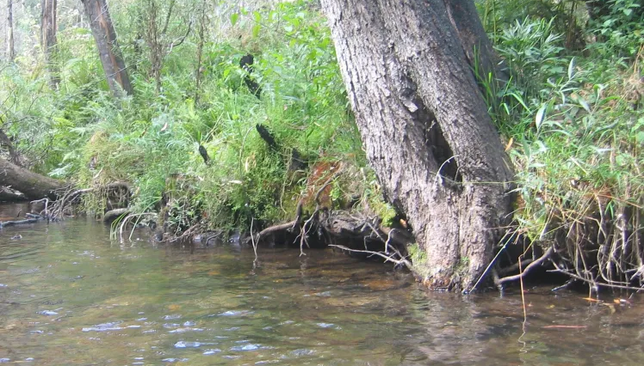
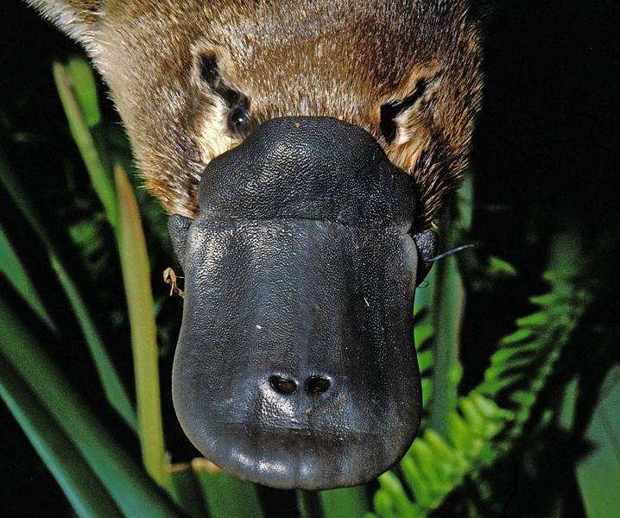
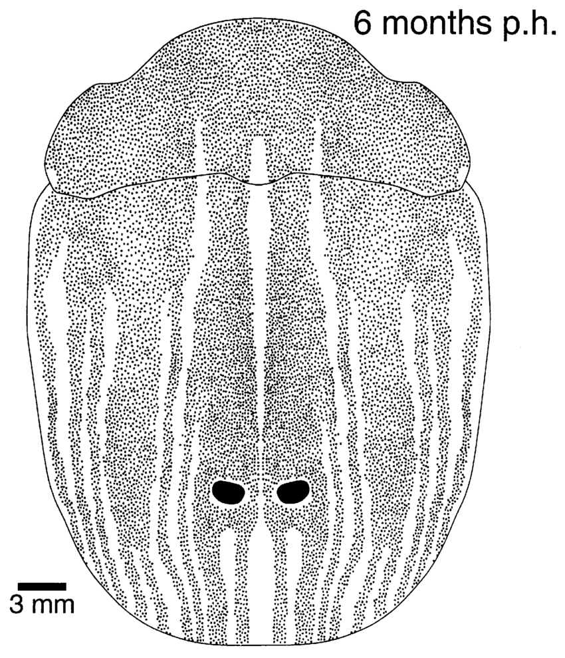
This is a platypus.
It lives in murky rivers and streams.
Platypus live in murky streams. It can be hard to see things. They find their food by sensing the electricity made by the small animals they eat. They have a special detector in their bill.
© 2025 Arizona Astrobiology Center

Slide 8
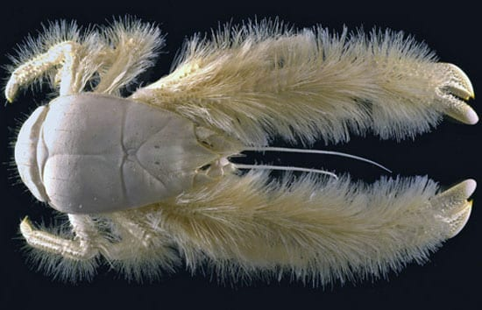
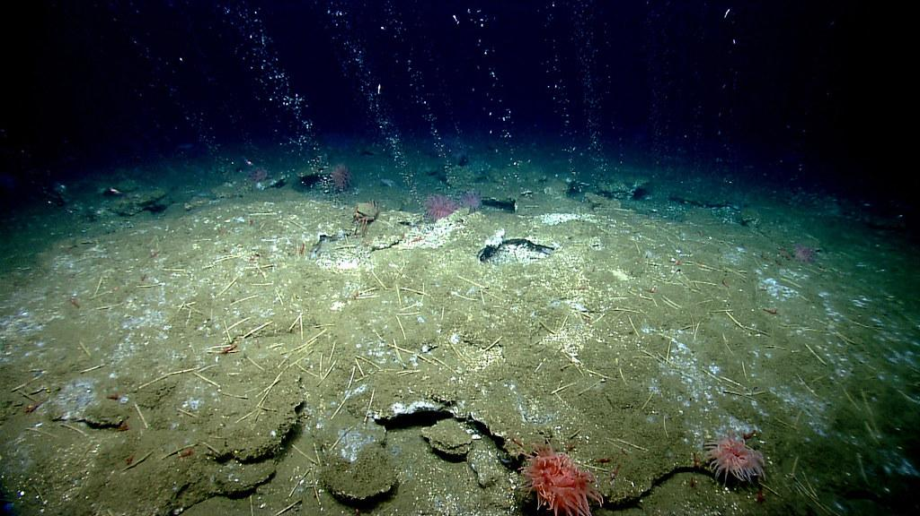
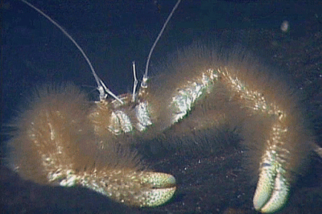
This is a yeti crab.
It lives deep in the ocean.
In deep parts of the ocean there are no plants because there is no sunlight. Some life in the deep ocean eat bacteria instead of plants. Yeti crabs grow bacteria on their long furry arms and eat it.
© 2025 Arizona Astrobiology Center

Slide 9
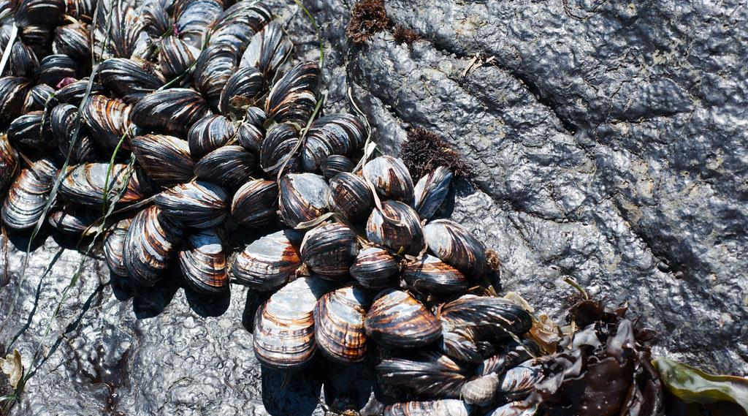
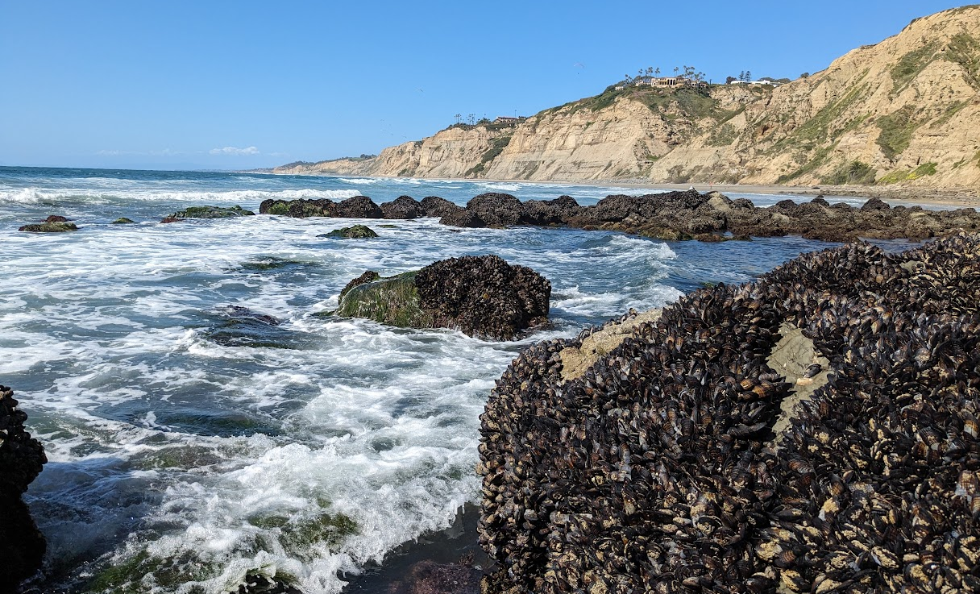
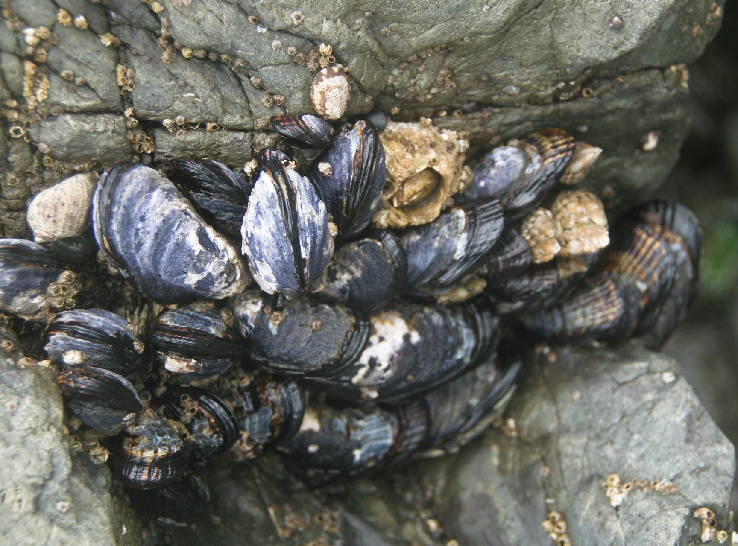
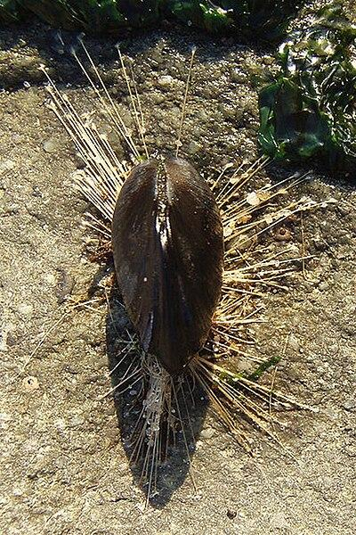
These are mussels.
They live on the coast where waves crash on the rocks.
Mussels use lots of thin threads to attach to the rocks so they don’t get knocked off by the waves. They also close their shells so they don’t dry out when they’re out of the water.
© 2025 Arizona Astrobiology Center

Slide 10
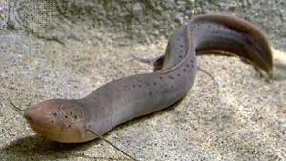
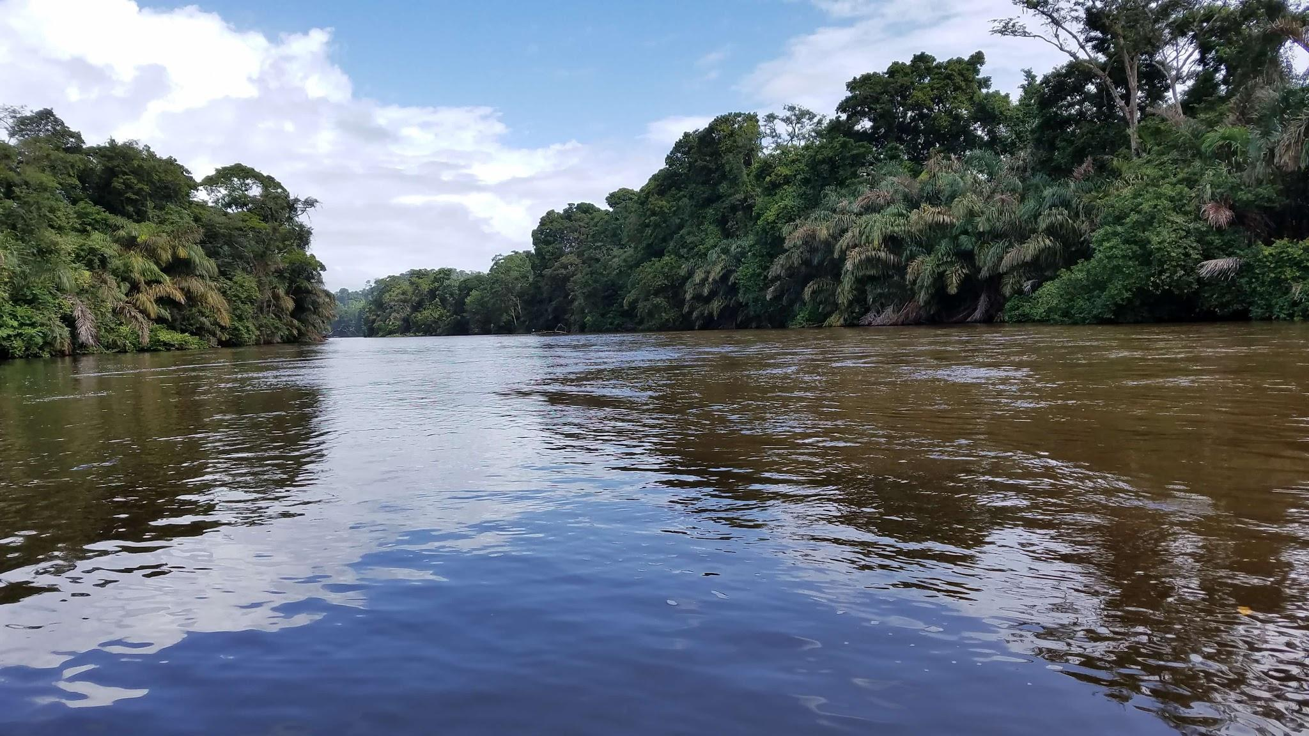
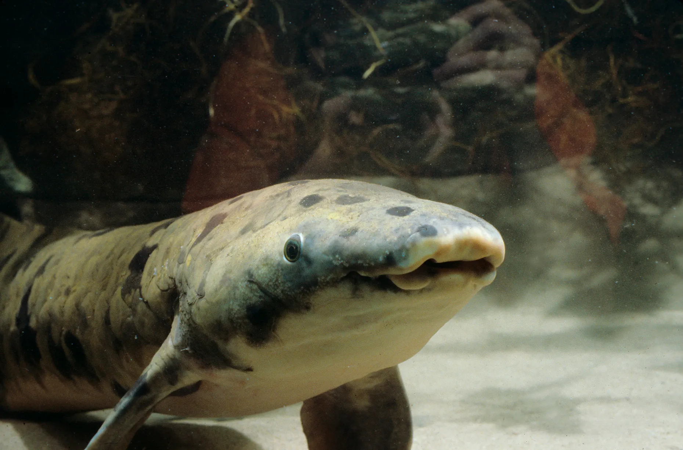
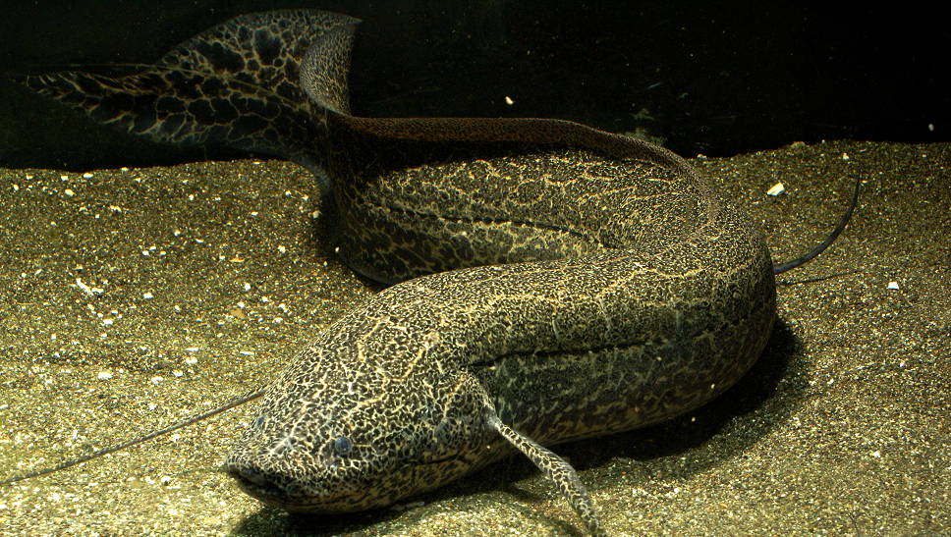
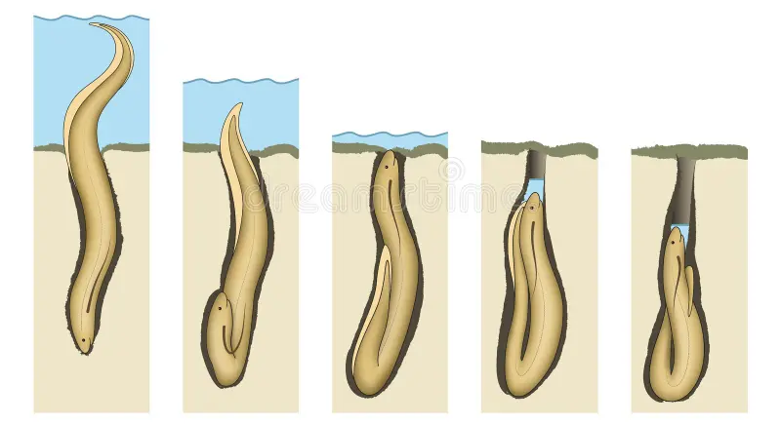
This is a lungfish.
It lives in tropical streams and lakes.
Lungfish live in streams and lakes that sometimes dry out. Lungfish can burrow in the soil when it is dry, and have a lung to breathe air.
© 2025 Arizona Astrobiology Center

Slide 11
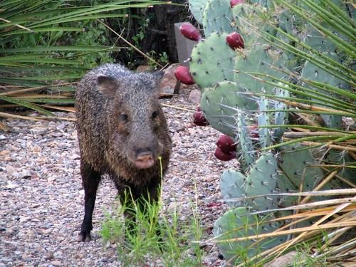
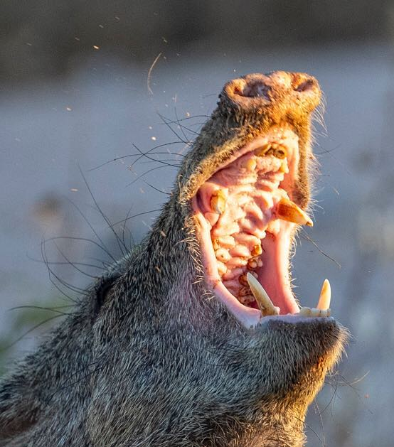
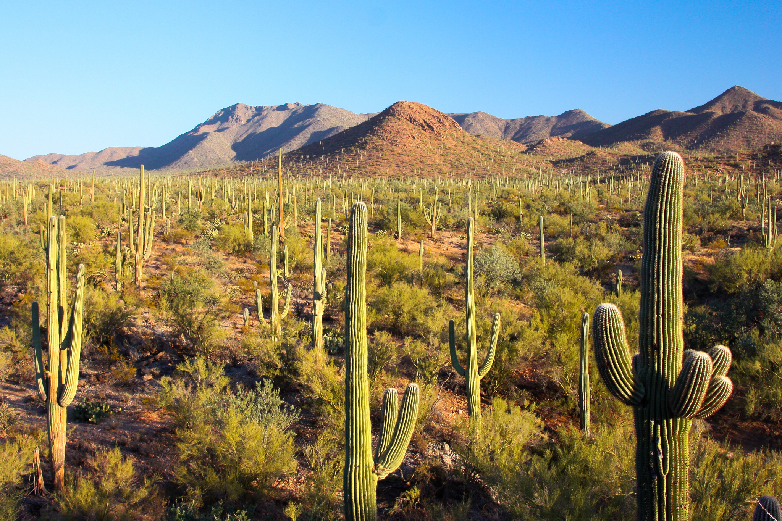
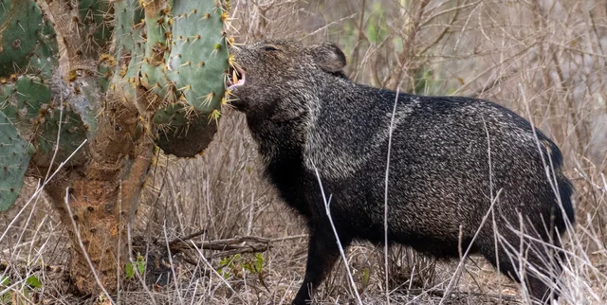
This is a javelina.
It lives in the Sonoran Desert.
Cacti store lots of water, but they have sharp spines. Javelinas have big teeth and tough skin so they can eat cacti and get the water they need.
© 2025 Arizona Astrobiology Center

Slide 12
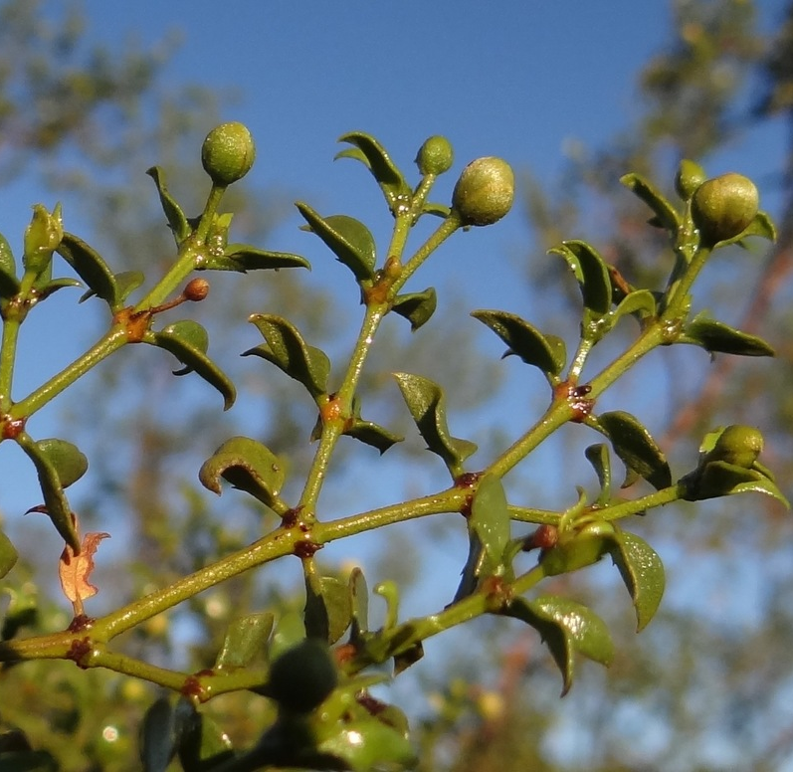
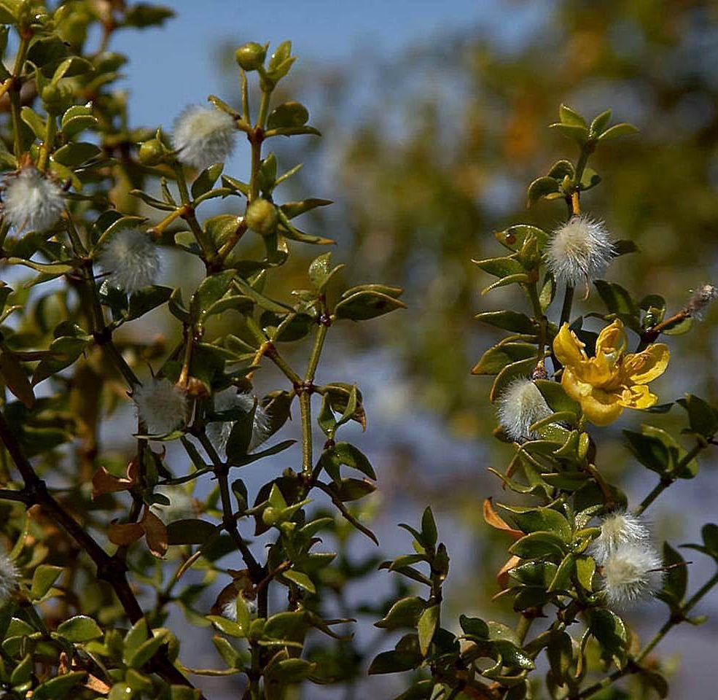
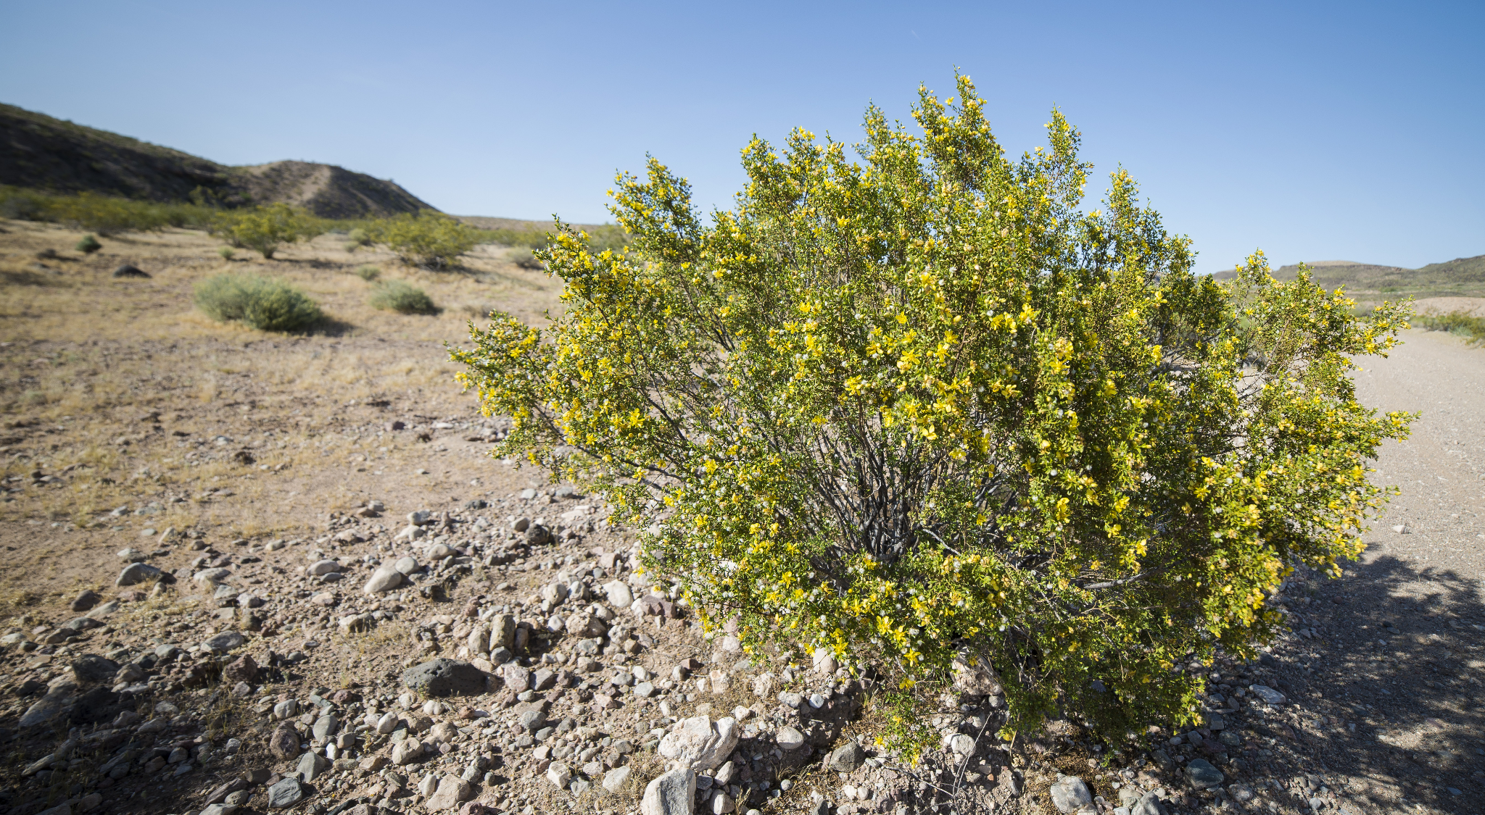
This is a creosote bush.
It lives in the Sonoran Desert.
Plants lose water through their leaves. Creosote bushes have small waxy leaves so they lose less water and don’t dry out.
© 2025 Arizona Astrobiology Center

Slide 13
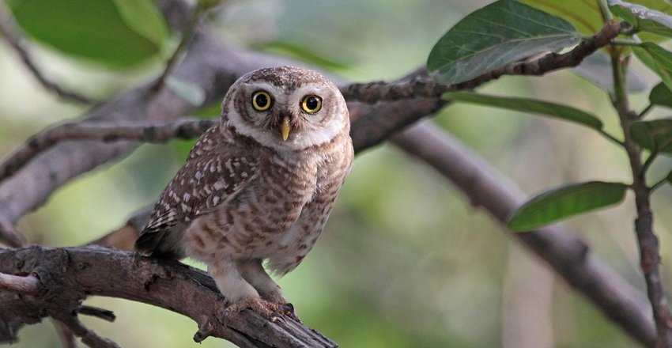
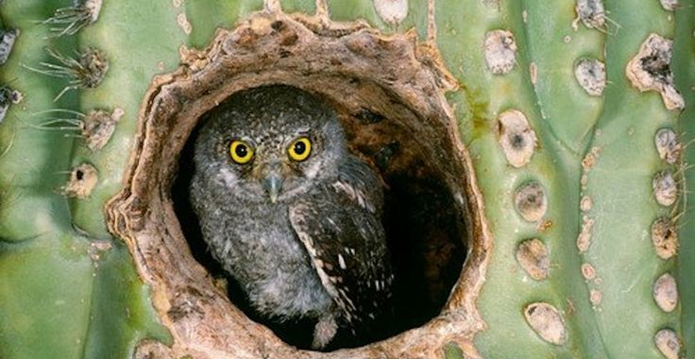
This is an elf owl.
It lives in the Sonoran Desert.
Elf owls are tiny owls that live in the holes of a saguaro cactus. Inside the cactus is cooler and keeps them safe from the sun.
© 2025 Arizona Astrobiology Center

Slide 14
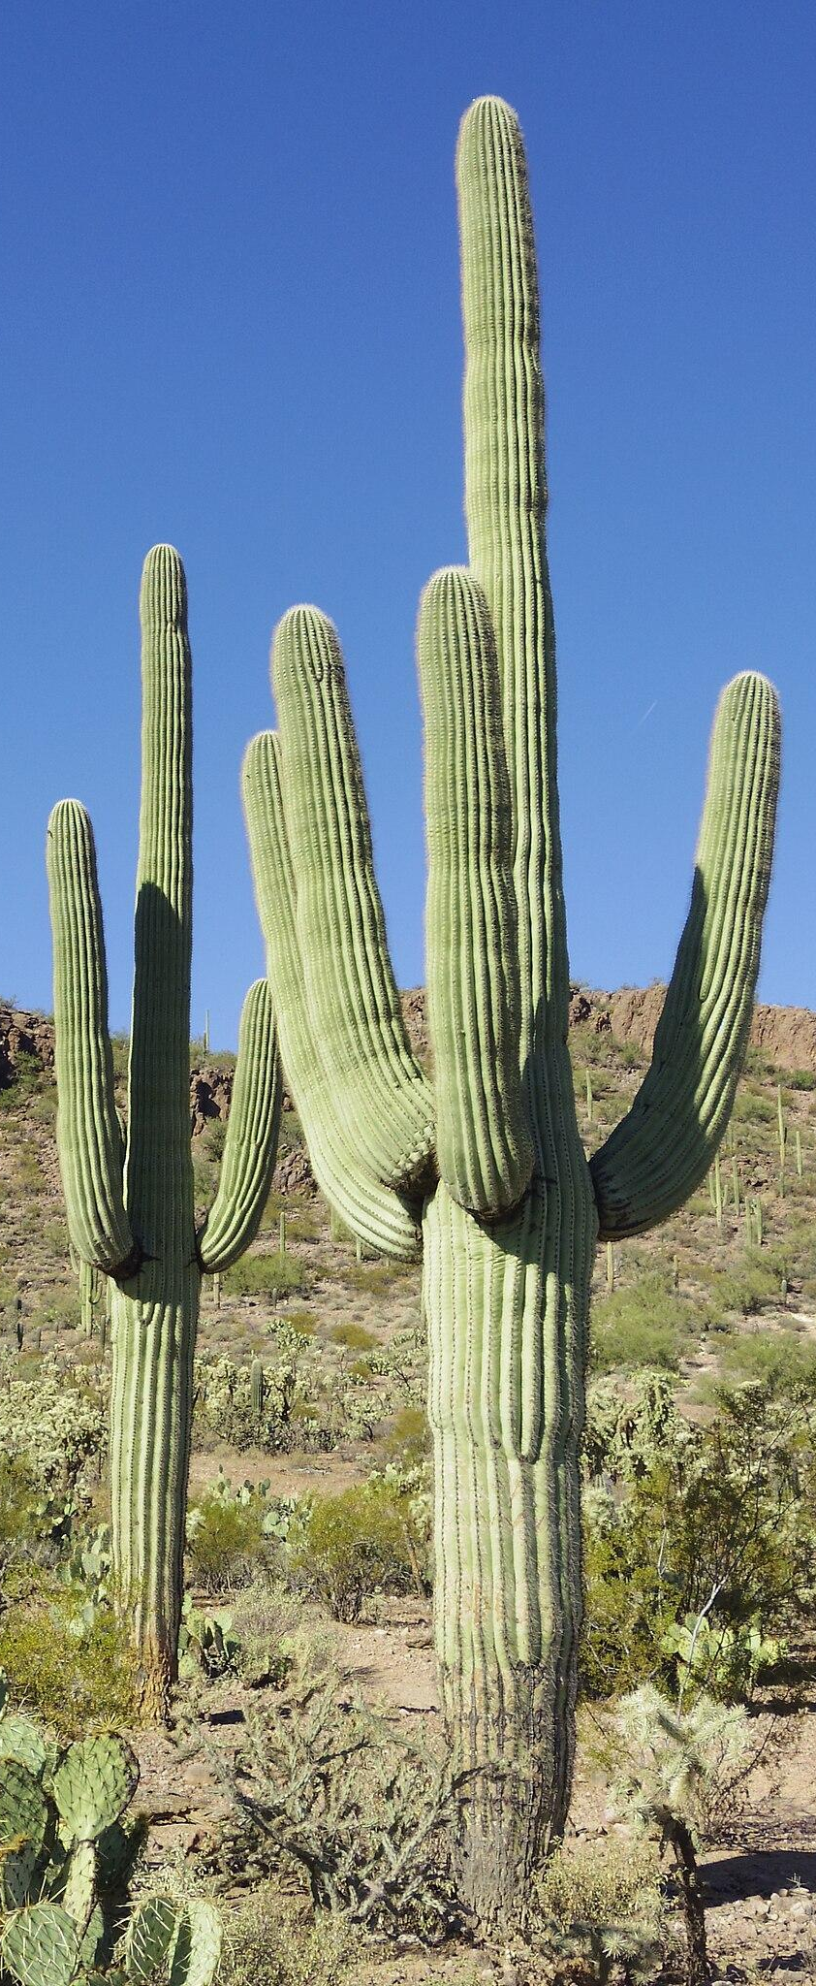

This is a saguaro cactus.
It lives in the Sonoran Desert.
When it rains, saguaros can fill up like a sponge to store water for when it’s dry.
© 2025 Arizona Astrobiology Center

