Slide 1

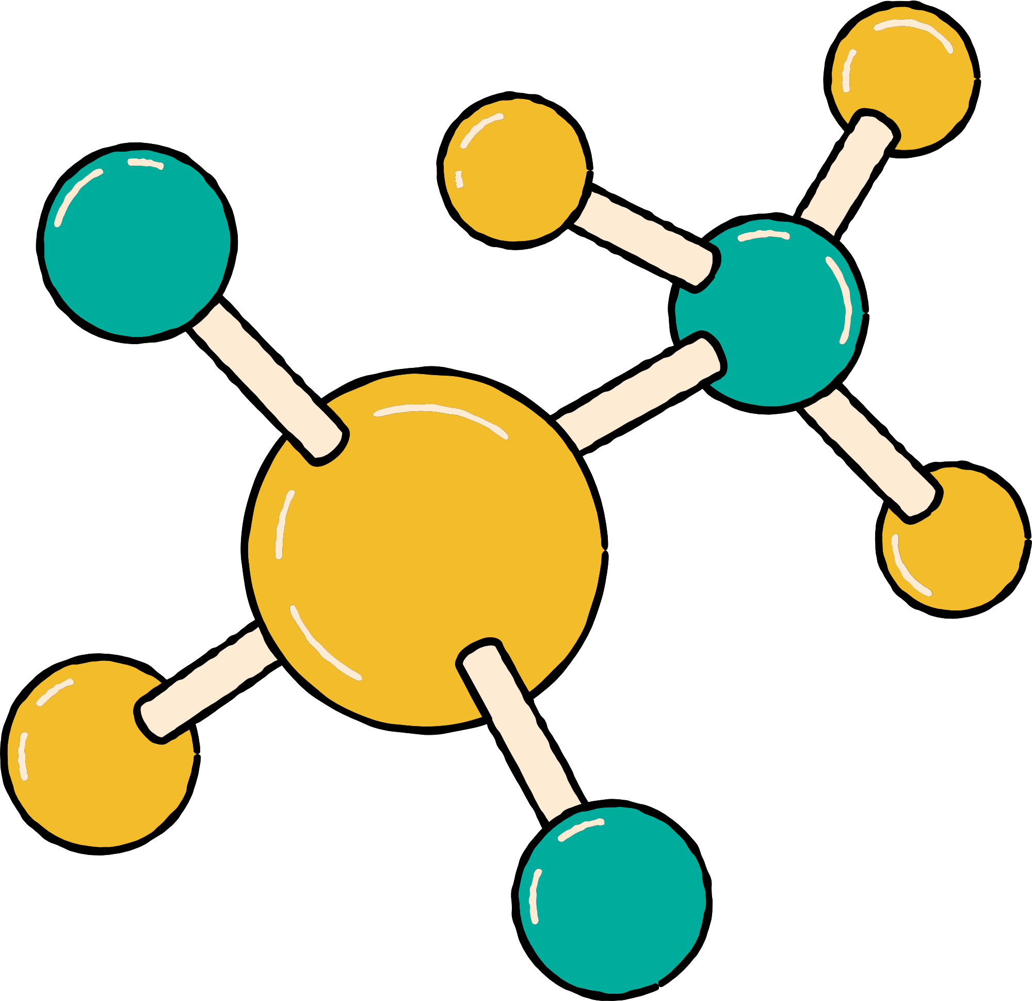


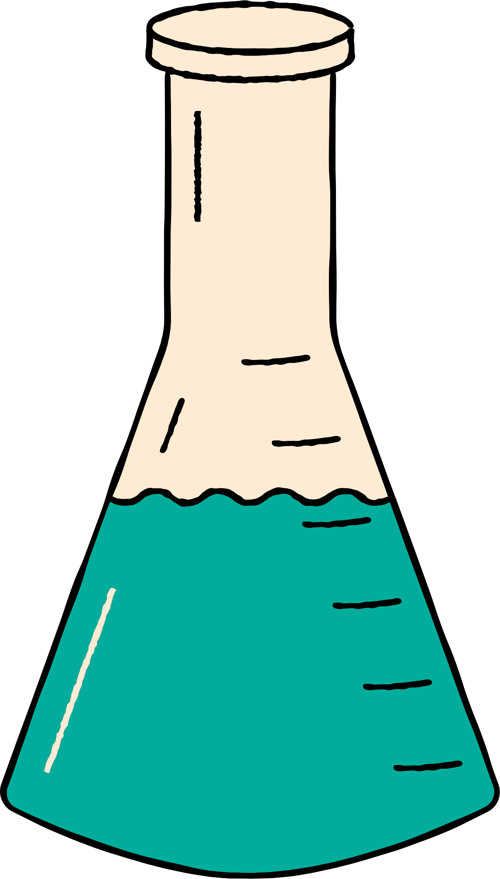



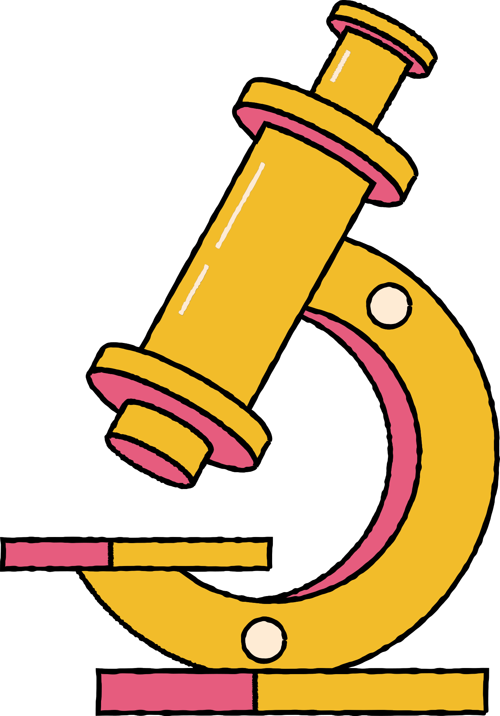






ALL ABOUT TARDIGRADES
ARIZONA ASTROBIOLOGY CENTER

Slide 2

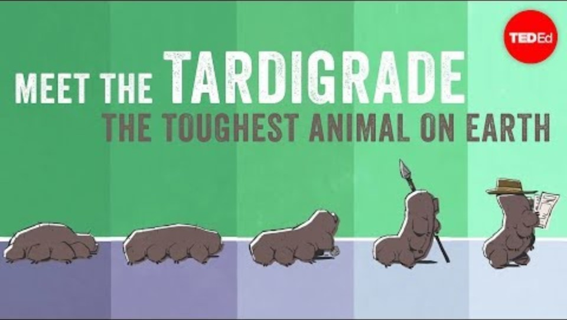
MEET THE TARDIGRADE, ONE OF THE TOUGHEST ANIMALS ON EARTH!

Slide 3
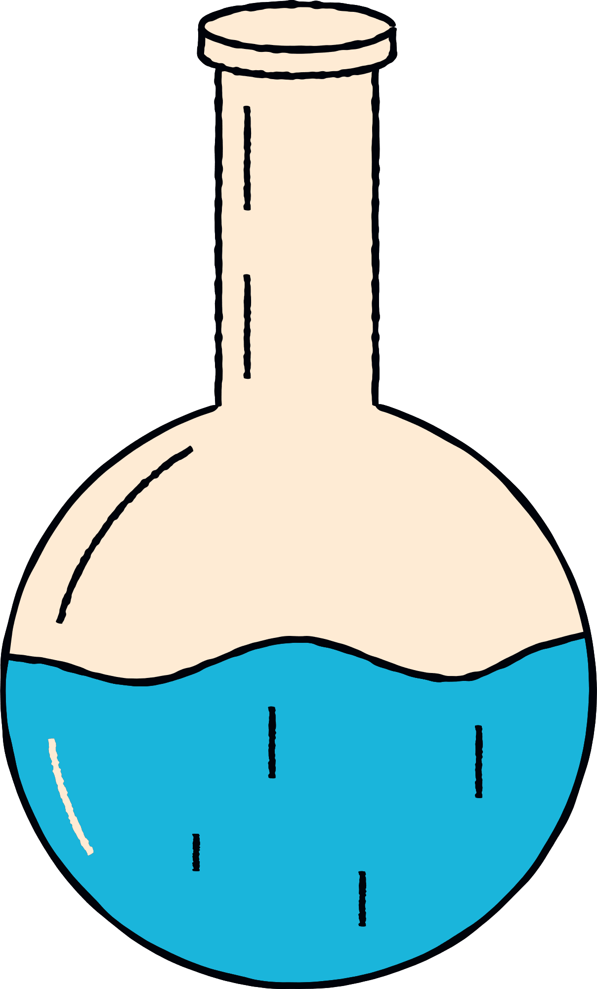
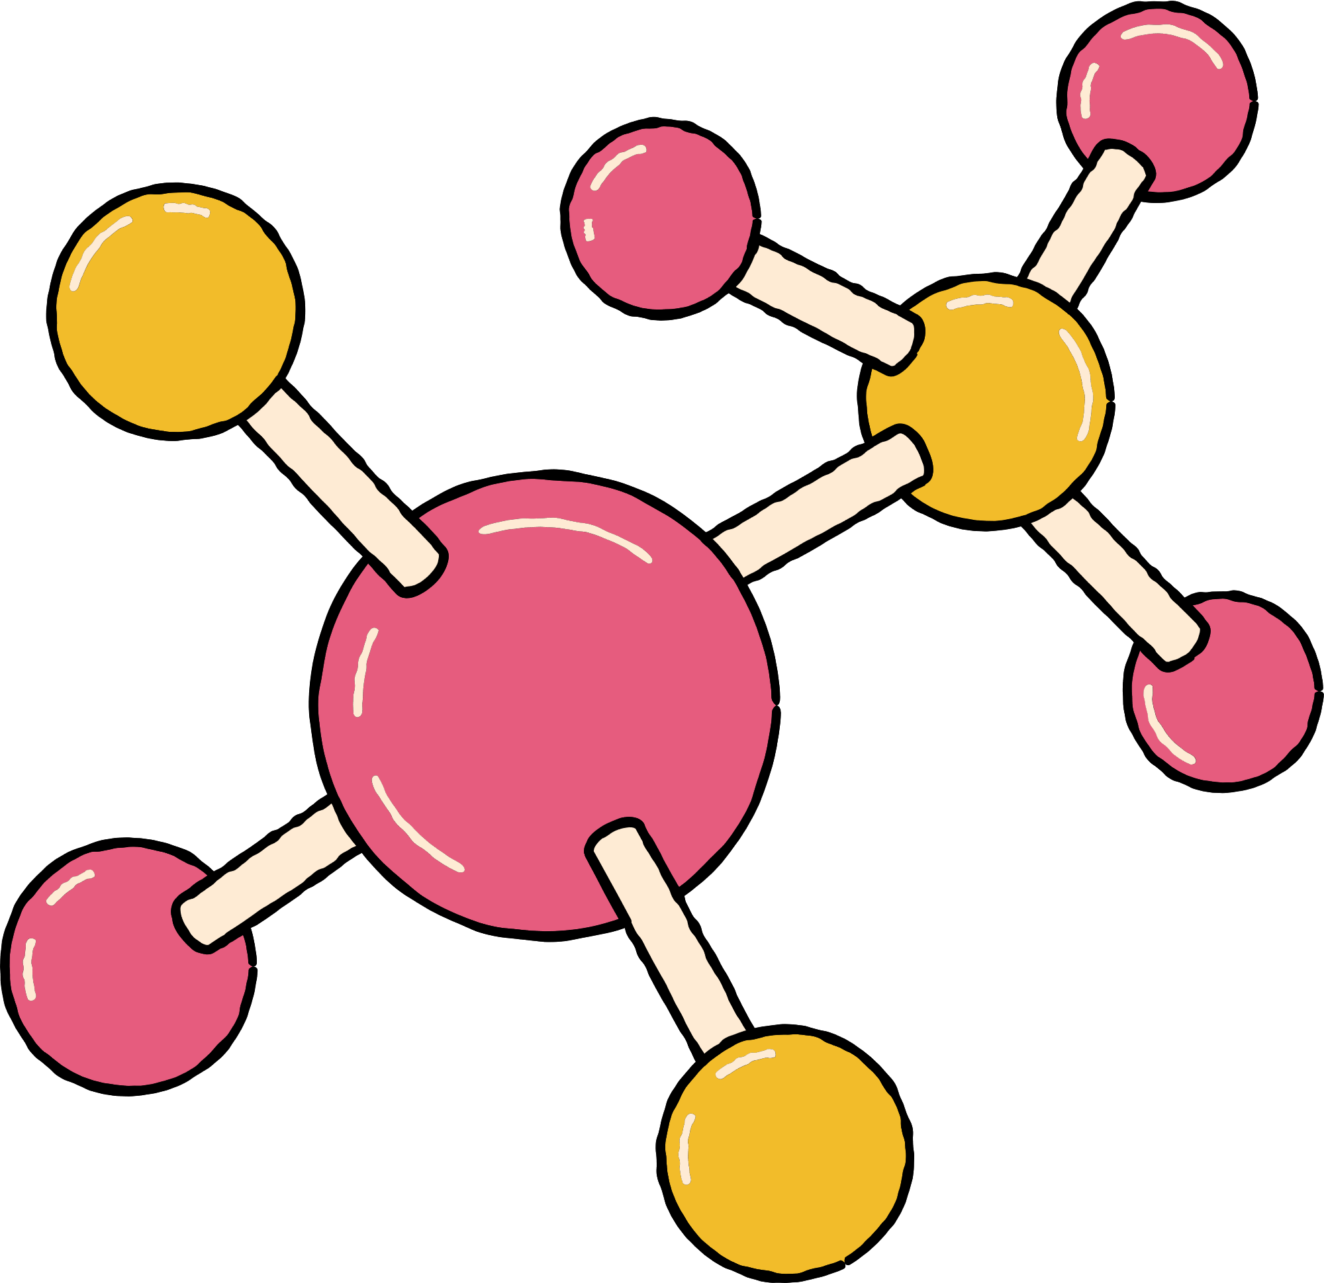


1:
FACTS ABOUT TARDIGRADES

Slide 4
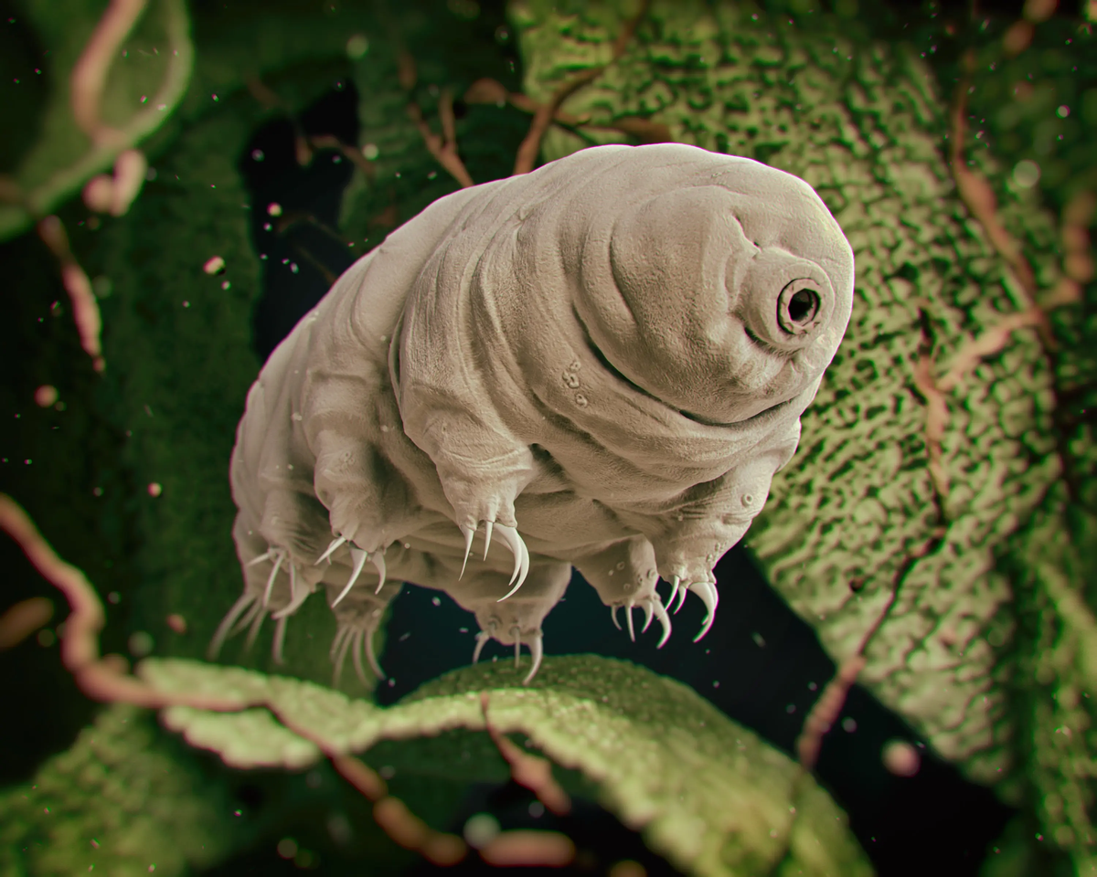
WHAT ARE TARDIGRADES?
  Tardigrades are tiny animals, about 1 millimeter long.
  They're also nicknamed water bears because of how they move and where they live.
  First discovered in 1773, scientists have now identified over 1,100 species.
Image Credit: Smithsonian Kids

Slide 5
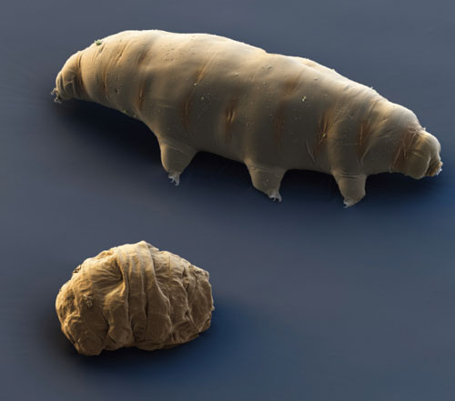
SURVIVAL WITHOUT WATER
  Most living things need water for their cells to function properly.
  Tardigrades can survive for decades without water!
  When water is scarce, they enter a "tun state" by curling into a dry, inactive ball.
  In this state, their cells are protected by special molecules that replace water and prevent damage.
  Once the water comes back, tardigrades can “come back to life” and move around again!
Image Credit: American Scientist

Slide 6

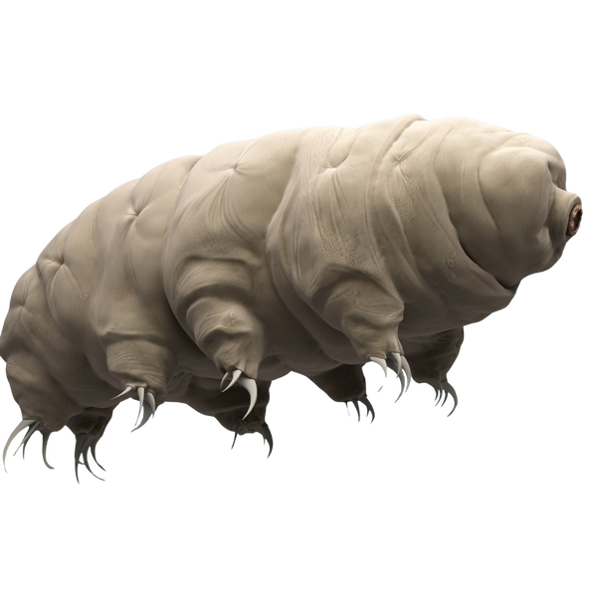
TOUGH IN EXTREME CONDITIONS
  Tardigrades can survive extreme temperatures, from below freezing to above the boiling point of water.
  They can handle high levels of radiation that would be deadly to humans.
  They've survived the vacuum and radiation of outer space during experiments.
This is NOT a real image. Tardigrades are microscopic and have been added to the image.
Image Credit: Gale Blog

Slide 7

WHERE THEY LIVE
  Tardigrades are found all over the world: in oceans, freshwater, deserts, and polar ice.
  They live on every continent, including Antarctica.
  You might find them in moss and lichen in your backyard, with a microscope and some patience.
  Their ability to survive harsh conditions makes them one of the most widespread animals on Earth.

Slide 8
2:
TARDIGRADES AS EXTREME LIFE

Slide 9
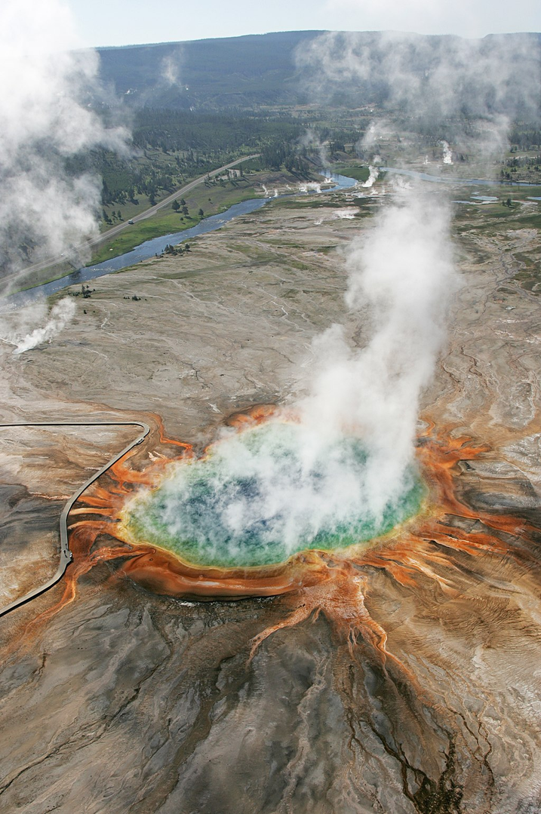
WHAT ARE EXTREME ENVIRONMENTS?
  Extreme environments are places where most life can't survive, like very hot, cold, dry, salty, or acidic places.
  Some examples on Earth include deep ocean vents, hot springs, Antarctica, deserts, and volcanoes.
Image Credit: Yellowstone National Park

Slide 10
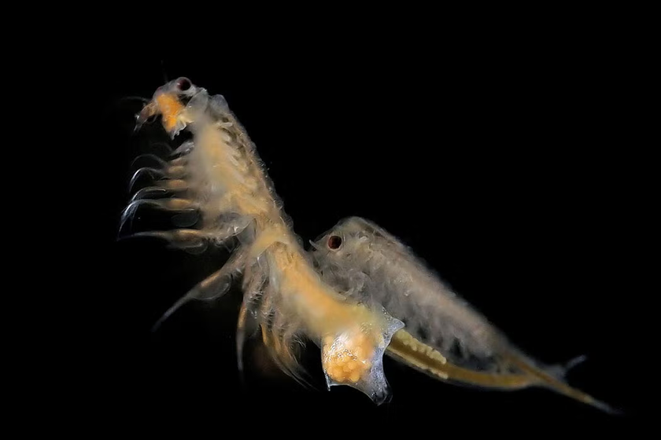
WHAT ARE EXTREMOPHILES?
  Extremophiles are living things that thrive in extreme environments.
  Most of these organisms are bacteria or archaea, but some are complex, multi-cellular animals, like the sea monkey (brine shrimp) pictured to the right.
  These organisms have special ways to survive, like strong cell walls or protective proteins..
Image Credit: Wikimedia Commons

Slide 11




TARDIGRADES ARE EXTREMOPHILES!
  Most extremophiles can survive one type of extreme condition, like heat, cold, or dryness.
  Tardigrades are unique because they can survive many extremes, not just one.
  They handle:
    Extreme temperatures (hot and cold)
    Dry environments by drying out into a tun
    Radiation levels that would kill other life
    High pressure and vacuum (like outer space!)

Slide 12

WHY SCIENTISTS STUDY TARDIGRADES
  Scientists hope to learn how tardigrades protect their cells during stress.
  This research could help improve how we store vaccines or food without refrigeration.
  It might also help us grow crops that survive drought and other extreme weather.
  Astrobiologists are also very interested in tardigrades (we will discuss this next).

Slide 13
3:
ASTROBIOLOGY & TARDIGRADES

Slide 14
WHAT IS ASTROBIOLOGY?
  Astrobiology is the study of life on Earth and in the universe beyond.
  Scientists ask big questions like:
    How did life begin?
    Is there life on other planets?
    What do living things need to survive?
  It combines science from biology, astronomy, chemistry, geology, and other fields of study.
  Astrobiologists look for signs of life on planets, moons, and even in space.
  They also study extreme environments on Earth, like deep oceans, volcanoes, or Antarctica, to learn where life might survive elsewhere.

Slide 15
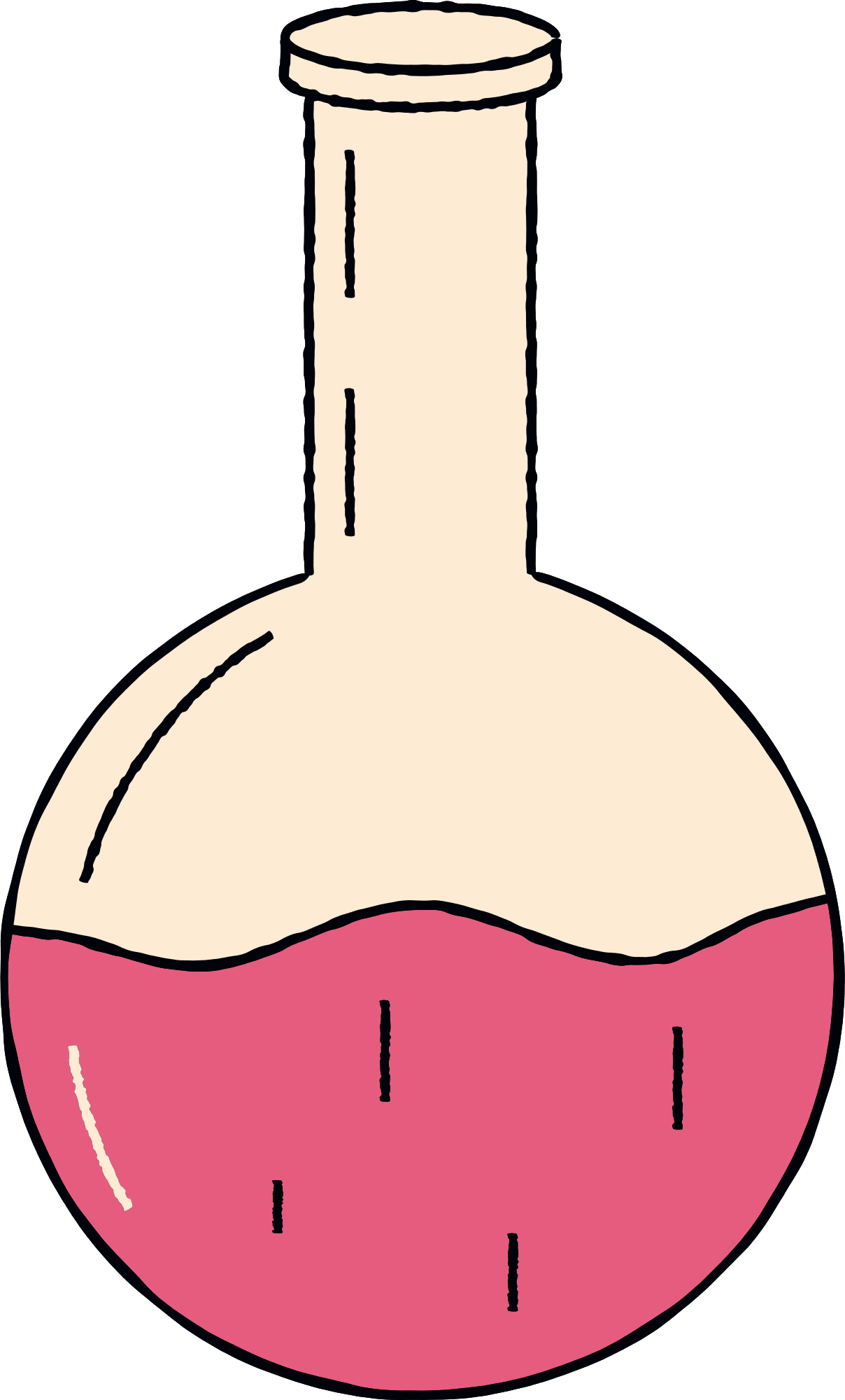

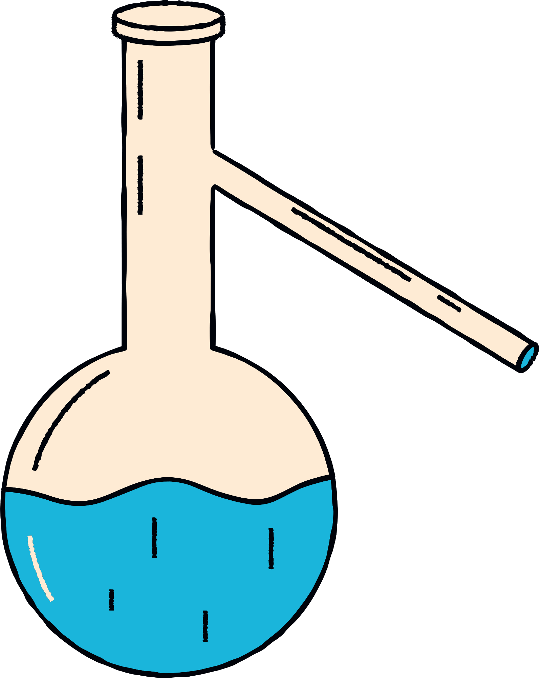
WHY DO YOU THINK ASTROBIOLOGISTS STUDY TARDIGRADES?
(HINT: THERE ARE MANY REASONS!)
Notes:
Call on students to answer this question! Make it a discussion

Slide 16
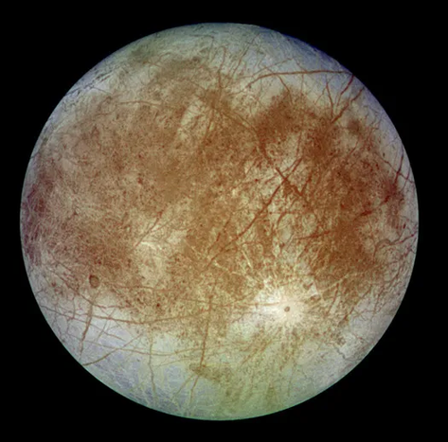
CAN LIFE EXIST ON OTHER PLANETS?
  Tardigrades survive extreme cold, high pressure, and no sunlight, just like conditions on places like Europa, one of Jupiter’s moons.
  Europa has an icy surface and a salty, liquid ocean underneath, and astrobiologists think it could possibly support life.
  By studying how tardigrades survive similar conditions on Earth, scientists can imagine what kind of life might exist on Europa or other icy worlds.
  Tardigrades help us test the limits of life and explore where else in the solar system life might survive.
Image Credit: Popular Science

Slide 17
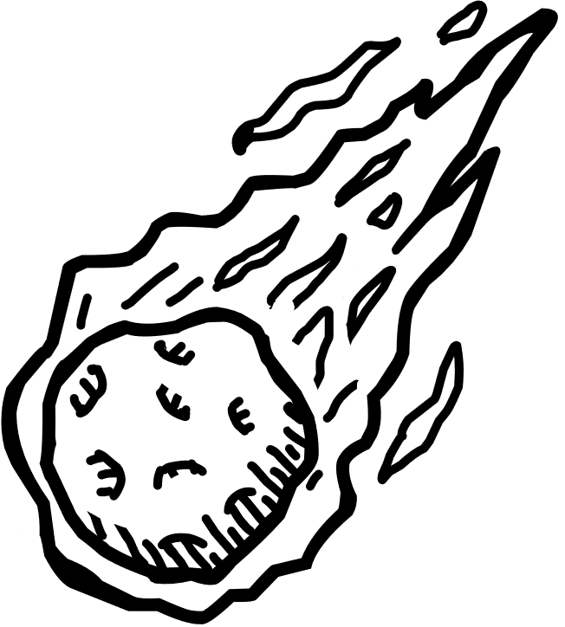
COULD LIFE ON EARTH HAVE COME FROM SPACE?
  The idea of panspermia means that life might have started somewhere else in space and traveled to Earth on an asteroid or comet.
  Tardigrades can survive the vacuum of space, including strong radiation, and impacts – just like what a space rock would experience.
  If tardigrades could survive space travel, it means life could possibly move between planets.
  Studying tardigrades helps scientists test if this idea that life came to Earth from somewhere else in space could be true.

Slide 18

PREPARING FOR SPACE MISSIONS
  Space is dangerous for living things – there’s radiation, extreme temperatures, and no air or water.
  Tardigrades survive all of these challenges, so astrobiologists study the adaptations they use to protect their cells and DNA.
  This could help us design better spacesuits, spacecraft, and survival systems for astronauts based on natural survival methods.
  Tardigrades might even inspire new ways to store medicine or food for long space trips.

Slide 19
3:
HOW TO LOOK AT TARDIGRADES

Slide 20
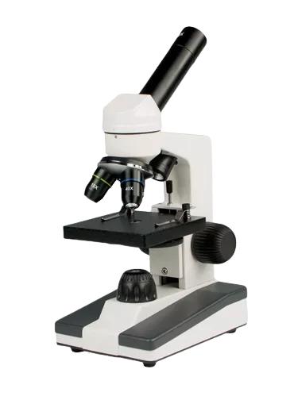
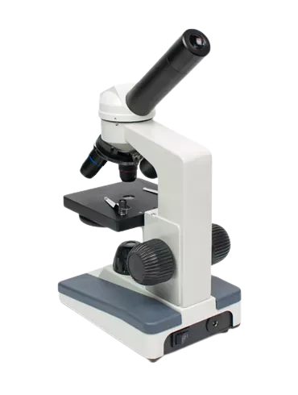
MICROSCOPE DIAGRAM
Eyepiece
Lenses, 3 different magnifications
Microscope stage with metal arms for the slide
Focusing knobs
Stage light
Base
Outlet port and power button

Slide 21
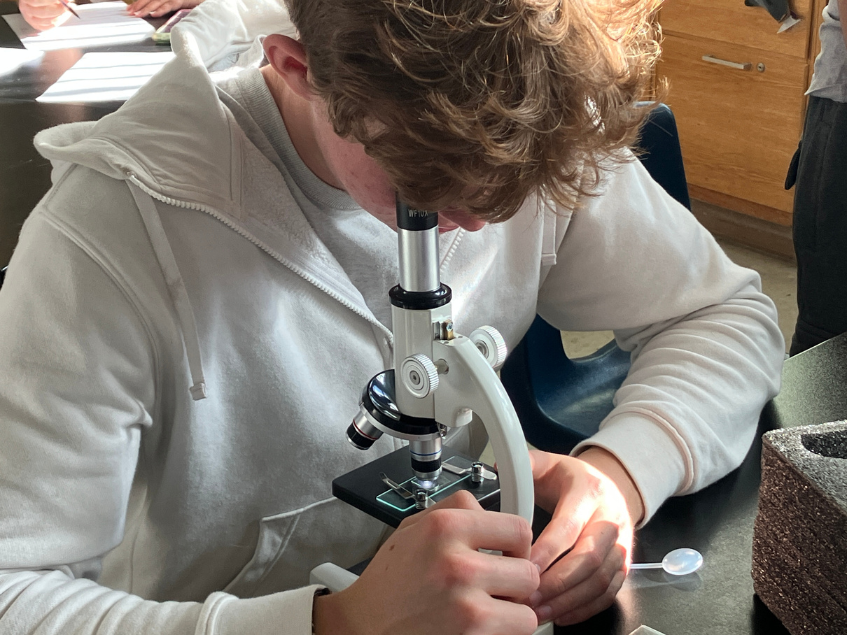
MICROSCOPE AND SLIDE SET UP
Prepare a Slide
  Use a clean glass slide with a small indentation in the center (called a well slide).
  Use a pipette to place a small drop of water from the tardigrade sample onto the slide. Look for algae clumps.
Place the Slide on the Microscope
  Carefully set the slide on the microscope stage, making sure the microscope is plugged in and the stage light is on.
  Start with the lowest magnification (usually 10x) to help find them more easily.
Focus and Search
  Use the coarse and fine focus knobs to slowly bring the image into view.
  Look for movement in or around the algae.
  Be patient: tardigrades may need a minute to start moving again after being disturbed.

Slide 22
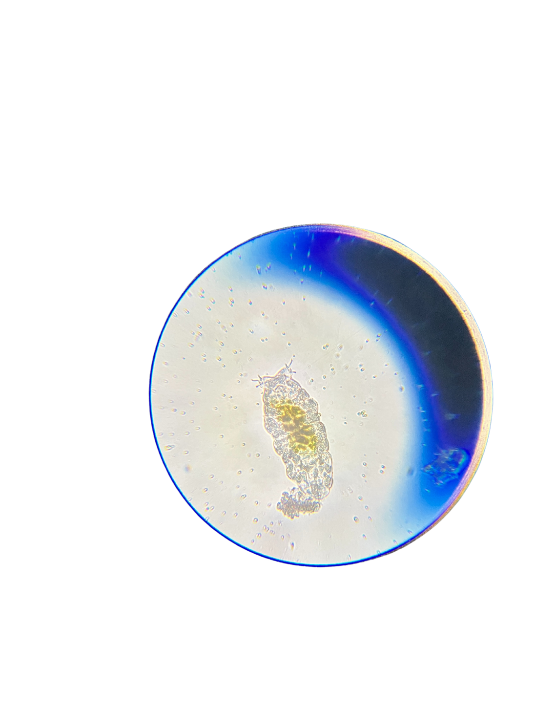
TARDIGRADE OBSERVATION WORKSHEET
Study the Diagram and Draw Your Tardigrade:
  Look at the diagram of a tardigrade’s body parts, and then draw the tardigrade you are observing, making sure to draw it exactly how you see it and labeling the body parts that are visible.
Fill Out the Tardigrade Observation Questions:
  While you are observing your tardigrade and its surroundings, fill out the questions on the back of the sheet.
  Pay attention to how the tardigrades interact with their surroundings, where tardigrades are usually found in the environment, and other signs of life.

Slide 23
MICROSCOPE AND SLIDE CLEAN UP
Keep the Slide Moist
  When observing the tardigrades, if the water starts to dry out: add a drop of water with the pipette to remove any air bubbles.
Clean Up Carefully
  When finished, gently return the tardigrades and water back to their container.
    Rinse the slide by adding a few drops of water, tilting it back into the container, and using the pipette to collect the rest. Repeat this until the slide is clean with no water or algae visible.
  DO NOT wipe off or throw away the tardigrades: this will kill them. They are living creatures and should be handled with care.

