Slide 1
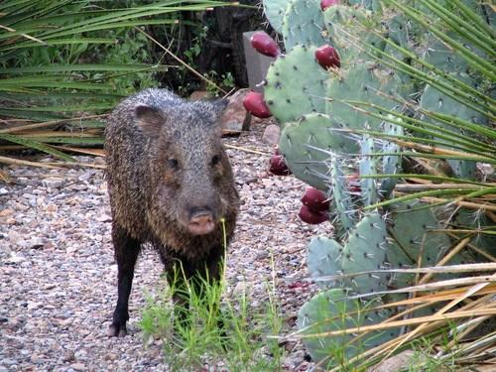
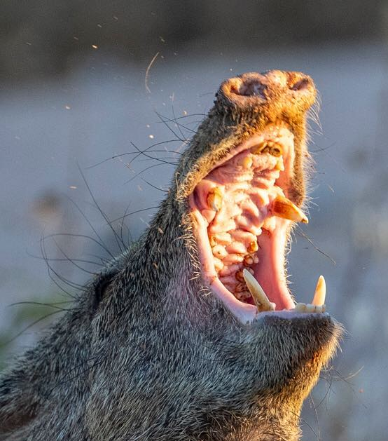
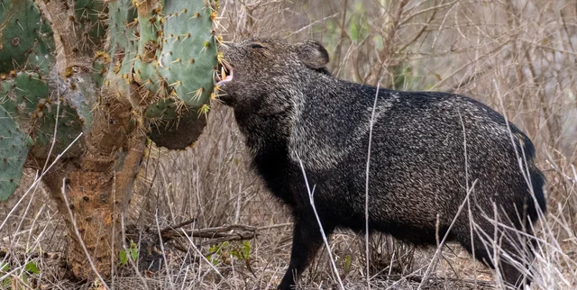
Javelinas
Animal
Javelinas can bite through cactus spikes because they have big teeth and strong mouths. This helps them get the water inside the cactus.

Slide 2
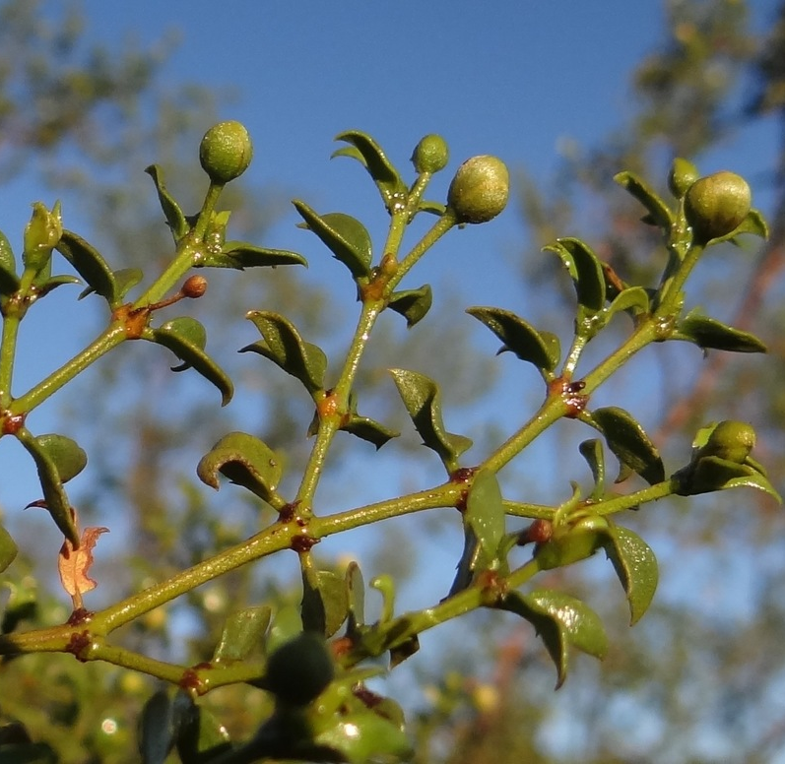
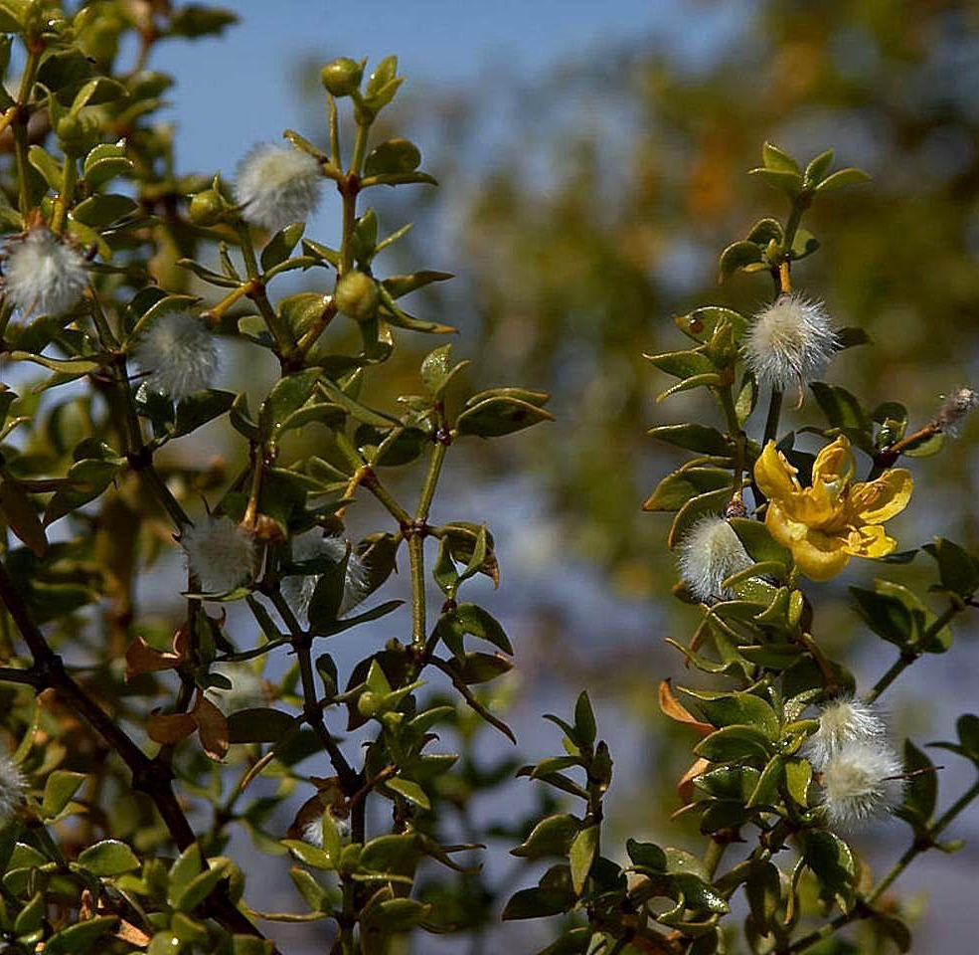
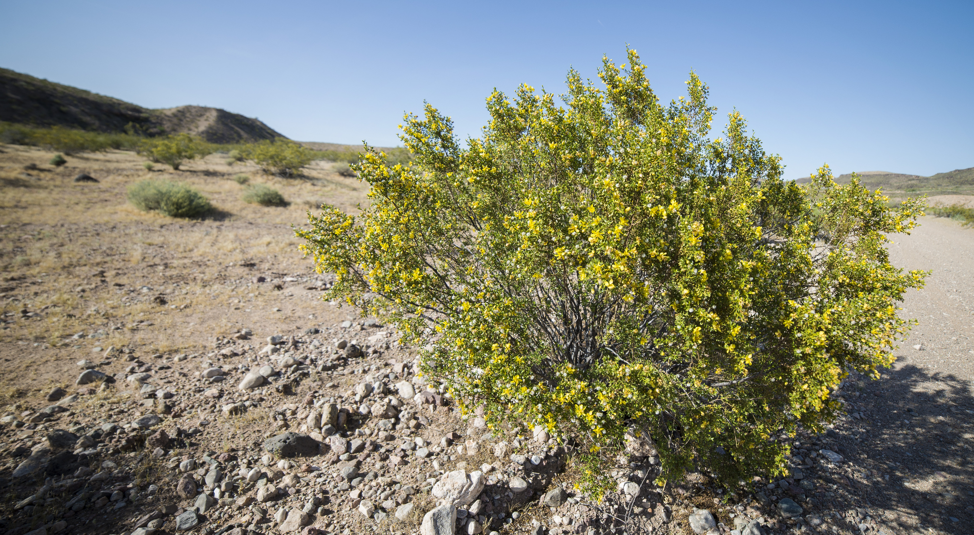
Creosote
Plant
Plants can lose water if their leaves are too big. Creosote bushes have small leaves with a waxy coating, so they don't lose as much water.

Slide 3
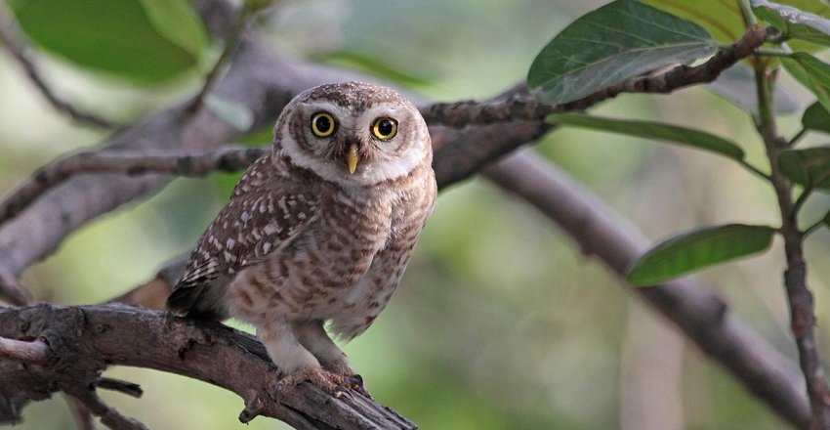
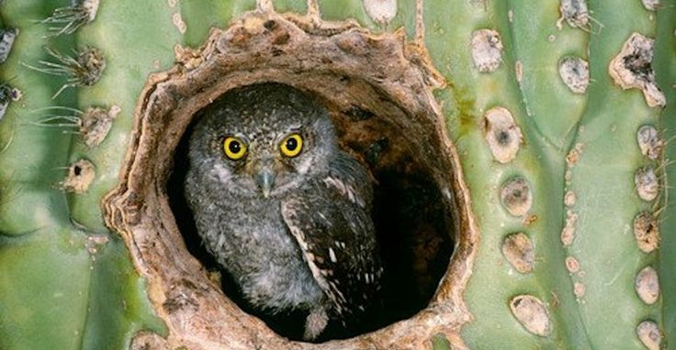
Elf Owl
Animal
Elf owls are tiny owls that live in the holes of a saguaro cactus. Inside the cactus is cooler and keeps them safe from the sun.

Slide 4
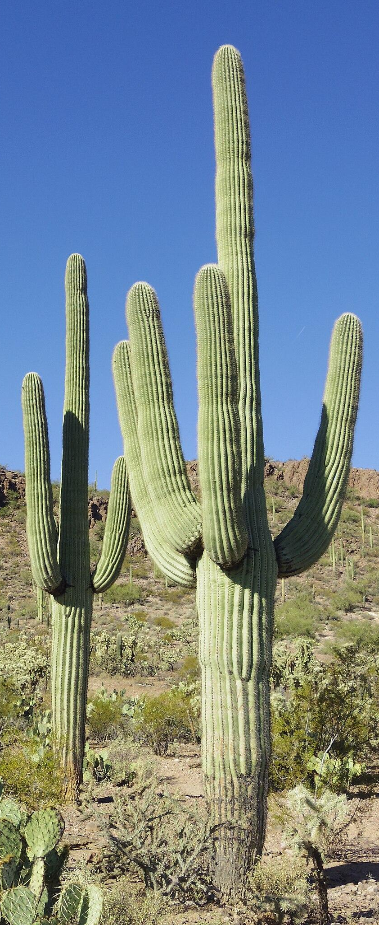
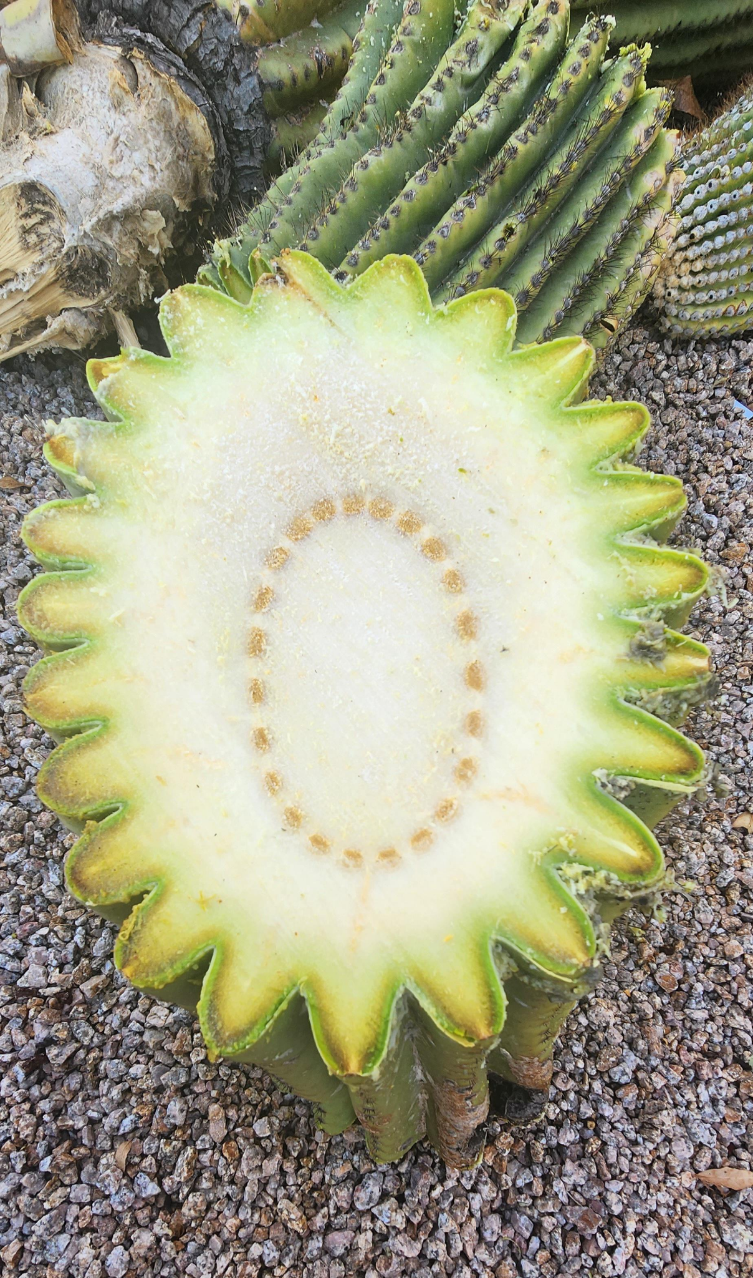
Saguaros
Plant
The inside of a saguaro cactus is soft and spongy. It can get bigger when it rains to hold lots of water. This helps the cactus save water for dry days.

Slide 5
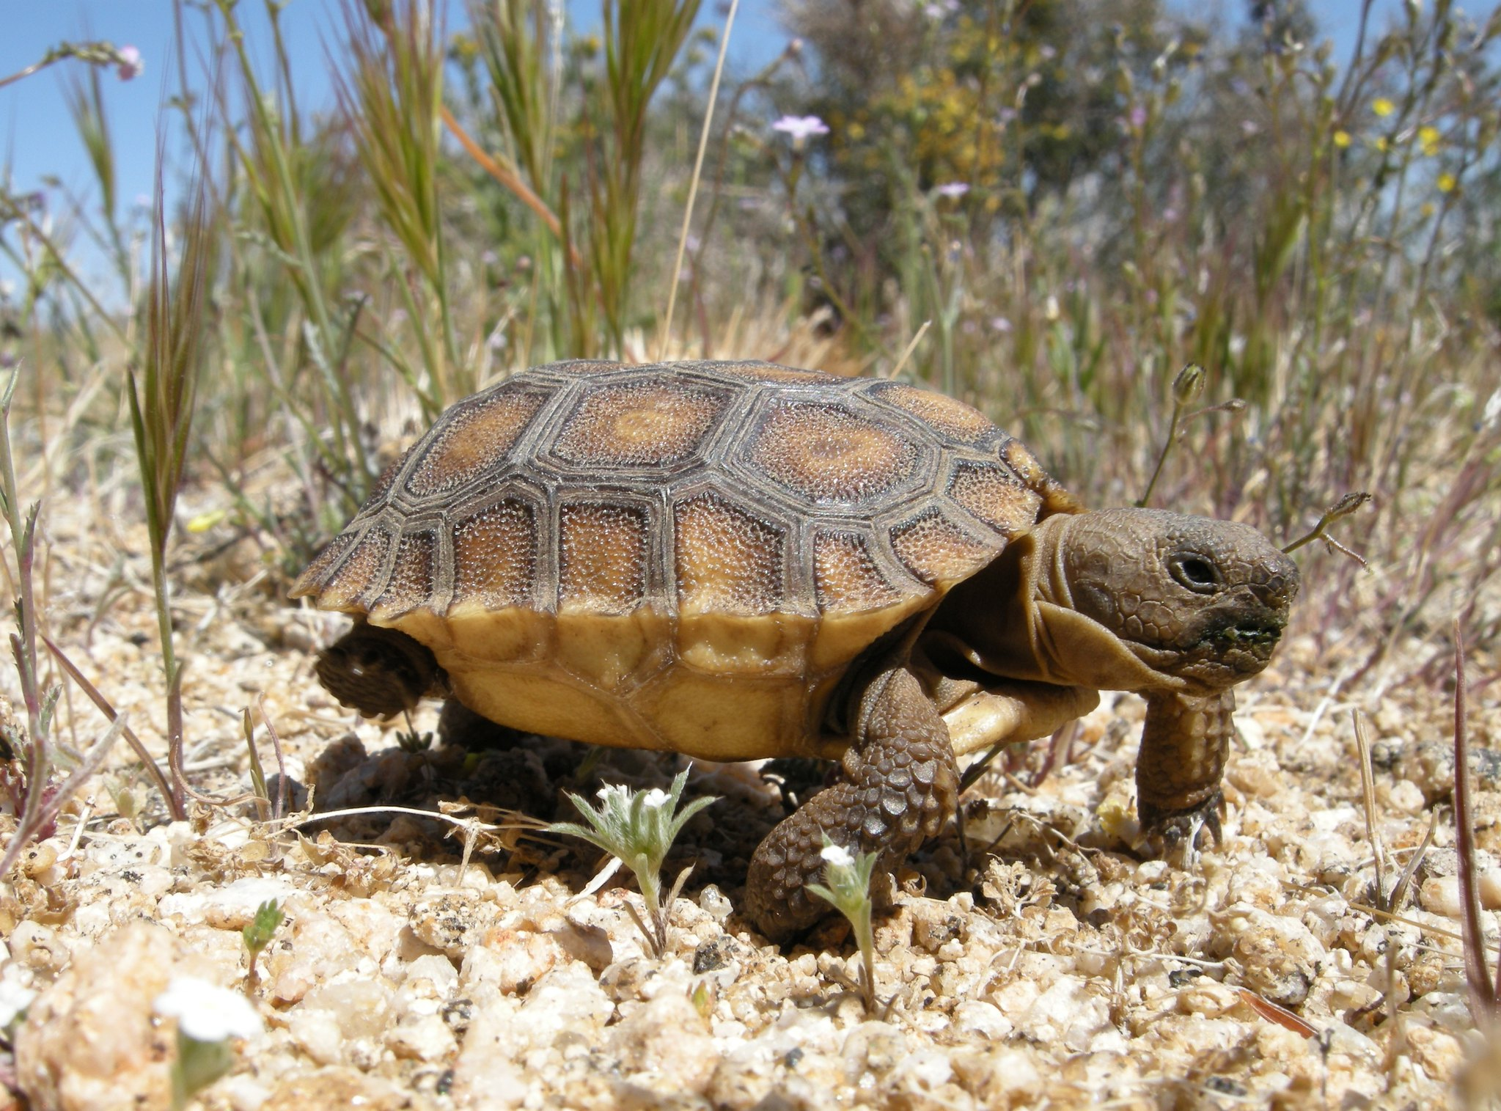
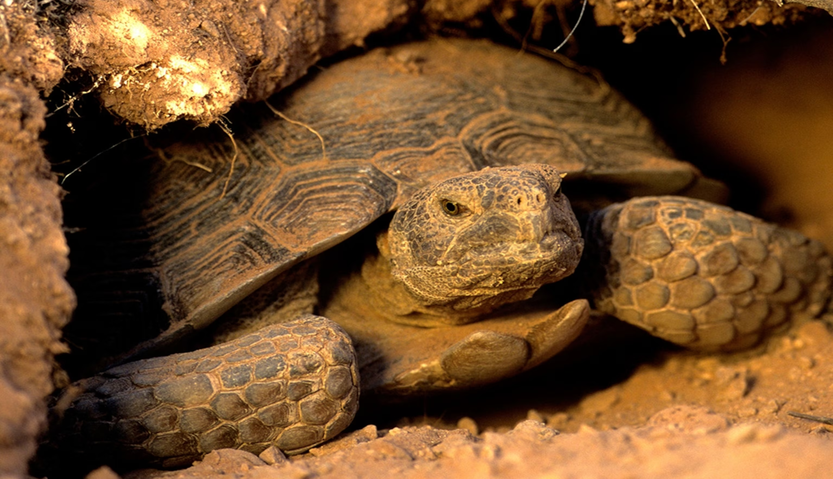
Desert Tortoise
Animal
Desert tortoises dig deep burrows to stay cool. Their bodies can store lots of water, so they can go a long time without drinking.

Slide 6
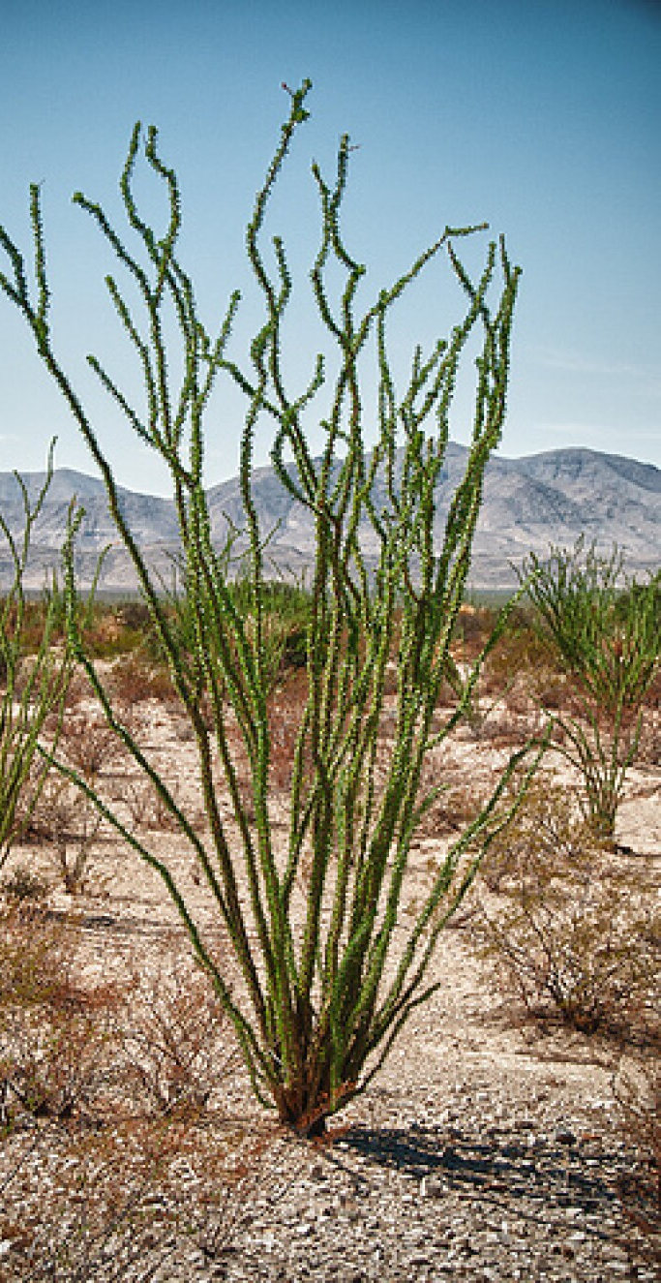
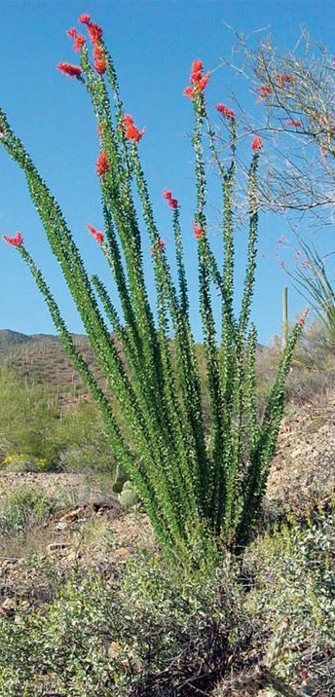
Ocotillo Plant
Plant
When it's dry, the ocotillo plant has no leaves. After it rains, it grows small green leaves to get energy from the sun.

Slide 7
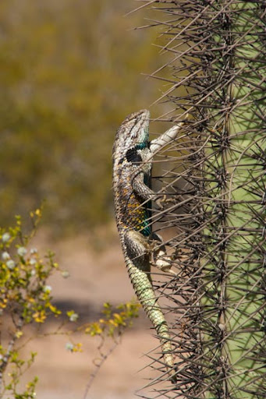
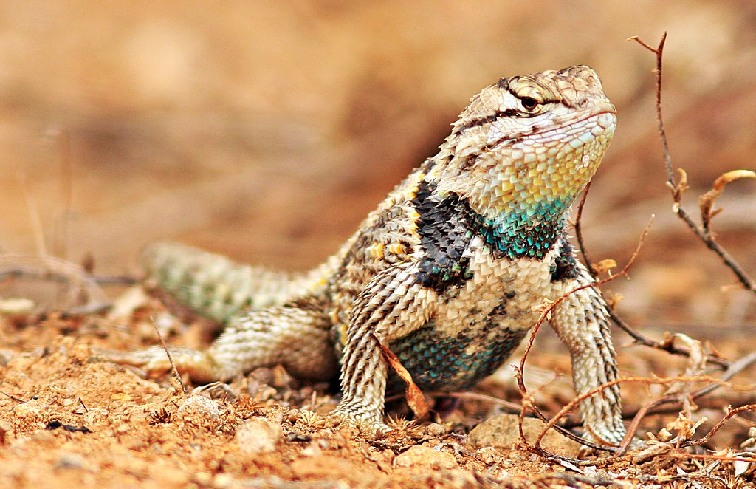
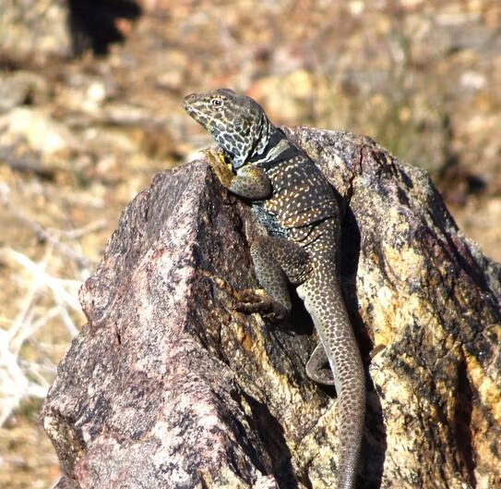
Spiny Desert Lizard
Animal
The spiny desert lizard has tough scales that help keep water inside its body. It looks for shade when it gets too hot.

Slide 8
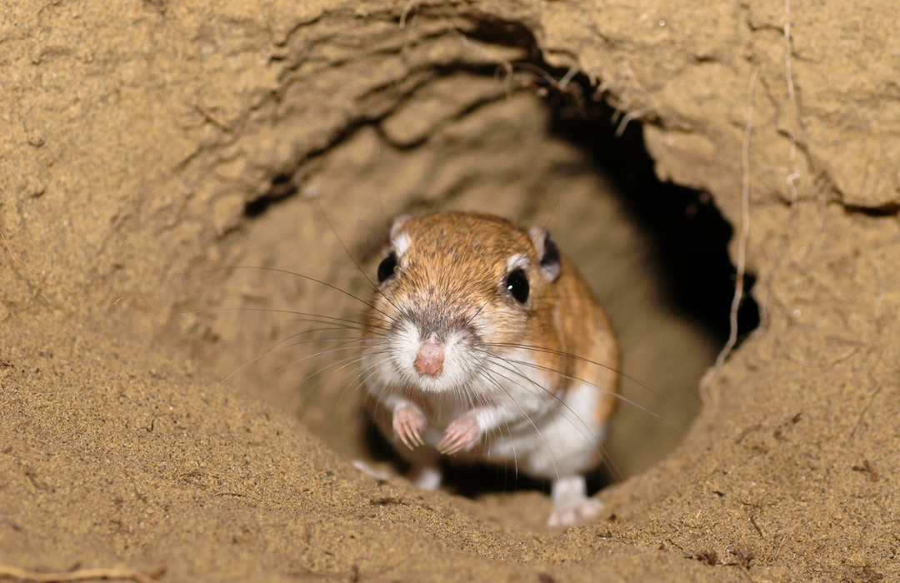
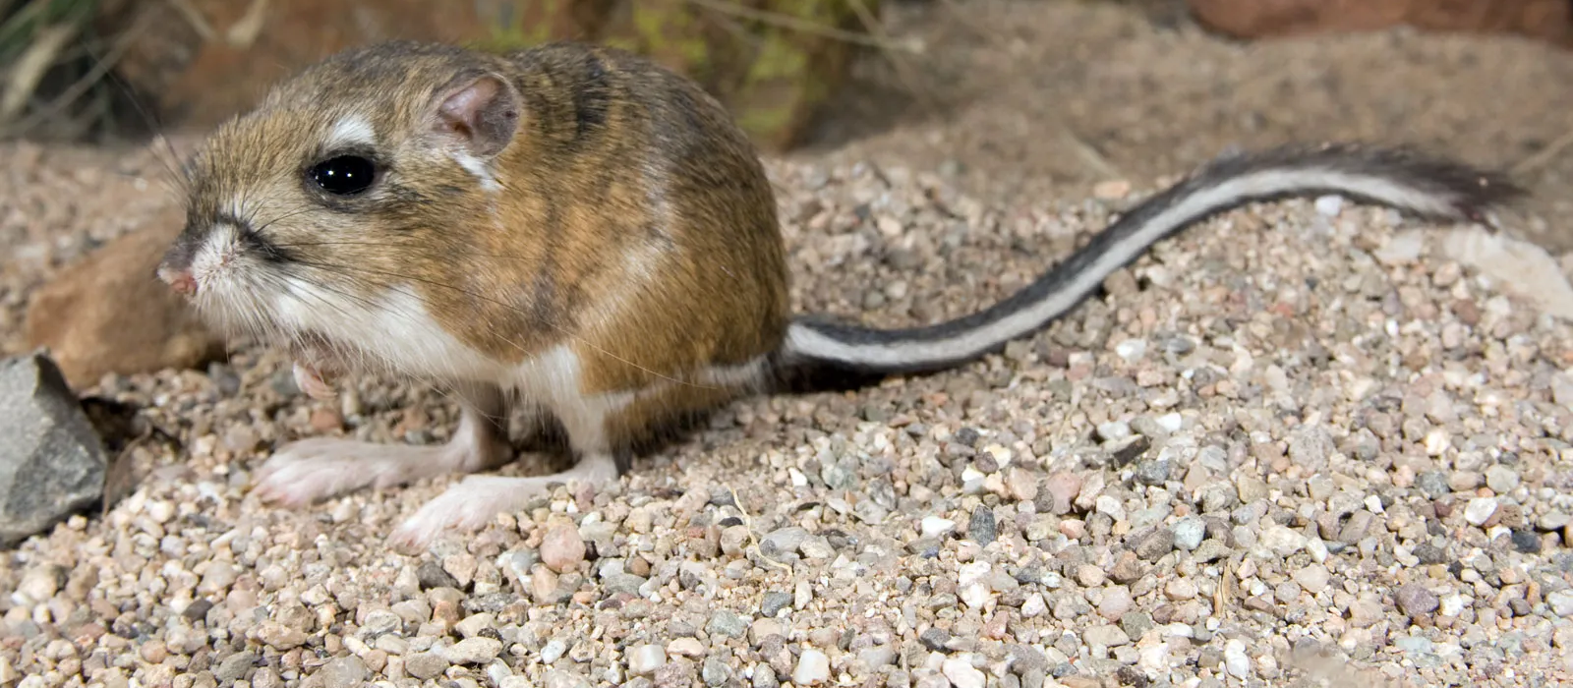
Kangaroo rat
Animal
The kangaroo rat never needs to drink water. It gets all its water from the seeds it eats.

Slide 9
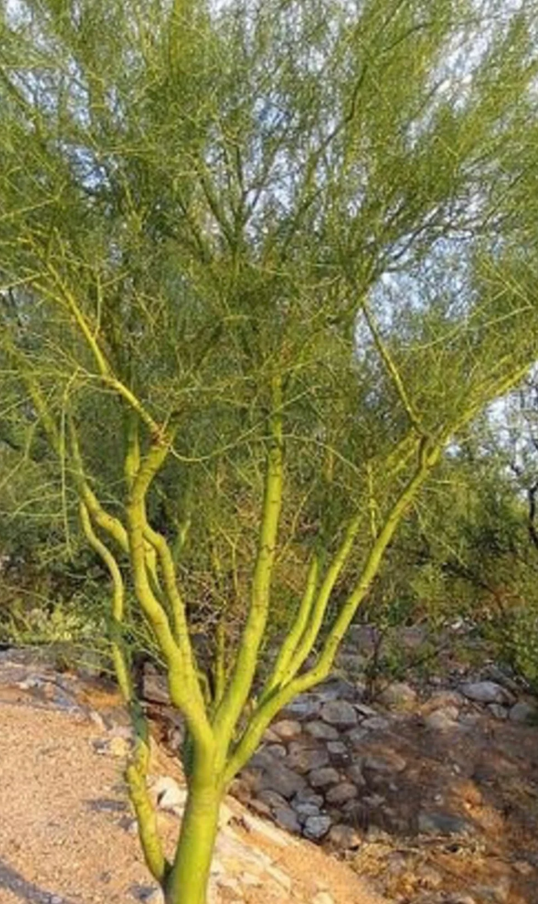
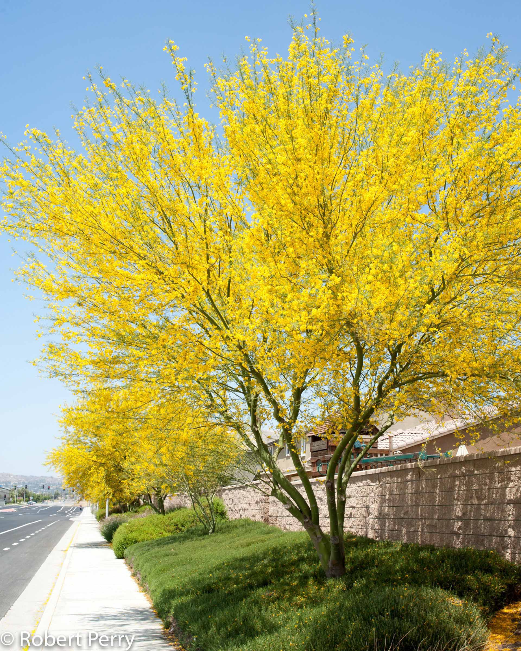
Palo Verde
Plant
Plants can lose water through their leaves if the leaves are too big. The palo verde has small leaves to save water. It also has green bark. The green bark helps the tree make food from sunlight, just like leaves do. This way, the tree can still grow even when it has very tiny leaves.

Slide 10
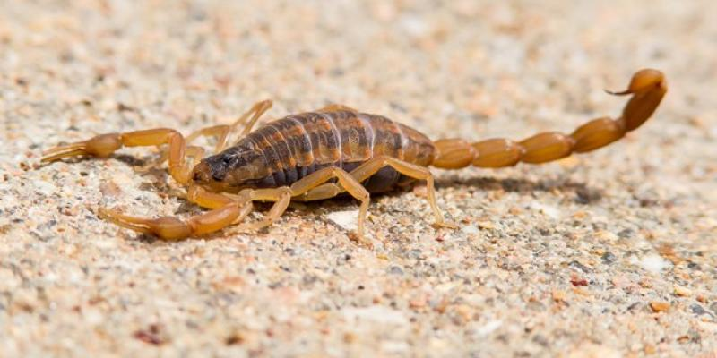
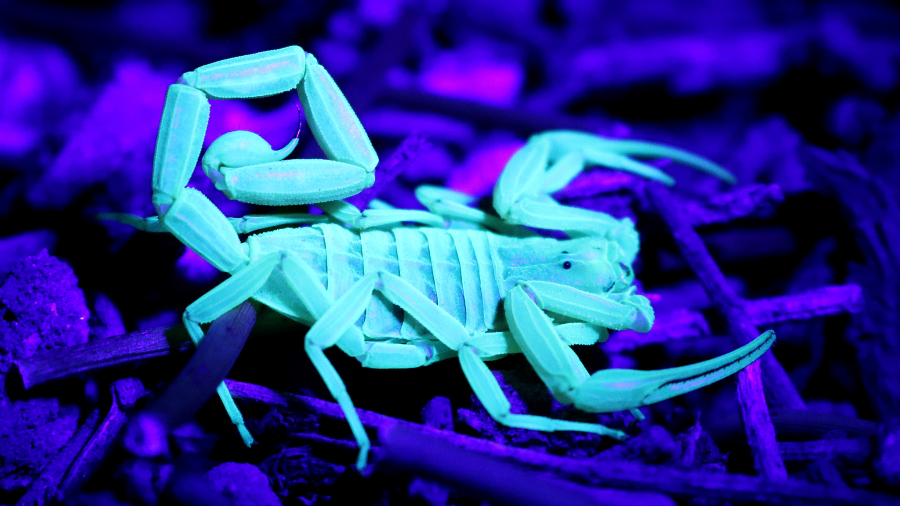
Arizona Bark Scorpion
Animal
The bark scorpion hides during the hot day and comes out at night when it’s cool. It uses very little energy because it moves slowly and rests a lot. This helps it stay alive for a long time without eating.

Slide 11
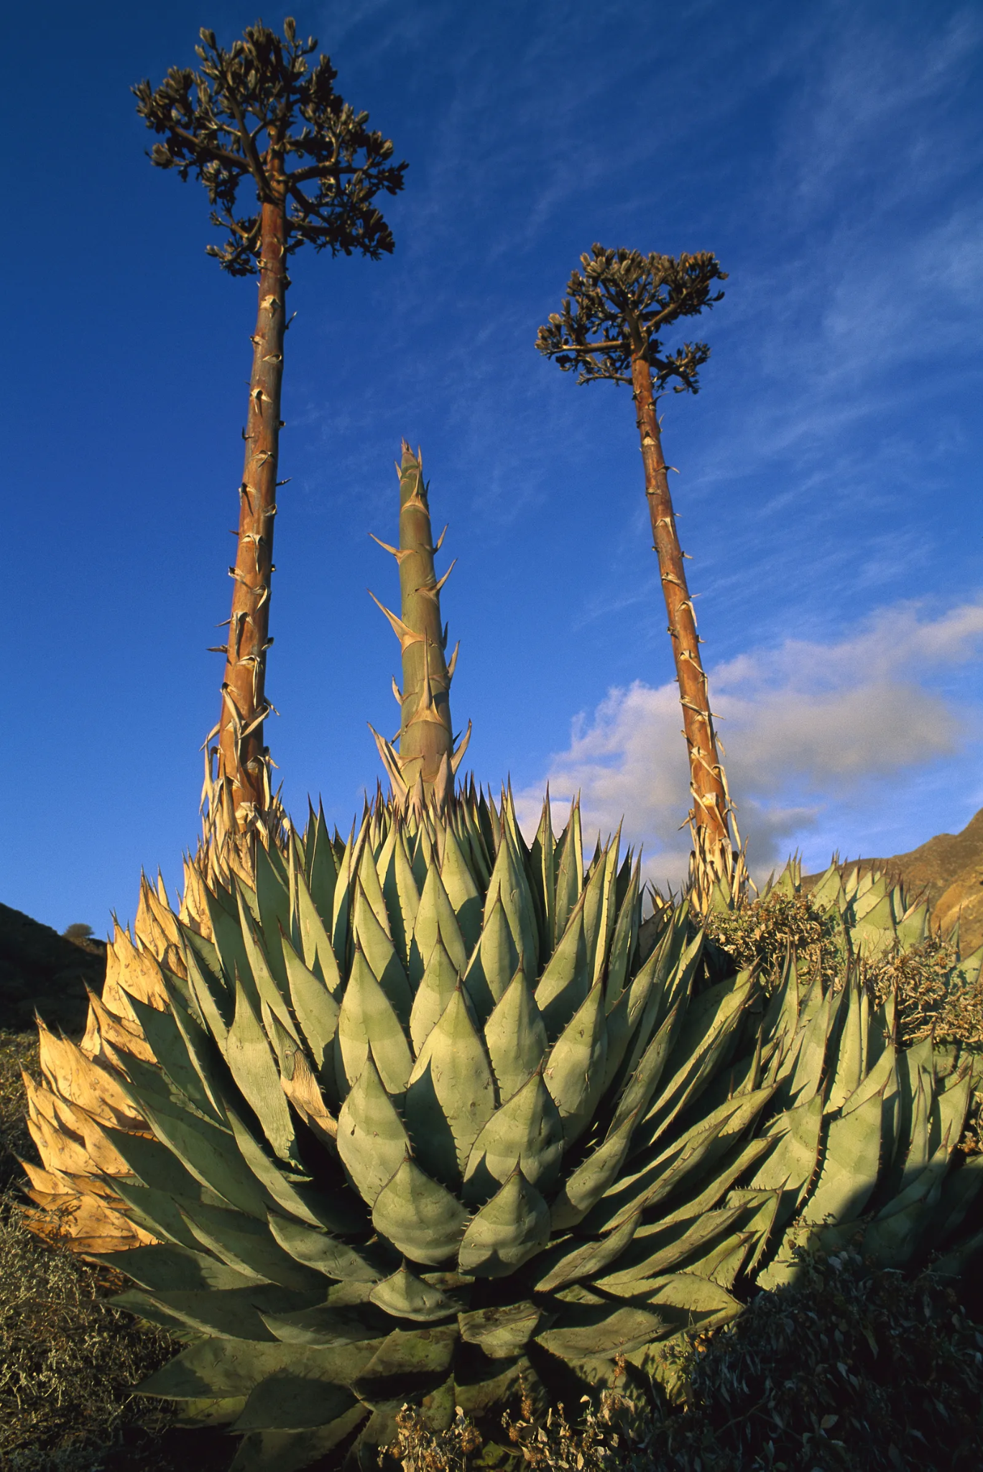
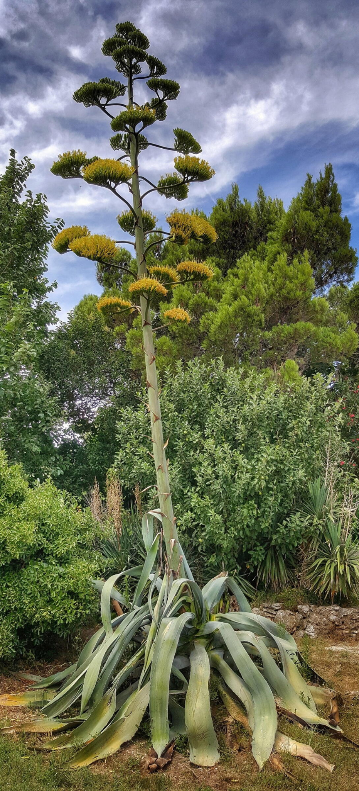
Agave
Plant
The agave plant has a waxy coating that helps it save water. Its special shape helps catch water and send it to its roots.

Slide 12
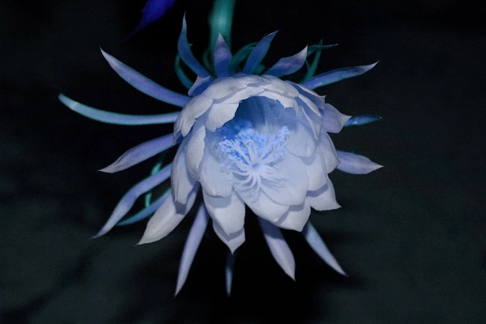
Plant
Night-Blooming Cereus
It opens its flowers at night when it's cooler. This helps keep its pollen safe from the hot sun.

