Slide 1
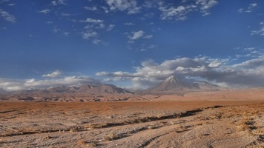
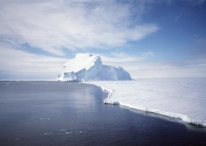
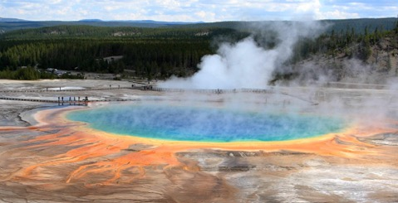
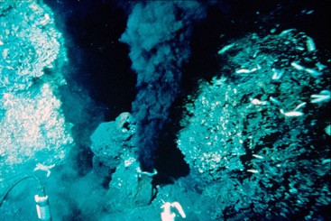
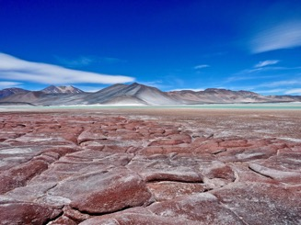
Extreme Life
Arizona Astrobiology Center

Slide 2
Why do astrobiologists care about extreme life?
Astrobiologists are interested in extreme life because these living things can tell us about the variety of environments that life is able to survive in, and the unique ways that it can adapt.
Try imagining an environment on another planet. It might be very different from Earth. We humans would probably consider it to be an extreme environment.
Understanding how life on Earth has adapted to different environments can help us think about different ways that life on other planets might be adapted.

Slide 3
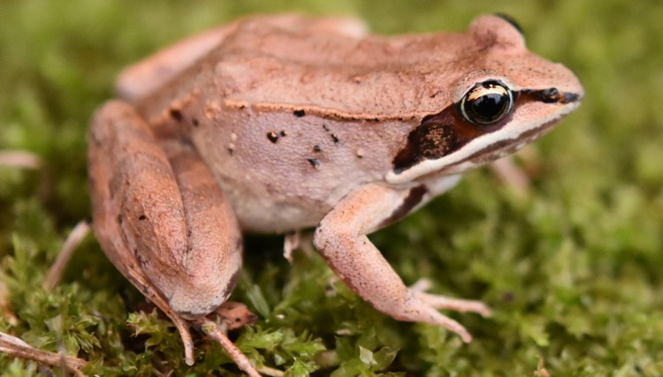
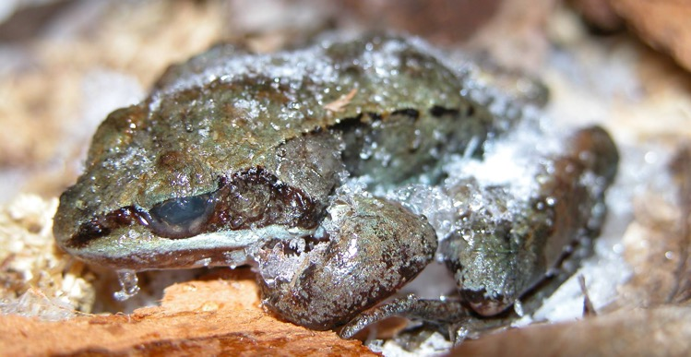
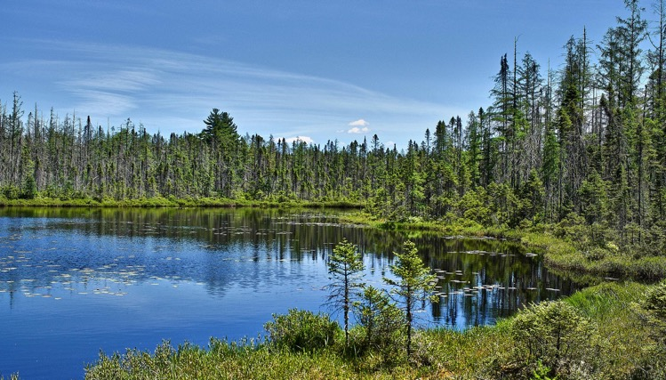
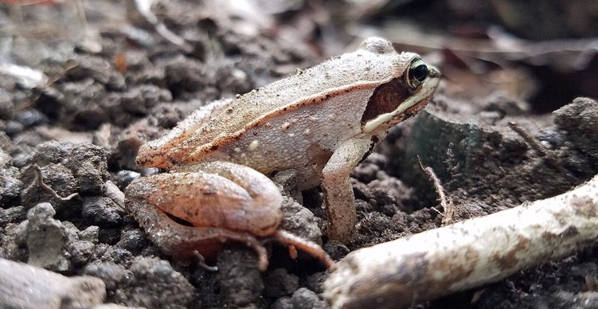
Wood Frog
Environment: Temperate Forests
Wood frogs live in forests and ponds that are warm and temperate during the summer, but are frozen all winter.
Some animals have strategies to stay warm during the cold winters, but wood frogs do the opposite. Their bodies are able to completely freeze during the winter. Then in the spring they, wake up and go back to being regular active frogs.

Slide 4
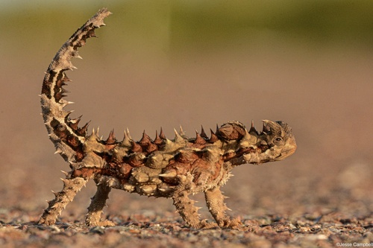
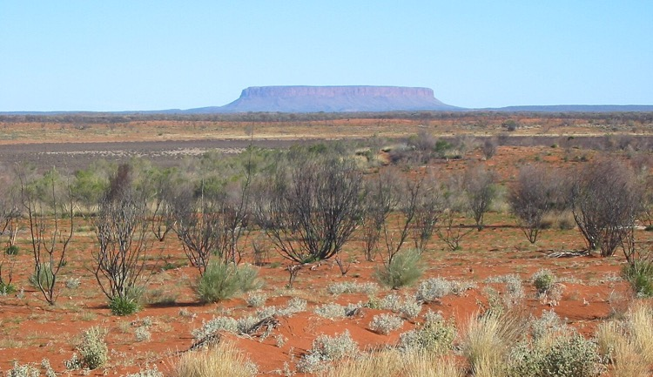
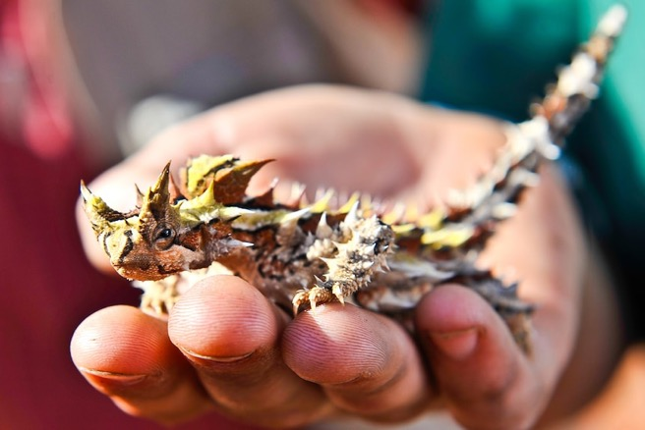
Thorny Devil
Environment: Australian Outback
These small spiny lizards live in Australia’s Outback desert, where there is very little water. Thorny devils have a very unique way of drinking that helps them get all the water they can.
Grooves between their scales form a network of channels leading to their mouth, so if they step in a small puddle or if droplets of water land on their back, the water can be transported to their mouth along their skin. Their tough scales also protect them and keep them from losing water.

Slide 5
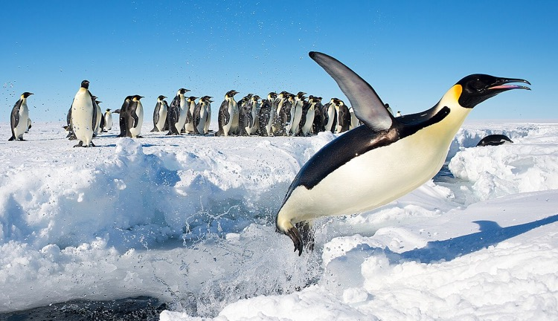
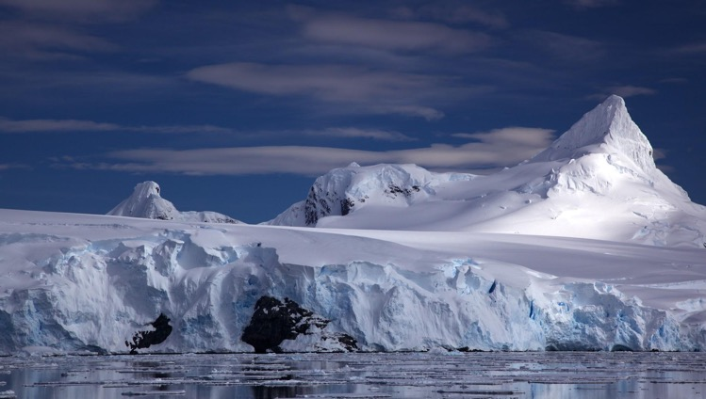
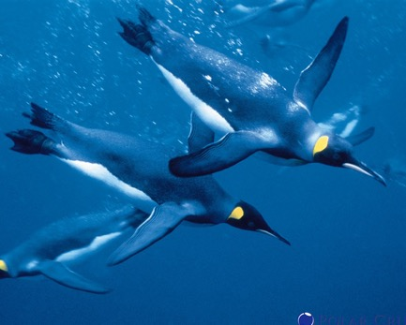
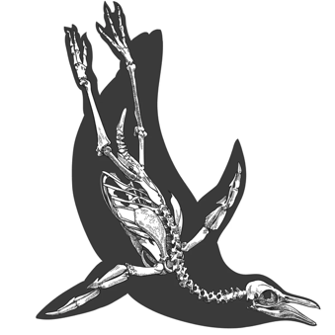
Emperor Penguin
Environment: Antarctica
Emperor penguins live on the frozen ice sheets of Antarctica and swim in the freezing cold ocean surrounding it. In the winter, the temperatures in Antarctica can get down to -50°F, so the penguins really need to stay warm.
They have a thick insulating layer of fat, a layer of soft feathers to trap warm air close to their skin, and a protective layer of waterproof feathers on top. They also huddle together in large groups to keep warm.

Slide 6
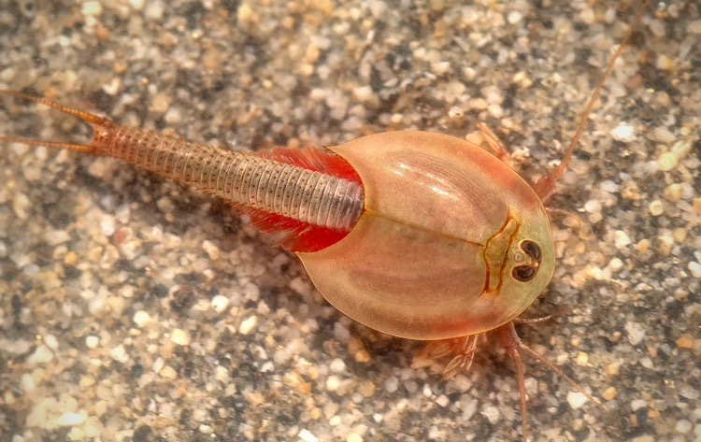
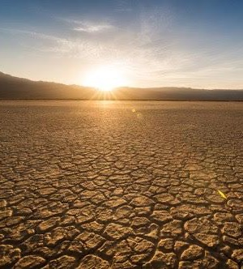
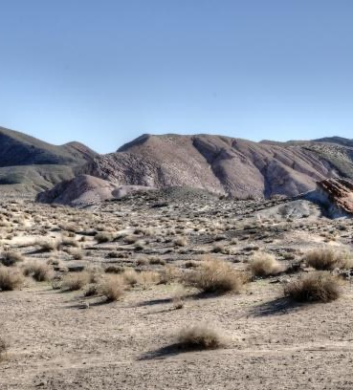
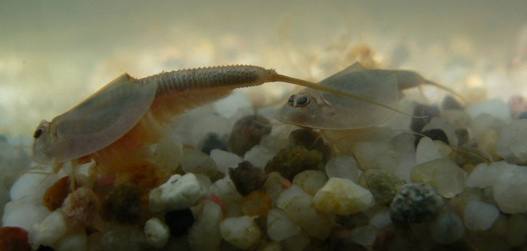
Tadpole Shrimp
Environment: Deserts with temporary pools of water
It may only rain once every few years in some deserts, and then the water quickly dries up again.
Tadpole shrimp eggs can last a very long time in the soil during dry times. The eggs are dry, but they’re still alive and just waiting for rain.
When it rains, they hatch and grow quickly, and then lay more eggs to last until the next rain.

Slide 7
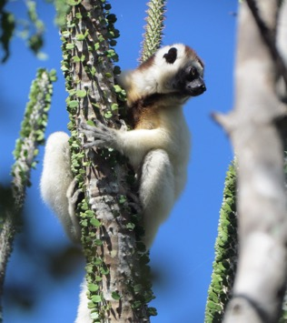
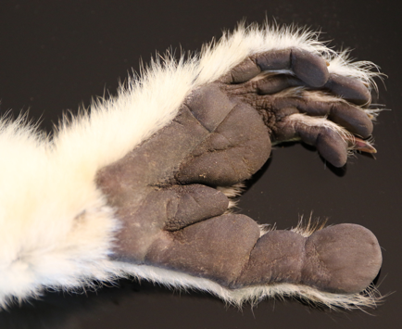
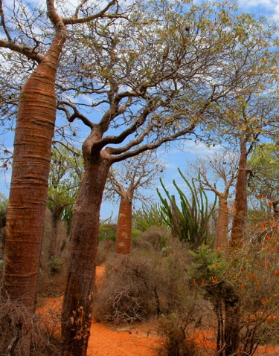
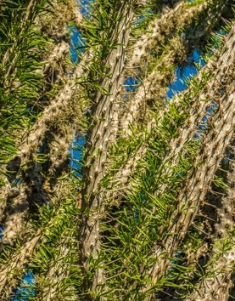
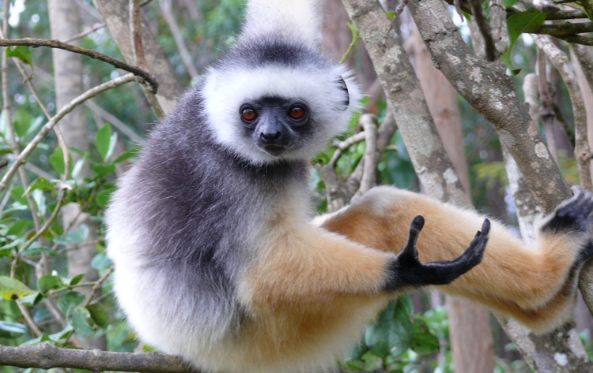
Sifakas
Environment: Spiny Forests of Madagascar
The island of Madagascar has forests full of spiny plants, which would normally be impossible to climb because of all the spines, but not for sifaka lemurs.
They have thick pads on their hands and feet to protect them from the spines and they’re excellent at maneuvering around the spines too. They can even jump huge distances from one plant to another.

Slide 8
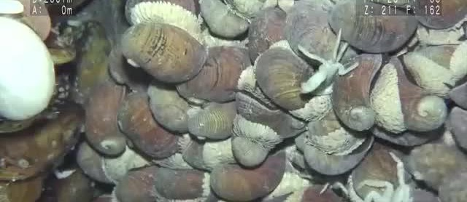
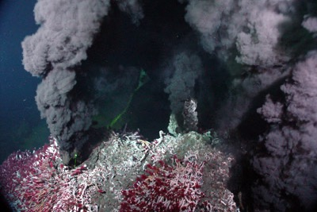
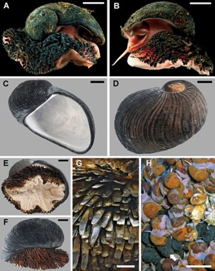
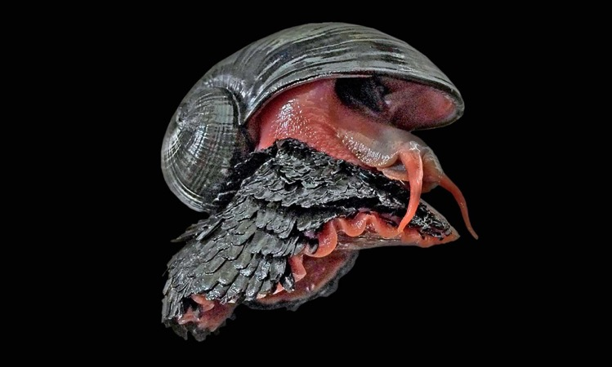
Volcano Snail
Environment: Deep Sea Hydrothermal Vents
These unique snails live around hydrothermal vents deep in the ocean. At the depths where they live, there is very high pressure from the water above. To protect the snails from the pressure, they have extremely tough shells made of iron minerals. No other animals have a shell or skeleton made of iron.

Slide 9
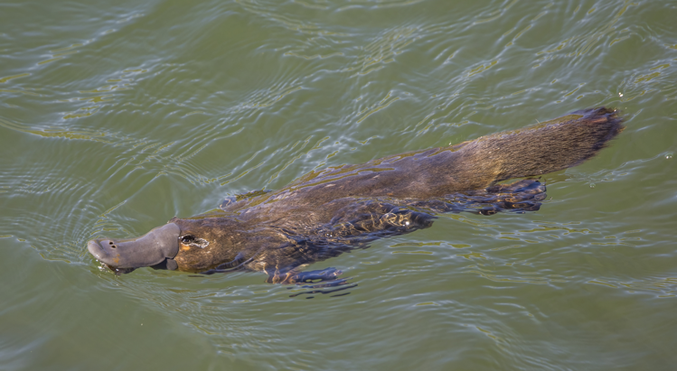
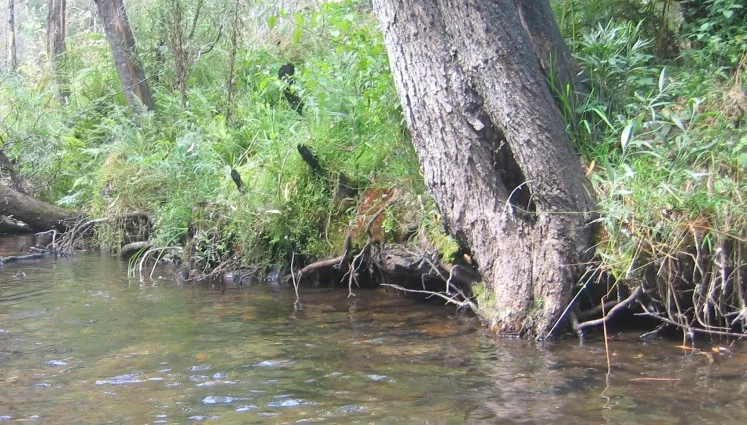
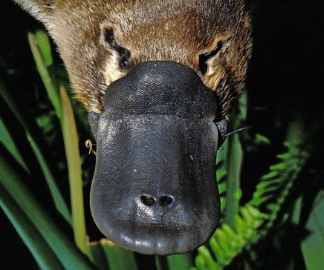
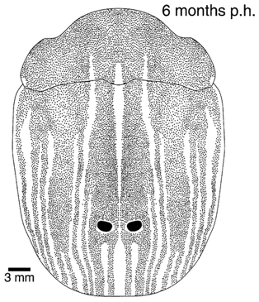
Platypus
Environment: Murky rivers and streams
Platypus forage for food in cloudy streams and rivers, where it can be very hard to see. This would make it very challenging to find food, since the water makes it nearly impossible to see. Platypus are able to find food there because they have an additional sense that we don’t have. When they swim, they close their eyes, nose, and ears, and instead use electroreceptors on their bills to forage, sensing tiny electric currents produced by their prey.

Slide 10
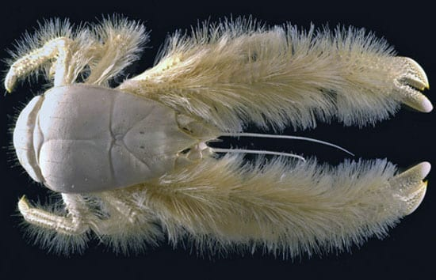
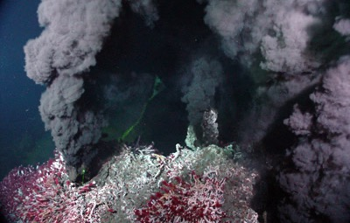
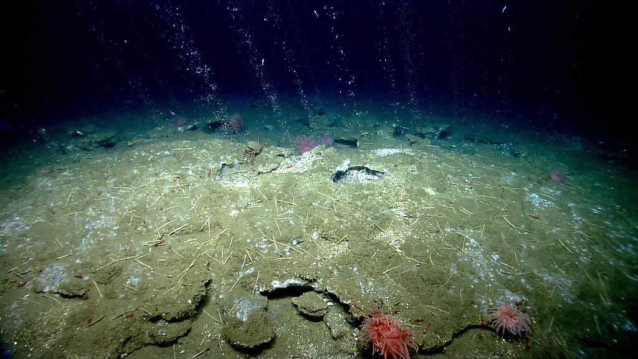
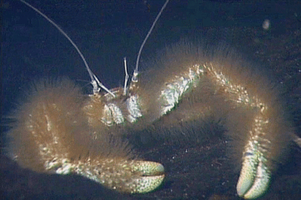
Yeti Crabs
Environment: Deep Sea Hydrothermal Vents
These fuzzy crabs live in deep parts of the ocean where there are no plants because there’s no sunlight. Because of that, life there gets its energy from bacteria that use chemicals from hydrothermal vents.
Yeti crabs use their long furry arms to grow bacteria by waving their arms over the mineral-rich water from the hydrothermal vents. Then they eat the bacteria.

Slide 11
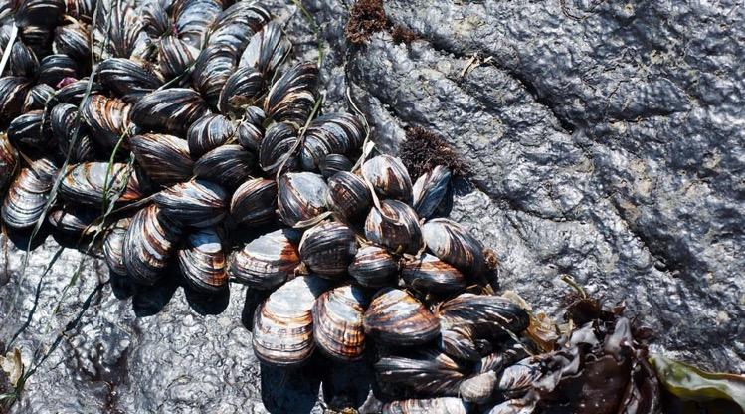
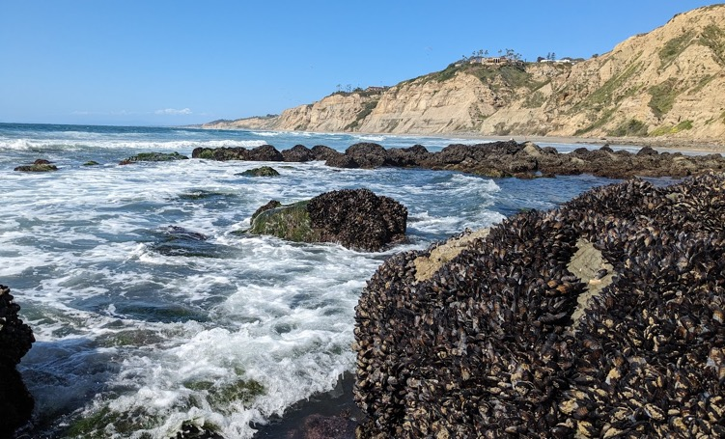
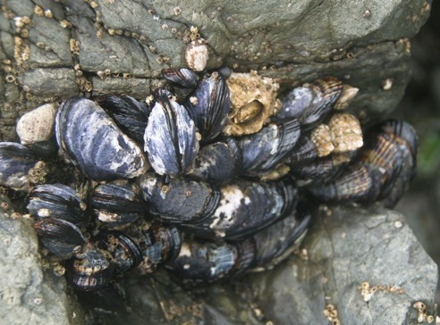
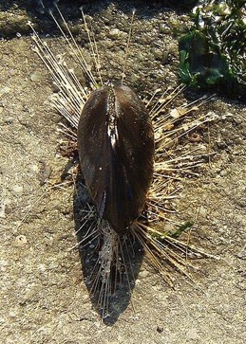
Mussels
Environment: Intertidal Zones
Mussels live along coastlines where the waves are constantly crashing against rocks. To keep themselves from being pulled off the rocks by the waves, mussels attach themselves to the rocks using many thin threads.
Since the water goes up and down throughout the day, mussels are out of the water sometimes, so they have to keep themselves from drying out. They prevent water loss by closing their shells when they’re out of the water

Slide 12
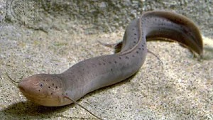
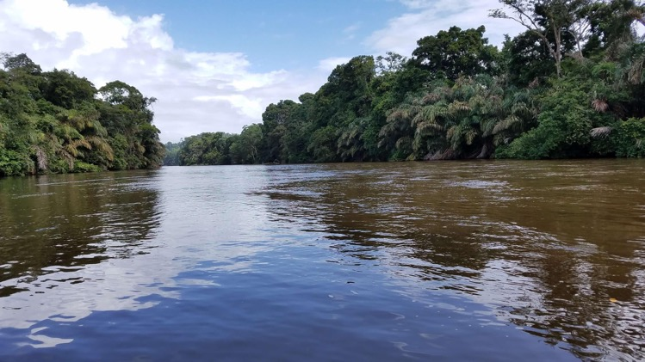
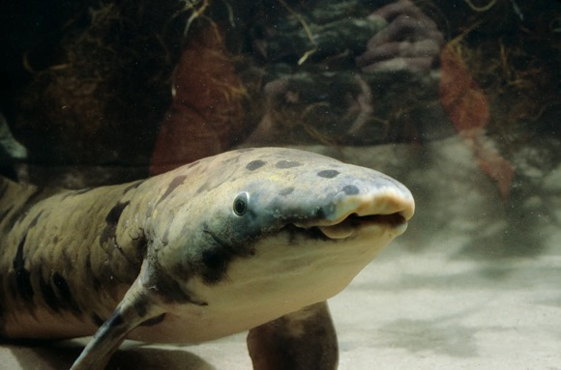
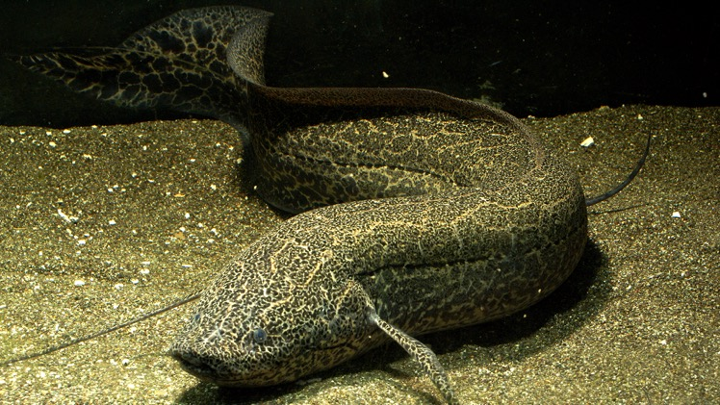
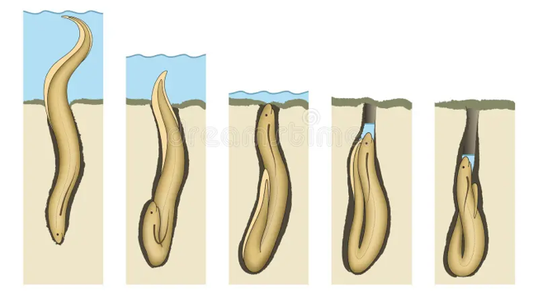
Lungfish
Environment: Tropical streams and lakes
Lungfish live in streams and lakes. Sometimes these habitats can become low in oxygen or can dry out. Lungfish have adapted to this by being able to breathe air. If there's not enough oxygen in the water, they can get more from the air. If the water dries out, they can burrow and stay in the soil breathing air for up to two years until the water comes back.
Lungfish are more related to us than any other fish.

Slide 13
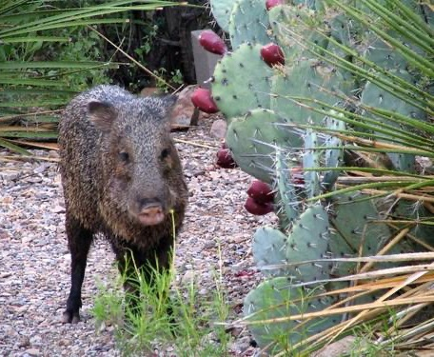
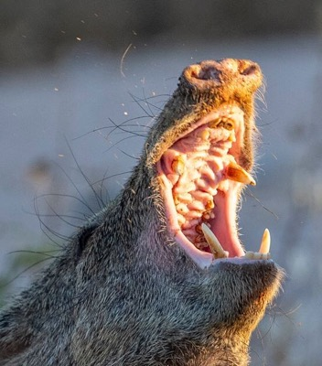
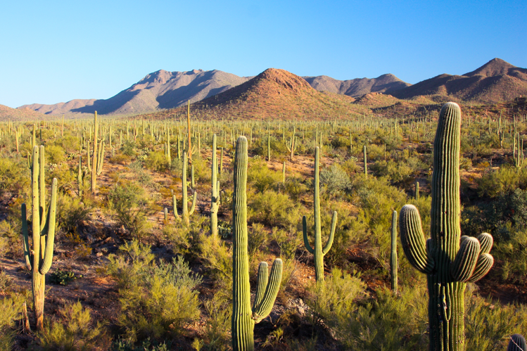
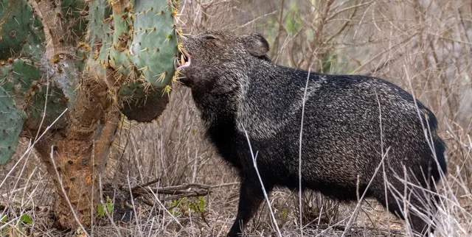
Javelinas
Environment: Sonoran Desert
Water is scarce in the Sonoran Desert, but there’s a lot of it stored inside cacti. The problem is cacti protect their water with lots of spines.
Javelinas can easily get through the spines using their large teeth and tough skin in their mouths, so they can get the water they need.

Slide 14
Creosote
Environment: Sonoran Desert
Plants in the Sonoran Desert need to have strategies to retain water so they don’t dry out. Plants can lose water through their leaves, so having specialized leaves can help reduce this. Creosote bushes have very small leaves to reduce the surface area that water can evaporate from. The leaves also have a waxy coating to help retain water.

Slide 15
Elf Owl
Environment: Sonoran Desert
The Sonoran Desert is hot, so animals need ways to stay cool and find shelter from the heat.
Elf owls are the smallest species of owl and they live in holes in saguaro cacti. The inside of the cactus is cooler and protects them from the sun

Slide 16
Saguaros
Environment: Sonoran Desert
Like everything else in the Sonoran Desert, saguaros need to make sure they don’t get too dehydrated. They do this by storing lots of water inside their trunks. The insides of saguaros are spongy and are able to expand when it rains to hold large amounts of water and keep it for when the weather is dry.

