Slide 1
Parts of a Spacecraft

Slide 2
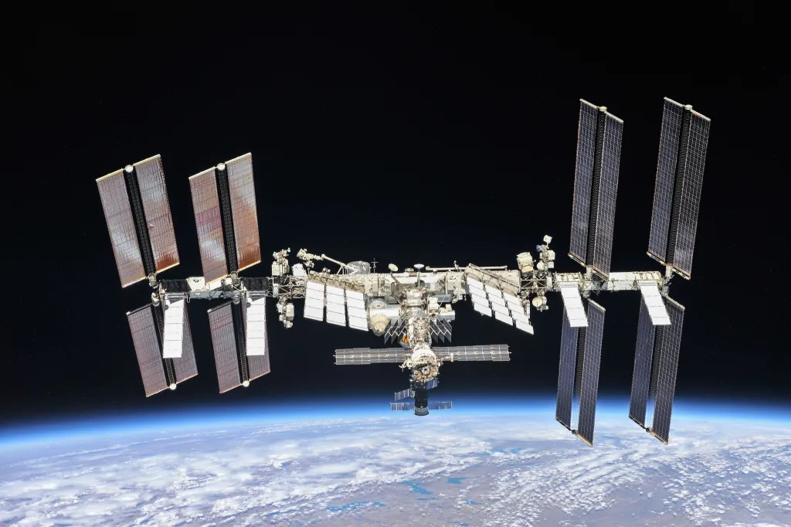
Solar Panels
These are like big wings that catch sunlight and turn it into electricity to power the spaceship

Slide 3
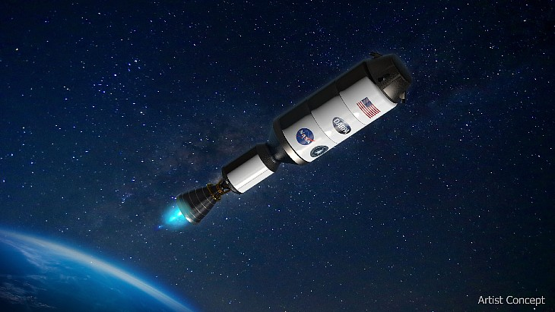
Engine
This is the part of the spacecraft that helps it move through space.

Slide 4
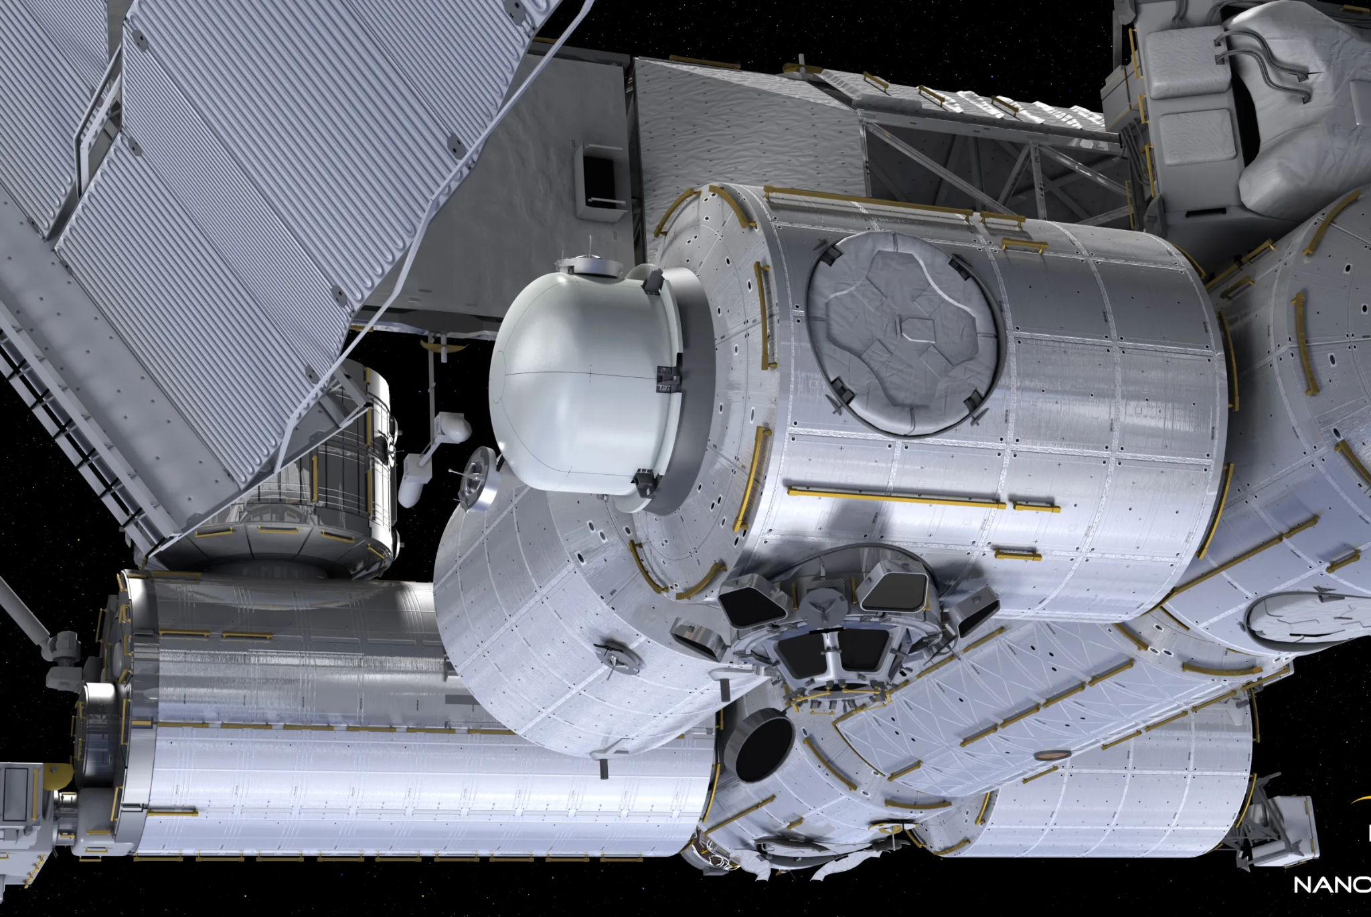
Airlock
This is a special door that lets astronauts go outside for spacewalks. It keeps the air in and space out

Slide 5
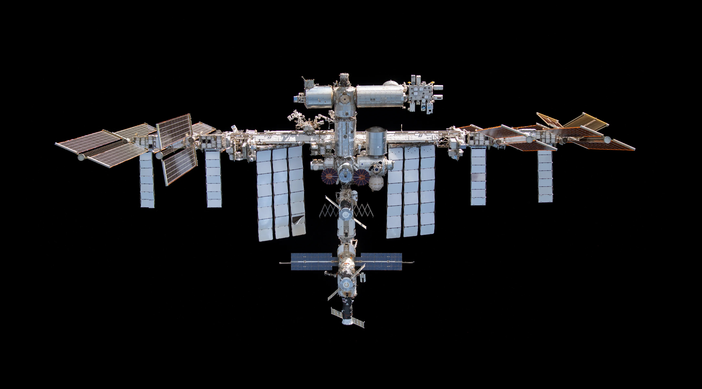
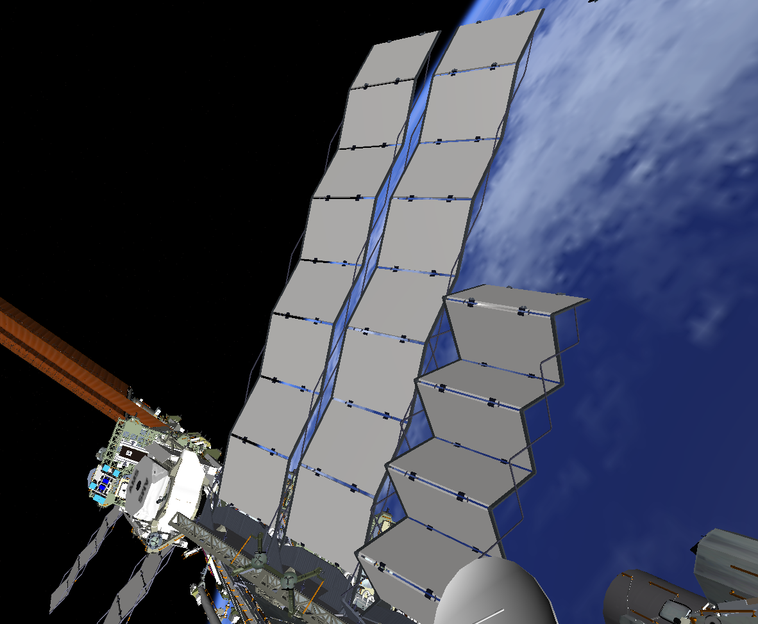
Radiator
This is like the spaceship’s air conditioner. It gets rid of extra heat so the space station doesn’t get too hot. It spreads the heat out into space

Slide 6
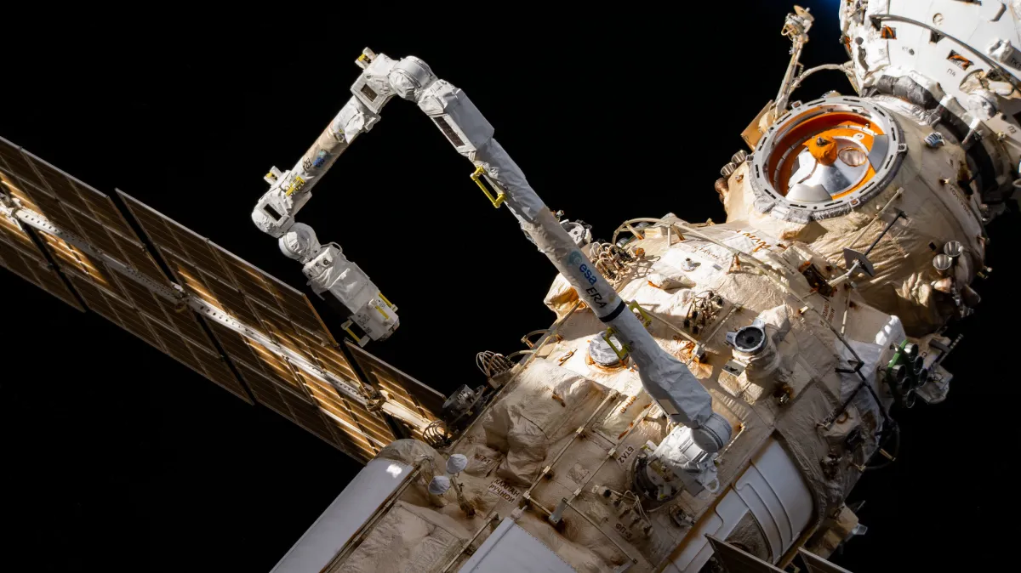
Robotic Arm
This arm helps grab things, move supplies, or even catch spaceships. Astronauts can control it from inside

Slide 7
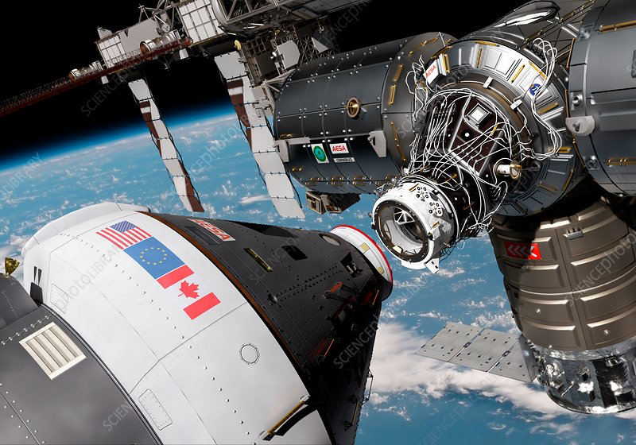
Docking Port
A special spot where spaceships connect, like plugging two pieces together

Slide 8
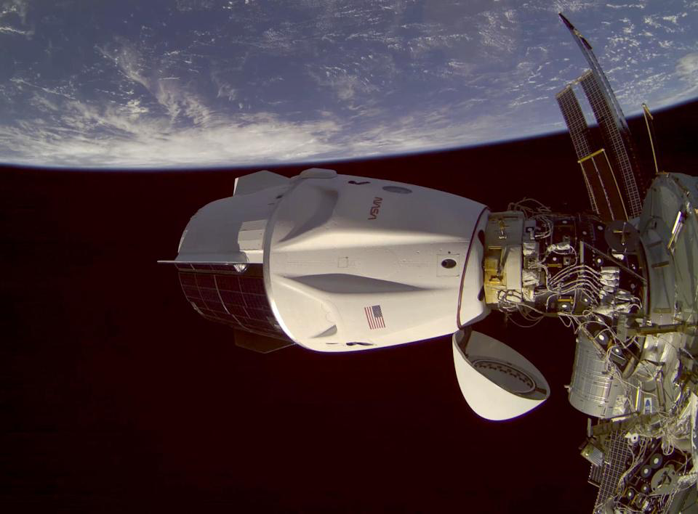
Crew Capsule
This is the space taxi for astronauts! It brings them to the space station and then goes back to Earth. It can connect to the station like a puzzle piece

Slide 9
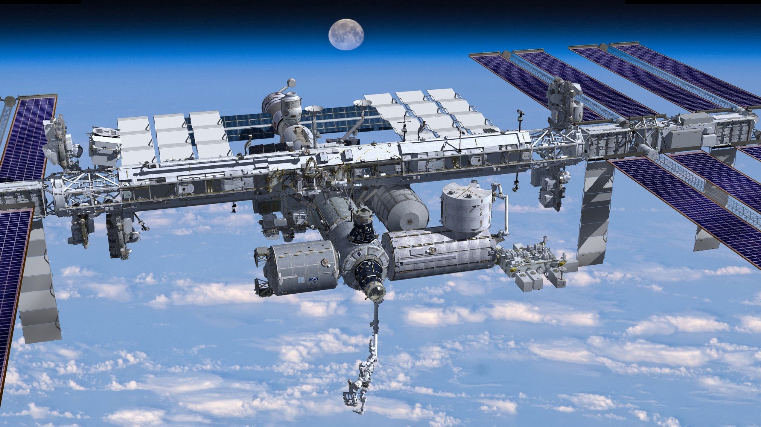
Living Quarters
Astronauts live, sleep, eat, and do science in these big tubes. Each tube has a different purpose like a kitchen, lab, or bedroom

Slide 10
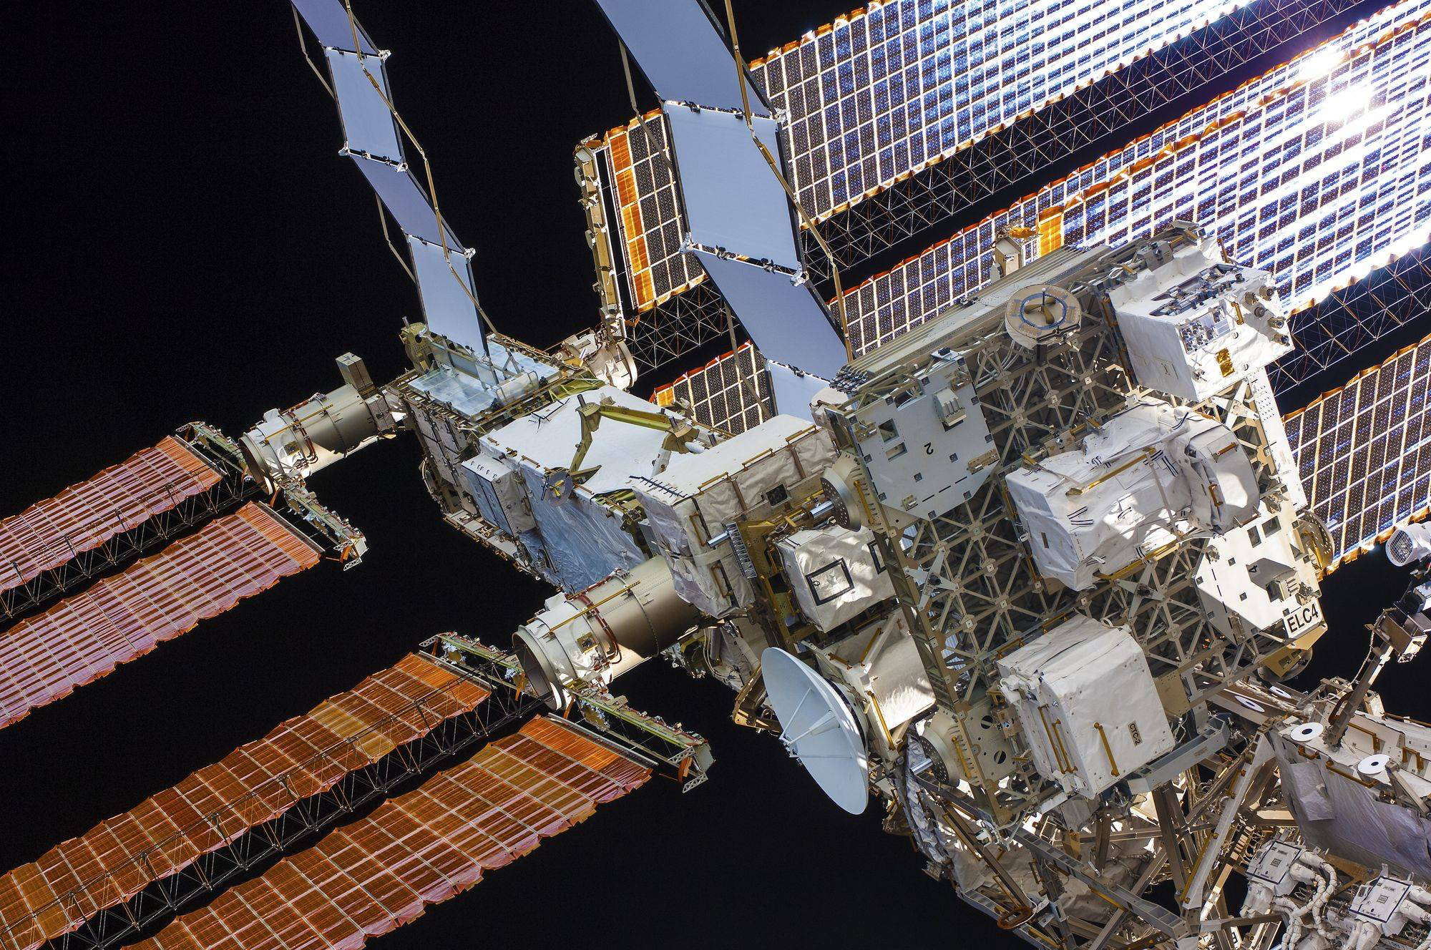
Antenna
This is how the space station talks to Earth! It sends and receives messages, like a space phone or walkie-talkie

Slide 11
Now let’s see what’s inside a spacecraft

Slide 12
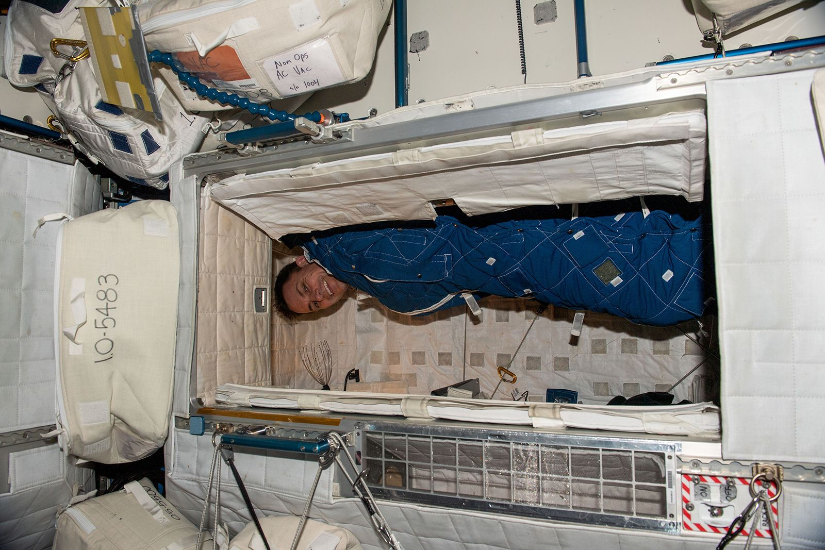
Bedroom
Astronauts sleep in special sleeping bags attached to the wall or inside a small room so they don't float away while they sleep

Slide 13
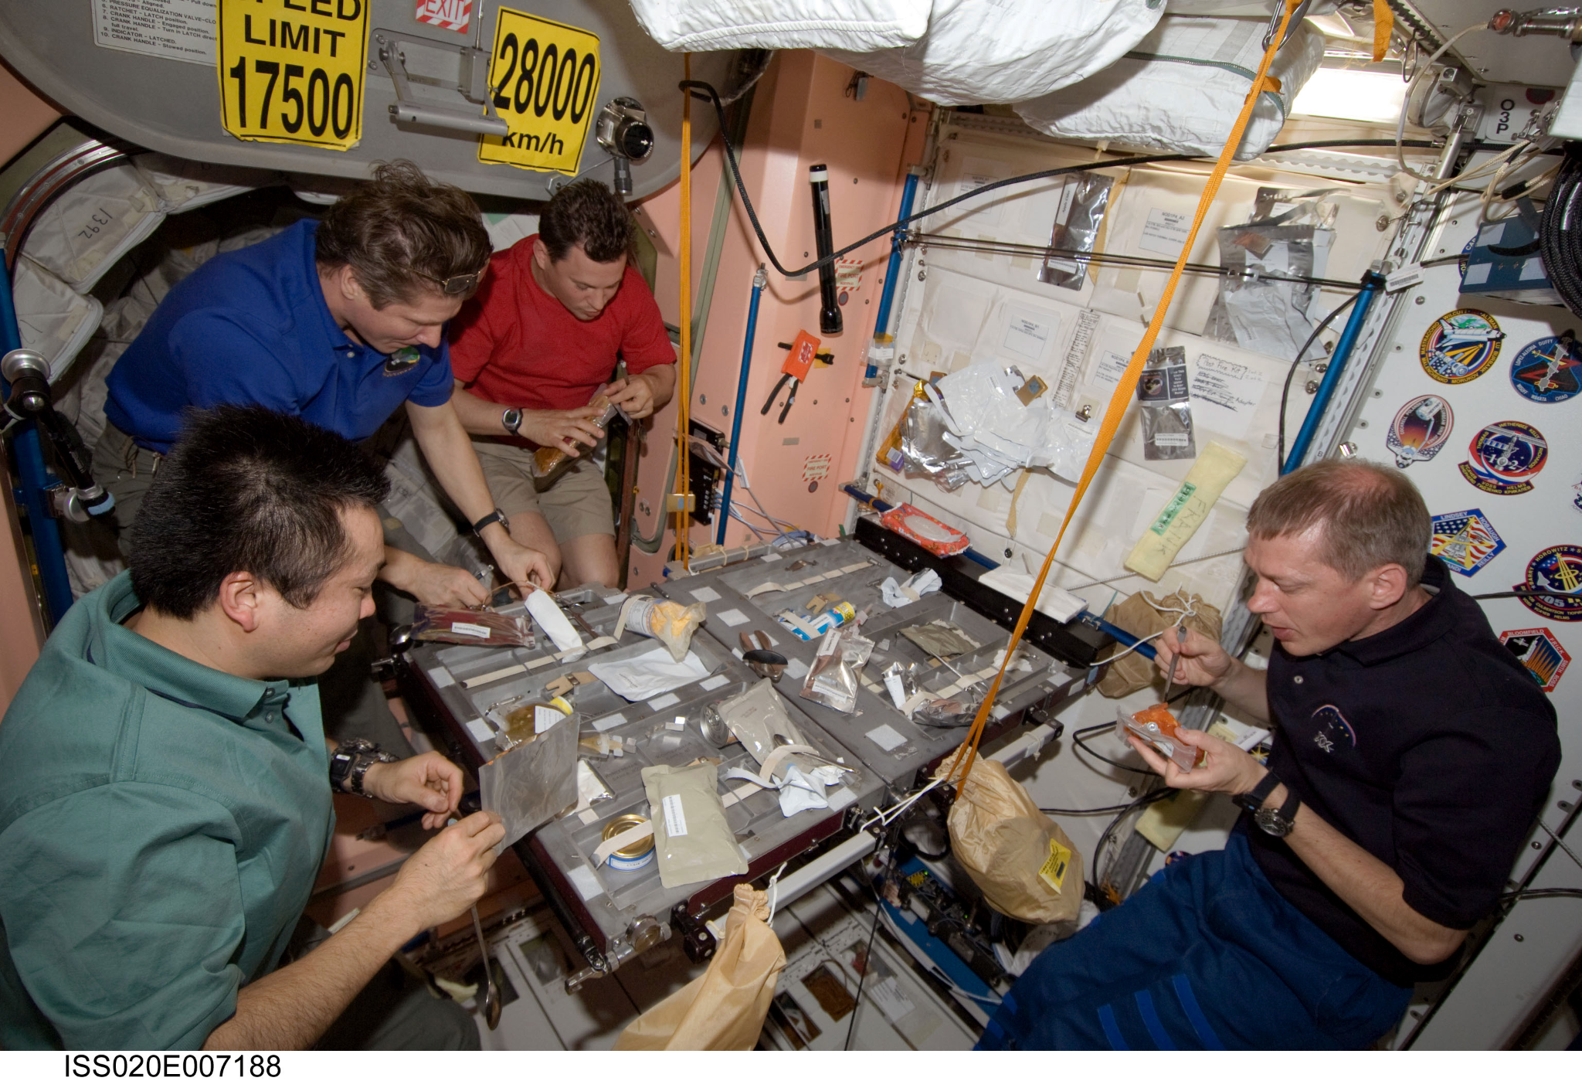
Dining Room
This is where astronauts eat their meals in space

Slide 14
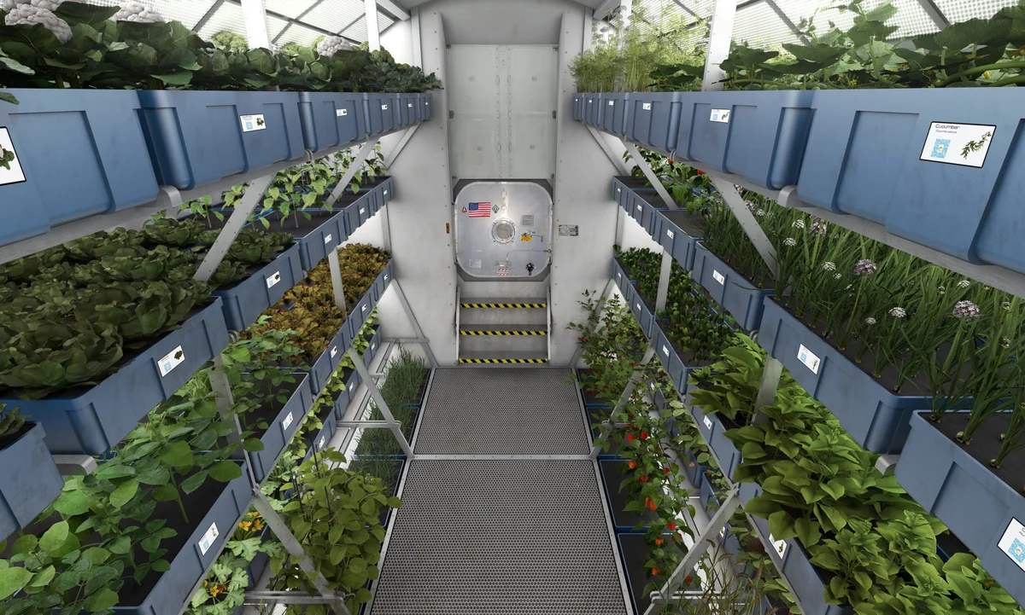
Garden
A long distance space flight to another planet would need a space to grow food.

Slide 15
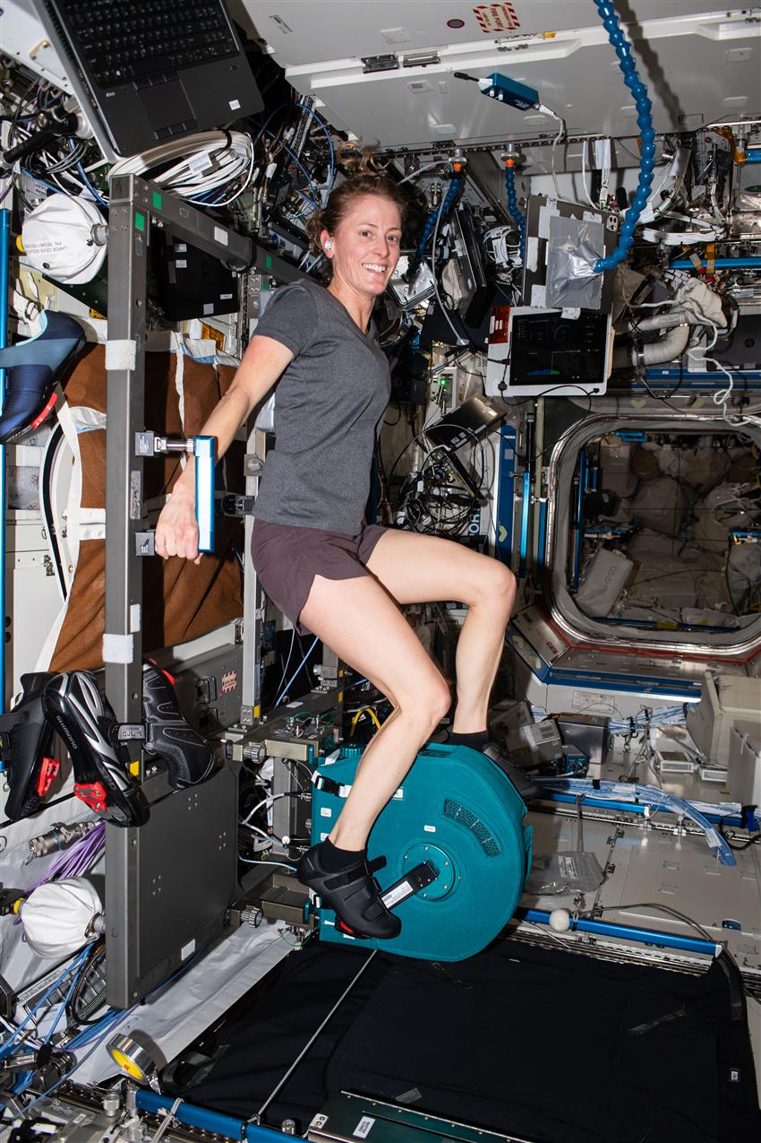
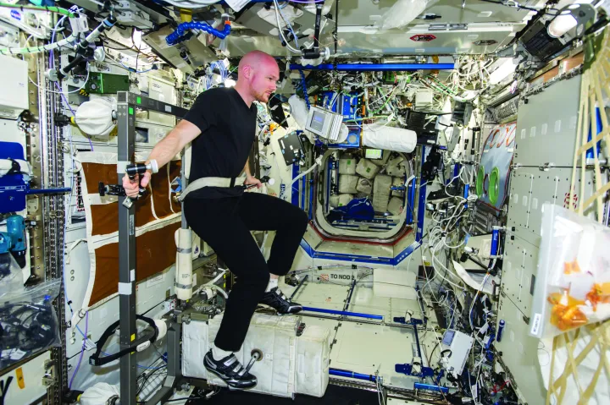
Gym
Astronauts work out every day in space to stay strong. They use special machines that work without gravity so their muscles and bones stay healthy

Slide 16
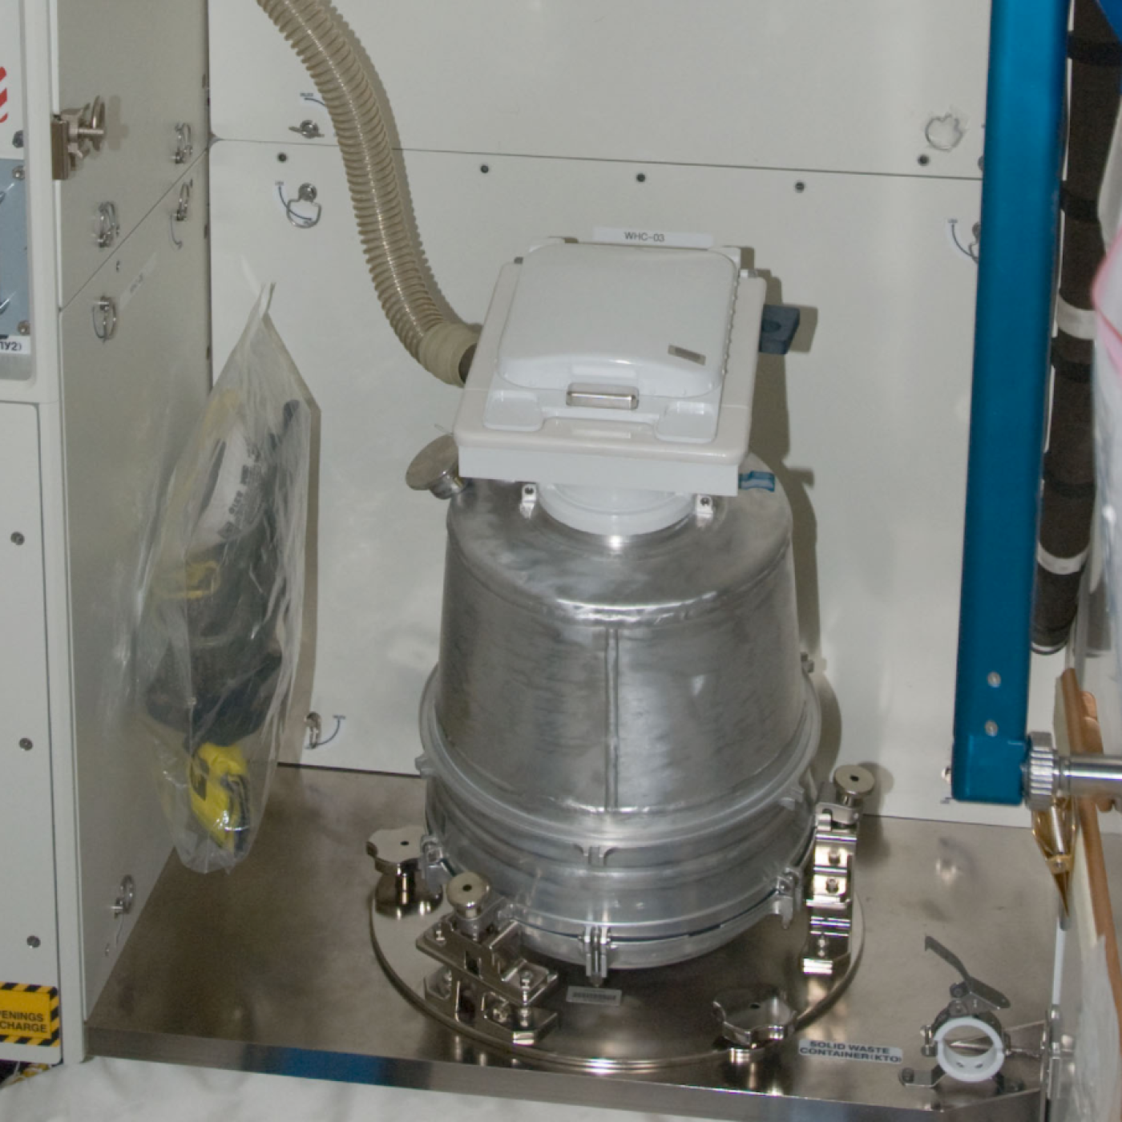
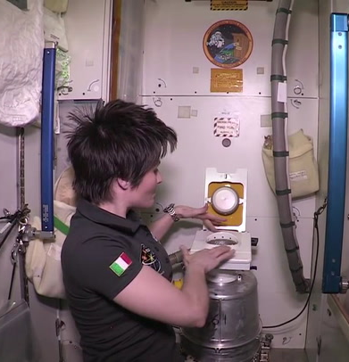
Bathroom
Everyone needs this, even astronauts!

Slide 17
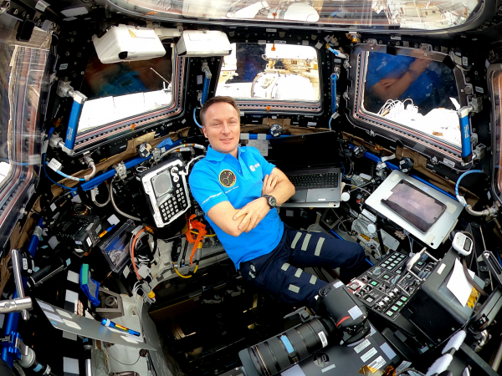
Cockpit
The cockpit is where a pilot would control the spacecraft.

Slide 18
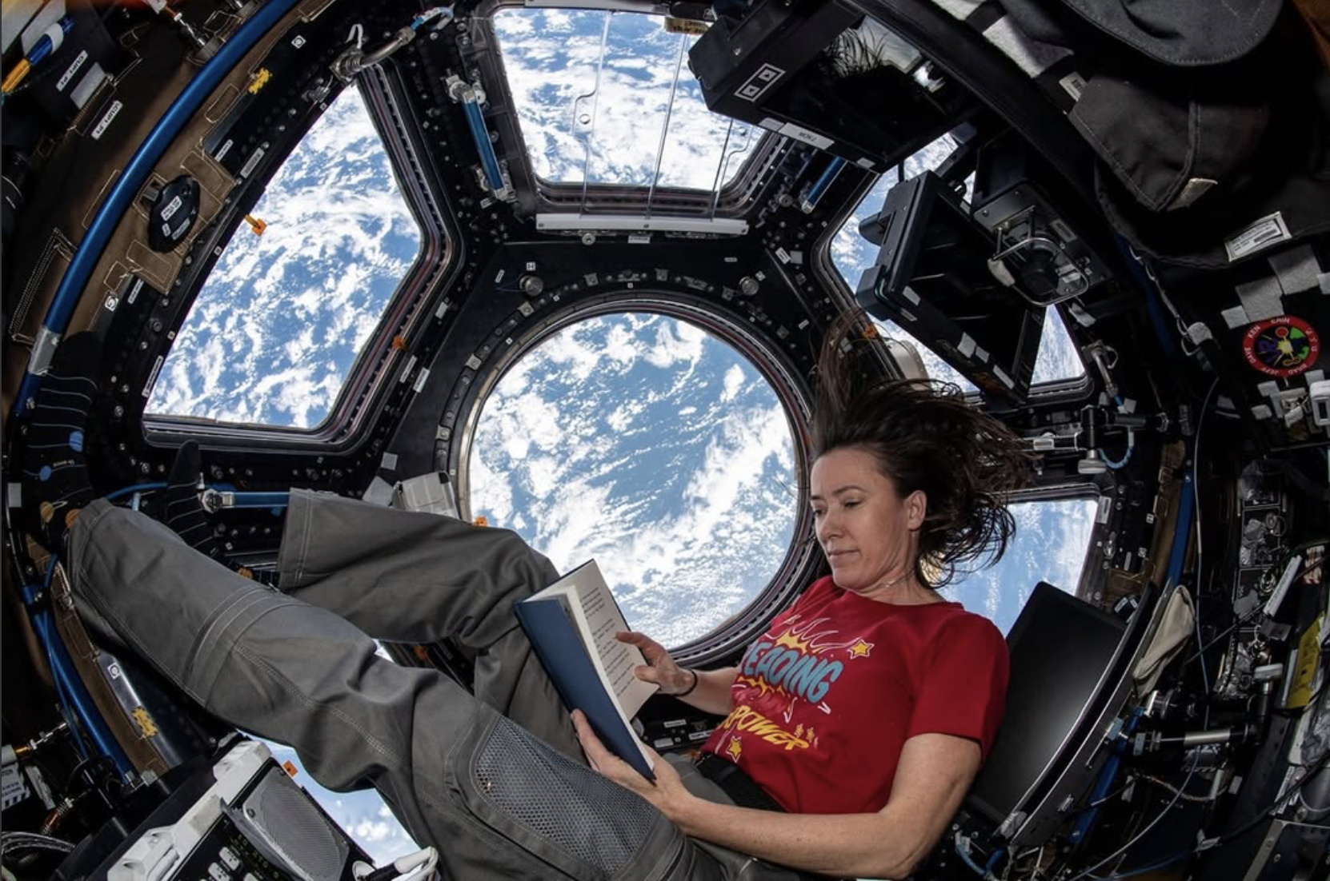
Relaxation Spot
This is where astronauts chill out. They can read, listen to music, or look out the window at Earth. It helps them relax and feel happy, even far from home

Slide 19
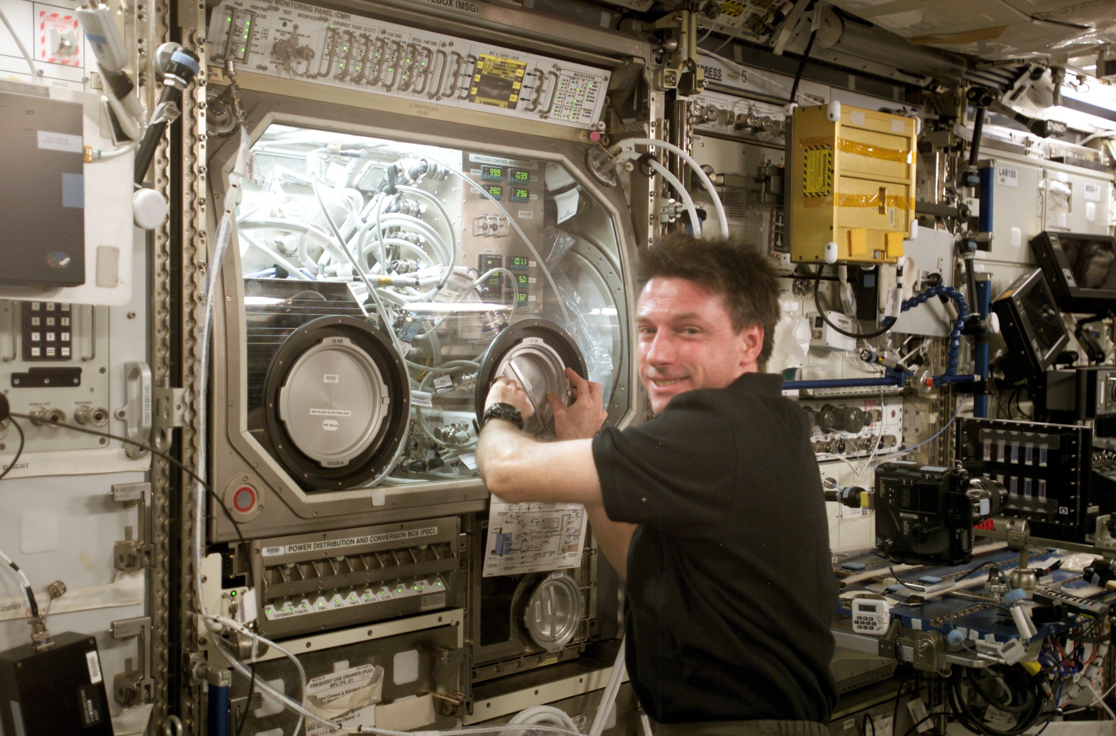
Laboratory
Areas for conducting scientific experiments and research.

Slide 20
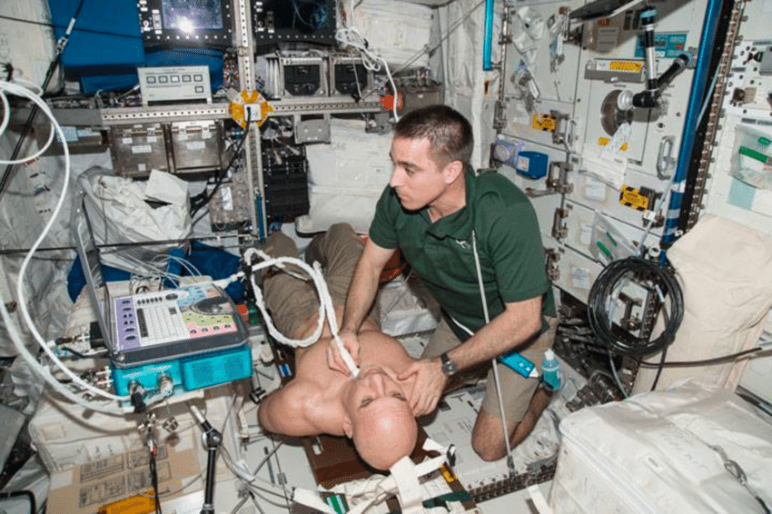
Medical Bay
This room has supplies for health checks and emergency care.

