Slide 1
Space Jobs

Slide 2
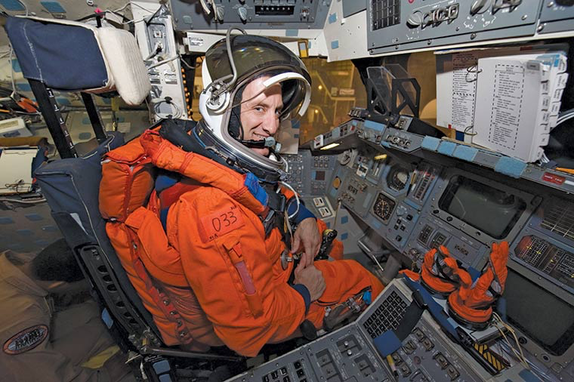
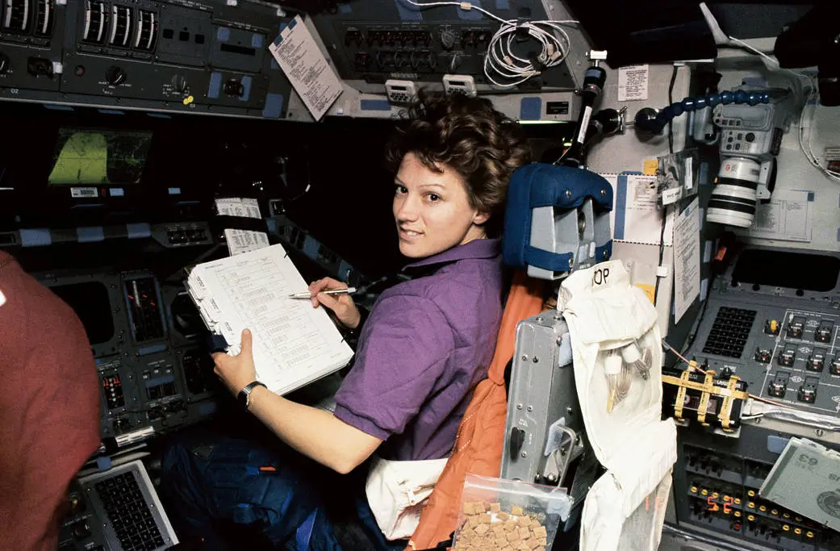
Pilot
Pilots fly the spaceship to where it needs to go.

Slide 3
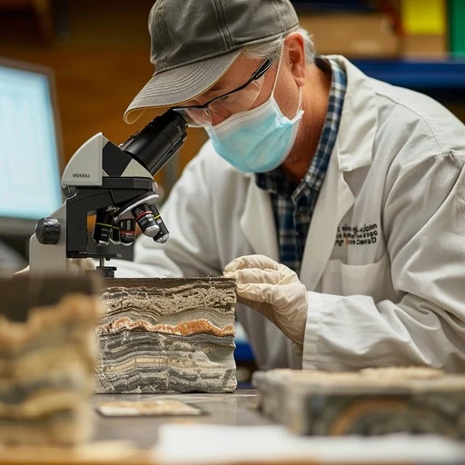
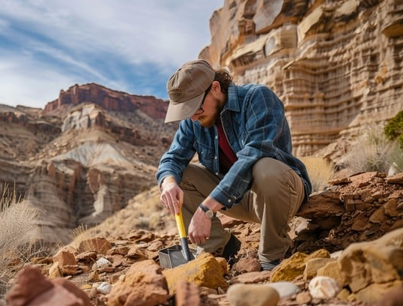
Geologist
Geologists study rocks and soil on Earth and other planets.

Slide 4
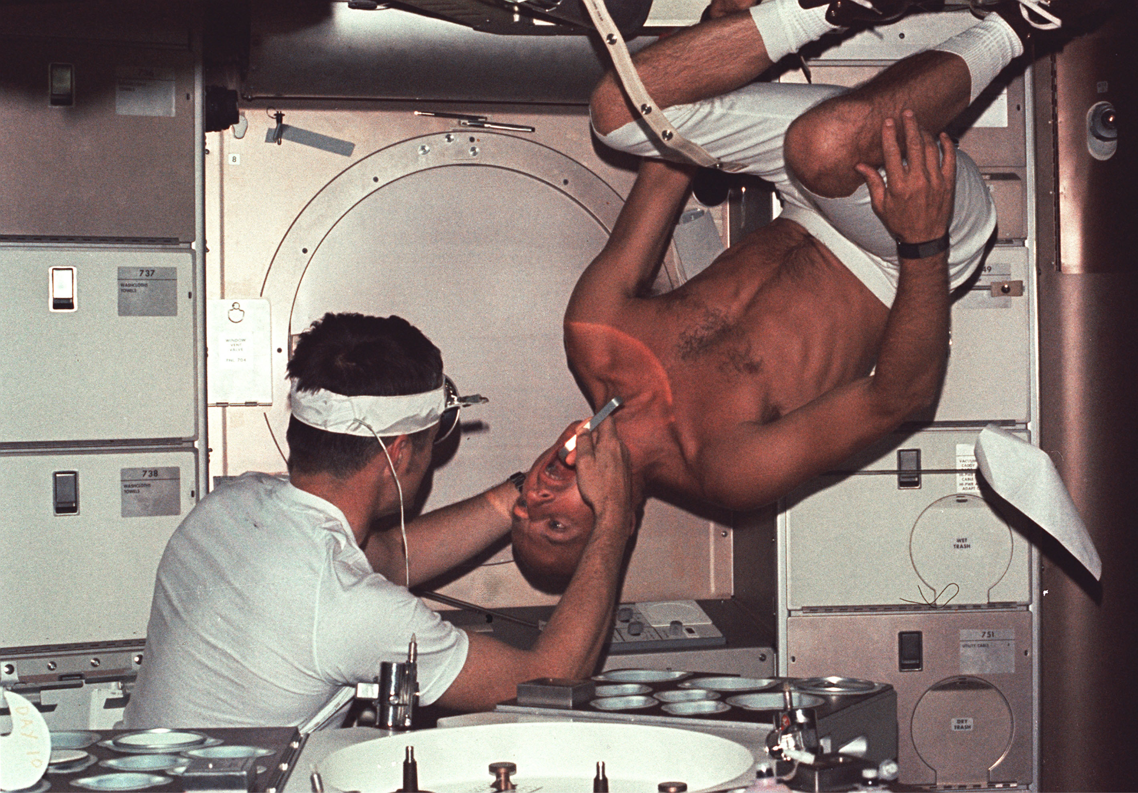
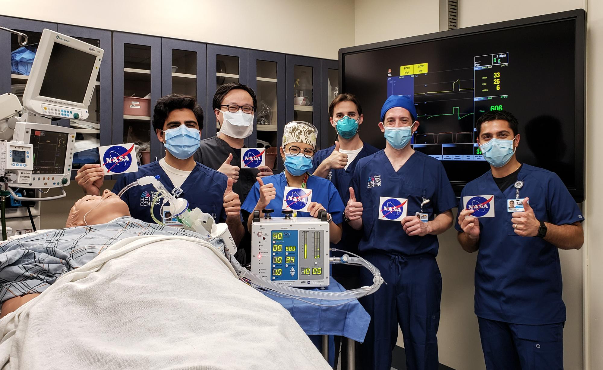
Doctor
Doctors help keep everyone healthy and take care of any injuries.

Slide 5
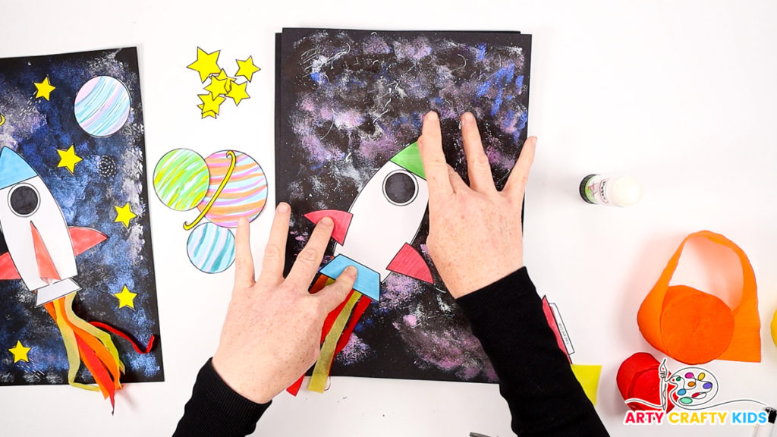
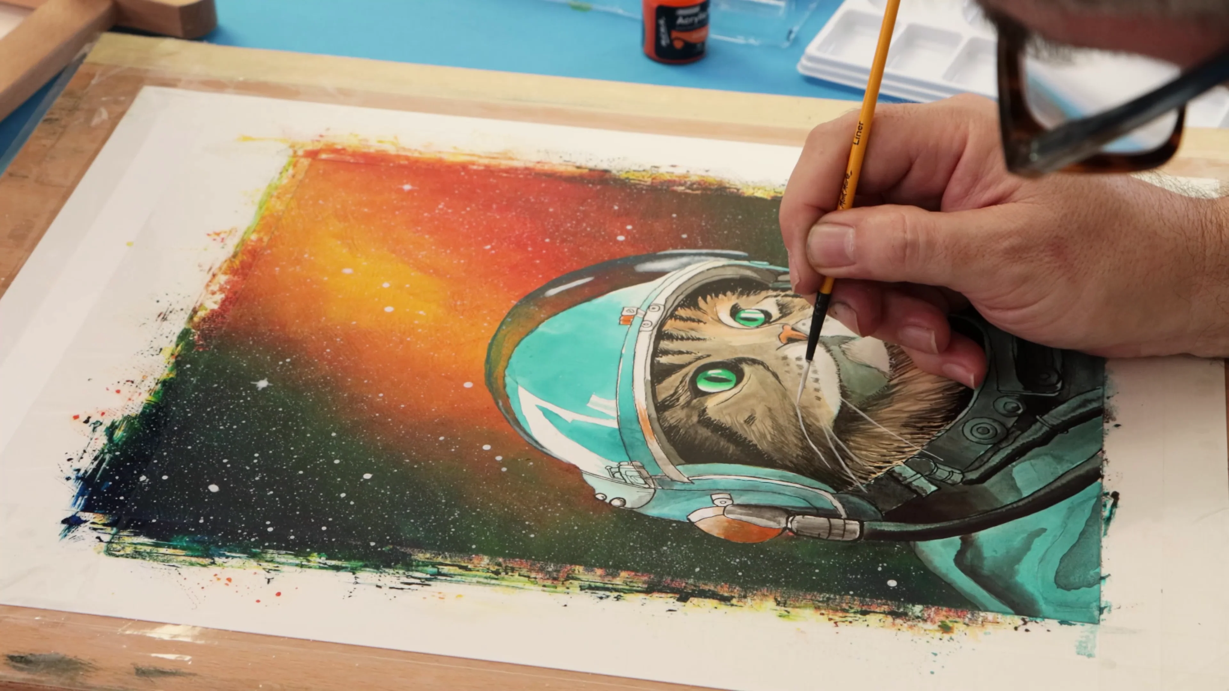
Artist
Artists create pictures and stories to share what we have learned about life or other worlds.

Slide 6
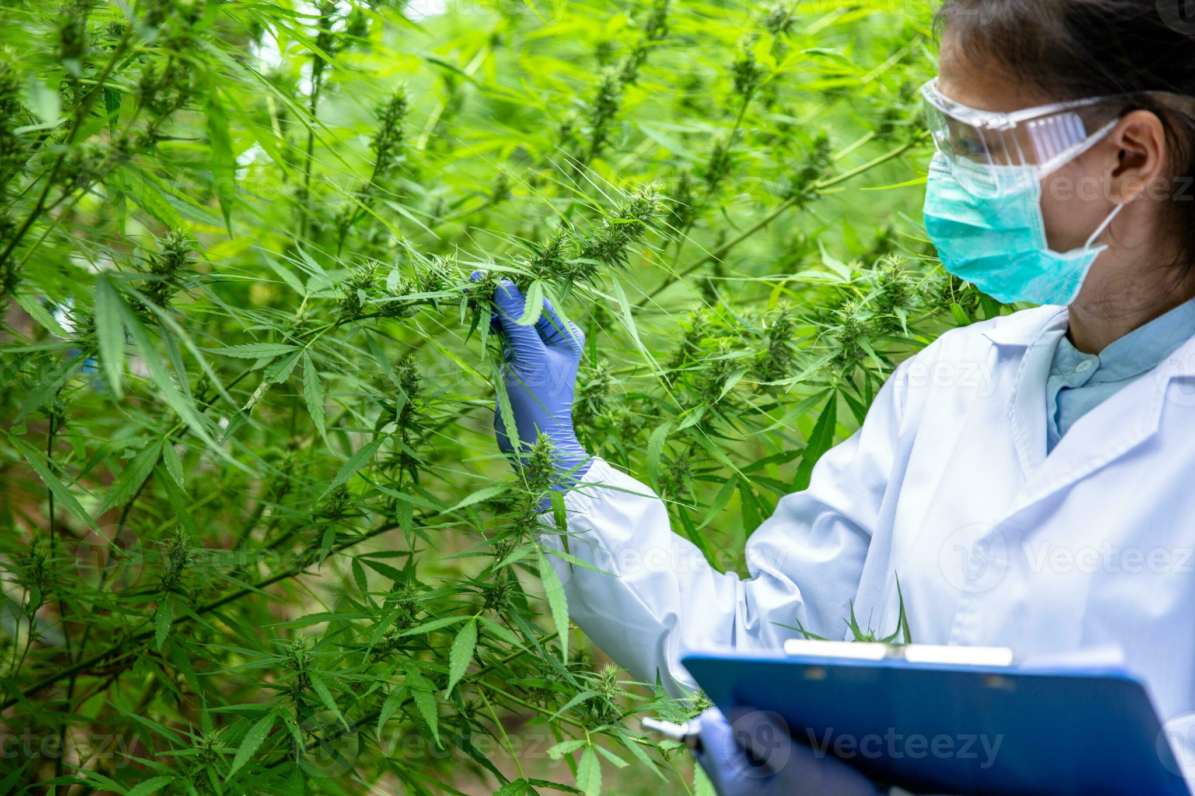
Biologist
Biologists study living things

Slide 7
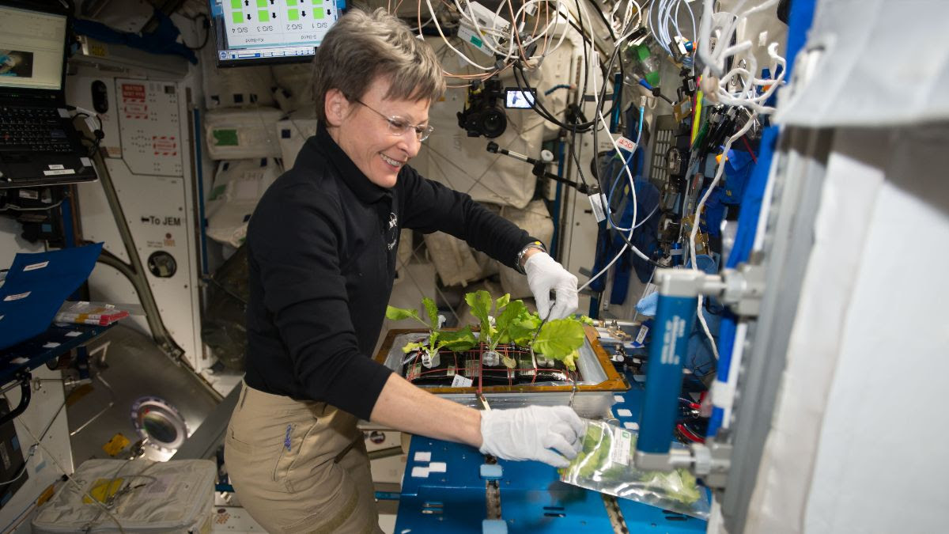
Astrobiologist
Astrobiologists study life on earth and beyond earth, including the possibility of life on other planets.

Slide 8
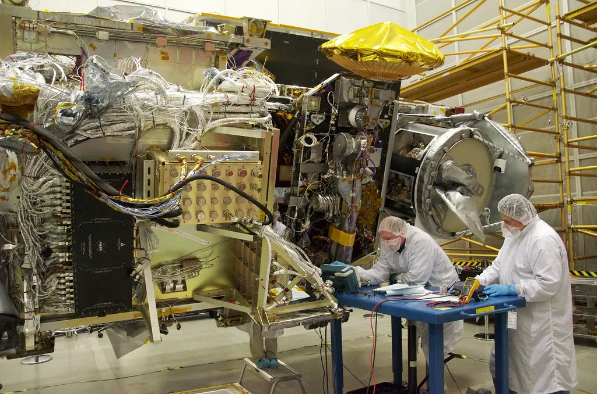
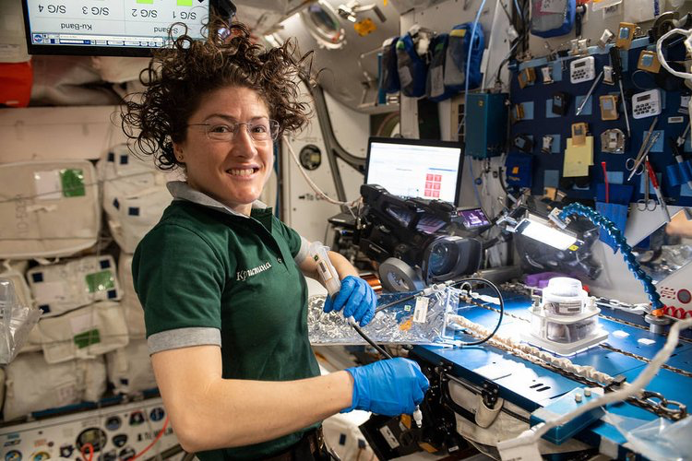
Engineer
An engineer helps design and build special tools, robots, and machines that look for signs of life on other planets. They help scientists explore space and learn if anything could live out there!

Slide 9
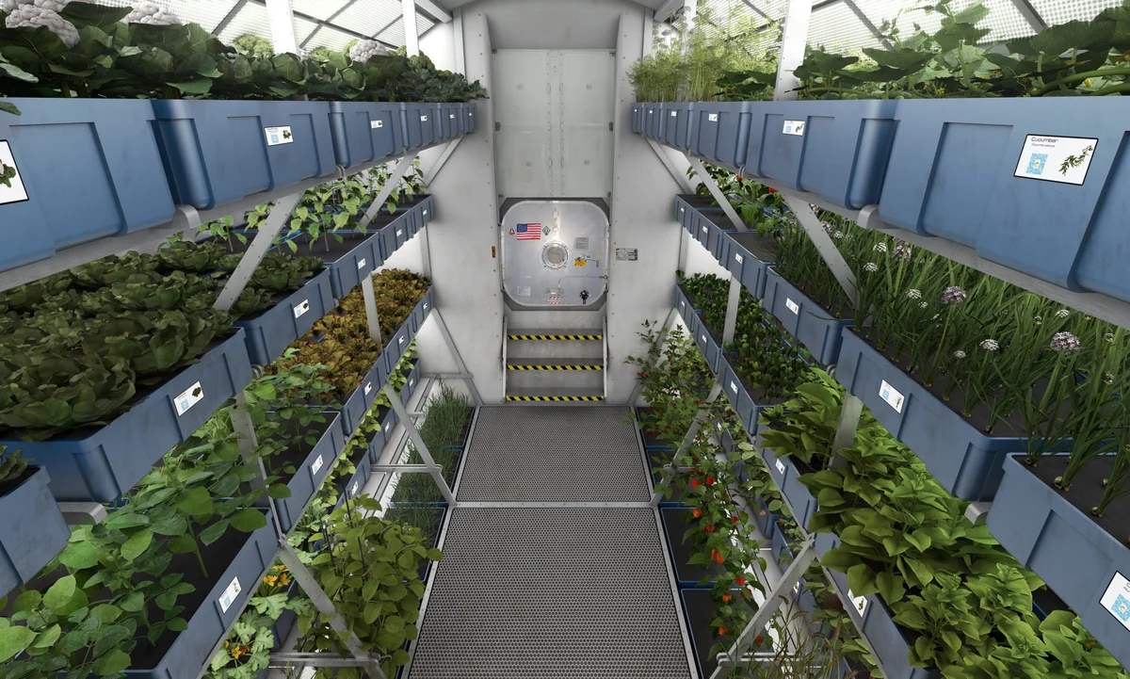
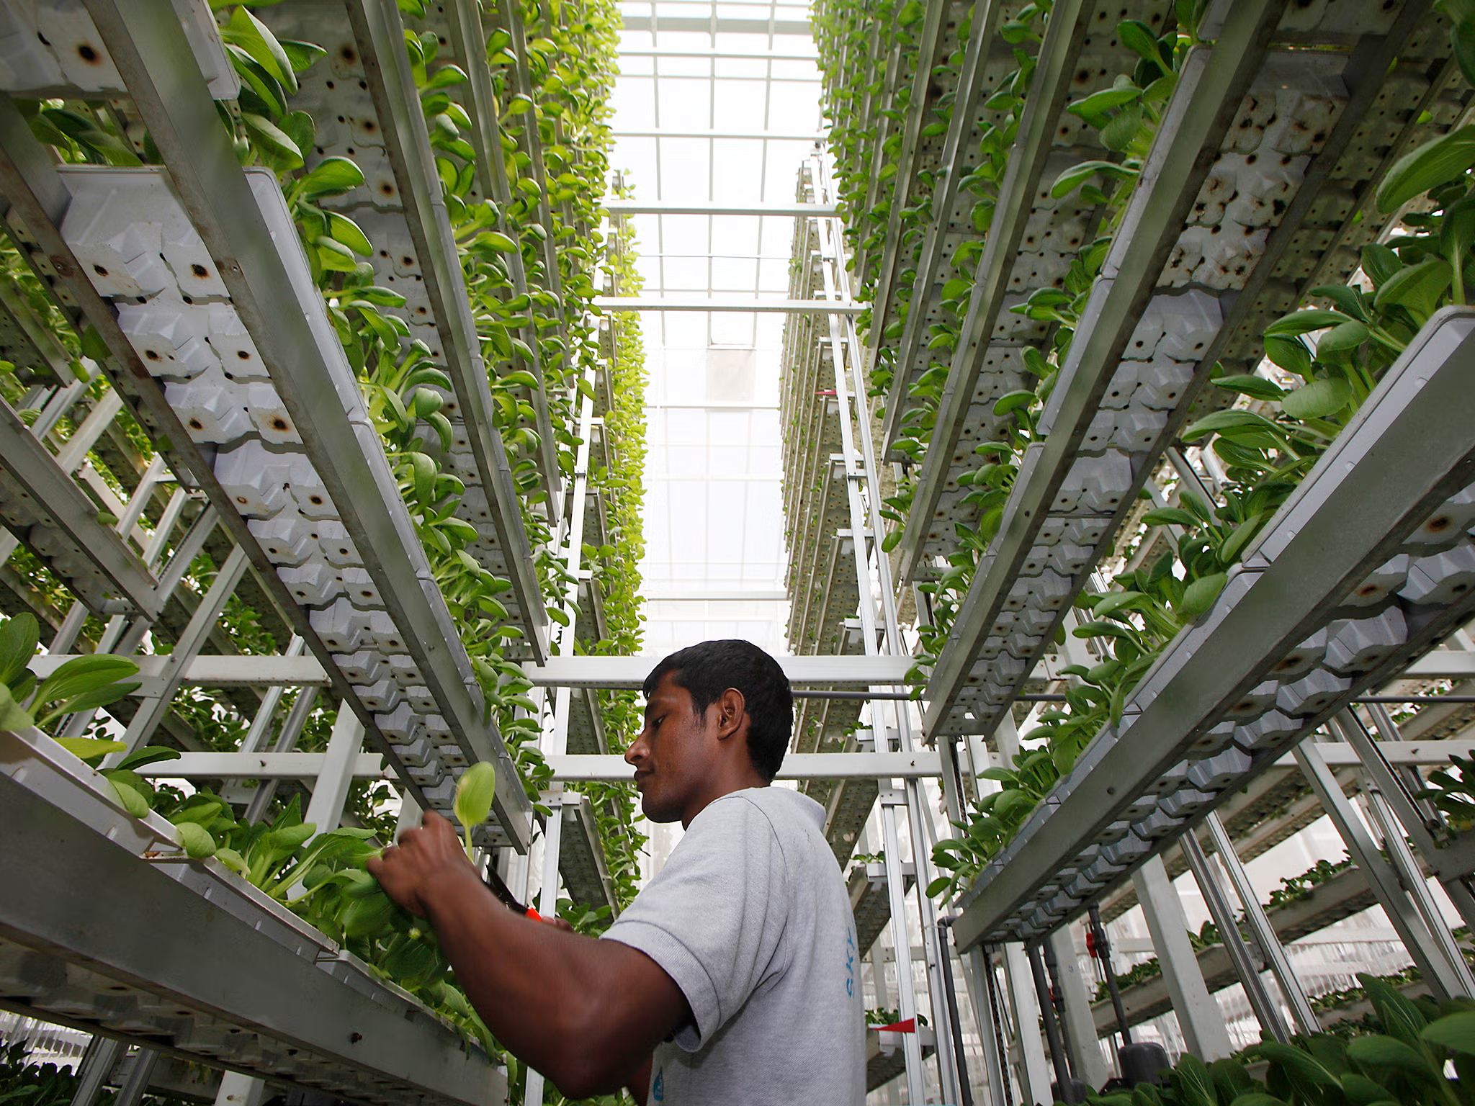
Farmer
Farmers grow food so everyone has something to eat this can be in space or on earth!.

Slide 10
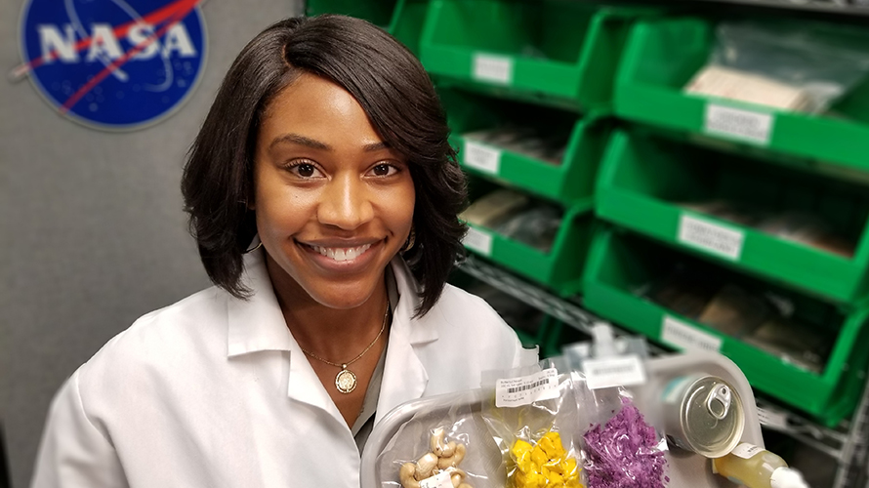
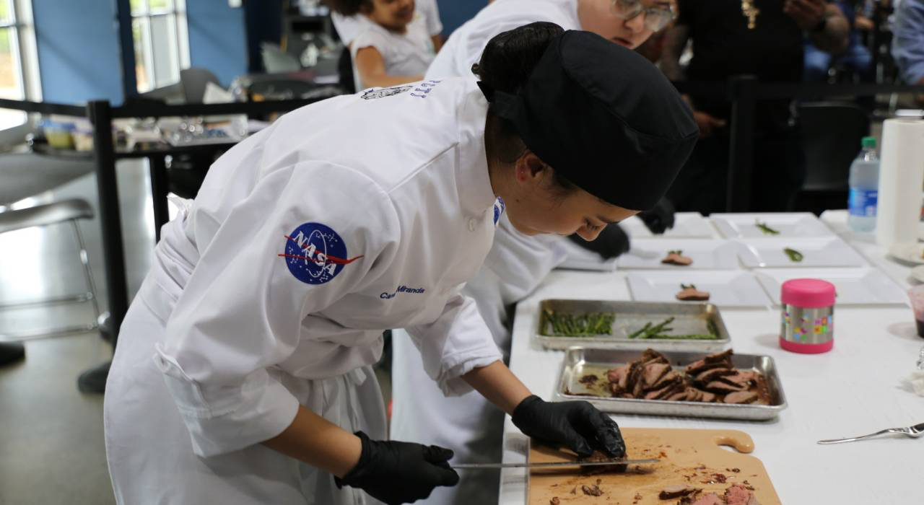
Food Scientists
Food scientists, chefs make sure there is nutrition food to keep everyone healthy.

Slide 11
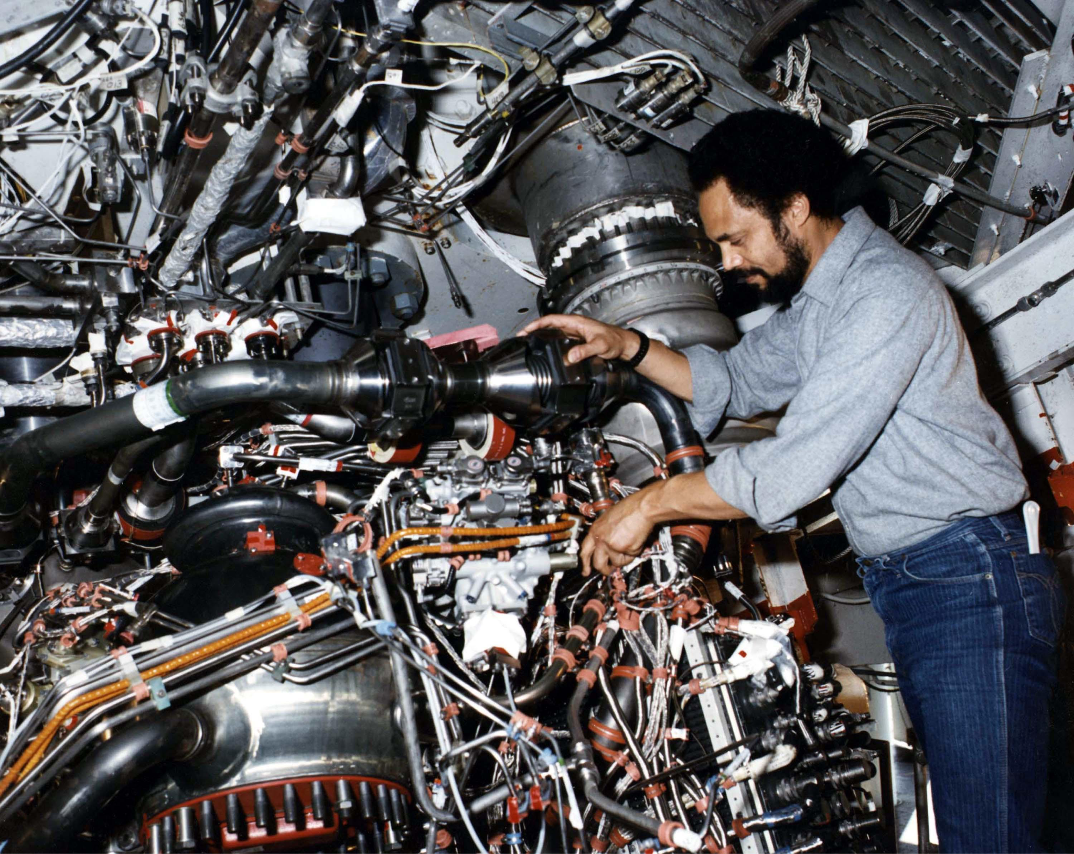
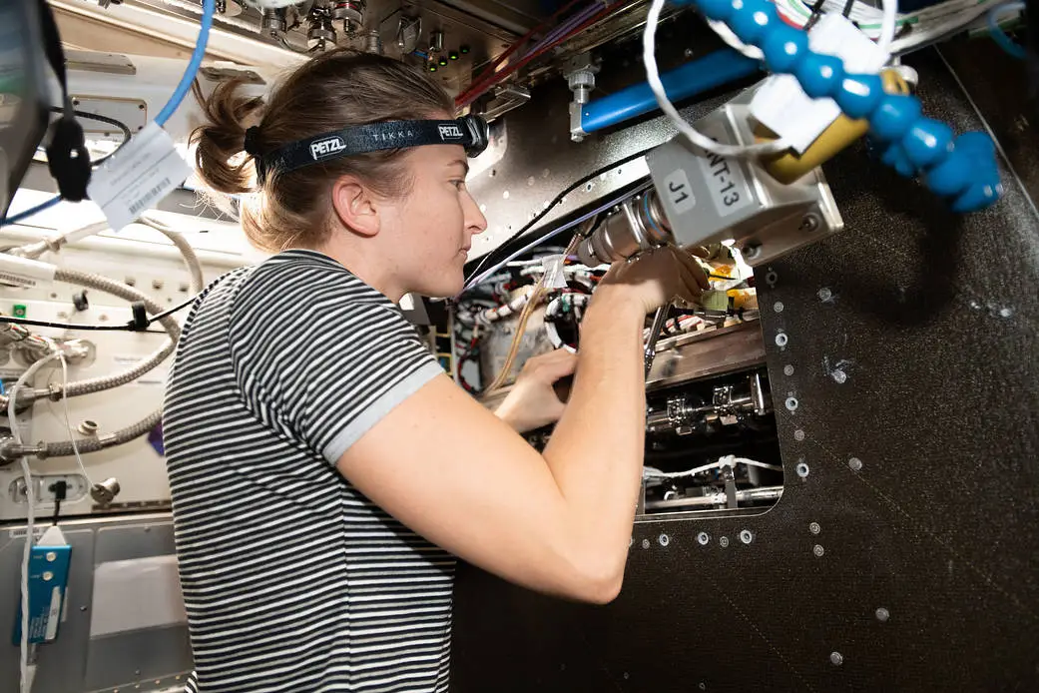
Mechanic
Mechanics fix cars, robots, and other machines when they break.

Slide 12
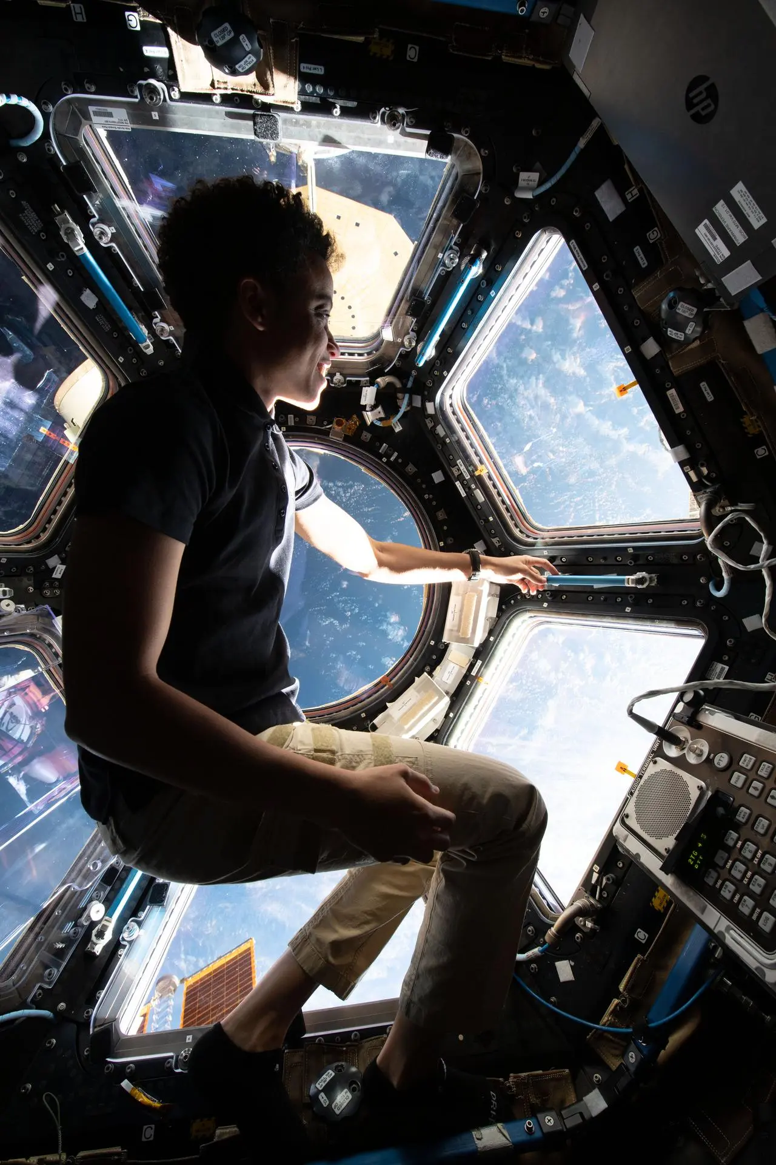
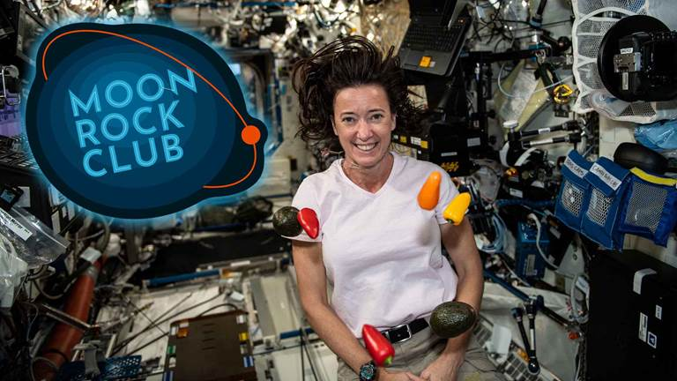
Communicator
These people talk to Earth and tell everyone back home how the space mission is going. They make sure everyone stays connected.

