Slide 1
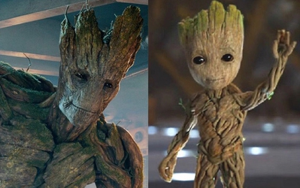
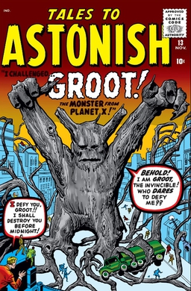
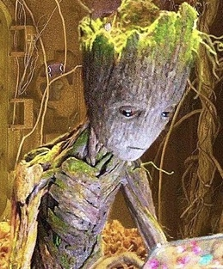
Flora colossus
Marvel
Notes:
Property: Marvel (First publication - 1961; Latest publication/premiere - 2025)
Images:
Guardians of the Galaxy (film) (2014)
Tales to Astonish (1960)

Slide 2
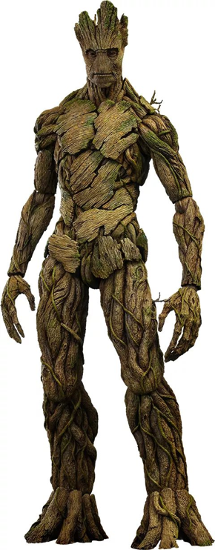
Flora colossus
Very little is known about this species because only one of them has been seen. They are big, tree-like creatures that can change their shape a bit, usually by stretching their limbs. They can heal themselves and grow back if they are almost destroyed. They have tough, bark-like skin that protects them. Sometimes, they even have leaves growing from their body. They might not talk much, but people close to them can still understand them.
Notes:
Notes:
With Groot as the only known individual, information is sparse.
Image:
Guardians of the Galaxy (film) (2014)

Slide 3
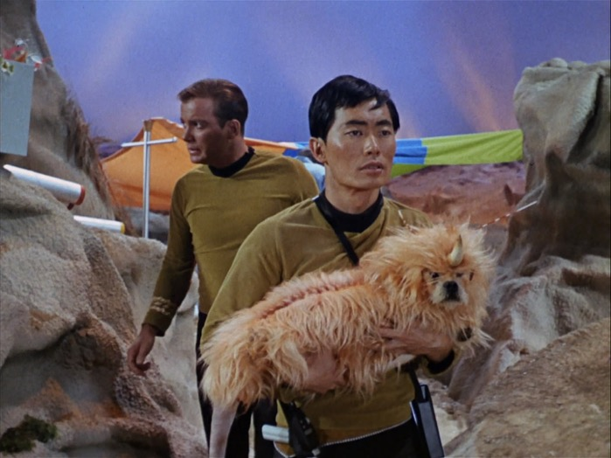
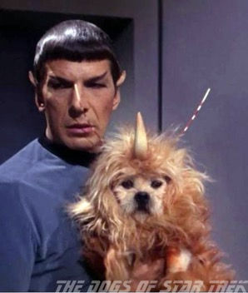
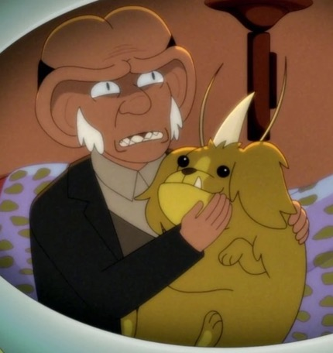
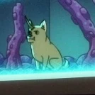
Alfa 177 canine
Star Trek
Notes:
Property: Star Trek (First premiere - 1966; Latest premiere - 2025)
Images:
Star Trek (1966) Star Trek: Lower Decks (2020)

Slide 4
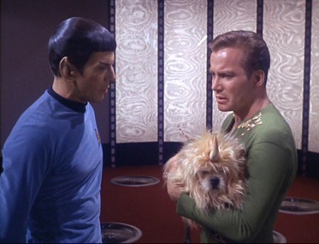
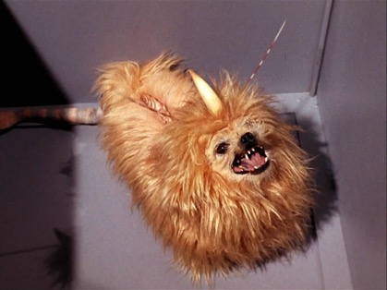
Alfa 177 canine
This animal looks like a small dog, but its long, shaggy fur hides most of its body. Later pictures showed that its body is also dog-like. It has some differences from a regular dog, like a single straight horn on its forehead and two antennas next to it. It also has a bony ridge along its spine that you can see through the fur. Its tail is a long, hairless cone with a tuft of fur at the end, looking a bit like a mix between a rat and a lion's tail.
Notes:
Notes:
A good non-human example of a rubber forehead alien, which allows the kids to ponder our biases without using up the humanoid budget.
Image:
Star Trek (1966)

Slide 5
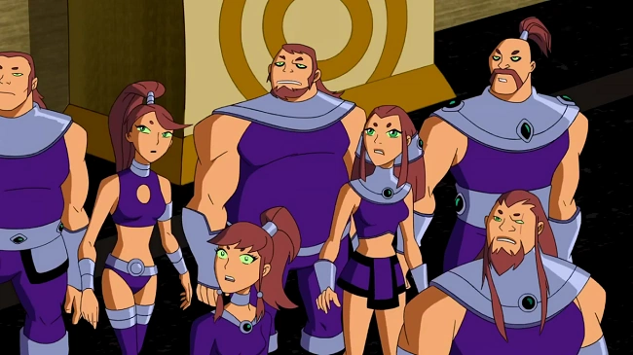
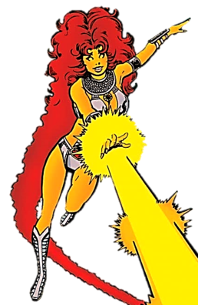
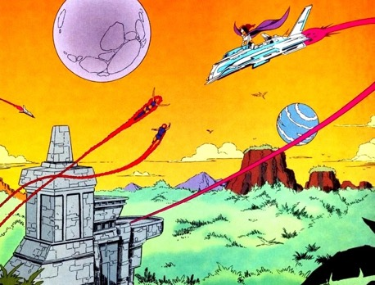
Tamaranean
Teen Titans
Notes:
Property: DC (First publication - 1935; Latest publication - 2025)
Images:
DC Comics (1980s)
Teen Titans (2003)

Slide 6
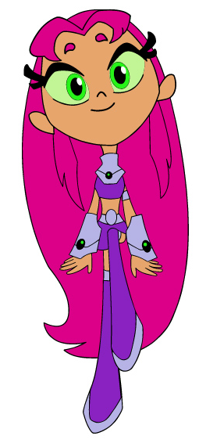
Tamaranean
These aliens look like humans with golden skin, but they come from the Vega system, which is 25 light years away from Earth. Most of them have red hair (from auburn to bright pink) and green eyes, including the normally white part. They can fly by using ultraviolet light.
The most famous member of this species is Starfire. She can shoot energy blasts, but this isn't a natural ability. It happened because of experiments that overloaded her and her sister with ultraviolet radiation.
Notes:
Notes:
They are technically a feline humanoid, but lack any overtly feline traits. Also as with any popular comic book character, there are many iterations (see the “in most versions”), so there may be some conflicting information depending on the version students are most familiar with.
Image:
Teen Titans Go! (2013)

Slide 7
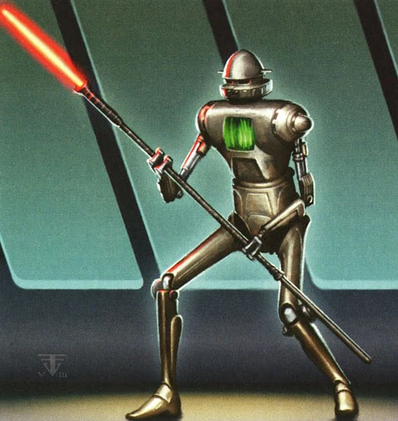
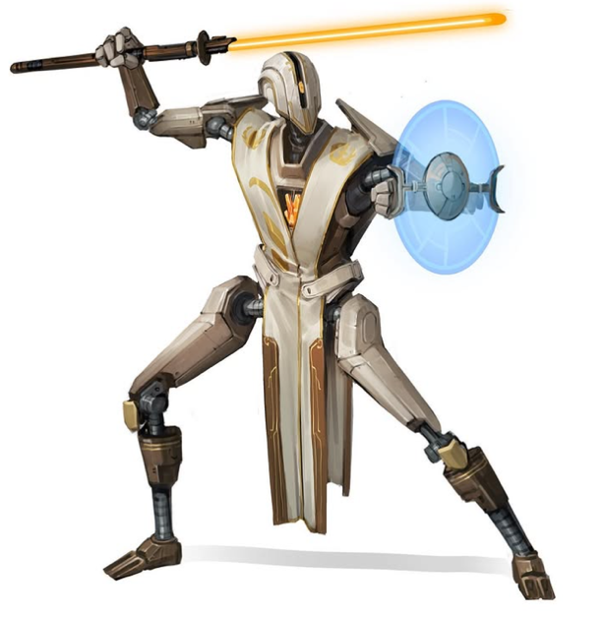
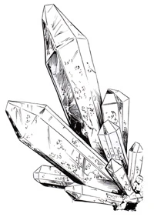
Shard
Star Wars
Notes:
Property: Star Wars (First premiere - 1977; Latest premiere - 2025)
(No longer canon since the Disney buyout)
Images:
Star Wars
Will Nunes (https://www.instagram.com/wnunesart/p/CrCCq7bOptU/)
(https://willnunesart.com/)

Slide 8
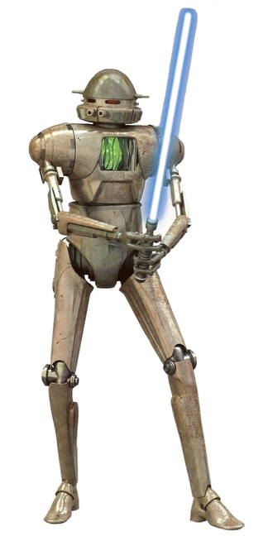
Shard
Shards are smart crystals made of silicon that can talk using light and electricity. They come from a planet called Orax, where they grow in big groups in hot springs.
When humans arrived, they noticed the crystals were talking and made devices to understand them. Later, humans built robot bodies for the Shards. The Shards in these robots loved the freedom and excitement of moving around because their colonies usually took a very long time to make decisions.
Some Shards could also use the Force. They created their own group of Jedi called the Iron Knights, but they were kicked out because they weren't organic.
Notes:
Notes:
The shard can be used to discuss the possibility of unconventional life; it took a long time for humans to even realize they were sentient. Can also have a discussion on where their energy comes from? The ones in droids likely have batteries, but what about the ones still in colonies? Maybe they “feed” from the heat from the hot springs, or maybe sunlight?
Something that could also be included is the shard life cycle, which is that they bud from their parents, bud their own children, and then erode. That can bring up question about what effect the erosion has on their mind; are they decentralized in intelligence, or does their mind slip with their “body”? Also where would they end and their family begin if they’re all connected like that? Where did humans cut to put them in the droids?
Image:
Star Wars

Slide 9
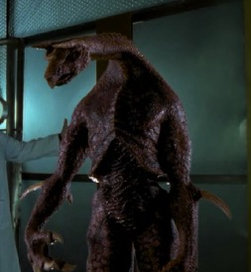
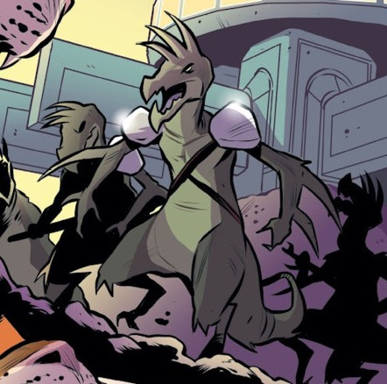
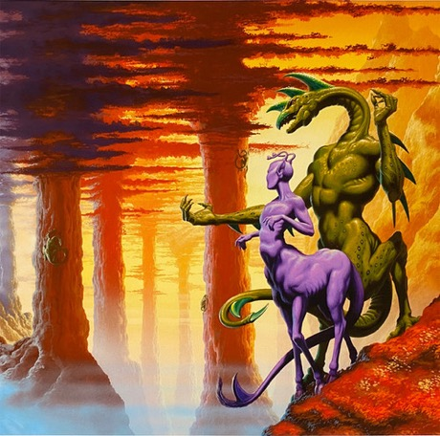
Hork-Bajir
Animorphs
Notes:
Property: Animorphs (First publication - June 1996; Latest publication - March 2025)
(2020 it was officially announced that a movie’s in the works) (also the most recent book came out on 03/04/2025)
Images:
Animorphs The Graphic Novel Book 1: The Invasion
Animorphs (TV Show)
Animorphs: The Hork-Bajir Chronicles

Slide 10
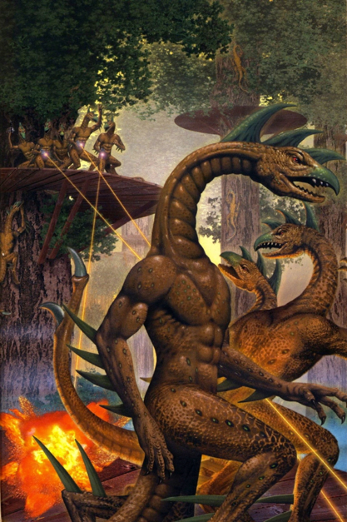
Hork-Bajir
The Hork-Bajir are 8-foot-tall reptile-like creatures who lived on a planet with huge canyons and very tall trees. They have sharp beaks and lots of blades on their bodies, but they are peaceful and eat mostly bark.
These gentle giants were wiped out in a war they didn't understand. They have a rich tradition of storytelling and are good at carpentry, even though they don't use many tools. They used hollowed-out trees called Speaking Trees to talk to each other over long distances instead of walking.
Notes:
Notes:
Asking the students what the blades could be used for if not fighting is a good way to spark a discussion about both appearances and evolution. After discussing, the students can be told that the blades are used to woodwork, climb trees, and strip bark.
Image:
Animorphs Book 34: The Prophecy

Slide 11
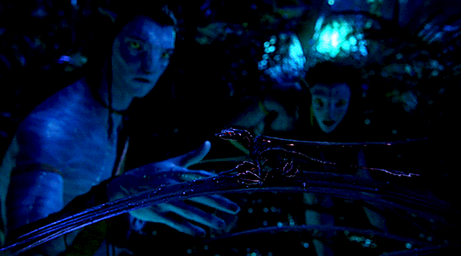
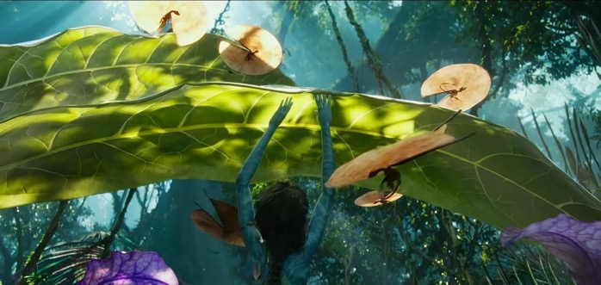
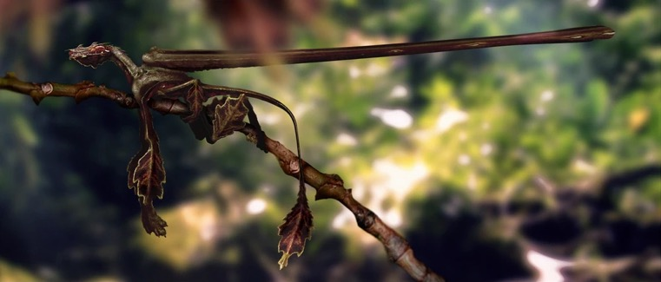
Kenten
Avatar
Notes:
Property: Avatar (First premiere - December 2009; Latest premiere - December 2022)
Images:
Avatar
Avatar: The Way of Water
Pandorapedia
Behind the scenes

Slide 12
Kenten
The Kenten, or Fan Lizard, is a six-legged animal, like many creatures on Pandora. They have two extra 18-inch long appendages on their back that are connected by a fan of glowing skin. When they feel scared, they swing the appendages around to spread out the fan, and it launches them into the air. This works because Pandora has lower gravity and a thicker atmosphere. Their skin looks like tree bark, and their legs and tail look like leaves.
Notes:
Notes:
There are several questions that can be asked about the Kenten’s adaptations. The first one is, why do they launch themselves when threatened? The reasons are manifold; it gets them away from the danger, and also hopefully the sudden movement and flash of color startle whatever startled them back. The other important question is why would they have leaf-mimicking traits? Which is simply for camouflage.
Image:
Behind the scenes

Slide 13
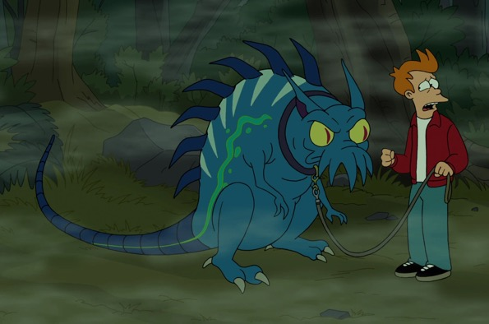
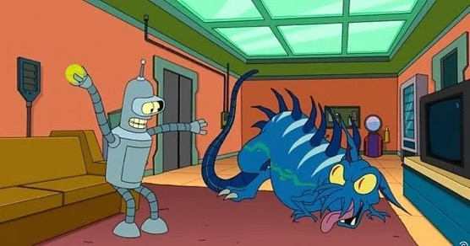
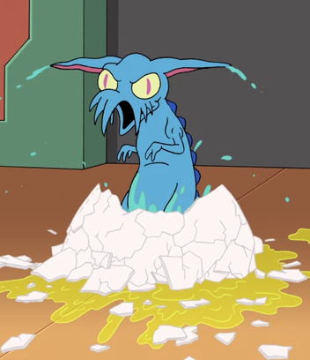
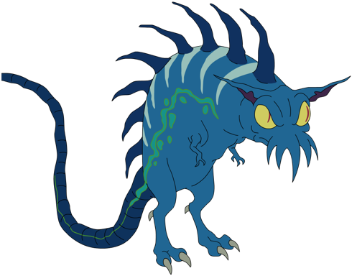
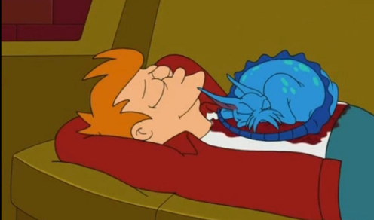
Bone Vampire
Futurama
Notes:
Property: Futurama (First premiere - March 1999; Latest premiere - September 2024)
Images:
Futurama

Slide 14
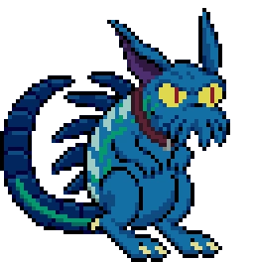
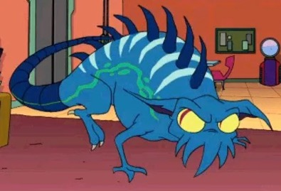
Bone Vampire
This big creature eats bones by sucking them out of its prey. It has acidic spit to help it eat and protect itself. Its home planet, Doohan 6, is wet and foggy with lots of forests. People almost hunted them to extinction because they thought the creatures were a threat to farm animals. Later, they were brought back to the planet. At first, people didn't want them back, but then they found out the creatures are good for the environment and helpful for removing bones from meat so that it’s easier to eat.
Notes:
Notes:
Bone Vampires provide an interesting discussion on odd animal diets; what nutritional value does it receive? What does the marrow do for it and does it need large amounts of calcium for some reason? Also can be an analog to the reintroduction of wolves to parts of America and their benefits. If it is appropriate for the class, it can also be mentioned that it reproduces asexually, like the New Mexico whiptail lizard.
Image:
Futurama: Worlds of Tomorrow
Futurama

Slide 15
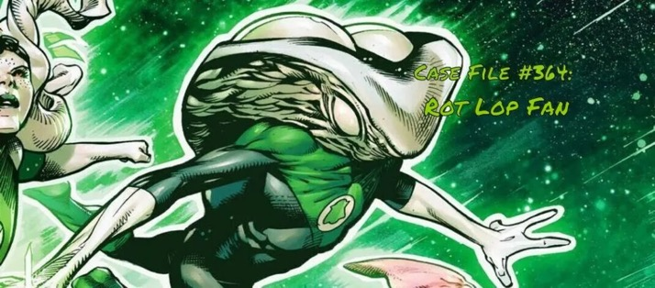
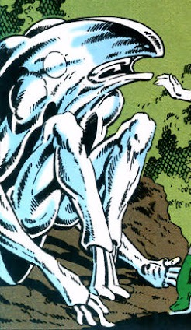
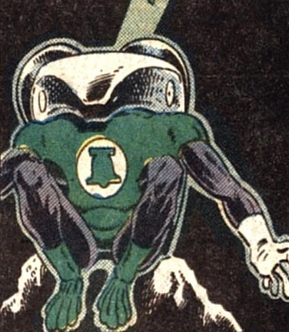
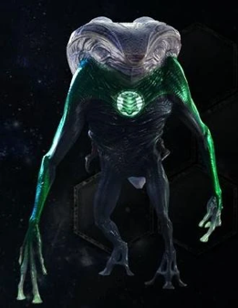
Rot Lop Fan’s species
Green Lantern
Notes:
Property: Green Lantern (First publication - July 1940; Latest publication - 2025)
Images:
Green Lantern (Comic)
Green Lantern (Film)

Slide 16
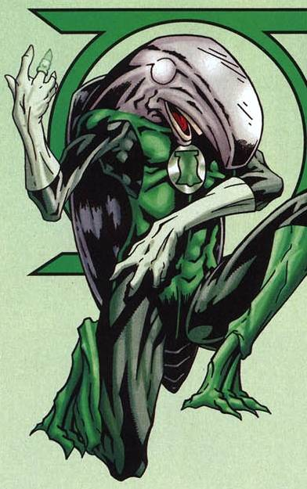
Rot Lop Fan’s species
This silicon-based creature is about 5 feet tall and weighs 230 pounds. They live in a dark area of space called the Obsidian Deeps, so they can't see. They have two circles on their face where eyes would normally be, but no one knows what these circles or the strange organs on their back do. They have a big mouth with flat teeth.
The only known member of this species is Green Lantern Rot Lop Fan. Since he can't understand the ideas of "Green" and "Lantern," he is called an F-Sharp Bell instead.
Notes:
Notes:
Rot Lop Fan is good for discussions on why we consider certain senses essential, and what it means to evolve without one (or even with extra).
Image:
Green Lantern (Comic)

Slide 17
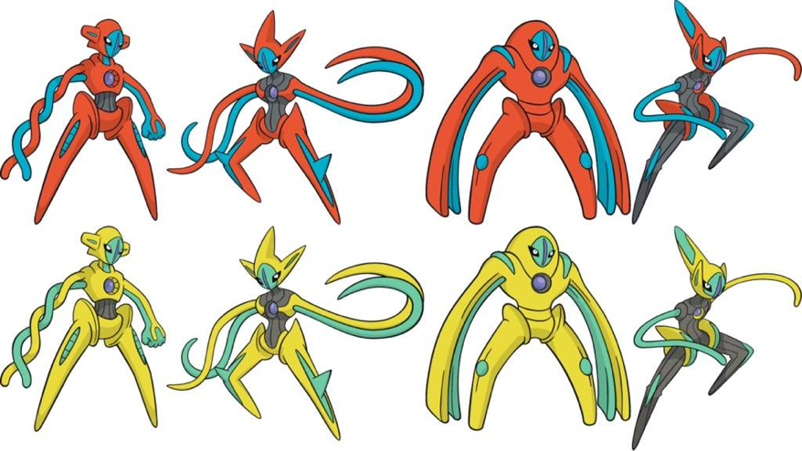
Deoxys
Pokemon
Normal
Attack
Speed
Defense
Notes:
Property: A (First publication/premiere - X; Latest publication/premiere - Y)
Images:
Pokemon Diamond & Pearl (2007)

Slide 18
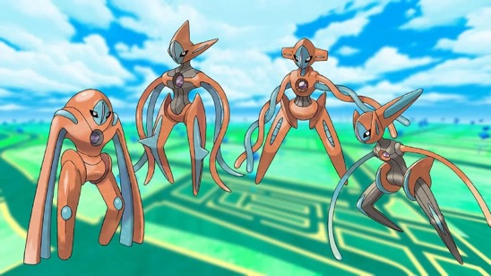
Deoxys
Deoxys was a space virus on a meteorite, but when it crashed on Earth, its DNA changed. Its brain is in the purple crystal on its chest, which can shoot laser beams. Deoxys can change its shape and abilities to deal with different challenges. It has four main forms: normal, attack, defense, and speed. It can also make small changes, like switching its arms from tentacles to human-like arms.
Attack
Normal
Defense
Speed
Notes:
Notes:
Deoxys is a virus that had its DNA mutated, which could make for a discussion DNA and Viruses. Also a discussion can be had as to how the physical changes represent their intended uses.
Image:
Pokemon Go (2016)

Slide 19
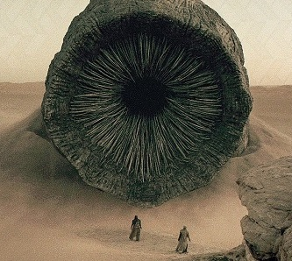
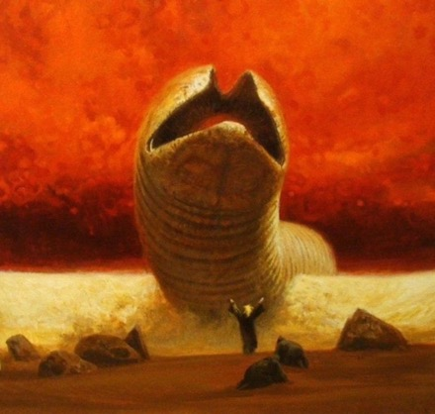
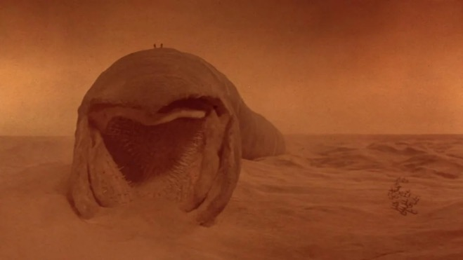
Shai-Hulud
Dune
Notes:
Property: Dune (First publication - 1963; Latest premiere - December 2024)
Images:
Dune (Film) (1984)
Dune (Film) (2021)
Heretics of Dune (1984)

Slide 20
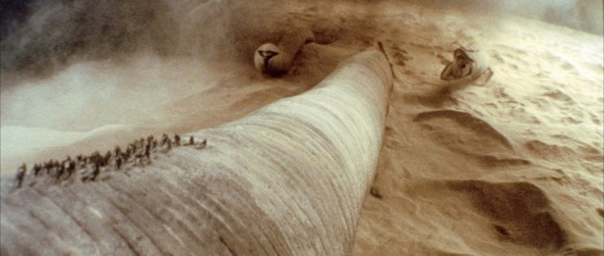
Shai-Hulud
This giant creature can grow up to 1300 feet long (almost a quarter mile!) and 400 feet wide. They start as tiny animals called sand plankton that eat a substance called spice. Then, they become leathery, flatworm-like creatures called sandtrouts that love water. When sandtrouts poop, it turns into spice! Some sandtrouts go into a 6-year hibernation and come out as 10-foot-long sandworms. These sandworms keep growing by eating other sandworms and sand plankton. At this stage, too much water is very dangerous for them (even the small amount inside a person).
Notes:
Notes:
The size of the sandworm makes for an interesting exploration of just how big life can get terrestrially (square-cube law, and also just the energy cost to such a creature). Also while desert life can be overwatered, usually they're pretty thirsty before that so it’s worth discussing a little why the sandworm isn’t. There could also be a discussion how the food chain makes up for energy loss considering it appears to be a closed system (maybe sand plankton also photosynthesize, or maybe spice is a fungus that thermosynthesizes and grows enough to make up for the system’s losses).
Also the Shai-Hulud’s relationship to the environment can be discussed. Arrakis used to be a wet planet before the introduction of sandtrout. Sandtrout then slowly sequestered away more and more water until their other life stages could survive. As it got drier, spice could form to feed the sand plankton, and there was less water to kill the sandworm.
Image:
Dune (Film) (1984)

Slide 21
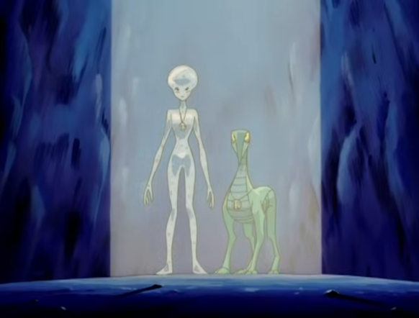
Qxotrokir Quadruped
Scooby-Doo
Click to Play Video
Notes:
Property: Scooby Doo (First premiere - 1969; Latest publication/premiere - 2000)
Video:
Scooby Doo & The Alien Invaders

Slide 22
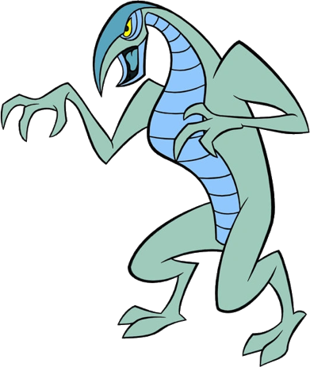
Qxotrokir Quadruped
This alien usually walks on four legs but can also walk on two. Its back legs are like a dog's, standing on two toes, and its arms have three-fingered hands. It's very strong and can bend steel bars and wrestle bulldozers. It has a beak and is mostly greenish-gray with dark blue on its back and light blue on its belly. It mostly makes squawks and screeches to communicate, but it can also speak English. It might share its planet with another smart species that looks like a see-through human.
Notes:
Notes:
There are a handful of animals that can switch between bipedalism and quadrupedalism comfortably (or between other kinds of locomotion), but it is not super common in imagined animals.
Pangolins switch from two to four legs.
Kangaroos switch from two to five “legs” (they use their tail).
Image:
Scooby Doo & The Alien Invaders

Slide 23
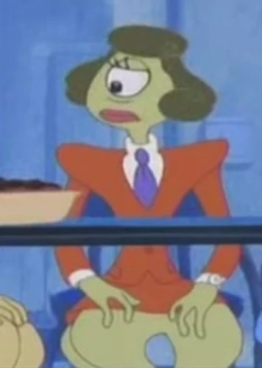
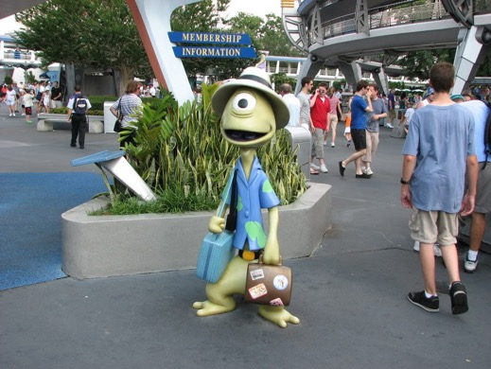
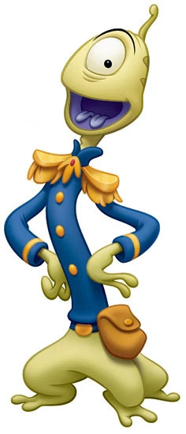
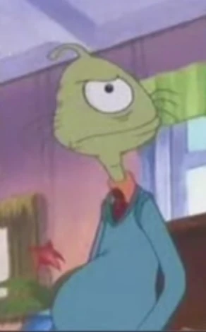
Plorgonarian
Lilo & Stitch
Notes:
Property: Lilo & Stitch (First premiere - June 2002; Latest premiere - May 2025)
Images:
Lilo & Stitch: The Series (2003)
Disney World
Lilo & Stitch (2002)

Slide 24
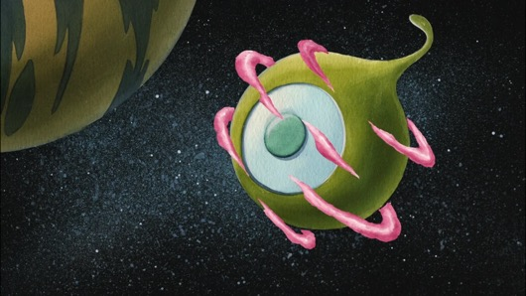
Plorgonarian
This lanky species is roughly 5ft tall and walks on three short legs. They have two arms with three fingered hands. They have one eye, two tongues, and an antenna on their head called a Plorgonarian quart flanch (a multi sensory organ that allows them to receive radio waves and smell). The quart flanch also turns orange with age, like how hair turns white. Their home planet, Plorgonar, orbits what appears to be a gas giant and looks like the species’ heads. It also has pink cloud cover and tentacle-like trees.
Notes:
Notes:
When revealed, images of live-action Pleakley can be used.
Image:
Lilo & Stitch: The Series (2003)

Slide 25
Upchuck
Ben 10
Notes:
Property: The Muppets (First premiere - September 1976; Latest premiere - February 2025)
Images:
The Muppets

Slide 26
Upchuck
Upchuck is a small, green alien with a big mouth and four strong, bendy tongues it can use to pick up and grab things. It can eat almost anything, even stuff that other creatures can't. Upchuck turns what it eats into powerful energy blasts. This makes Upchuck very useful and strong, especially when other aliens might have trouble. Upchuck's small size and surprising strength make it a tough opponent.
Notes:
Notes:
Gonzo's a fun character and usually labeled as a "whatever", but Muppets From Space made him an extraterrestrial. Also a conversation could be had about his eyes and whether or not that makes him a predator (at the very least, his species need depth perception).
Image:
The Muppets

Slide 27
Worms/Annelids
Men In Black
Notes:
Property: Men In Black (Films) (First premiere - July 1997; Latest premiere - June 2019)
Images:
Men In Black (Films)
Men In Black (Series)

Slide 28
Worms/Annelids
These short, two-legged aliens have long torsos and legs compared to their main set of arms. Besides their main arms, they have two sets of smaller arms on their torso. Their skin is sandy and mottled. They have small heads with black eyes, a big mouth, and two large antennae. They can survive being cut in half and can easily reattach their two halves.
Notes:
Notes:
They're kind of crass in the films, but they got a big role in the animated series, which was for kids. Their healing ability is also fairly unique, as usually regeneration is focused on regrowing rather than reattaching.
Image:
Men In Black (Films)

Slide 29
Gallaxhar’s species
Monsters Vs. Aliens
Notes:
Property: Monsters Vs. Aliens (First premiere - 2009; Latest premiere - 2014)
Images:
Monsters Vs. Aliens (2009)

Slide 30
Gallaxhar’s species
This species is about 8 feet tall and looks mostly human above the waist. Instead of legs, they have six tentacles with clawed feet at the ends. Their bodies seem soft and might not have bones inside. They have four eyes: the two in the middle work together, while the ones on the outside work more independently. They drink through their ear, which is connected to their mouth. They hear using "ear nubs," but it's not clear where these are on their bodies.
Notes:
Notes:
Not much is known about them, since there is only one living individual. They operate on comedy rules, which could be fun to contemplate with students, but also might be a bit difficult to come up with solid answers. All four eyes usually work in tandem, but the outside one occasionally operate like a chameleon’s. This possibly allows them to focus on one think while still ensuring a wider awareness of their surroundings.
Image:
Monsters Vs. Aliens (2009)

