Slide 1

Imagining Life on Other Worlds

Slide 2
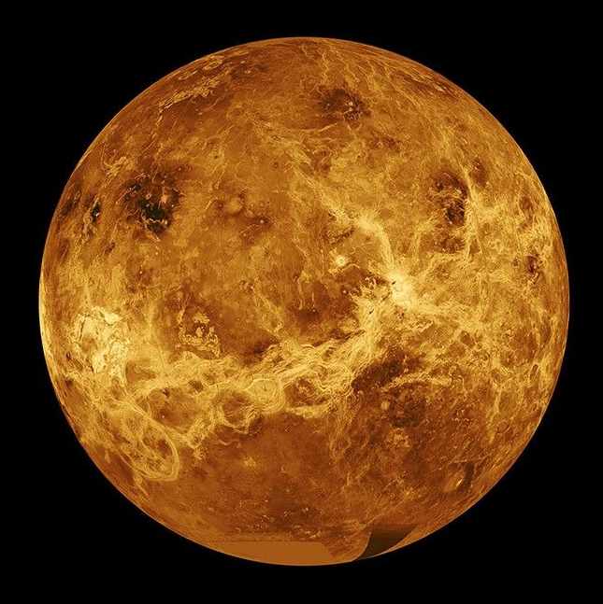
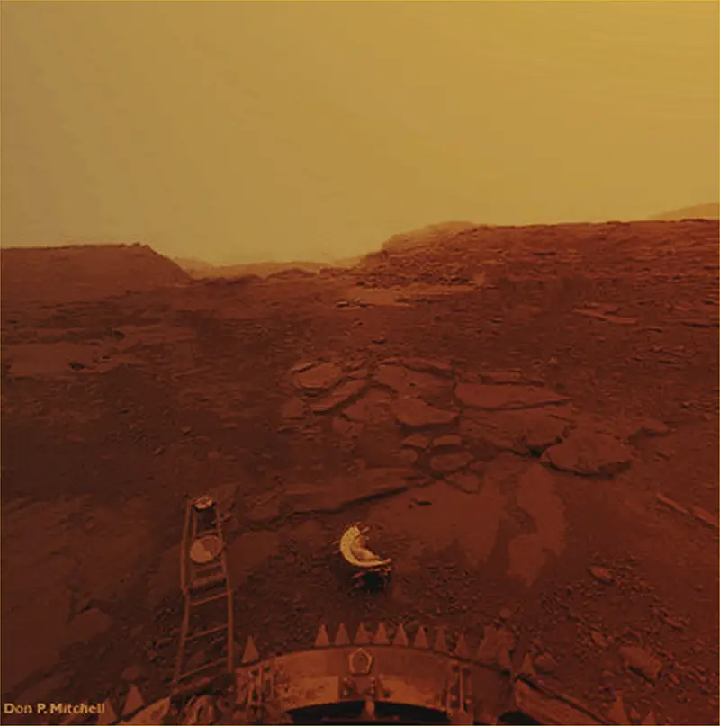
Venus
Galaxy: Milky Way
Sun: Our Sun! Located in our solar system
Distance from Earth: 31 million miles (travel time 2-3 months)
Venus’s surface is too hot and dangerous for the kinds of living things we know about, but its big clouds might be a good place for tiny floating life to live.

Slide 3
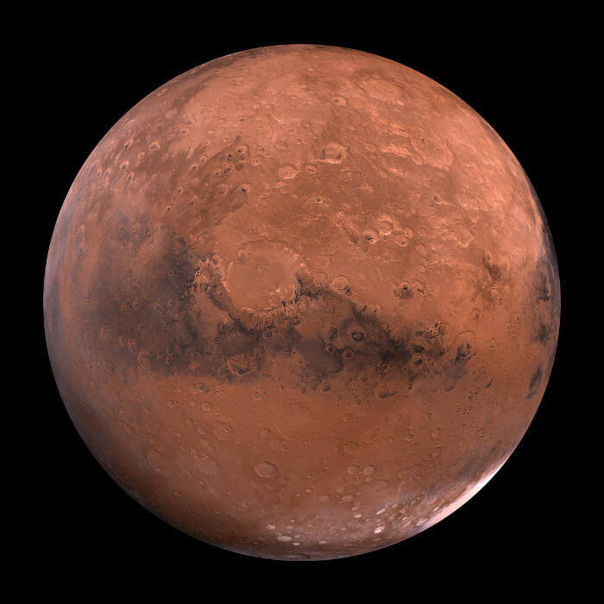
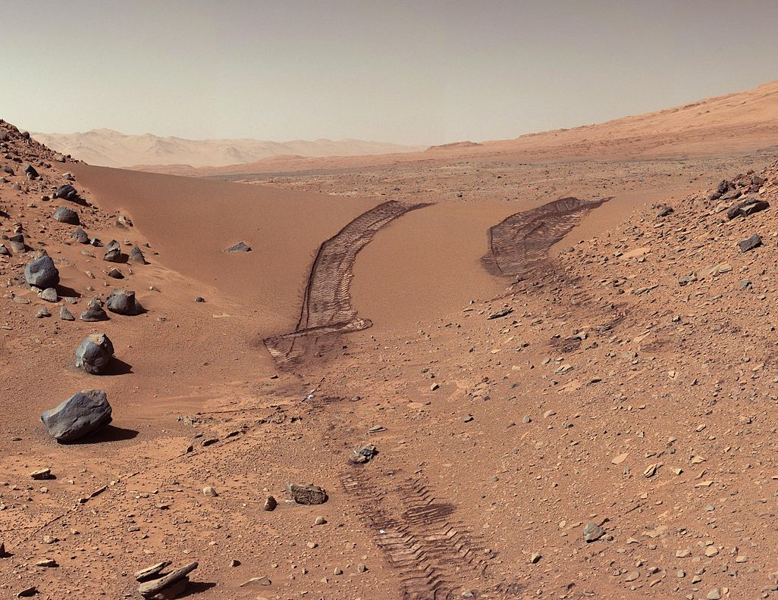
Mars
Galaxy: Milky Way
Sun: Our Sun! Located in our solar system
Distance from Earth: 140 million miles (travel time 6-9 months)
If life exists on Mars, it might survive the Sun's intense radiation by living in underground ice caves.

Slide 4
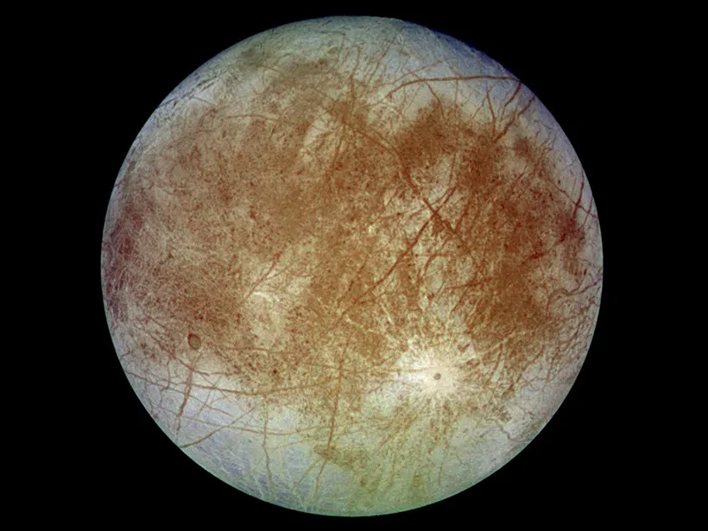
Europa
Galaxy: Milky Way
Sun: Our Sun! Located in our solar system
Distance from Earth: 390 million miles (travel time 2 years)
This one of Jupiter’s moons. Its very thick icy surface might hide a huge ocean underneath.

Slide 5
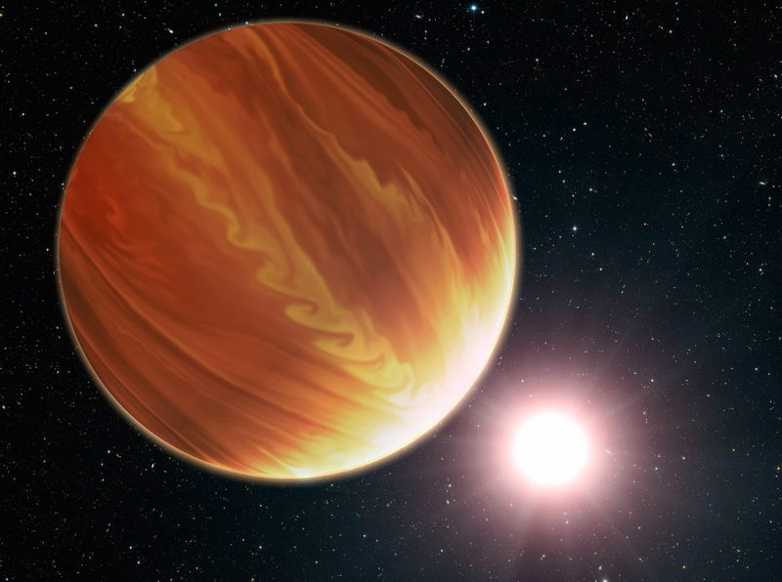
Tylos
Galaxy: Milky Way
Sun: WASP-121
Distance from Earth: 900 light-years
This planet has oceans of lava and sparkly clouds that rain down lava.

Slide 6
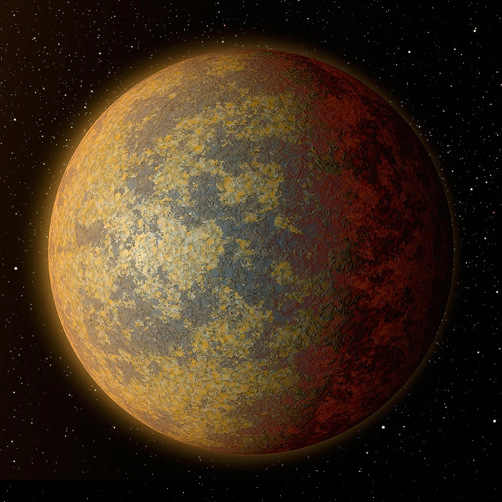
HD 34445b
Galaxy: Milky Way
Sun: GW Orionis
Distance from Earth: 1,300 light-years
This planet has THREE suns! It gets a lot of sunlight.

Slide 7
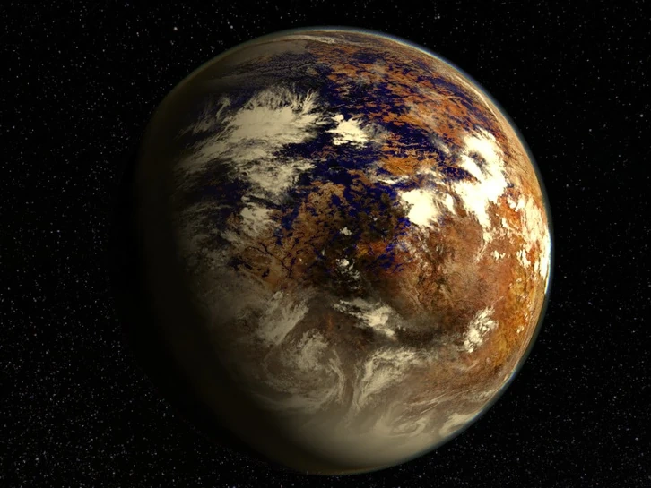
Proxima Centauri b
Galaxy: Milky Way
Sun: Proxima Centauri (the closest solar system to our own)
Distance from Earth: 4.2 light-years
This desert planet is tidally locked. This means one side is always sunny and hot, while the other side is always dark and cool.

Slide 8
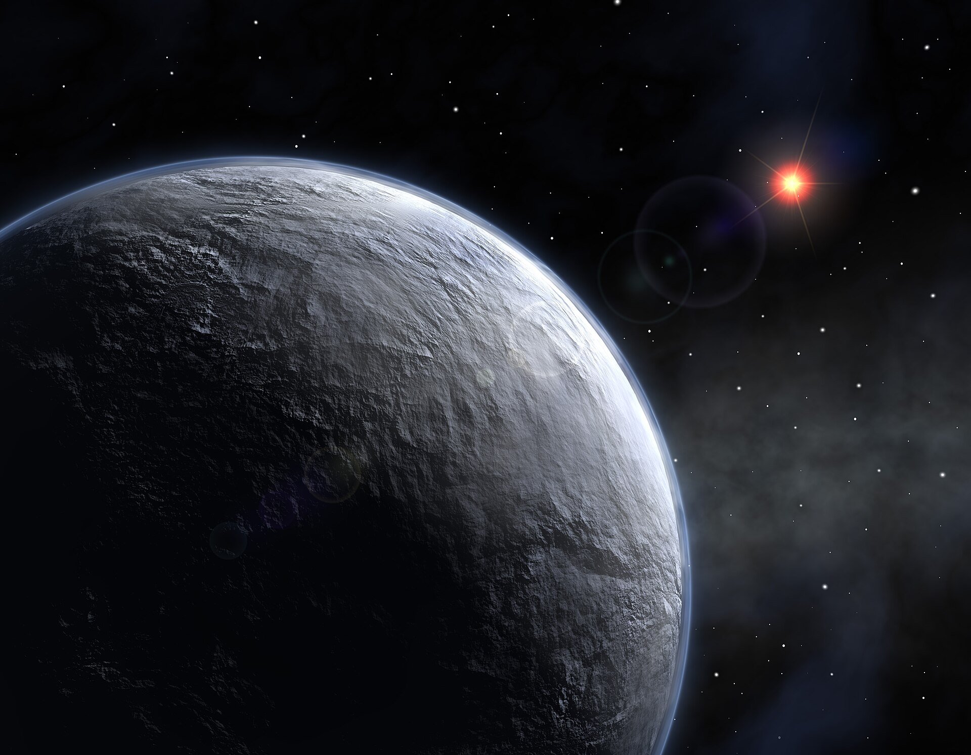
OGLE-2005-BLG-390Lb
(nicknamed “Hoth” by NASA)
Galaxy: Milky Way
Sun: OGLE-2005-BLG-390
Distance from Earth: 21,500 light-years
This planet is mostly covered in ice, but there is a chance that there might be enough liquid water to support life!

Slide 9
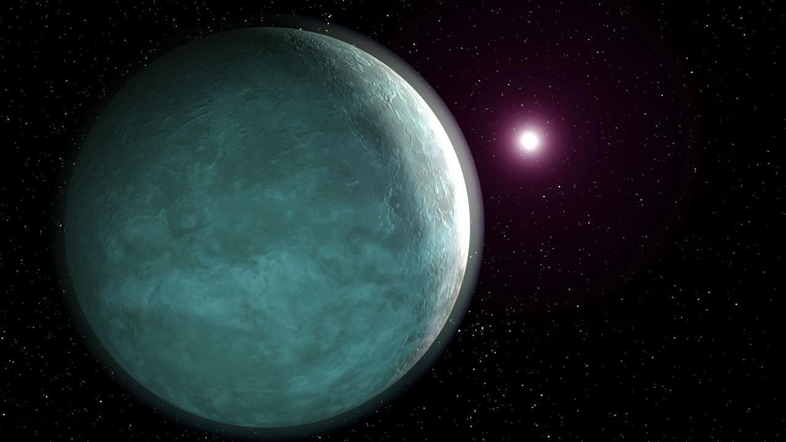
TOI-2257b
Galaxy: Milky Way
Sun: TOI-2257
Distance from Earth: 188 light-years
This planet has an oval-shaped orbit, which gives it extremely hot summers and extremely cold winters.

Slide 10
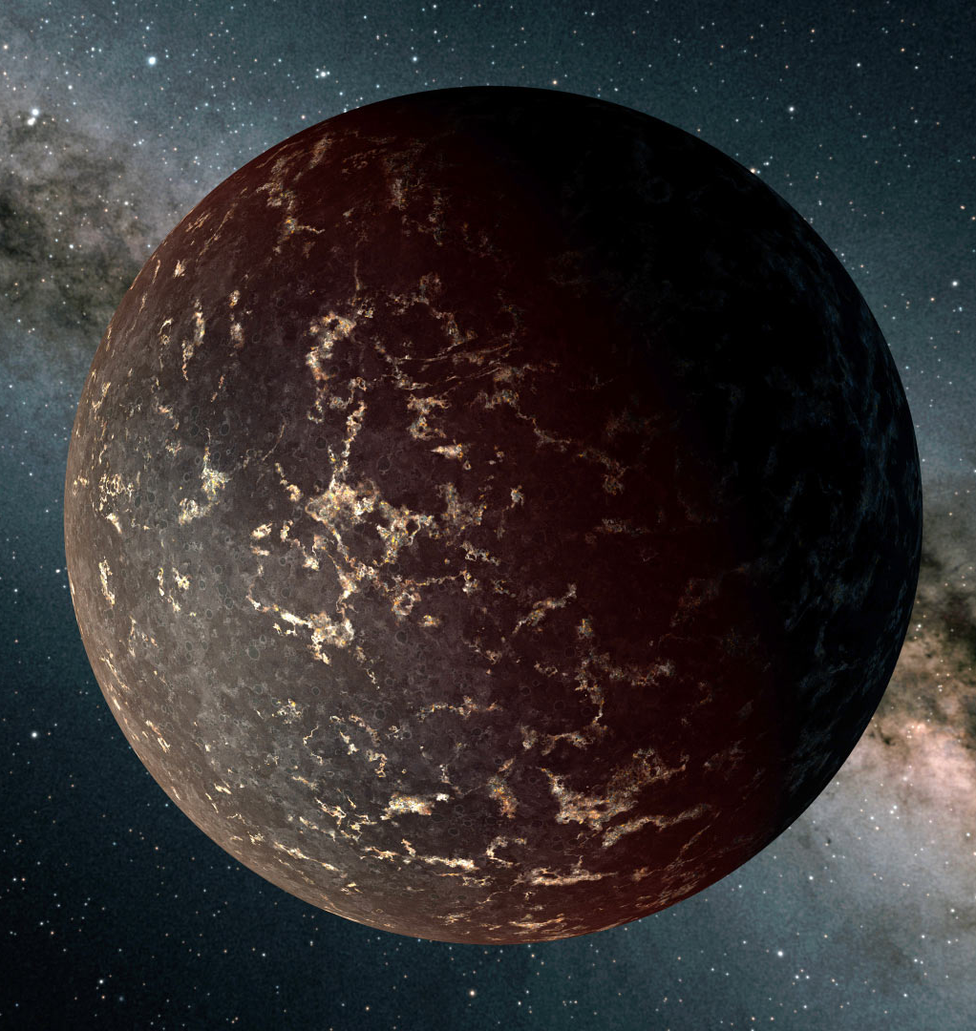
Kua'kua
Galaxy: Milky Way
Sun: LHS 3844
Distance from Earth: 48.5 light years
The intense gravity from this planet's sun
causes constant earthquakes.

Slide 11
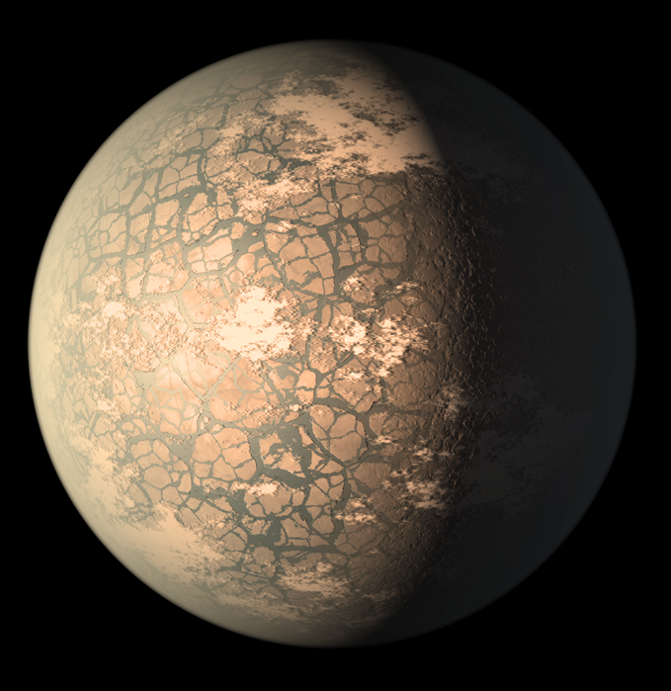
TRAPPIST 1F
Galaxy: Milky Way
Sun: TRAPPIST-1
Distance from Earth: 39.46 light years
This planet's sun is a flare star. Every few days, its sun has a sudden, violent burst of energy and light, and then it goes back to normal again.

Slide 12
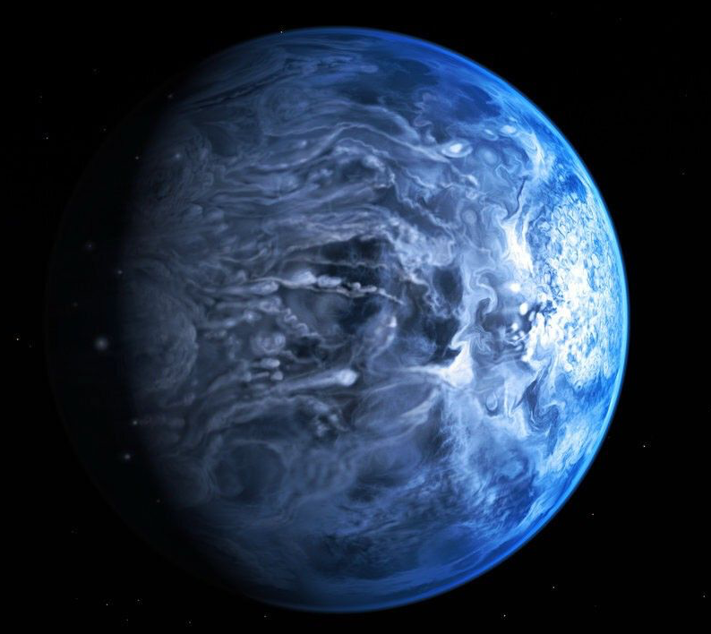
HD 189733 b
Galaxy: Milky Way
Sun: HD 189733 A
Distance from Earth: 63 light years
This planet has storms with 5,000 mph
winds, and clouds that rain shards of glass

Slide 13
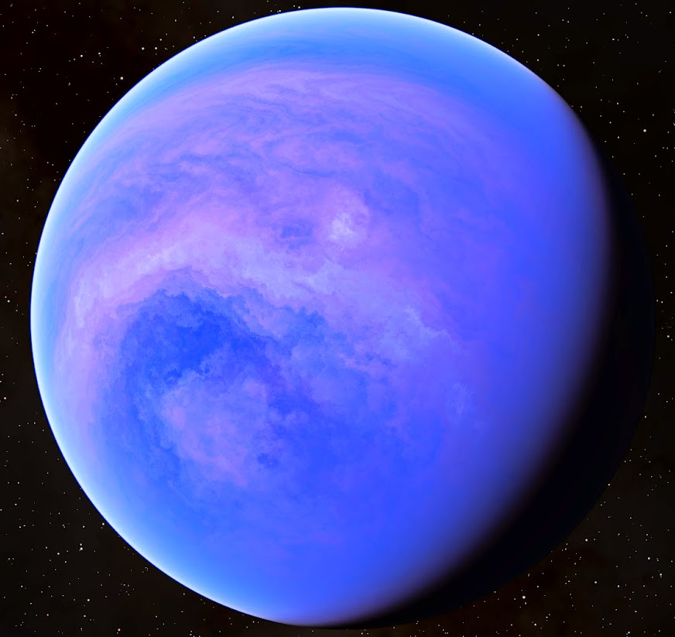
Enaiposha
Galaxy: Milky Way
Sun: GJ 1214
Distance from Earth: 47 light years48 light-years
This planet's atmosphere is made of thick, dense fog

Slide 14
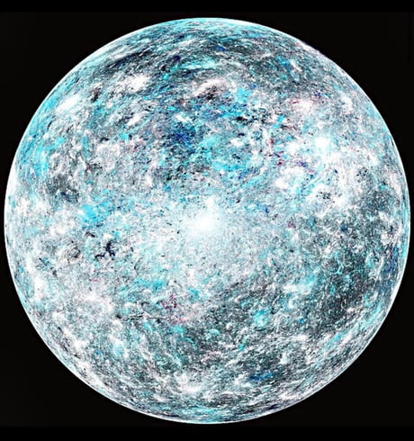
55 Cancri e
Galaxy: Milky Way
Sun: 55 Cancri
Distance from Earth: 40 light years
This planet's surface might be made of glittering diamonds.

Slide 15
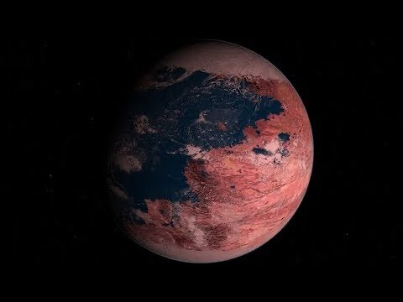
Kepler-442b
Galaxy: Milky Way
Sun: Kepler-442
Distance from Earth: 1,196 light years48 light-years
This planet's star is very dim. There is not much light on the surface.

Slide 16
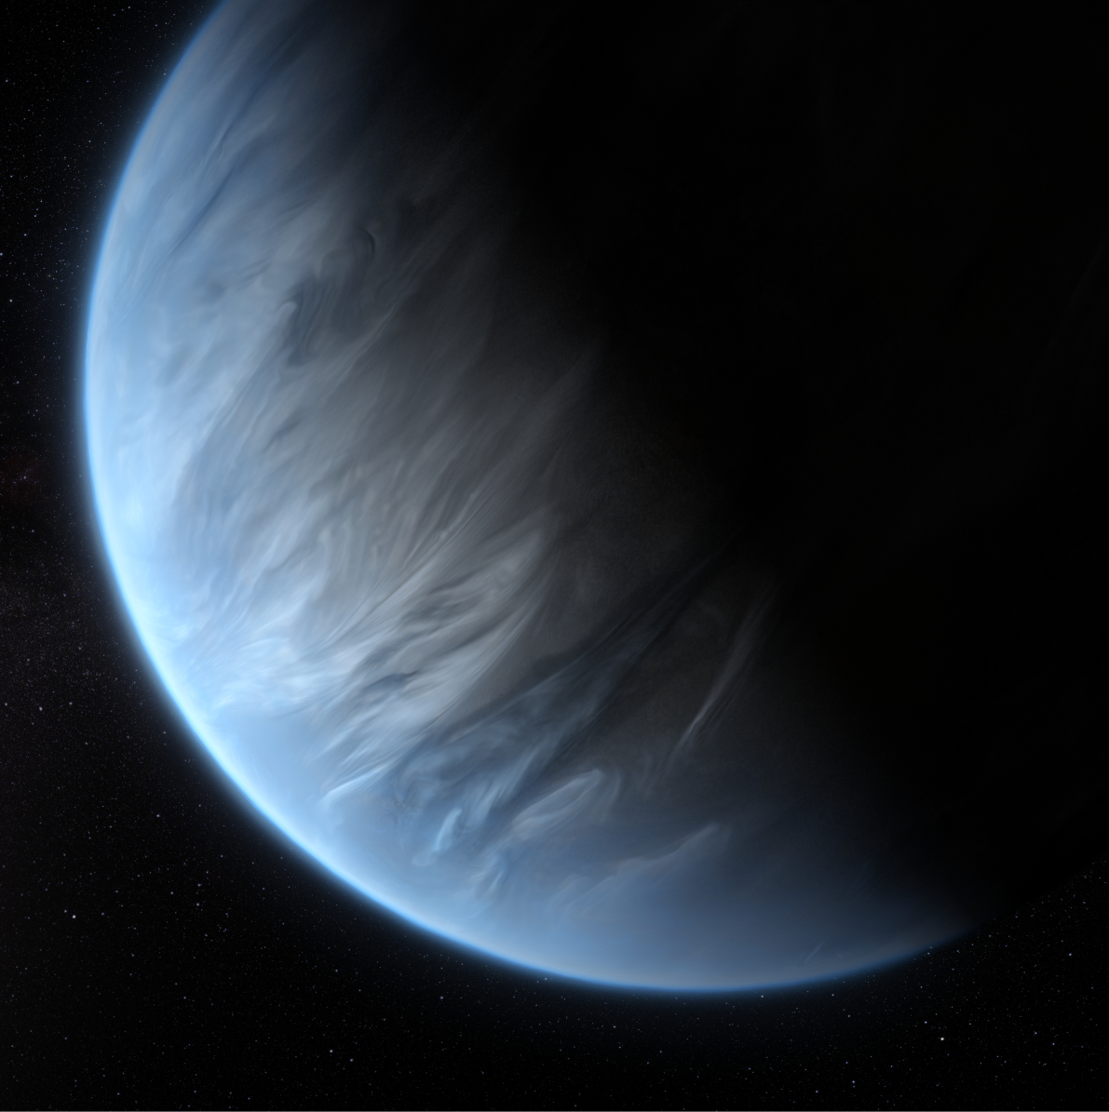
K2-18b
Galaxy: Milky Way
Sun: K2-18
Distance from Earth: 120 light years
This planet has no land at all. The surface is one big ocean.

Slide 17
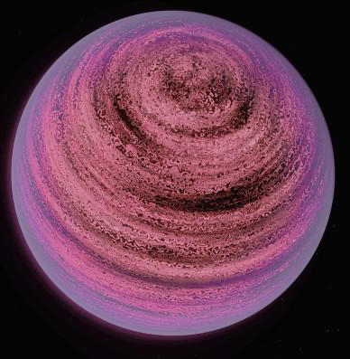
PSO J318.5-22
Galaxy: Milky Way
Sun: No star, it’s a rogue planet!
Distance from Earth: 80 light years
This planet has no star. It is always night. It has some heat from inside the planet, which makes it glow pink.

